Slide 1
KAU/RH PhD supervision
Status update and planning for next meeting
by Frey Alfredsson
Status
ESPRESSObin
Toke’s new xdp_redirect_pifo hook
Plan for the next meeting

Slide 2
Status
Technical report
  All sections with known points have been written
ESPRESSObin
  Is up and running with a custom compiled kernel
  A pull-request with updated documentation on how to get Fedora 35 is in XDP-Project.
Toke’s new xdp_redirect_pifo hook
  My main focus, but I am having issues compiling the new kernel from Toke’s repo

Slide 3
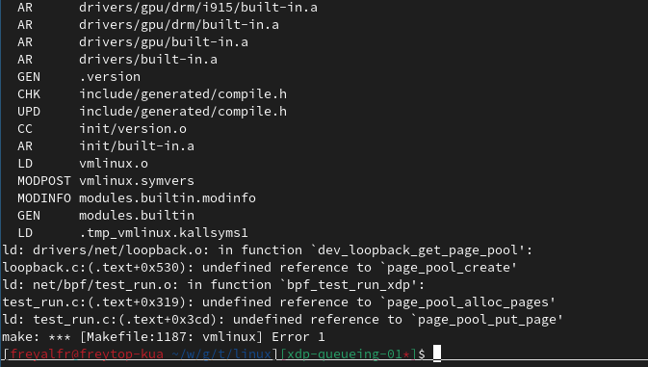
Kernel issues
Compilation issues:
  Related to missing definitions in my .config
  I have been using “make defconfig” as my starting config. Do you recommend another one?

Slide 4
ESPRESSObin
Missing in the current documentation:
  ZRAM support
    Slows down the boot process when it is missing
    How to enable it in the .config file of your custom kernel
    How to disable it when you do not include it
      Simple config file change
  Minor fixes about extra software. Still mentions f31, but works fine in Fedora 35

Slide 5
Plan for next meeting
ESPRESSObin board
  Setup cross compiled kernel deployment support
  Further looking into the network driver
Toke’s new xdp_redirect_pifo hook
  Fix the compilation issue
  Start experimenting with the code
  Write a few schedulers using the current interface
  Try to see if the interface needs tweaking

