Slide 1
KAU/RH PhD supervision
Status update and planning for next meeting
by Frey Alfredsson
Status
Plan for the next meeting

Slide 2
Status
Courses
  Performance Modeling and Simulation (DVAD15)
    Lab assignment for performance modeling
Inria Workshop On Systems 2021 (WOS10)
  Slide draft ready for this meeting

Slide 3
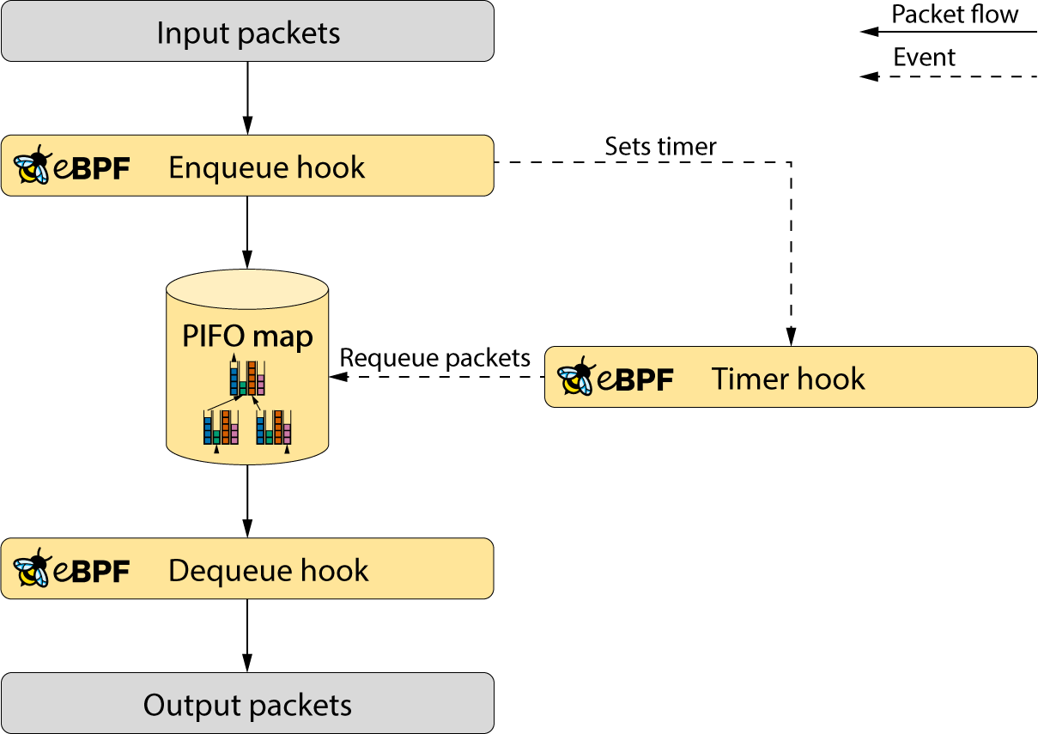
Plan for next meeting
Next steps:
  Technical Report
    Further work
  Inria Workshop On Systems 2021 (WOS10)
    Official handin of slides is the 5th of October
    The talk is the 12th of October

