Slide 1
KAU/RH PhD supervision
Breakdown of the Eiffel paper
by Frey Alfredsson
cFFS
Gradient Queue
PIFO changes

Slide 2
Eiffel overview
Main objective: The design and implementation of efficient and flexible packet scheduling in software
Difficulties:
  Simple scheduling policies are CPU intensive
  Comparison-based priority queues rely on O(log n)
    Or O(m log n) with m priority queues
Contributions
  An optimization for ExtractMin and ExtractMax
  A method to make binary structures circular
  Modified PIFO for better flexibility in software

Slide 3
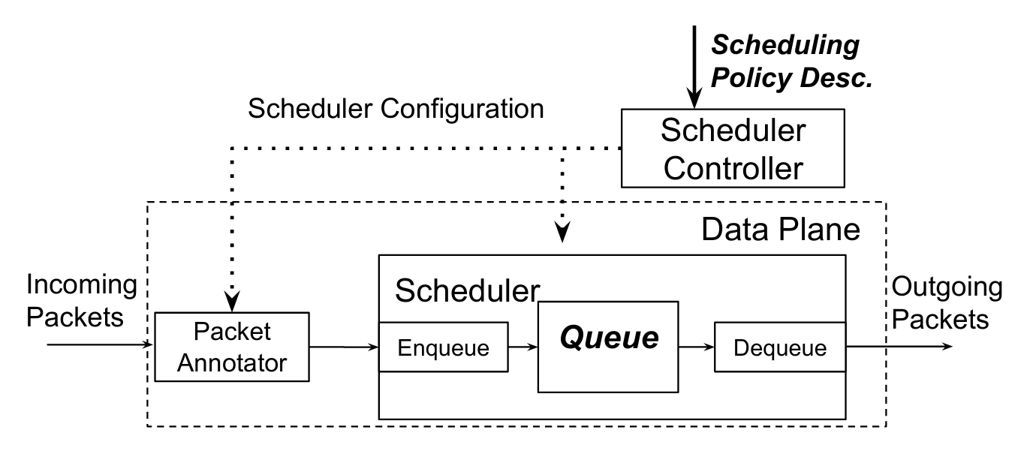
Eiffel flow: Packet flow

Slide 4
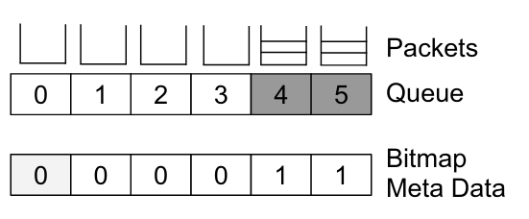
Find First Set (FFS)
A bitmap represents the occupied queues
Most CPUs have FFS instructions that can find the min and max set bits

Slide 5
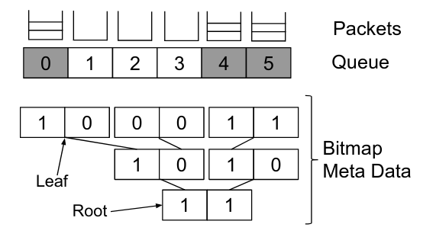
Eiffel flow
Queues that have more than CPU word size queues can be split into a binary tree

Slide 6
FFS in code
for (w = 0; w < bq_count; w++) {
  while ((i = ffs(bq[w])) {
    /* work on bq_data[w][i] */
  }
}

Slide 7
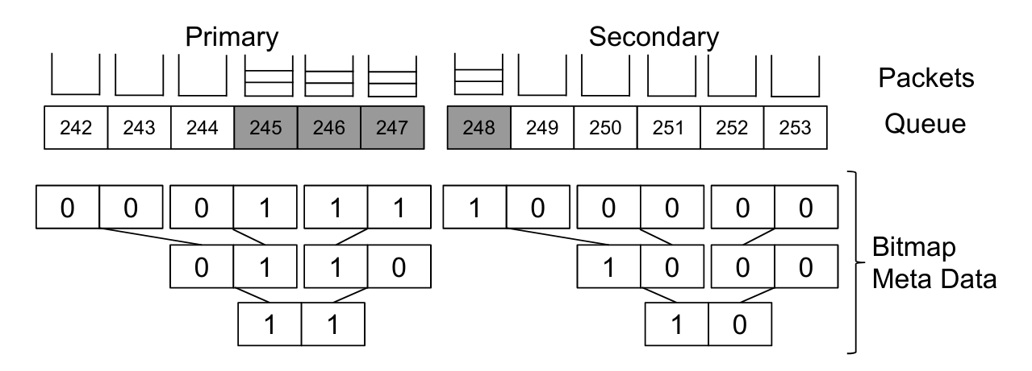
Circular Find First Set
cFFS uses a buffer for lower priority flows
  After the primary scheduling queue is processed the primary queue is swapped with the Secondary queue
Flows with a higher priority than available are stacked in the last queue

Slide 8
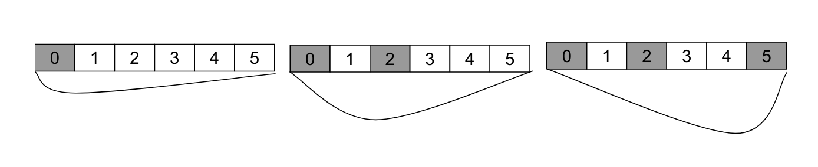
Gradient Queue / (Approximate Gradient Queue)
The set binary values are combined into a value x
A weight function is calculated using each value at position i
  Weight function 2^(i)(x-i)^2
Using the the equation ax^2-bx+c and that there is only one solution (x = b/2a), the position is ceil(b/a)

Slide 9
Eiffel PIFO changes
Eiffel PIPO changes
  Per flow ranking and scheduling
  Can schedule on dequeue

Slide 10
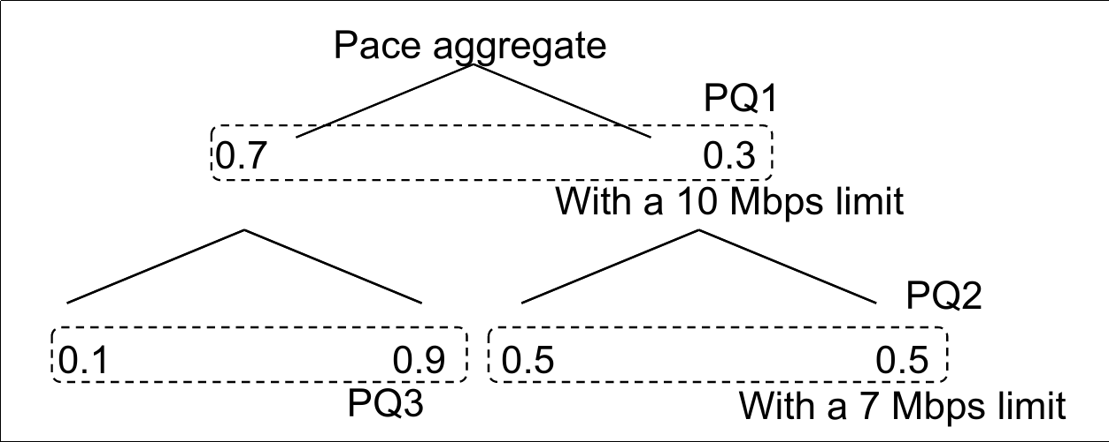
Traffic shaping policy

Slide 11
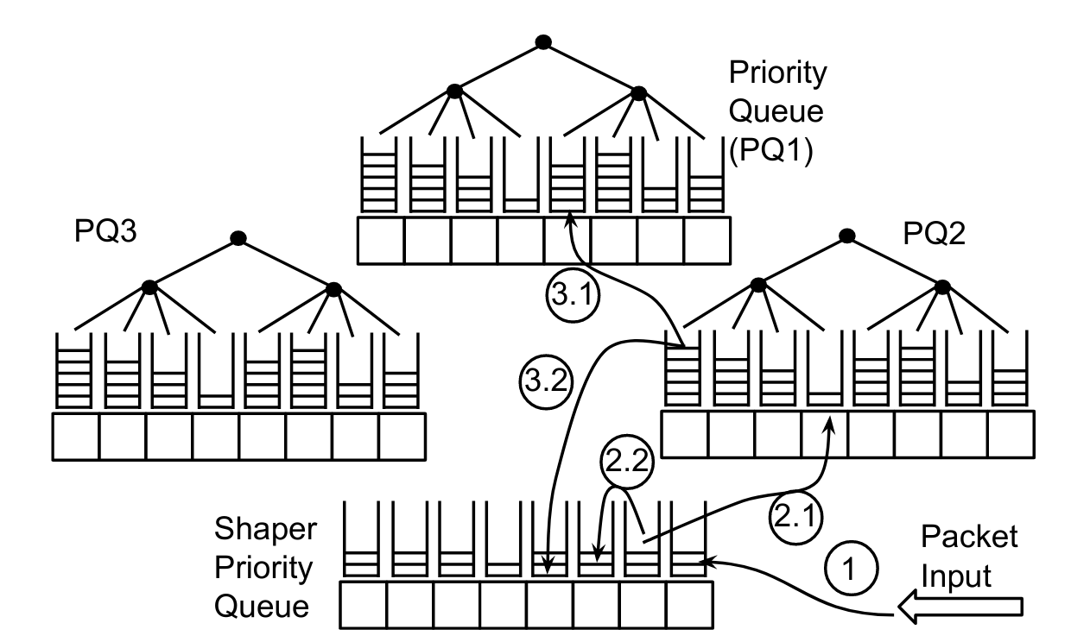
Traffic shaping queue view

