Slide 1
KAU/RH PhD supervision
Status update and planning for next meeting
by Frey Alfredsson
Status update
  Personal
  Karlstad University
  Project
Plan for next meeting

Slide 2

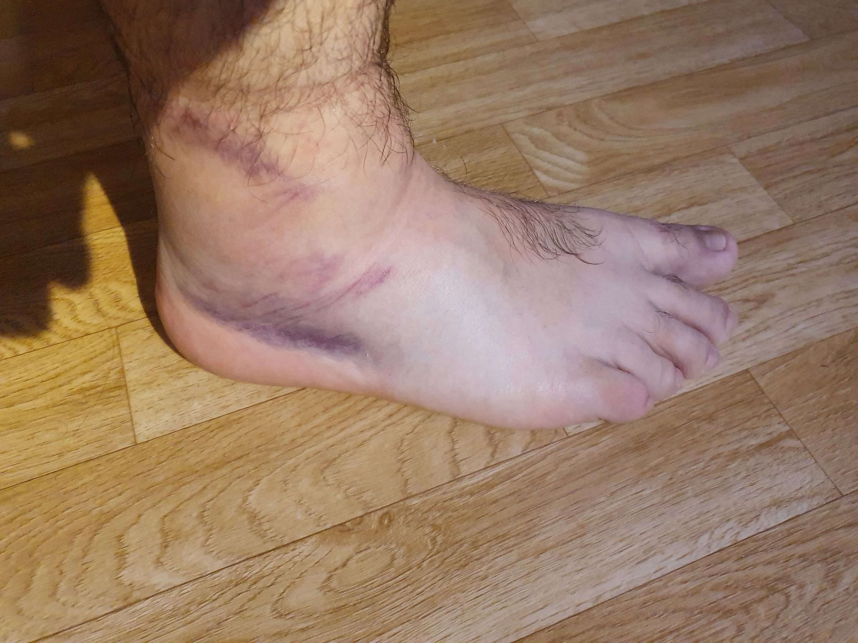
Personal Status Update
Back from Iceland to Karlstad
Finally got my ID card and can open a bank account
Managed to sprain my ankle

Slide 3
Karlstad University and Project
Karlstad University
  Registered for two courses
  TA in Computer Networking
Project
  Simple Qdisc implementation: complete
  Qdisc eBPF filter: not started
  Redesign drop handling in ndo_xdp_xmit: Getting into

Slide 4
Plan
Project
  eBFP filter
  Redesign drop handling in ndo_xdp_xmit
Next meeting
  Skip the January 18th meeting?
  Keep the biweekly meetings

