Slide 1
KAU/RH PhD supervision
Status update and planning for next meeting
by Frey Alfredsson
Status
Plan for the next meeting

Slide 2
Status
Courses
  Performance Modeling and Simulation (DVAD15)
    Lab assignment on XDP accepted
Inria Workshop On Systems 2021 (WOS10)
  Finished – YouTube link to the recording not available yet
Technical report
  Draft ready for comments on the pnl list

Slide 3
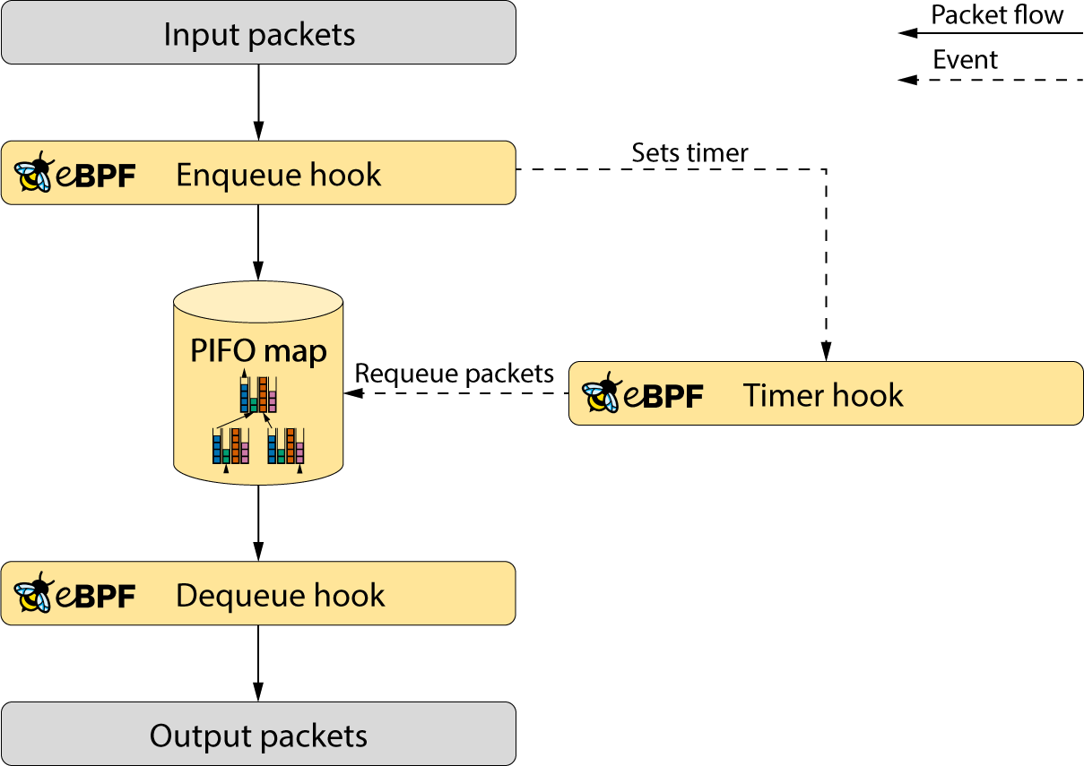
Plan for next meeting
Next steps:
  Technical Report
    Finalize next draft using
    comments from current draft
  Further development on the queue-exp
    The aim is to push a pull-request early next week
  Performance Modeling and Simulation report
    Run experiments
    Prepare tests for XDP qeueuing when available

