Slide 1
KAU/RH PhD supervision
Status update and next steps
by Frey Alfredsson
Project Status
Next steps from my point of view
How to proceed from here

Slide 2
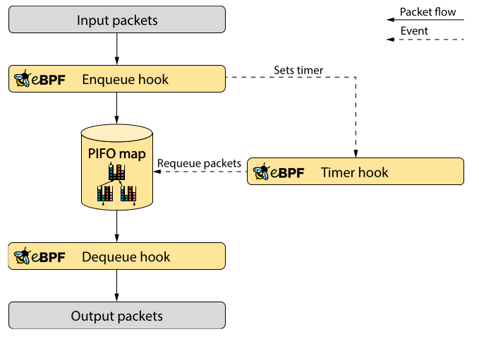
Project Status
Scheduling testing framework and schedulers
  Has enough features for basic scheduler testing
  Currently I have FIFO, SPQ, WFQ, STFQ, and SRPT
Technical report has
  The basic background
    XDP, BPF, PIFO, Eiffel, and the dequeue hook
  Missing the interesting parts
    Performance measurements and comparisons
    Technical details related to the implementation

Slide 3
Next steps from my point of view
I need to engage more actively and consistently with Toke online about code issues, API discussions, and questions I have related to BPF, BTF, and the verifier
  I need a better understanding of the verifier
Schedulers and testing framework
  I need to do more experiments with the hierarchical scheduler API
  Eventually, I will need it connected to the network path
Technical report
  I need to write about the API with an example
  I need to add to the appendix about the testing framework

Slide 4
How to proceed from here
I need a deadline for the Technical report and tangible milestones for parts of the schedulers
I need to post an email thread with a discussion about the hierarchical scheduler API to get a dialog going
I need to share my current code with Toke and get feedback
Question
  Do you think there is any overlap of Bolaji Gbadamosi’s work that could be helpful
  Can we have a workshop related to the verifier?

