Slide 1
KAU/RH PhD supervision
Status update and planning for next meeting
by Frey Alfredsson
Status at KAU and the technical report
Summer vacation planning
Plan for next meeting

Slide 2
Status
Karlstad University
  All TA work is finished
Project work
  Pull-request on the way
Emacs
  Magit
    Forge
    Github-review (not working)

Slide 3

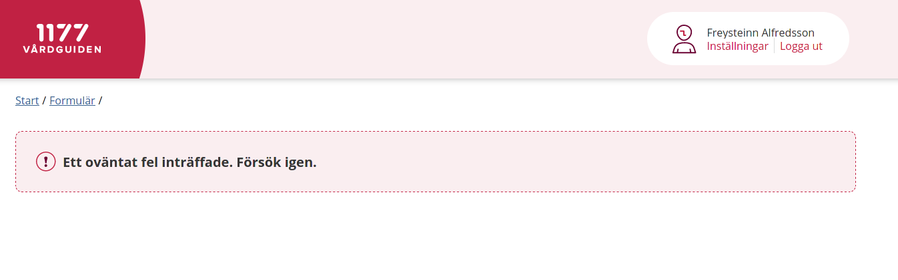
Questions regarding the summer vacation
When is everyone going on summer vacation?
I aim to leave for Iceland. However, there are some planning issues regarding the vaccinations

Slide 4
Plan
Project and agenda
  Submit a new pull-request with the Eiffel code
  Continued work on the technical report
  Preparation for the Wednesday meeting

