Slide 1
KAU/RH PhD supervision
Status update and planning for next meeting
by Frey Alfredsson
Back from vacation in Iceland
Start of new semester in Karlstad University
Discussion for this semester

Slide 2
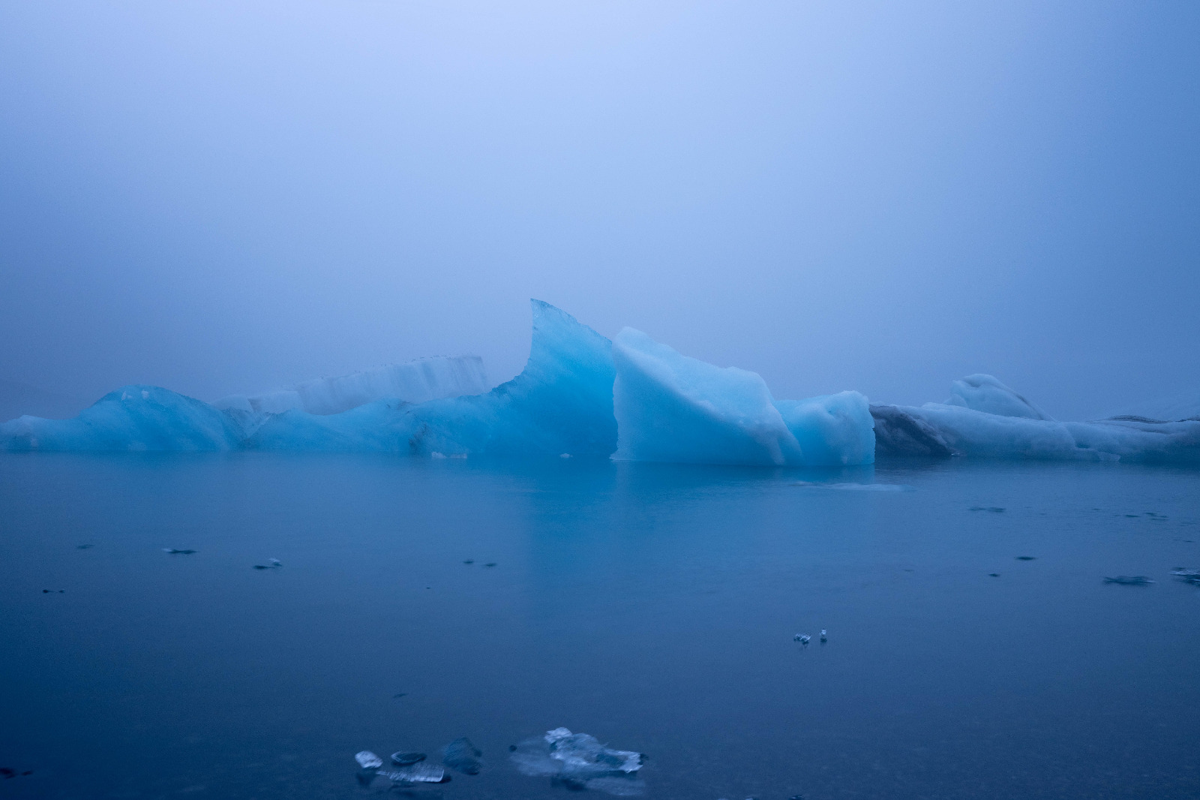
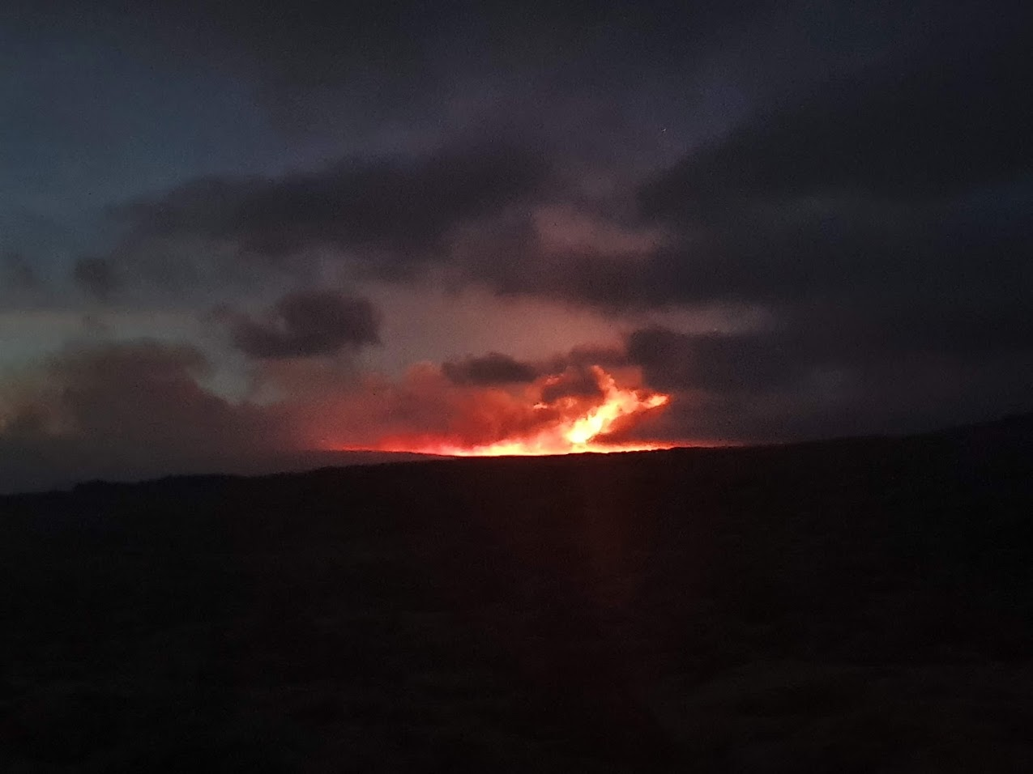
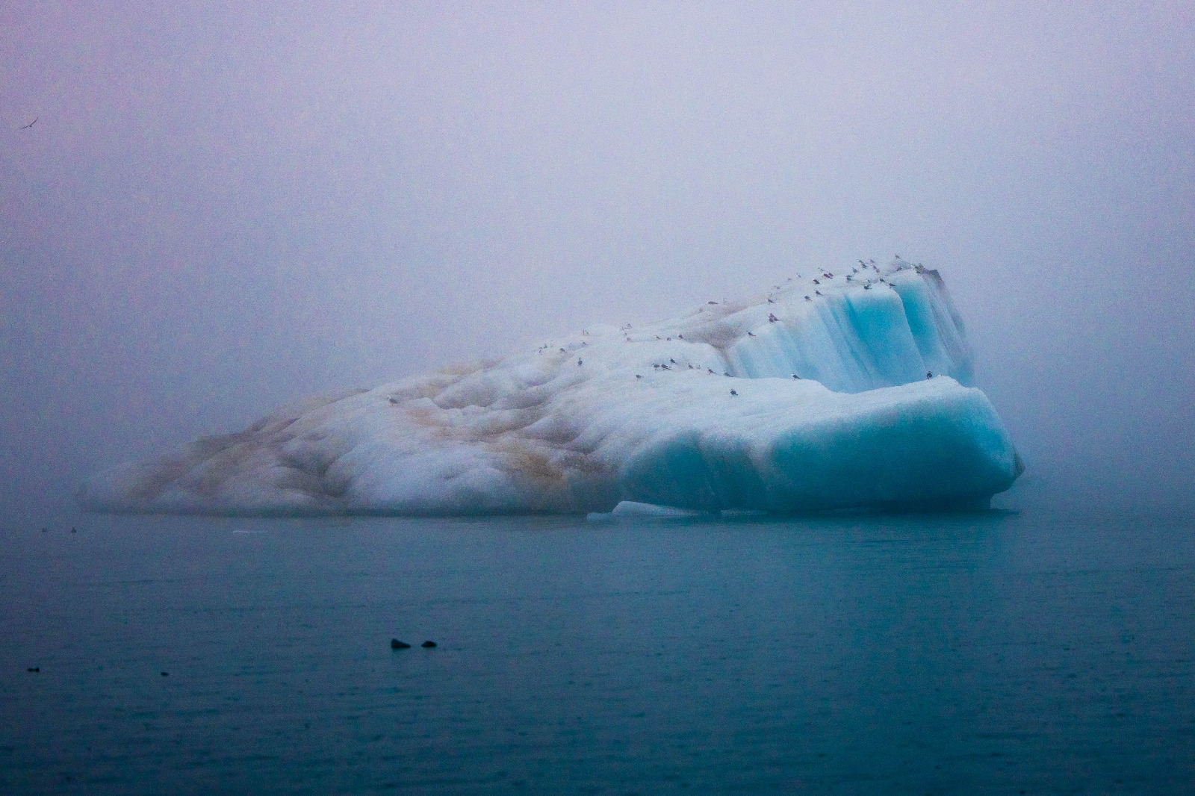
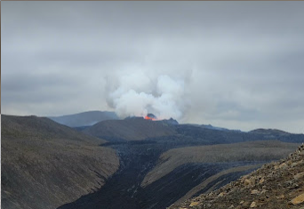
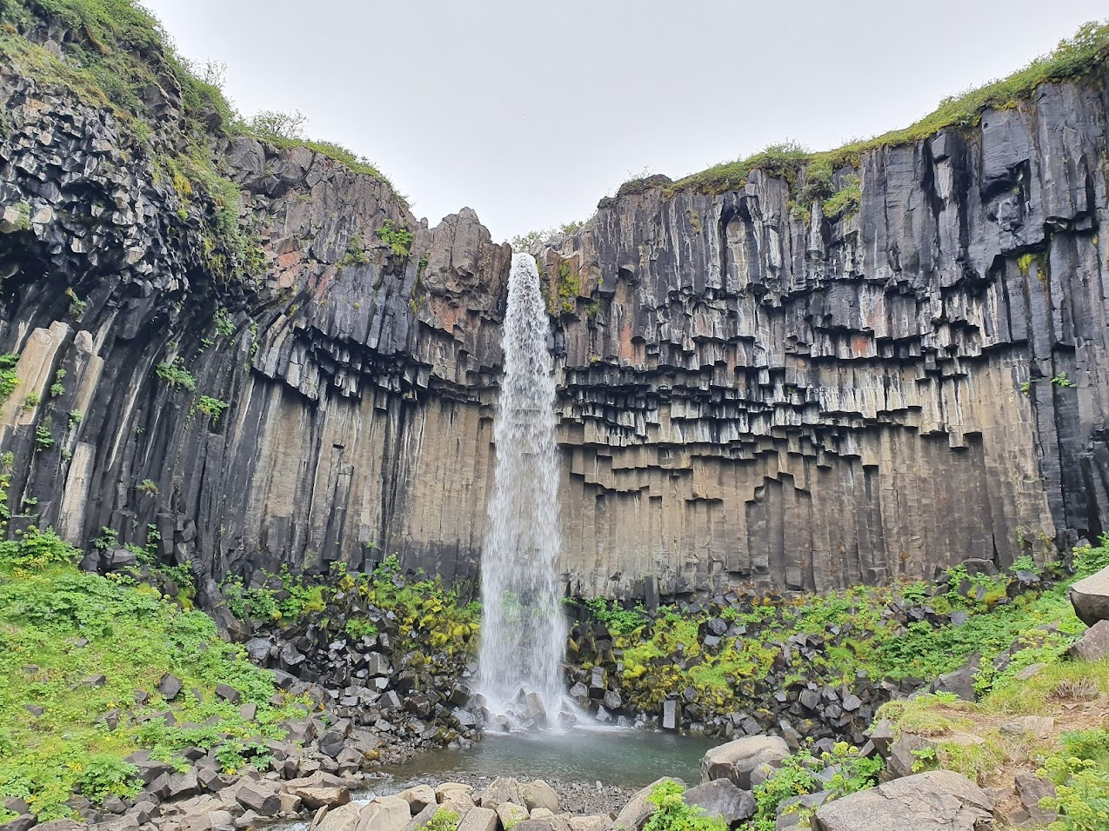
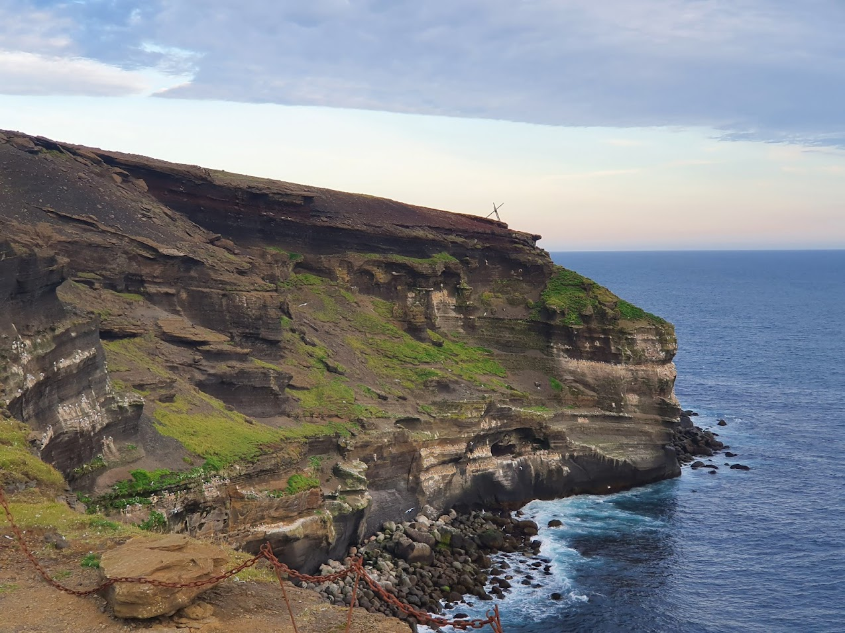
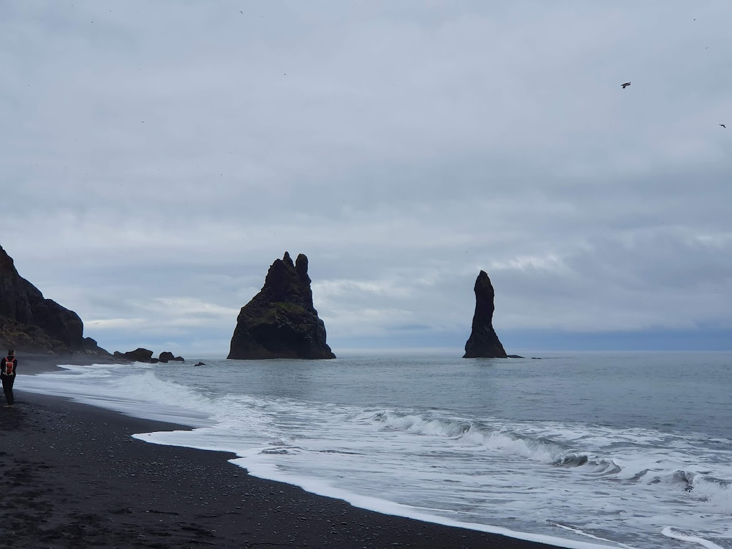
Back from vacation in Iceland
Went on a couple of trips to see the nature in Iceland
COVID
  Unfortunately, Iceland became red while I was there
  I got my second vaccine in Iceland

Slide 3
Start of a new semester at Karlstad University
Courses
  DISCO reading course (continued from last semester)
  Performance Modeling and Simulation (DVAD15)
TA work
  Operating Systems (DVGB01)

Slide 4
Discussion for the next steps this semester
Next steps:
  Technical Report
    Toke’s and Lorenzo’s work on XDP Queueing
  Eiffel algorithm implementations
  Inria/Interdigital Workshop On Systems

