Slide 1
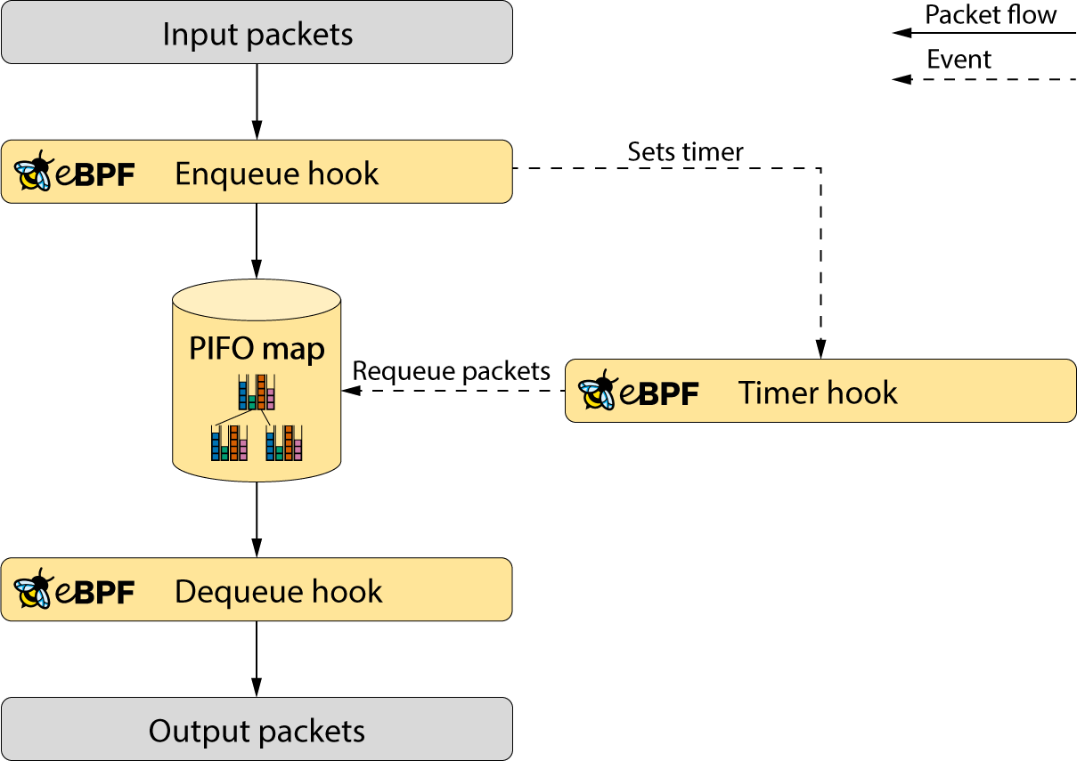


WOS10 October 12th 2021
Bringing packet queueing to XDP
by Frey Alfredsson
Attribution 4.0 International (CC BY 4.0)
Includes work from https://www.ebpf.io
c
Overview BPF
XDP
Packet Scheduling
PIFO
Packet queueing to XDP

Slide 2
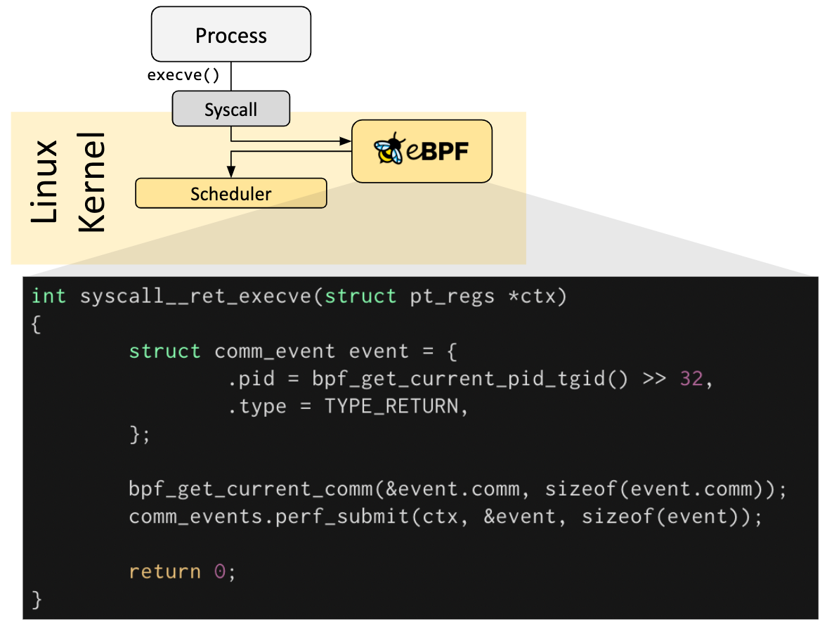
What is BPF?
BPF is a run-time environment to attach and run specialized code within the Linux kernel
This run-time provides us with:
  Inter-process communication between kernel- and user-space
  Inter-process communication between BPF attached code
  A full tool-chain:
    Compilers
    Loader libraries
    Tools

Slide 3
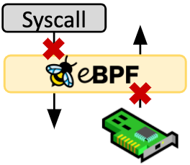
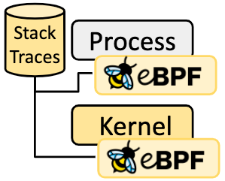
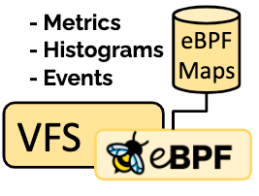
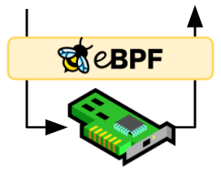
What can BPF do for us?
Security
  cgroups
  IDS
  IPS
Tracing & Profiling
  Debugging
    Software chain
    Kernel internals
  Applications
    Performance
    RAID size
Observability & Monitoring
  Monitoring
    I/O
    Network
    System calls
    Process scheduling
    Memory
Networking
  XDP
    Acceleration
    Load balancing
    DDoS prevention
  XDP socket
    Load balancing
  cgroup
    TC hook
    Packet Processing

Slide 4
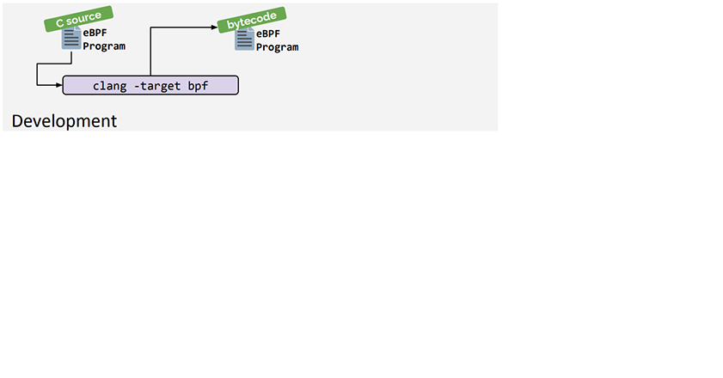
The ten-thousand feet view of BPF (1/3)
Development environment:
  Bytecode / Machine instruction language
  Compilers and tools

Slide 5
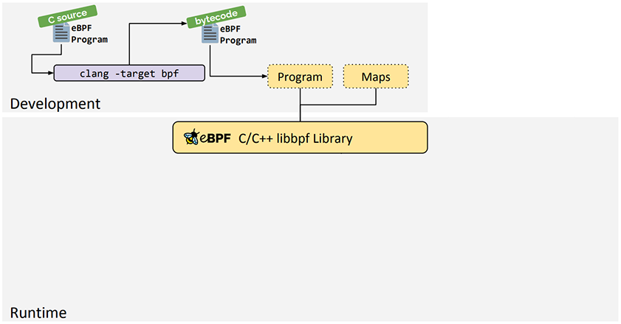
The ten-thousand feet view of eBPF (2/3)
A runtime environment that loads the BPF code
  Multiple libraries and programs exist
    It’s recommended to use libbpf today

Slide 6
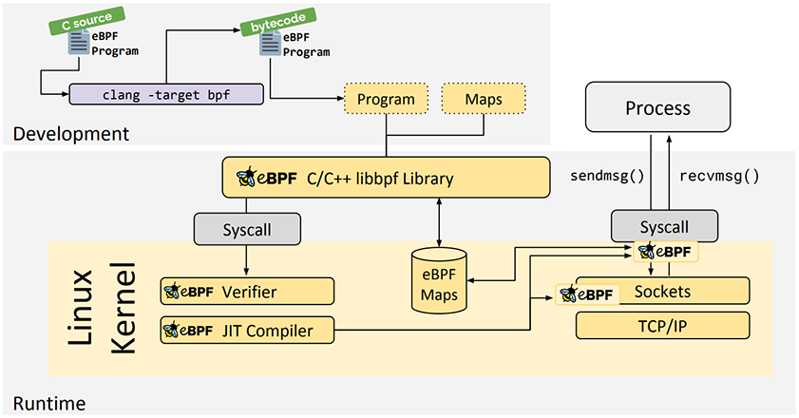
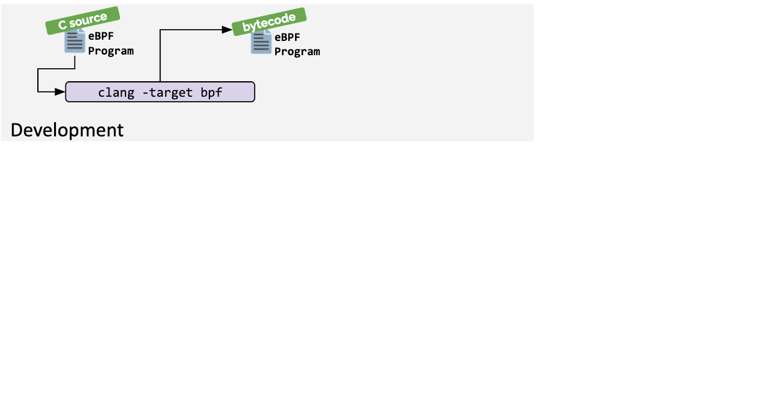
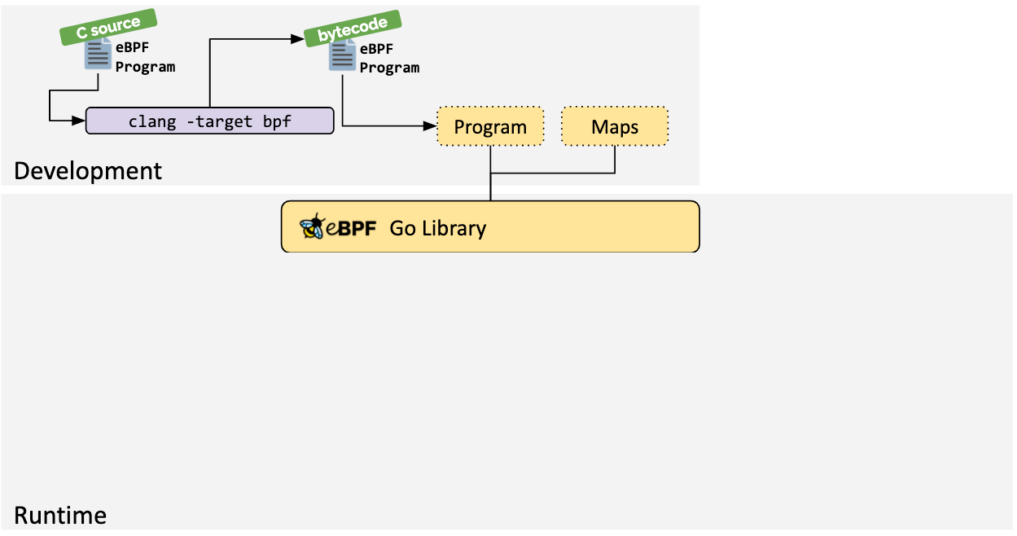
The ten-thousand feet view of eBPF (3/3)
The kernel handles the BPF program by:
  Verifying that it does not break the kernel
  Attaching the BPF program to a hook

Slide 7
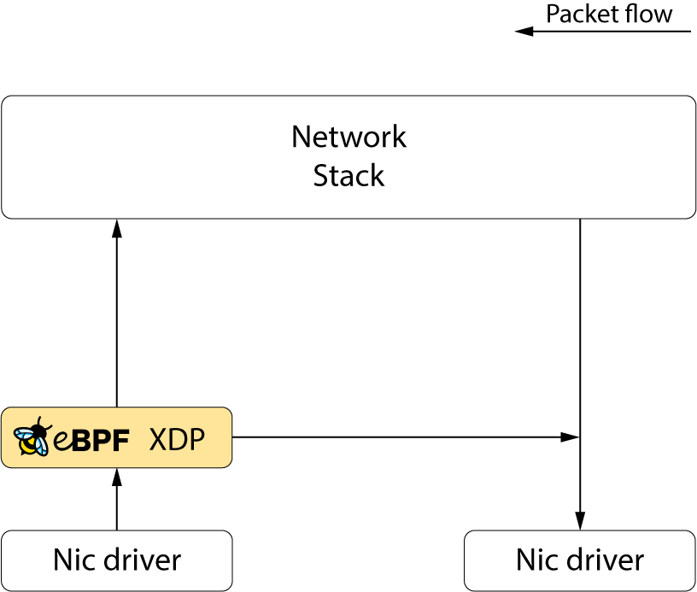
XDP – eXpress Data Path
The eXpress Data Path is an in-kernel network fast-path
XDP is a BPF hook that resides in-front of the network stack
It provides the following operations:
  Packet manipulation
  Packet redirection
  Packet drop
  Monitoring
XDP Lacks packet scheduling capabilities!

Slide 8
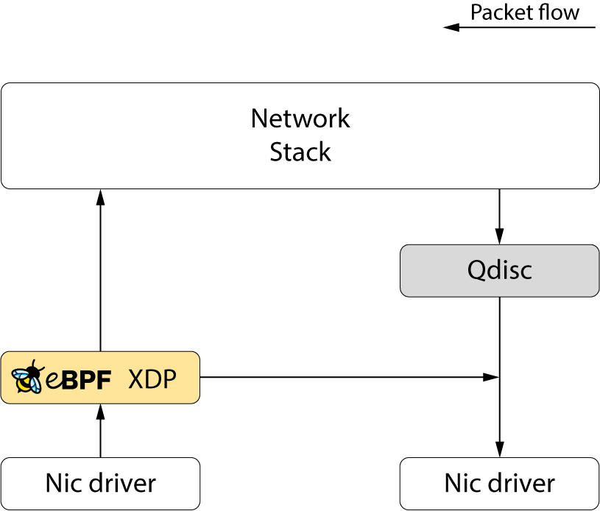
XDP – eXpress Data Path
The eXpress Data Path is an in-kernel network fast-path
XDP is a BPF hook that resides in-front of the network stack
It provides the following operations:
  Packet manipulation
  Packet redirection
  Packet drop
  Monitoring
XDP Lacks packet scheduling capabilities!
Which the Linux kernel otherwise provides as Qdisc

Slide 9
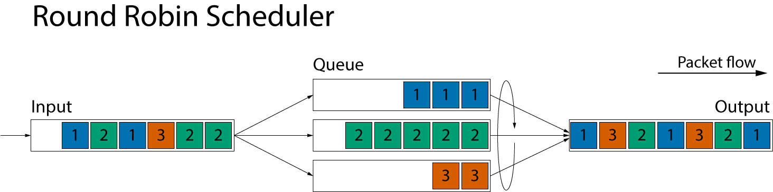
Packet Scheduling
Packet Scheduling is the art of rearranging packets before transmission
  A simple scheduler example:
  In this example, packets are sorted by flows into different queues that are dequeued in a round robin fashion

Slide 10
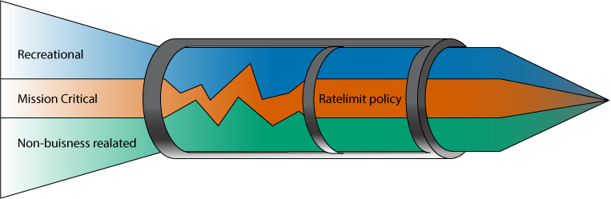
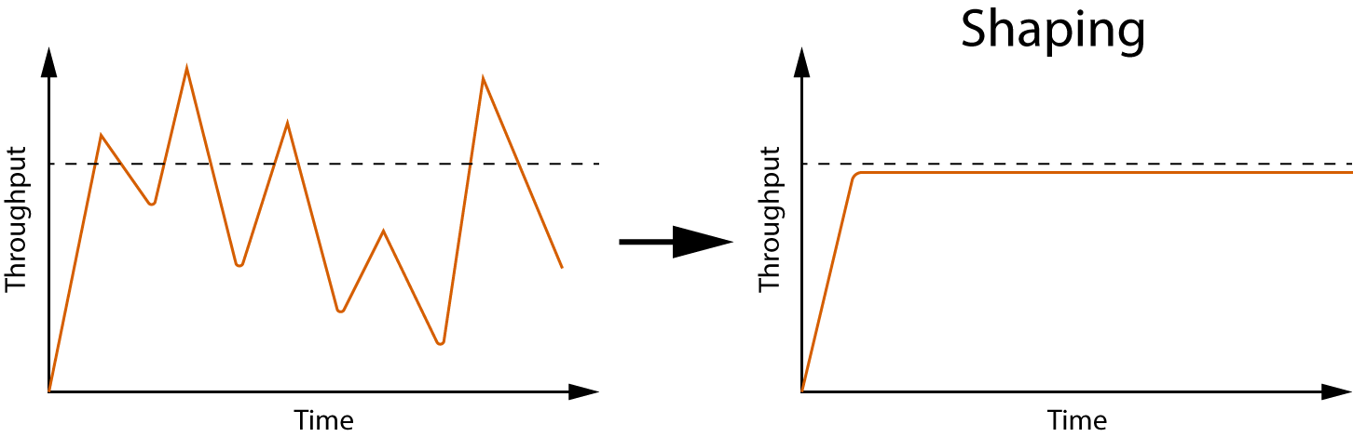
Policy and Shaping
Rate limiting a different type of packet scheduling practice were throughput is capped:
Shaping algorithms rely on timers and have the capability of delaying packets.

Slide 11
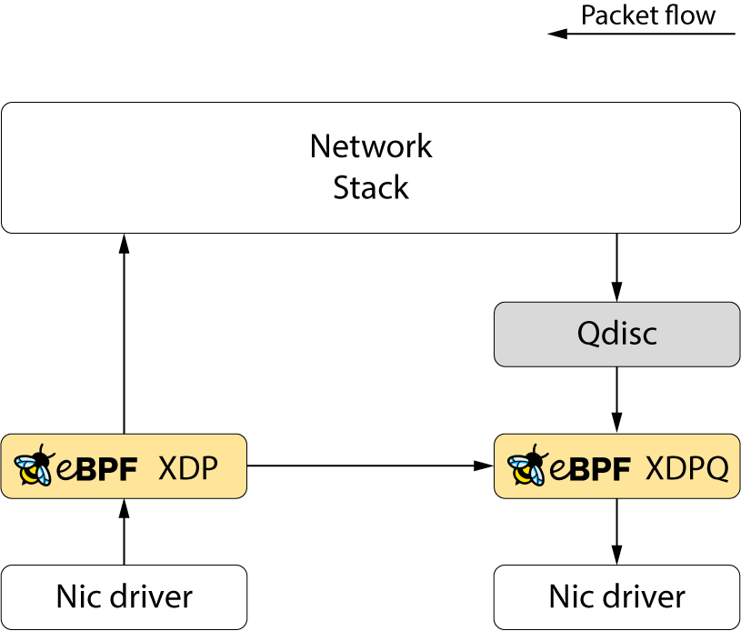
Packet Queuing for XDP
Our goal is to add programmable queuing capabilities to XDP
  Add a dequeue hook to XDP

Slide 12
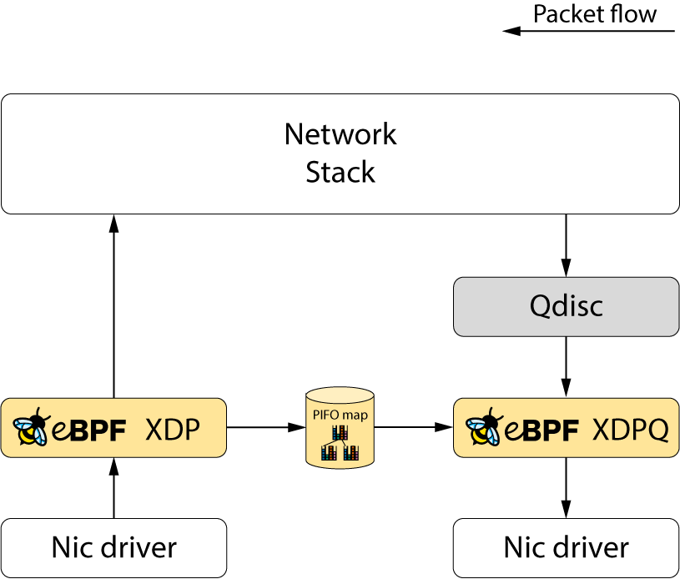
Packet Queuing for XDP
Our goal is to add programmable queuing capabilities to XDP
  Add a dequeue hook to XDP
  Allowing XDP to redirect packets to a new BPF map scheduling data structure

Slide 13
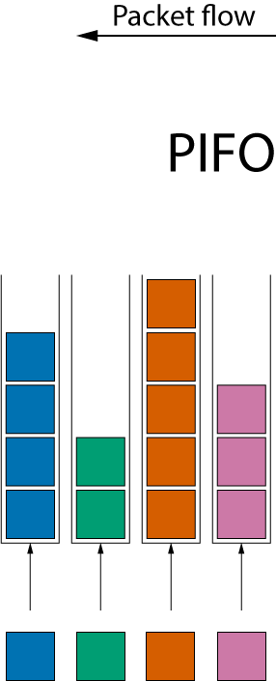
PIFO – Push-In First-Out
A common data structure for programmable packet schedulers is the PIFO:
  A PIFO is a set of queues
  Packets can be pushed in any order into the queues

Slide 14
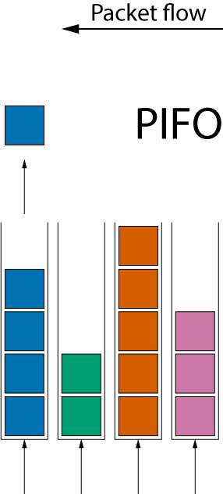
PIFO – Push-In First-Out
A common data structure for programmable packet schedulers is the PIFO:
  A PIFO is a set of queues
  Packets can be pushed in any order into the queues
  However, packets can only be retrieved from the head of the data structure

Slide 15
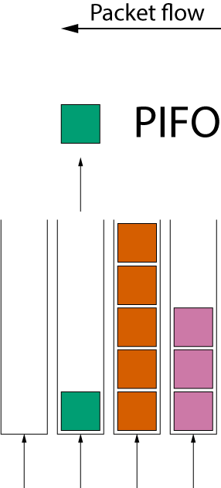
PIFO – Push-In First-Out
A common data structure for programmable packet schedulers is the PIFO:
  A PIFO is a set of queues
  Packets can be pushed in any order into the queues
  However, packets can only be retrieved from the head of the data structure

Slide 16
PIFO – Push-In First-Out
A common data structure for programmable packet schedulers is the PIFO:
  A PIFO is a set of queues
  Packets can be pushed in any order into the queues
  However, packets can only be retrieved from the head of the data structure
  PIFOs do not allow rearranging the packets after queueing them

Slide 17
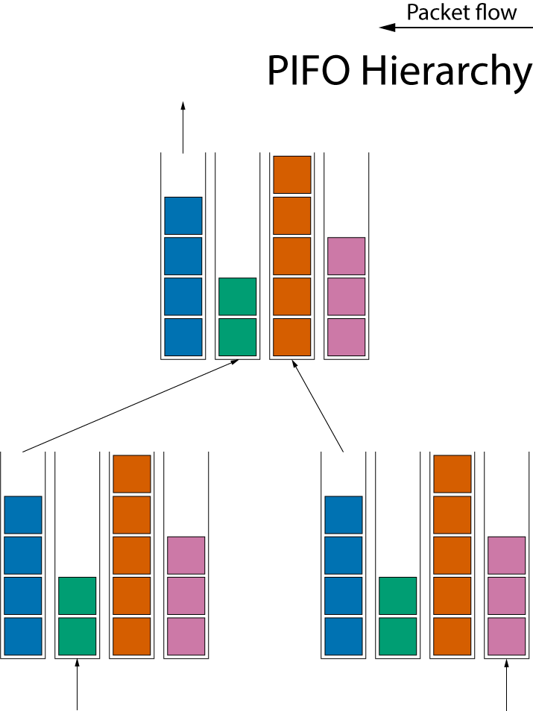
PIFO Hierarchy
Most packet scheduling algorithms can be constructed by creating a hierarchy of PIFOs

Slide 18
XDP queuing with shaping
We can provide shaping by using the new BPF timer API
  XDP hook enqueues packets into a delay PIFO
  Using the timer hook, we can requeue the delayed packets from the delay PIFO and into the active PIFO

Slide 19
Summary
Bringing packet queueing to XDP
  Our aim is to add programmable packet scheduling capabilities to XDP by adding:
    A new XDP dequeue hook
    A new BPF PIFO map
  We will provide shaping though BPF timers

