Slide 1
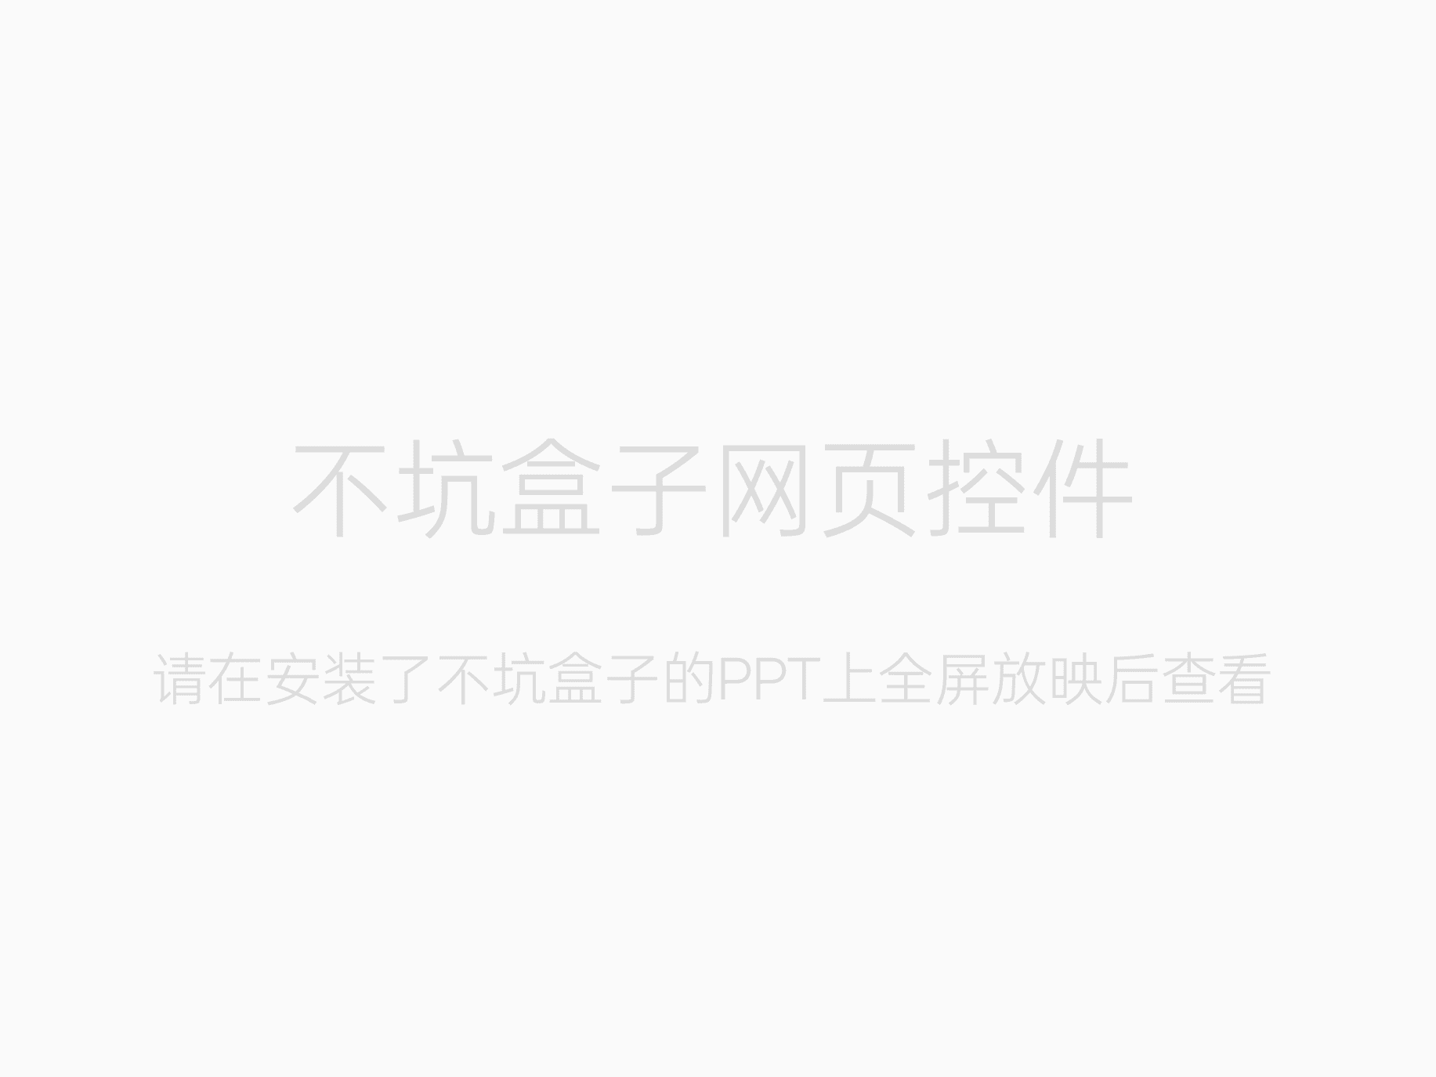
https://web-production-27bb4.up.railway.app/

