Slide 1
Marketing and CS
Philip Chan

Slide 2
Enticing you to buy a product
What is the content of the ad?
Where to advertise?
  TV, radio, newspaper, magazine, internet, …
Who is the target audience/customers?
Which question is the most important?

Slide 3
Target customers
The more you know about the customers
  The more effective to find the “right” customers
Advertising kids’ toys
  Where to advertise?
  How to advertise?

Slide 4
Traditional vs Modern Media
Traditional media (TV, Newspaper, …)
  non-interactive
  mostly broadcast
Modern media (via internet)
  interactive
  more individualize
  more information on individuals

Slide 5
Problems to Study
Problem 1
  Ranking Ad’s on Search Engines
Problem 2
  Product Recommendation

Slide 6
Ranking Ad’s on Search Engines
Problem 1

Slide 7
Advertising on Search Engines
User
  Query
Advertiser
  Ad
  Keyword
    for triggering the ad to be considered
  Bid on a keyword
    How much it’s willing to pay
    https://adwords.google.com/select/KeywordToolExternal?defaultView=3
Search Engine
  Score and rank ad’s to display
  Advertiser pays only when its ad is clicked

Slide 8
Factors affecting the score
Advertiser’s bid
  Highest bidder wins (auction)
  Is that sufficient?

Slide 9
Factors affecting the score
Advertiser’s bid
  Highest bidder wins (auction)
  Is that sufficient?
  Bigger companies have deeper pocket…
  What if the ad is not relevant?
    Bid on keywords that are very popular
      e.g. “ipod” but selling furniture
  What if the ad/company/product is not “well received”?

Slide 10
Importance of audience/customer
If the ad is not relevant
  The users don’t click
  Doesn’t matter how high the advertiser bids

Slide 11
Importance of audience/customer
If the ad is not relevant
  The users don’t click
  Doesn’t matter how high the advertiser bids
Displaying ad’s relevant to users is important
  Advertisers get more visits/revenue
  Search engines get more revenue
  User experience is better

Slide 12
Problem Formulation
Given (Input)
  Ad
  Keyword
  Bid
  Query
  (part of the algorithm is to decide other factors)
Find (Output)
  Score of Ad

Slide 13
Ad Rank score [Google AdWords]
Cost Per Click (CPC) bid
Quality Score
https://support.google.com/adwords/answer/1722122

Slide 14
Quality Score [Google AdWords]
Ad’s relevance
Keyword relevance
Landing page experience

Slide 15
Quality Score [Google AdWords]
Clickthrough Rate (CTR) of ad via that keyword [clicks / displays]
CTR of display URL (URL in the ad)
CTR of other ad’s of the advertiser

Slide 16
Quality Score [Google AdWords]
Clickthrough Rate (CTR) of ad via that keyword [clicks / displays]
CTR of display URL (URL in the ad)
CTR of other ad’s of the advertiser
Relevance of keyword to ad
Relevance of keyword to query

Slide 17
Quality Score [Google AdWords]
Clickthrough Rate (CTR) of ad via that keyword [clicks / displays]
CTR of display URL (URL in the ad)
CTR of other ad’s of the advertiser
Relevance of keyword to ad
Relevance of keyword to query
Usefulness and clarity of landing page
Relevance of landing page

Slide 18
Quality Score [Google AdWords]
Clickthrough Rate (CTR) of ad via that keyword [clicks / displays]
CTR of display URL (URL in the ad)
CTR of other ad’s of the advertiser
Relevance of keyword to ad
Relevance of keyword to query
Usefulness and clarity of landing page
Relevance of landing page
Advertiser’s performance in geographical location
Ad’s performance on a site
Ad’s performance on devices
Others
https://support.google.com/adwords/answer/2454010
https://support.google.com/adwords/answer/1659694

Slide 19
Weighted Linear Sum
Score = w₁x₁ + w₂x₂ + w₃x₃ + ... + w_{n}x_{n}

Slide 20
Product Recommendation
Problem 2

Slide 21
Product Recommendation
Shopping sites: amazon, netflix, …
To sell more products
  Recommend products the customers might buy

Slide 22
Can you read minds?
“Can you read minds?” (amazon.com recruitment T-shirt)
Why does amazon.com want employees who can read minds?

Slide 23
Recommendation Systems
amazon.com
  based on what you have looked at, bought, on your wish list, what similar customers bought, …
  recommends products
netflix.com
  based on your ratings of movies, what similar customers rate, …
  recommends movies

Slide 24
Netflix Prize (2006)
Task
  Given customer ratings on some movies
  Predict customer ratings on other movies
If John rates
  “Mission Impossible” a 5
  “Over the Hedge” a 3, and
  “Back to the Future” a 4,
  how would he rate “Harry Potter”, … ?
Performance
  Error rate (accuracy)
www.netflixprize.com

Slide 25
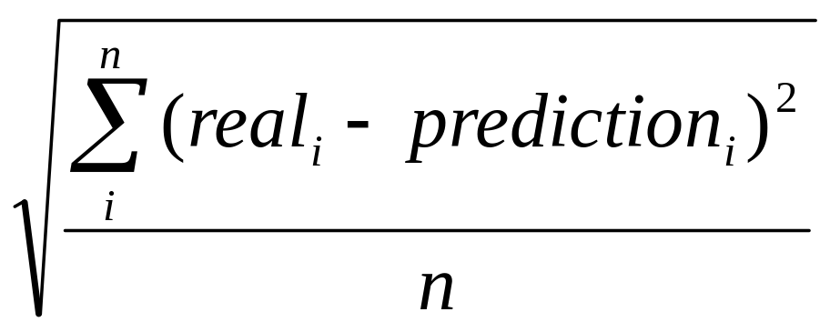
Performance of Algorithms
Root Mean Square Error (RMSE)

Slide 26
Cash Award
Grand Prize
  $1M
  10% improvement
  by 2011 (in 5 years)

Slide 27
Leader Board
Announced on Oct 2, 2006
Progress
  www.netflixprize.com/community/viewtopic.php?id=386
Improvement by the top algorithm
  after 1 week: ~ 0.9%
  after 2 weeks: ~ 4.5%
  after 1 month: ~ 5%
  after 1 year: 8.43%
  after 2 years: 9.44%
  after ~3 years: 10.06% [July 26, 2009]

Slide 28
Problem Formulation
Given (input)
  Movie
    MovieID, title, year
  Customer:
    CustID, MovieID, rating, date
Find (output)
  Rating of a movie by a user
Simplification: no actors/actresses, genre, …

Slide 29
Netflix Data (1998-2005)
Customers
  480,189 (ID: 1 – 2,649,429)
Movies
  17,770 (ID: 1 – 17,770)
  ID, title, year
Ratings given in Training Set
  100,480,507
  min=1; max=17,653; avg=209 ratings per customer
  Rating scale: 1 – 5
  Date
Ratings to predict in Qualifying Set
  2,817,131
About 1 GB (700 MB compressed)

Slide 30
Naïve Algorithm 1
Calculate the average rating for each movie
Always predict the movie average
  with no regard to the customer
RMSE =1.0515
“improvement” = -11%

Slide 31
Naïve Algorithm 2
For each movie
  Instead of simple average
  Weighted average
    customers who have rated more movies are weighted higher
RMSE = 1.0745
“Improvement” = -13%

Slide 32
Naïve Algorithm 3
Calculate the average rating for a customer
Always predict the customer average
  with no regard to the movies
RMSE = 1.0422
“Improvement” = -10%

Slide 33
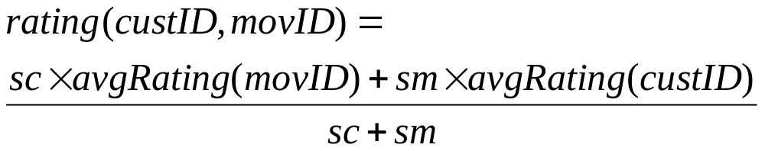
Naïve Algorithm 4
Weight the two average ratings by their standard deviation
sm = stdev of movie ratings
sc = stdev of customer ratings
RMSE = 0.9989
“Improvement” = - 5%

Slide 34
Getting more serious…
Find customers who:
  Rated the same movies
  Gave the same ratings

Slide 35
Getting more serious…
Find customers who:
  Rated the same movies and
  Gave the same ratings
  How likely you’ll find such customer?

Slide 36
Getting more serious…
Find customers who:
  Rated the same movies?
  Gave the same ratings?
  Rated the same movies and more?
    Ratings might not be the same

Slide 37
Superset customers
For each customer X
  Find “superset” customer Y
  Use the “superset” customers to predict X’s rating

Slide 38
Superset Example
 | m1 | m2 | m3 | m4 | m5 | m6 | m7 | m8 | m9
c1 | ? |  | 1 |  | 3 |  | 4 | ?
c2 | 2 |  | 3 |  | 1 |  | 4 | 5
c3 | 4 | 5 | 3 | 3 | 3 |  | 4 | 4 | 1
c4 |  |  | 3 |  | 2 |  | 4
c5 | 3 |  |  |  |  | 4 | 1 | 3 | 3
? = unknown rating to be predicted
  (for simplicity, only for c1)
c2 and c3 are supersets of c1
How to predict “?”

Slide 39
Algorithm for Rating Prediction
Average the movie ratings of the “superset” users
Can we improve this algorithm?

Slide 40
Algorithm for Rating Prediction
Average the movie ratings of the “superset” users
Weighted average based on how “close” the “superset” users are
  distance(X, Y) = ?

Slide 41
Algorithm for Rating Prediction
Average the movie ratings of the “superset” users
Weighted average based on how “close” the “superset” users are
  distance(X, Y) = “RMSE(X , Y)”

Slide 42
Algorithm for Rating Prediction
Average the movie ratings of the “superset” users
Weighted average based on how “close” the “superset” users are
  distance(X, Y) = “RMSE(X , Y)”
  But smaller distance, higher weight, so we want “similarity(X, Y) ” not “distance(X, Y) ”
  similarity(X, Y) = ?

Slide 43
Algorithm for Rating Prediction
Average the movie ratings of the “superset” users
Weighted average based on how “close” the “superset” users are
  distance(X, Y) = “RMSE(X , Y)”
  But smaller distance, higher weight, so we want “similarity(X, Y) ” not “distance(X, Y) ”
  similarity(X, Y) = maxDist - distance(X, Y)
  maxDist = ?

Slide 44
Algorithm for Rating Prediction
Average the movie ratings of the “superset” users
Weighted average based on how “close” the “superset” users are
  distance(X, Y) = “RMSE(X , Y)”
  But smaller distance, higher weight, so we want “similarity(X, Y) ” not “distance(X, Y) ”
  similarity(X, Y) = maxDist - distance(X, Y)
  maxDist = 4

Slide 45
Euclidean Distance
2-dimensional
  A: (x₁ , y₁ )
  B: (x₂ , y₂ )
  sqrt ( (x₁ – x₂ )² + (y₁ – y₂ )² )
n-dimensional
  A: (a₁ , a₂ , ... , a_{n})
  B: (b₁ , b₂ , ... , b_{n})
  sqrt( Σ_{ι} ( a_{i} - b_{i} )² )
Similarity
  1 / EuclideanDistance

Slide 46
Prediction Range
Netflix allows rating prediction in fractional values, e.g. 3.4, but users can only rate in integers
  Why?
Do we want to predict smaller than 1 or larger than 5?
  Why?
Notes:
Rank recommendations

Slide 47
What if a customer doesn’t have a superset
What to predict?

Slide 48
Key operation
For each customer X
  Find “superset” customer Y
  Use the “superset” customers to predict X’s rating
Which step is more time consuming?

Slide 49
Superset Problem
O(C²) problem
  C = number of customers
  C(C - 1) pairs of customers
    check if A is a superset of B
    check if B is a superset of A
    could be neither, why?
To find the supersets
  ignore ratings

Slide 50
B is potentially a superset of A
B A | Y | N | ?
Y
N
?

Slide 51
B is potentially a superset of A
B A | Y | N | ?
Y | T | F | F
N | T | T | T
? | T | F | F

Slide 52
Implementation for Superset
Key operation:
  Find supersets of customer X
How to store which customer rated which movie?

Slide 53
2D Boolean Array
C = number of customers
M = number of movies
C x M Boolean array
  480189 * 17770 * 1 = ~8 GB

Slide 54
Bit Vector
Movie ID list for each customer
  c1: 1,4,7,8
  c2: 1,7
  c1 is a superset of c2
Bit (Boolean) Vectors

Slide 55
Bit Vector
Movie ID list for each customer
  c1: 1,4,7,8
  c2: 1,7
  c1 is a superset of c2
Bit (Boolean) Vectors
  c1: 10010011
  c2: 10000010
  c1 is a superset of c2

Slide 56
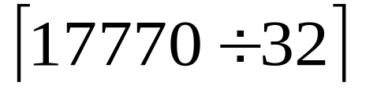
Bit Vectors
1 bit per Boolean value
= 556 words per customer
480189 * 556 * 4 = ~1 GB
If you have 1GB physical memory, is this a good idea?

Slide 57
Array of Linked Lists
100,480,507 ratings
Each movie ID needs 2 bytes
  100,480,507 * 2 = ~0.2 GB
Each pointer needs 4 bytes
  ~0.4 GB
Array of ~500K pointers, 4 bytes each
  ~0.002 GB
Total: ~0.6 GB
If you have 1GB physical memory, is this a good idea?

Slide 58
Just storing the data
Data Structure | Size in GB
2D Boolean array | ~8
Array of bit vectors | ~1
Array of linked lists | ~0.6

Slide 59
What is in the memory?
Running on my office Linux machine:
  Operating system
  Web browser
  Email reader
  emacs
  xterm
  Viewer for pdf, ps
  …

Slide 60
Superset Implementation 1
Instead of storing the movie IDs in memory
  Read from the text files when needed
  Each customer has two text files
    Training set
    Qualifying set
Use pointer arithmetic, inlining, …
Run the program for a while and extrapolate its completion time
How long was the extrapolated completion time?

Slide 61
Some Hints
~230 billion pairs of customers to compare
  average 209 movies per customer
  ~48.2 trillion movie comparisons
1 day = 86,400 seconds (~100K)
walk clock time
on the background with medium priority
How many days?
Probably making your head hurt

Slide 62
Estimated Completion 1
~109 days
~41 microseconds per customer pair

Slide 63
Superset Implementation 2
Text files were preprocessed into binary files
Read from the binary files when needed
Run the program for a while and extrapolate its completion time

Slide 64
Estimated Completion 2
~9 days (> 10x faster)
~3.4 microseconds per customer pair

Slide 65
Superset Implementation 3
One binary file:
  all movie IDs in customer order (~.2 GB)
  index to the offset for each customer (~2 MB)
Read from the file and store in memory
Basically most of the data are memory resident
Run the program for a while and extrapolate its completion time

Slide 66
Estimated Completion 3
~4 days (~2x faster)
~1.5 microseconds per customer pair

Slide 67
Just storing the data
Data Structure | Size in GB
2D Boolean array | ~8
Array of bit vectors | ~1
Array of linked lists | ~0.6
Array + Offset | ~0.2

Slide 68
Revisit customers without supersets
Find customers Y that intersect (overlap) X
If intersection(X, Y) = X
  Y is a superset of X
If no supersets
  Find Y such that intersection(X, Y) is a subset of X
  Overlap is less than 100% of X

Slide 69
Intersection Algorithm: 3 cases
intersection(X, Y) = X [superset]
intersection(X, Y) is a subset of X [subset]
intersection(X, Y) is empty

Slide 70
Intersection example
 | m1 | m2 | m3 | m4 | m5 | m6 | m7 | m8 | m9
c1 | ? |  | 3 |  | 3 |  | 4
c2 | 4 |  | 3 |  | 3 |  | 4 |  | 1
c3 | 4 |  | 3 |  | 3 |  |  | 3
c4 | 3 |  | 3 |  |  |  |  |  | 4
c5 |  |  | 3 |  | 3 | 4 |  | 3 | 3
X is c1
How to compute/compare similarity(X, Y) if the intersections are of different sizes?
c2, c3, c4 all have the same RMSE=0

Slide 71
Intersection example
 | m1 | m2 | m3 | m4 | m5 | m6 | m7 | m8 | m9
c1 | ? |  | 3 |  | 3 |  | 4
c2 | 4 |  | 3 |  | 3 |  | 4 |  | 1
c3 | 4 |  | 3 |  | 3 |  |  | 3
c4 | 3 |  | 3 |  |  |  |  |  | 4
c5 |  |  | 3 |  | 3 | 4 |  | 3 | 3
X is c1
How to compute/compare similarity(X, Y) if the intersections are of different sizes?
c2, c3, c4 all have the same RMSE=0
  are they all equally similar to c1?

Slide 72
Distance
Two factors
  RMSE
  %NotRated
Distance = RMSE + %NotRated
  RMSE is 4 times more important because max is 4.
Distance = RMSE/4 + %NotRated
  If we want them to be equally important/weighted

Slide 73
Distance
Error is automatically 4 (MaxDist)
  When there is no rating

Slide 74
Missing Rating
Replace it with:
  0 [MaxDist is 5]
    Good:
    Bad:

Slide 75
Missing Rating
Replace it with:
  0
    Good: more zeros, more error
    Bad: no rating means Y “hates” the movie?
  3
    Neutral value
    No rating means Y is neutral on the movie

Slide 76
Missing Rating
Replace it with:
  0
    Good: more zeros, more error
    Bad: no rating means Y “hates” the movie?
  3
    Neutral value
    No rating means Y is neutral on the movie
  a predicted value
    global averages weighted by standard deviation

Slide 77
Intersection Algorithm: 3 cases
intersection(X, Y) = X [superset]
  weighted average of supersets
intersection(X, Y) is a subset of X [subset]
  weighted average of subsets
intersection(X, Y) is empty
  global averages weighted with standard deviation

Slide 78
Summary of Intersection Algorithm
If X has supersets, use supersets only
If X does not have supersets, but has subsets, use subsets
If X does not have supersets nor subsets, use naïve algorithm.

Slide 79
k-Nearest Neighbor Algorithm
Distance/Similarity for any pair of customers
Find the top k most similar customers (nearest neighbors)
  Weighted by similarity
Customers with no supersets or subsets do not have neighbors—use naïve alg
One issue is how to determine k

Slide 80
Summary
Problem 1
  Ranking Ad’s on Search Engines
Problem 2
  Product Recommendation

