Slide 2
Interpretable deep reinforcement learning policies
DEPARTMENT OF INFORMATION TECHNOLOGY
IDLAB - Internet technology and data science lab
Xander De Visch

Slide 3
Problem situation

Slide 4
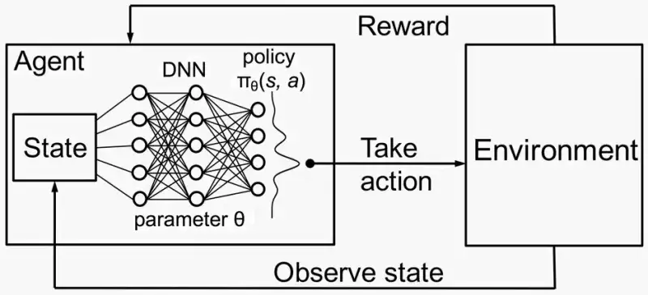
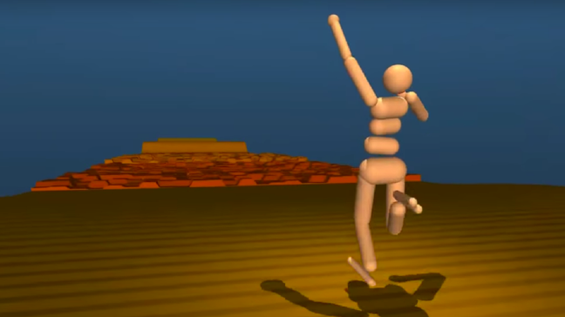
Deep reinforcement Learning (DRL)
Rewarding agent for actions with desired output
Maximizing reward by exploring
Uses Deep Neural Networks (DNN)
Big breakthroughs last decade (robotics, Alpha Go, Alpha Zero, Dota2)

Slide 5
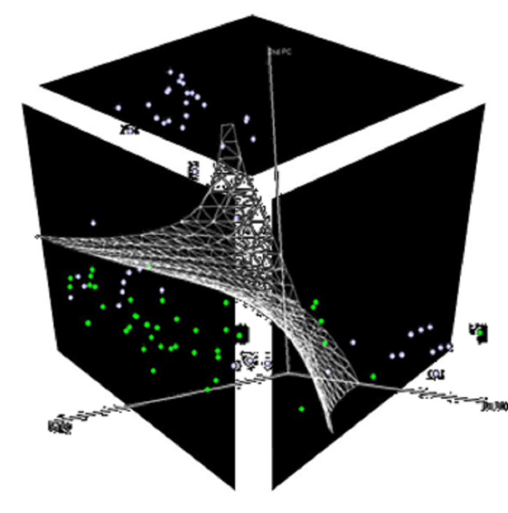
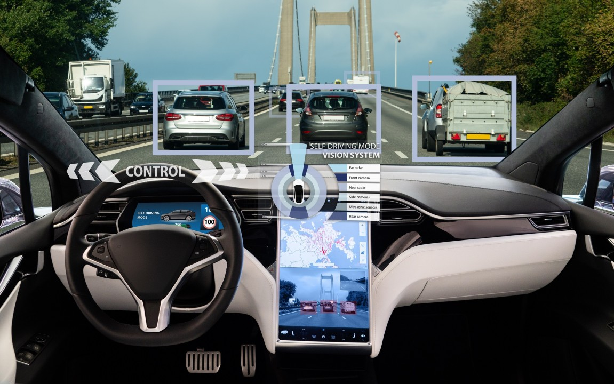
Problems with Dnn in drl
Complex architectures and high-dimensional feature spaces
Black box nature
Critical environments (e.g. self riding cars, robotics in healthcare, etc.)
Increasing demand for interpretability and explainability
Notes:
Interpretability: the ability to determine cause and effect from a machine learning model
Explainability: The knowledge of both what a node represents and its importance to the model’s performance

Slide 6
Research questions and objectives

Slide 7
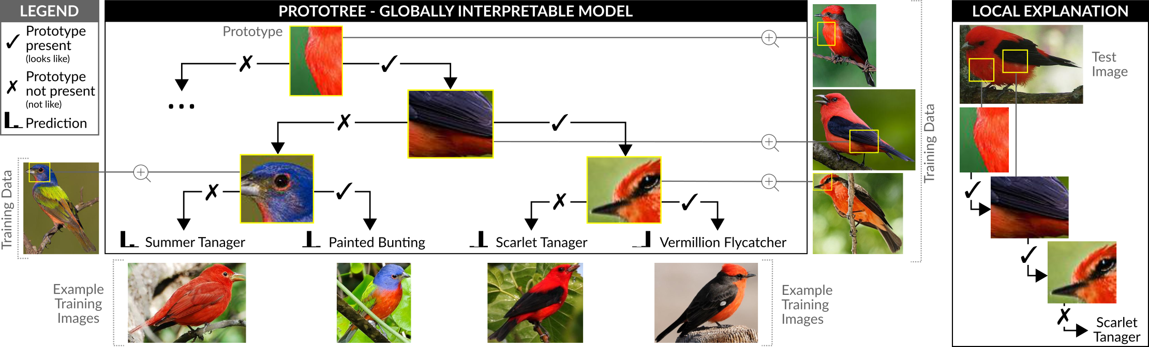
Neural Prototype Tree (Prototree)
Combining predictive power of DNNs with transparency of decision trees
Break up decision process with prototypical parts
Accuracy-interpretability trade-off
Notes:
Local en global explanation uitleggen

Slide 8
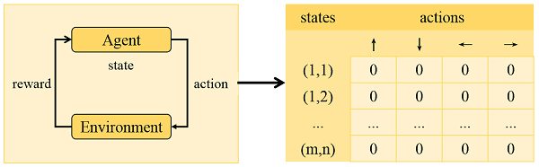

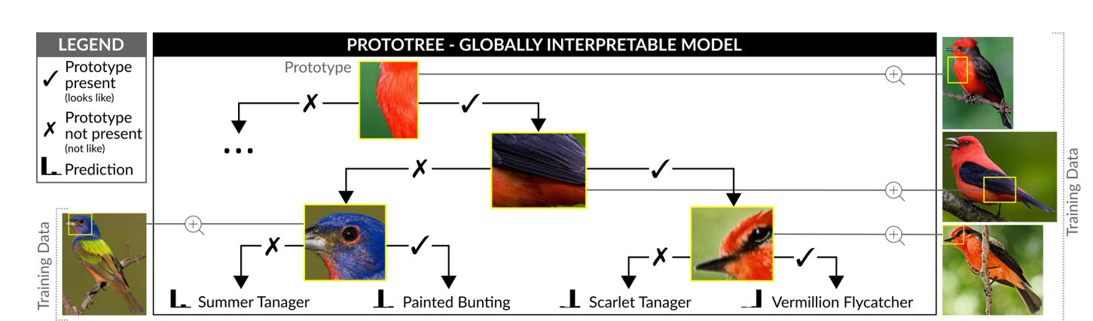

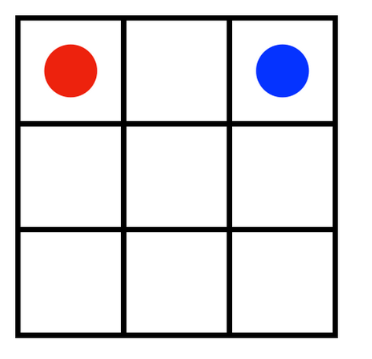
















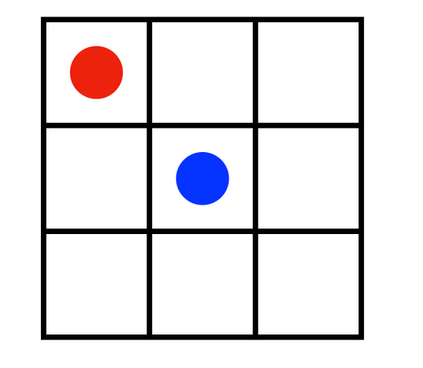











Represent policy with Prototree
Action policy characterizes how agent reacts to environment
Train Prototree with samples from policy of trained Deep Q Network (DQN)
Represent decision making process a posteriori
down
right
down
right
left
up
up
left
Notes:
Zelf figuur maken, figuren van kerstman houden voor action plan

Slide 9
1) train dqn on Cub dataset
1) research of prototype tree
2) DQN policy voorstellen doormiddel van een prototypetree supervised
3) inserting prototype tree in dqn

Slide 10
action plan

Slide 11



Slide 12
1)
2) Training DQN with gym openai

Slide 13
schedule for second semester

Slide 16



Xander De Visch
Thesis student
DEPARTMENT OF INFORMATION TECHNOLOGY
E Xander.DeVisch@ugent.be
T +32 9 000 00 00
M +32 400 00 00 00 www.ugent.be
Universiteit Gent
@ugent
@ugent
Ghent University

