Slide 1
Czech economy

Slide 2
Datasets
Transport, retail and services revenues index
Industry production index
Construction production index
Consumer price index

Slide 3
Different index types

Slide 4
Questions
Consumer price index overall, different areas
Covid19 influence on CPI, construction, industry and retail

Slide 5
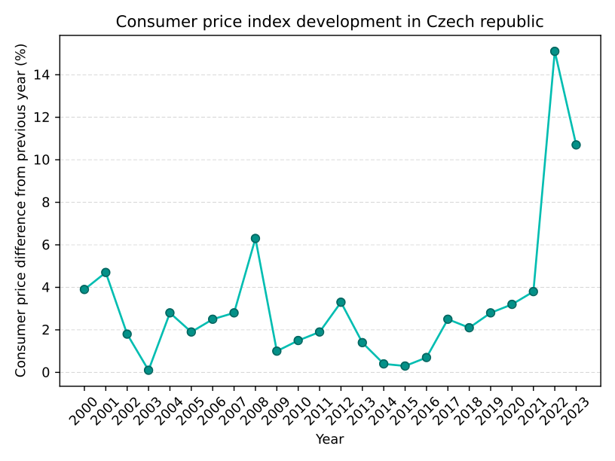
Šipky s důvodama
Food and non-alcoholic beverages
Alcoholic beverages,tobacco and narcotics
Clothing and footwear,
Living expenses, water, energy, fuel
Furniture, household maintenance and repairs
Education,
Health,
Transport,
Communication services
Recreation and culture,
Meals and accommodation,
Postal services and telecommunication,

Slide 7
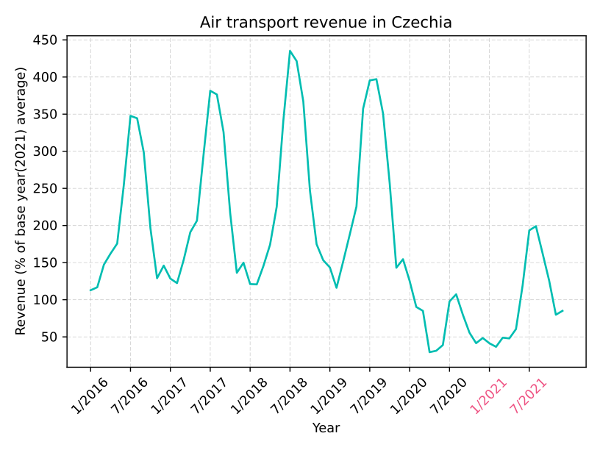
Working with seasonal data
Yt = St * Tt * Rt
Yt … data
St … seasonal component
Tt… trend cycle component
Rt … remained component

Slide 8
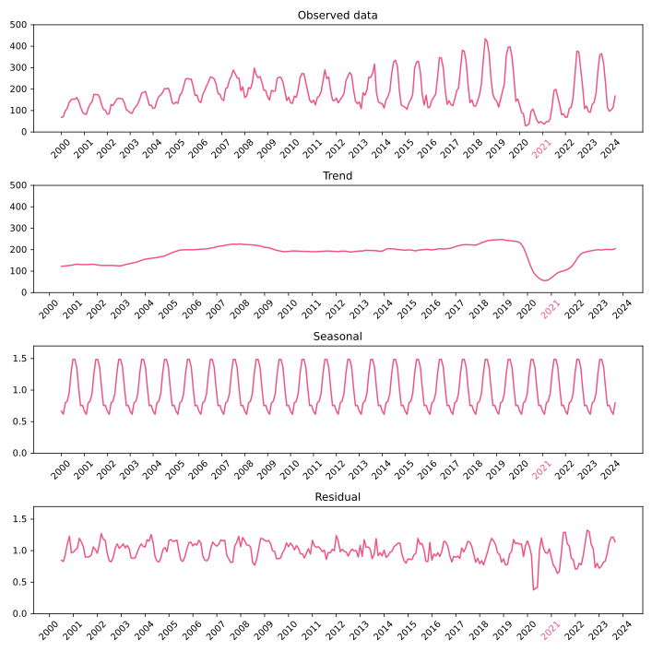

Slide 9
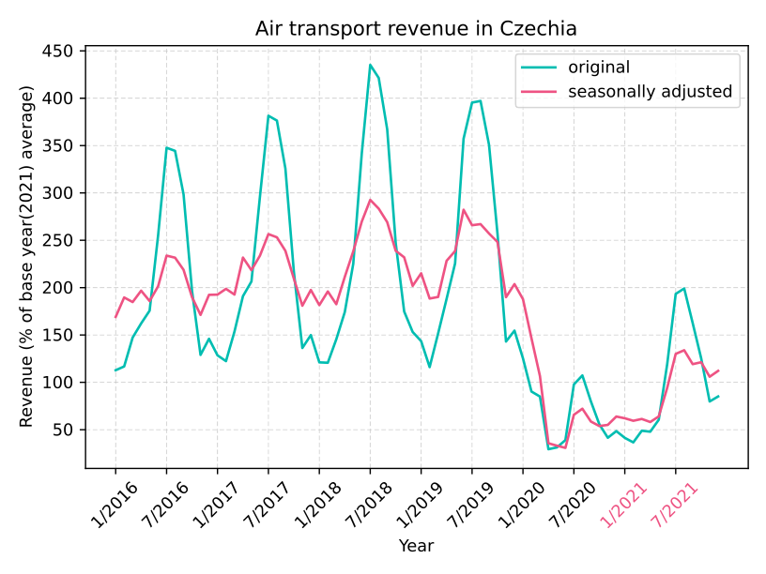
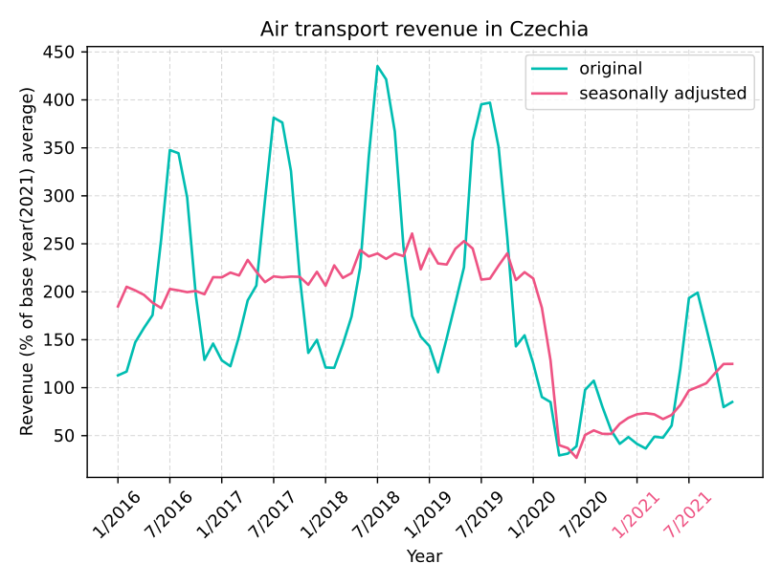
Adjustment using statsmodels.tsa.seasonal_decompose
y_t = y_t / S_t
Adjustment by Czech Statistical Office

Slide 10
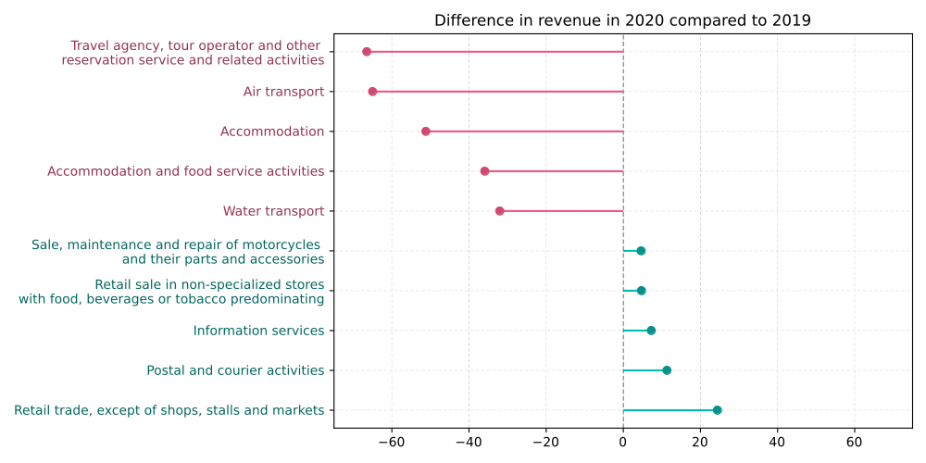
Revenues during COVID19

Slide 11
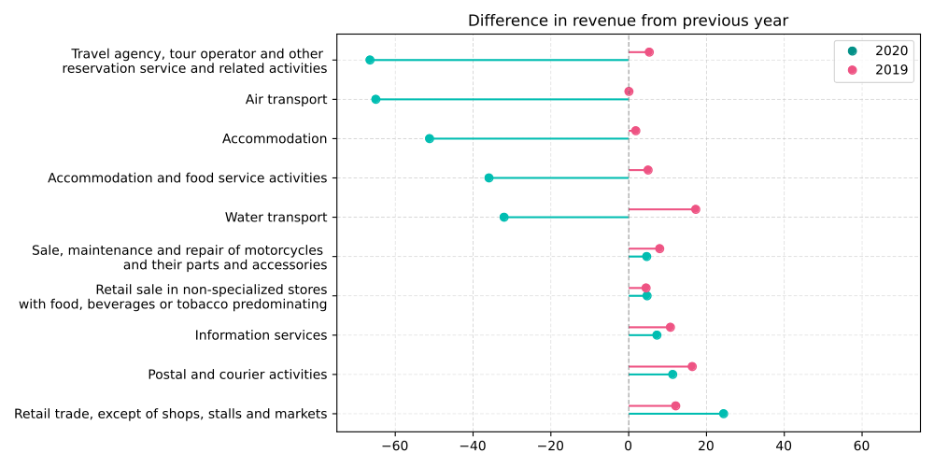
Revenues during COVID19

Slide 12
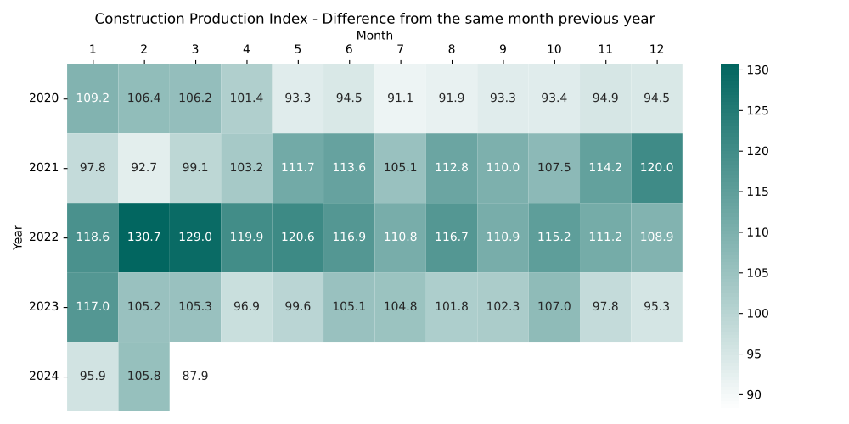
What about construction and industry?

Slide 13
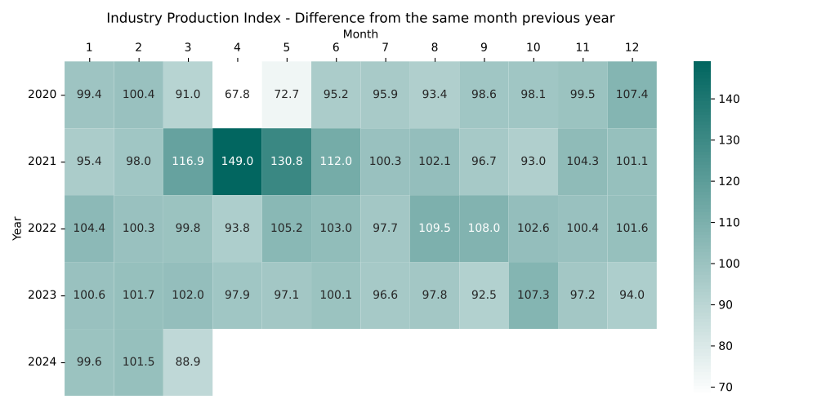

Slide 15
Nejaka korelacni matice

