Slide 1












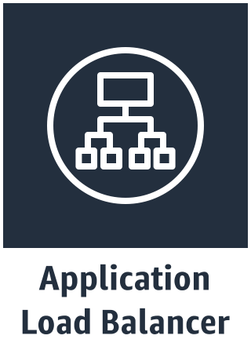











AWS Existing VPC
AWS Region
VPC
Existing Internet gateway
Availability zone 1
Availability zone 2
Existing Public subnet
Existing Public subnet
Existing NAT gateway
Existing NAT gateway
Existing Bastion host
Existing Bastion host
Existing Private subnet
Existing Private subnet
Existing Private data subnet
EFS Volume
Existing Private data subnet
Existing Aurora PostgreSQL
Existing Aurora PostgreSQL

