Slide 1





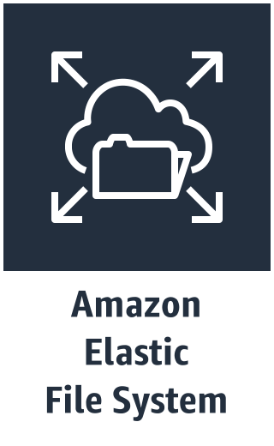






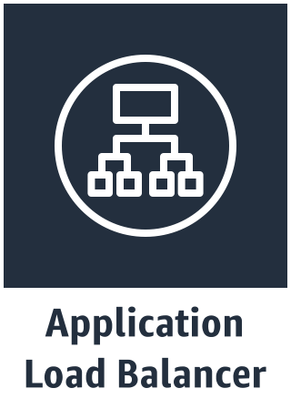
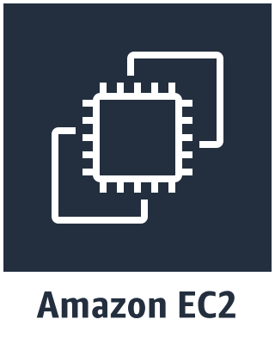










AWS VPC
AWS Region
VPC
Internet gateway
Availability zone 1
Availability zone 2
Public subnet
Public subnet
NAT gateway
NAT gateway
Bastion host
Bastion host
Private subnet
Private subnet
Private data subnet
EFS Volume
Private data subnet
Aurora PostgreSQL
Aurora PostgreSQL

