Slide 1
GEOGRAPHIC HEALTH PATTERNS
Regional Utilisation Analysis of Health Facility Visit Data
Capstone Project 2D | SCA Technical Deep Dive 3.0
Zainab Muhammad Nasir
Internal Defence — 15 September 2026

Slide 2
Business Problem & Objective
The Problem
Dataset at a Glance
Health service utilisation and facility performance vary across regions, but the state health programme lacks a consolidated, region-level view of where demand is highest, which facilities and services drive regional differences, and where resource-planning gaps exist.
25,000
Patient visits analysed
40
Health facilities
Analytical Questions
4
Which regions have the highest and lowest utilisation?
Which facilities/services drive regional differences?
Are there notable geographic imbalances?
How do regional patterns change over time?
Regions covered
Jan 2024 – Aug 2026
Reporting period
SCA Technical Deep Dive 3.0 | Capstone Project 2D — Geographic Health Patterns
2

Slide 3
Data Preparation & Modelling
1
2
3
4
Clean
Model
Calculate
Analyse
Removed 3 duplicate visit records; filled 340 missing wait-time and 221 missing cost values with dataset averages
Built a star schema — Health_Visits_FACT connected to Facilities, Patients, Services, and a dedicated Date dimension
Created DAX measures for Total Visits, Unique Patients, Average Wait Time, Average Cost, and Referral Rate %
Compared regions on utilisation, facility count, service mix, cost, wait time, and month-by-month trend
Why a dedicated Date table? It guarantees every day in the reporting window is represented — even ones with zero visits — so monthly trend comparisons never silently skip a gap.
SCA Technical Deep Dive 3.0 | Capstone Project 2D — Geographic Health Patterns
3

Slide 4
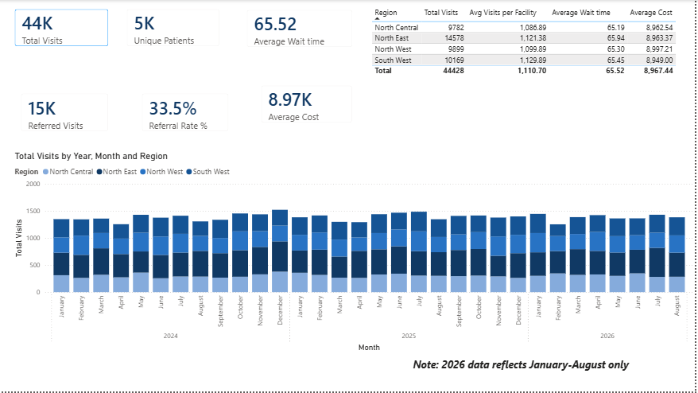
Report Page 1: Executive Overview
Headline KPIs, regional summary table, and monthly visit trend across all four regions (Jan 2024 – Aug 2026).
SCA Technical Deep Dive 3.0 | Capstone Project 2D — Geographic Health Patterns
4

Slide 5
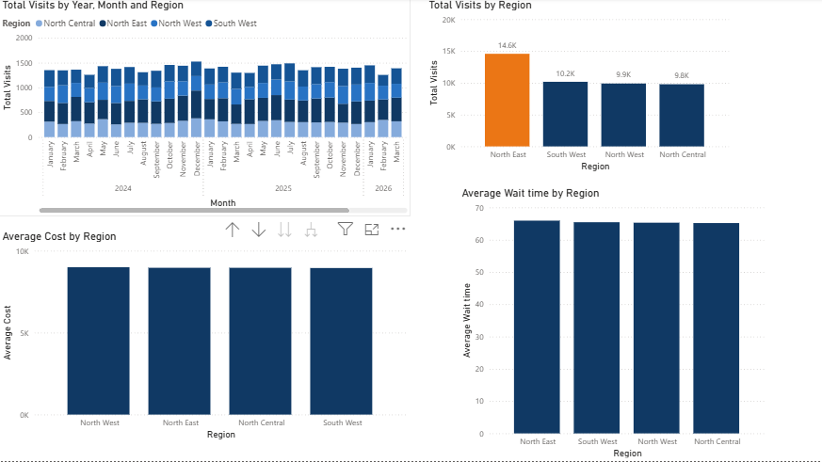
Report Page 2: Trend and Performance
North East (highlighted) leads total visits, while average wait time and cost stay consistent across every region.
SCA Technical Deep Dive 3.0 | Capstone Project 2D — Geographic Health Patterns
5

Slide 6
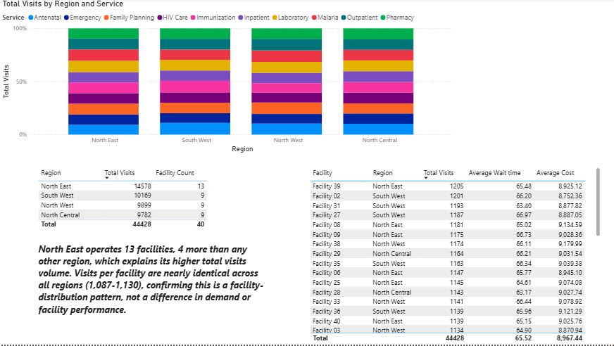
Report Page 3: Detailed Analysis
Service mix by region and facility-level detail — confirming the pattern holds down to individual facilities.
SCA Technical Deep Dive 3.0 | Capstone Project 2D — Geographic Health Patterns
6

Slide 7
Five Evidence-Based Insights
01
North East's higher visit volume (14,578) is explained entirely by operating 13 facilities — 4 more than any other region.
02
Visits per facility are nearly identical everywhere (1,087–1,130) — facility workload is balanced nationwide.
03
Service mix is proportionally consistent across all regions (8.8%–11% per service) — no region has distinct care needs.
04
Visit volumes are stable over time in every region, from 2024 through 2026 — the pattern is structural, not recent.
05
Wait time (65.2–65.9 min) and cost (₦8,948–₦8,998) are virtually uniform system-wide — no facility is a bottleneck.
SCA Technical Deep Dive 3.0 | Capstone Project 2D — Geographic Health Patterns
7

Slide 8
Recommendations
1
2
3
Review facility distribution across regions
Maintain current staffing and resourcing models
Investigate the absence of South East and South South facilities
North East's volume reflects facility count, not demand. Assess whether North Central, North West, and South West need additional facilities to match coverage — especially where population sizes are comparable.
Wait time, cost, and visits-per-facility are consistent nationwide. Resources should scale with facility count, not be redirected based on regional totals alone.
These zones have zero representation in the dataset. Confirm whether this is a genuine PHC coverage gap or a data-reporting gap that needs correcting.
SCA Technical Deep Dive 3.0 | Capstone Project 2D — Geographic Health Patterns
8

Slide 9
Thank You
Questions & Discussion
Prepared to walk through: Power Query cleaning decisions, the star-schema model and Date table, each DAX measure, and how the evidence led to a facility-distribution recommendation rather than a performance narrative.
Zainab Muhammad Nasir
SCA Technical Deep Dive 3.0 — Cohort 3
Capstone 2D: Geographic Health Patterns

