Slide 1
Facial Expression Recognition Using CNN
A Deep Learning Approach to Classifying Facial Emotions

Slide 2
Introduction
The goal of this project is to classify facial expressions into seven emotion categories using a CNN. This project uses the 'Face Expression Recognition Dataset' from Kaggle.

Slide 3
Dataset Description
We used the Face Expression Recognition Dataset consisting of grayscale and RGB images of size 48x48 pixels, labeled with seven emotion classes: Angry, Disgust, Fear, Happy, Sad, Surprise, and Neutral.

Slide 4
Model Architecture
A Convolutional Neural Network (CNN) was used. The architecture includes:
1. Convolutional Layers
2. Pooling Layers
3. Fully Connected Layers
4. Dropout Layers
Input shape: (48, 48, 1) for grayscale, (48, 48, 3) for RGB.

Slide 5
Training Details
Training used the Adam optimizer, categorical crossentropy as loss function, and 30 epochs. Batch size: 32. Data augmentation was applied to enhance generalization.

Slide 6
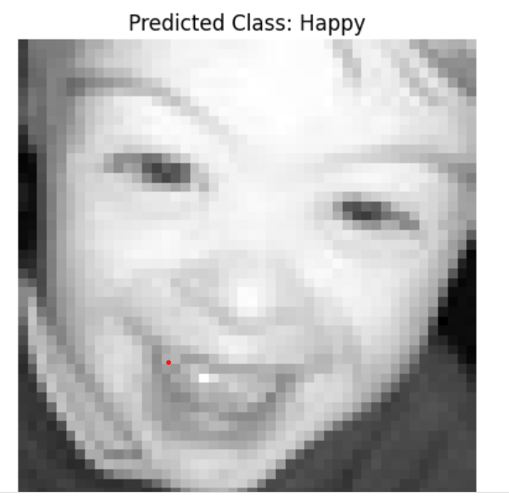
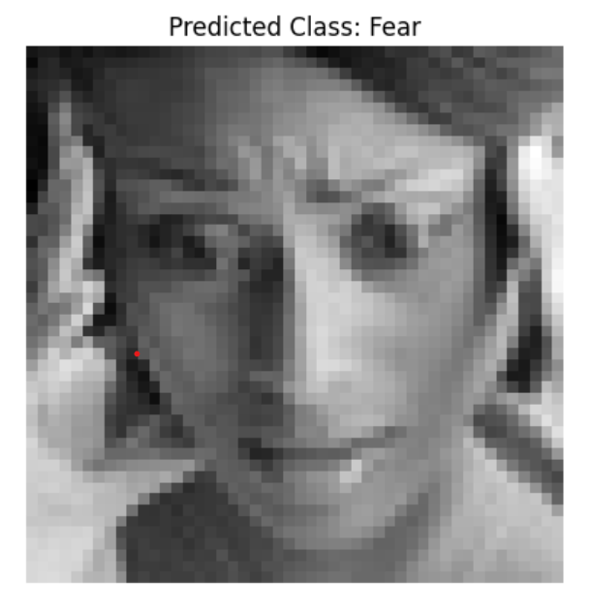
Prediction Example

Slide 7
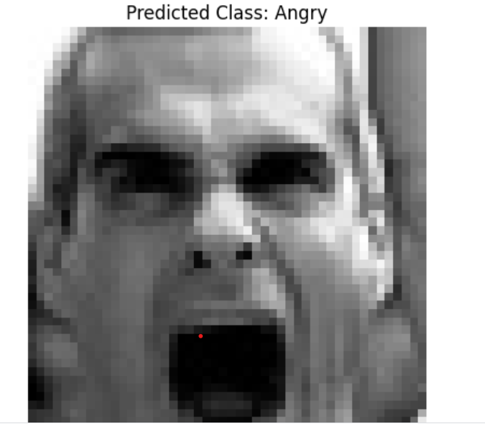
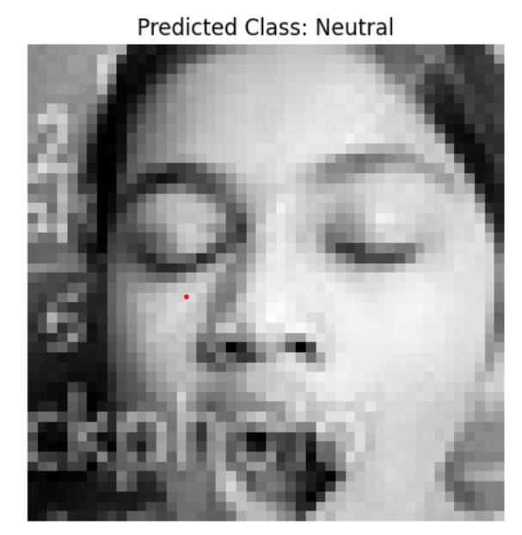
Prediction Example

Slide 8
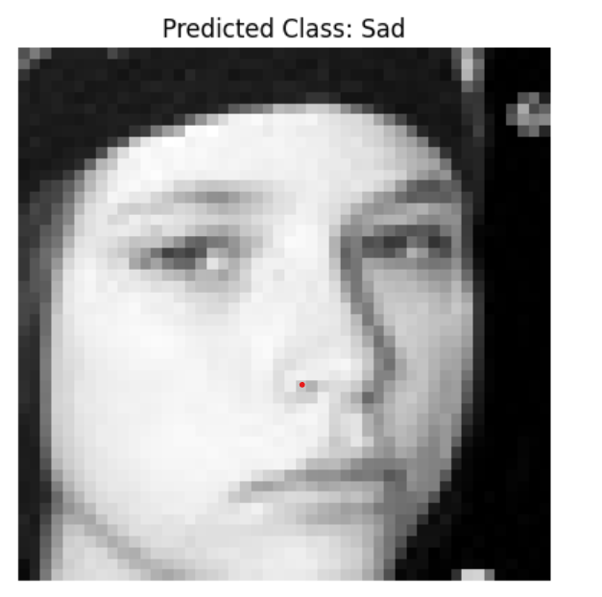
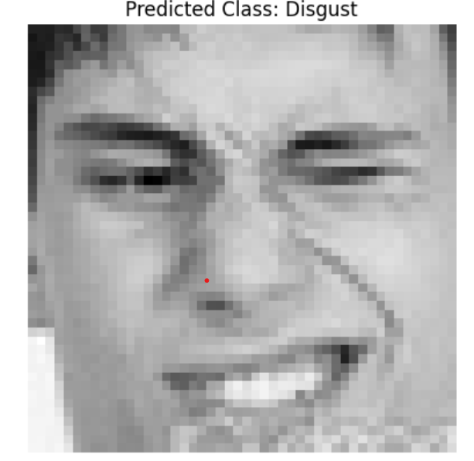
Prediction Example

Slide 9
Conclusion
The CNN model successfully classified facial expressions into 7 classes. Further improvements can be made by using transfer learning, hyperparameter tuning, or larger datasets.

Slide 10
Project Resources
Dataset: Face Expression Recognition Dataset (Kaggle)
Link: https://www.kaggle.com/datasets/jonathanoheix/face-expression-recognition-dataset

