Slide 1
CS100
Introduction to Programming
Recitation 7
<Yang Feiming>
<yangfm@shanghaitech.edu.cn>

Slide 2
Problem 1 std::chrono

Slide 3
Get the time and measure times with std::chrono
Header:
#include <chrono>
Use
std::chrono::high_resolution_clock
Figure out how to
Get time-points
Extract durations
Express durations in microseconds, and cast them to an int

Slide 4
Get the time and measure times with std::chrono
Test the time/duration functionality
You may use a dummy function to consume time
// long operation to time int dummyFunction(int n) { if (n < 2) { return n; } else { return fib(n-1) + fib(n-2); } }

Slide 5
Problem 2 Implement a Timer class

Slide 6
Implement a Timer class
Lap timer to accumulate iteration times!
Interface:
class Timer { public: Timer( bool start = false ); virtual ~Timer(); void start(); void stop( bool restart = false ); void stop( size_t iterations, bool restart = false ); void reset(); double averageTime(); std::list<double>::iterator begin(); std::list<double>::iterator end(); … };

Slide 7
Implement a Timer class
What private variable to choose?
What type should the lap time container be?
begin():
Iterator to first element in lap-time container
end():
Iterator to last element in lap-time container

Slide 8
Test the Timer class
Use dummyFunction()

Slide 9
Problem 3 Filling lists and vectors

Slide 10
Define a large object
class LargeObject { public: LargeObject(); virtual ~LargeObject(); private: int m_data[1000000]; }; LargeObject::LargeObject() {}; LargeObject::~LargeObject() {};

Slide 11
Measure filling times
Measure times for putting elements into a list and a vector!
Fill 500 LargeObjects into a list and a vector
Measure the time of each iteration with a Timer
Print all times into the console
What can you observe?

Slide 12
Constant time & linear time
For a container…
Constant time: an ops takes the same amount of time no matter what
e.g. array get/set. linked list push_back/pop
Linear time: an ops takes the time proportional to number of elements in the container
e.g. linked list random access
Notes:
Note to TA: You should not cover big O notation. It is not within the course schedule, and you will easily go over the time limit that way.

Slide 13
Part 4 std::unordered_map

Slide 14
Associative container
Stores elements as as key-value pairs
Similar to std::map, every element needs to have unique key
Search, insertion, and removal all have approximately constant-time complexity! (remember that std::map has complexity of O(log(n)) name employee
string Employee
map<string, Employee *> employees;

Slide 15
Associative container
Stores elements as as key-value pairs
Similar to std::map, every element needs to have unique key
Search, insertion, and removal all have approximately constant-time complexity! (remember that std::map has complexity of O(log(n)) name employee
string Employee
unordered_map<string, Employee *> employees;

Slide 16
How does it work?
Internally, the elements are organized into buckets
Which bucket an element is placed into depends on its key
From an arbitrary key-type, we derive a bucket-index
The bucket-index is called a hash
A hash-function is a function that maps an arbitrary input type to a defined type with defined range
This allows fast access to individual elements, since once a hash is computed, it refers to the exact bucket the element is placed into

Slide 17
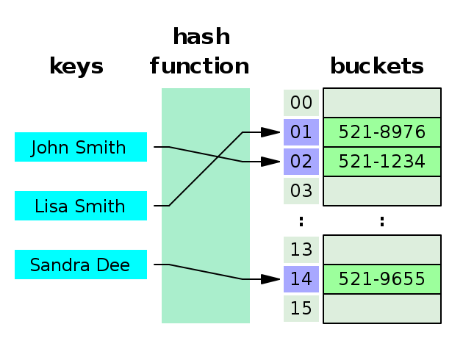
How does it work?
Hash table
https://en.wikipedia.org/wiki/Hash_table
Ideally: Every key leads to an individual bucket

Slide 18
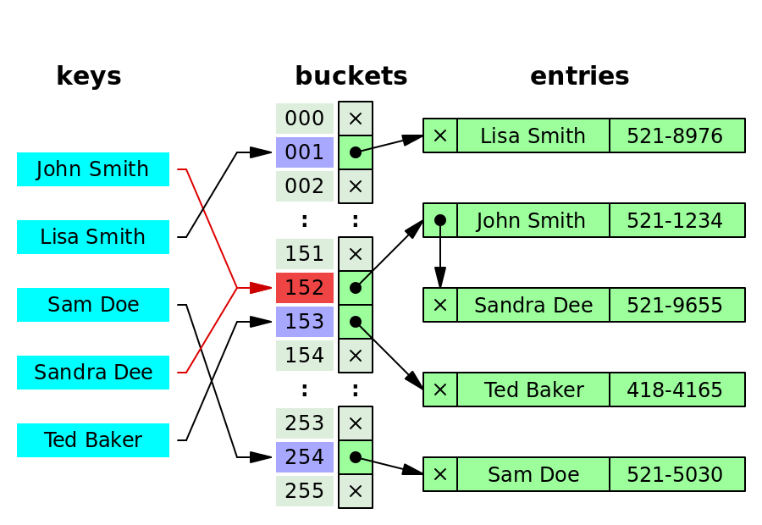
How does it work?
Hash table
https://en.wikipedia.org/wiki/Hash_table
In practice: Limited number of bucket & extra collision resolving (e.g. chaining)

Slide 19
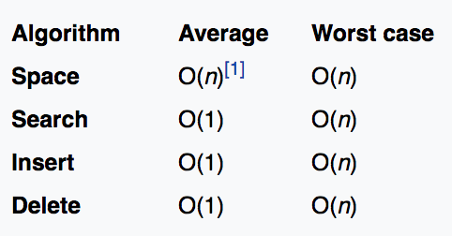
How does it work?
Properties:
How does the space property come across?
Only a table with (initially NULL) bucket pointers is installed
This table has a constant size equal to the range of the hash
The actual buckets are growing linearly with the actual number of elements in the list

Slide 20
Exercise
Create a main function in which you
Fill a std::map with key value pairs of the form std::map<int,std::string>
Notes:
The int can simply increase linearly for every element
The string can be same, dummy string everytime
Task 1:
Add 10000 elements, then measure the time of adding 100 more elements

Slide 21
Exercise
Task 2:
Do the same for an unordered map
What do you observe?
Task 3:
Now increase the initial size of the container by a factor of 10.
What do you observe?

Slide 22
Part 5 LinkedMap

Slide 23
LinkedMap
Behavior:
A generic container just like map.
Ordered based on insertion order instead of comparison
Approximate constant time insertion, deletion, look up and iteration
Implementation:
Composition of a std::list and a std::unordered_map
Define an appropriate node structure

Slide 24
Implement your own template map container
Requirements:
Reasonable iterators
Reasonable constructor and destructors
Able to be printed to a stream with operator <<
Required interface functions:
iterator begin();
iterator end();
bool empty();
int size(); void erase(const K& k);
void set(const K& k, const V& v);
V& get(const K& k); void clear();
Notes:
Note to TA: Do not mangle too much with const here.

Slide 25
Test LinkedMap with this
Instantiate new map and fill it with elements
#include "LinkedMap.hpp” #include <iostream> #include <algorithm> #include <vector> int main() { //instantiate one of my new map object and set two entry LinkedMap<int, double> linkedMap; linkedMap.set(1, 1.0); linkedMap.set(2, 4.0); linkedMap.set(0, 0.0);
…
}

Slide 26
Test LinkedMap with this
Print them out using the operator you defined
Verify they are in the correct order
#include "LinkedMap.hpp” #include <iostream> #include <algorithm> #include <vector> int main() {
… // print them out
std::cout << linkedMap << std::endl;
…
}

