Slide 1
CS100 Introduction to Programming
Recitation 2
<Yang Feiming>
<yangfm@shanghaitech.edu.cn>

Slide 2
NO PLAGIARISM!!!
The most likely cause for failing this course.
You WILL be caught!
We WILL punish!
They WILL know!
Parents
University
School
Fellows
We have already found a dozen of you cheating.

Slide 3
Code Smell
Every recitation will have this section

Slide 4
Code smell
You already know this won’t work every time
We don’t grade on how small your source file is
This is causing san check every now and then
int times,a[100],b[100],c[100],d[100];(single line multi declaration: int* a,b,c)
float mood=100,gap[100];
char y;
int n,i,a[100],b[100],c[100]={0},d[100]={0},e[100],f[100];
float mood=100.0;
a=(q+r+u)/3;
b=(w+t+i)/3;
m=sqrt( (q-a)*(q-a) + (w-b)*(w-b) );
n=sqrt( (q-a)*(q-a) + (w-b)*(w-b) );
m=max(m, sqrt( (r-a)*(r-a) + (t-b)*(t-b) ) );
n=min(n, sqrt( (r-a)*(r-a) + (t-b)*(t-b) ) );
m=max(m, sqrt( (u-a)*(u-a) + (i-b)*(i-b) ) );
n=min(n, sqrt( (u-a)*(u-a) + (i-b)*(i-b) ) );

Slide 5
Code smell
No OJ oriented programming. Just NO. And don’t indent with 3 spaces.
Do not use home made abbreviations. Plus, we are still using C.
max>a?max=max:max=a;
min<a?min=min:min=a;
sacnf("%f",&save);
inline void ckmx(double &a, double b) {
if (a < b) a = b;
}
inline void ckmi(double& a, double b) {
if (a > b) a = b;
}

Slide 6
Code smell
Don’t repeat yourself. (a.k.a. DRY)
buffer[0]=q;
buffer[1]=0;
buffer[2]=0;
buffer[3]=0;
buffer[4]=0;
buffer[5]=0;
buffer[6]=0;
buffer[7]=0;

Slide 7
Code smell
Global variables are global. Keep everything to local unless absolutely necessary.
#include<memory.h>
int SUM1 = 1, SUM2 = 1, ZAN = 0, SHI = 0, k = 1, CHA, i = 1, j, TOT = 0, NE = 0, XT = 0, ok, i2, n = 1, p, PRI;
int main(void)
{
int* A = NULL;
int* B = NULL;
int NUMBER = 5;
// ......

Slide 8
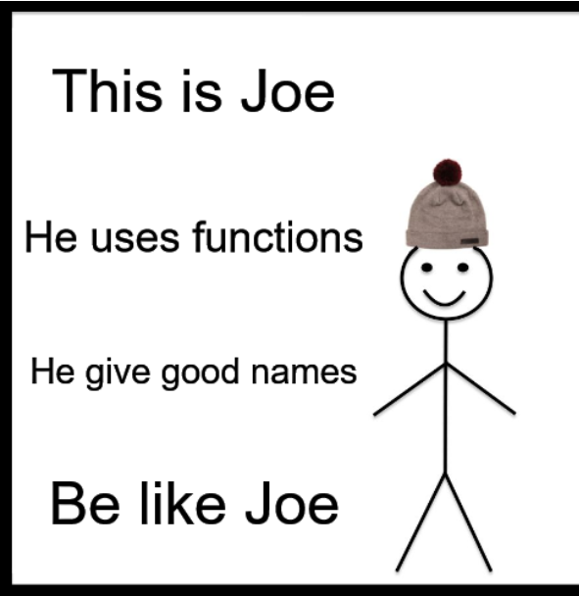
Be like Joe
Some of you deserve a big thumbs up.
His code quality is not perfect, but is definitely among the top.
Some other submissions were considered, we choose this with the help of RNG.
We decided not to disclose his name, nor alert him beforehand.
This is a honor. Do not be ashamed nor worried.

Slide 9
Be like Joe
for(n;n>0;n--)
{
scanf("%d:%d-%d:%d",&h1,&m1,&h2,&m2);
time=TimeInterval(temph1,tempm1,h1,m1);
mood=recover(mood,time);
time=TimeInterval(h1,m1,h2,m2);
mood=drop(mood,time);
temph1=h2;
tempm1=m2;
if(mood<=0)
{
printf("…… hospital.");
goto loop;
}
}
time=TimeInterval(h2,m2,22,00);
mood=recover(mood,time);
if(mood>0)
printf("…… is %.1f at the……",mood);
float drop(float a,int b)
{
if(b<=60)
a=a-b*0.4;
else
a=a-24.0-(b-60.0)*0.8;
return a;
};
float recover(float a,int b)
{
a=a+b*0.5;
if(a>100)
a=100.0;
return a;
};
*Slightly edited to fit in the slides
Variable declarations and some unimportant details omitted

Slide 10
Overview
Pointers
Memory allocation
Arrays
Functions
String functions
Basic file IO
ed--

Slide 11
Pointers

Slide 12
What it is?
Name | Address | Value
num1 | 0xffff0000 | 3
num2 | 0xffff0004 | 5
 | 0xffff0008
 | 0xffff000c
 | 0xffff0010
 | 0xffff0014
 | …
#include <stdio.h>
int main(void) {
int num1 = 3, num2 = 5;
int *ptr1, *ptr2;
ptr1 = &num1;
(*ptr1)++;
ptr2 = &num2;
Assume 32 bit machine

Slide 13
What it is?
Name | Address | Value
num1 | 0xffff0000 | 3
num2 | 0xffff0004 | 5
ptr1 | 0xffff0008
ptr2 | 0xffff000c
 | 0xffff0010
 | 0xffff0014
 | …
#include <stdio.h>
int main(void) {
int num1 = 3, num2 = 5;
int *ptr1, *ptr2;
ptr1 = &num1;
(*ptr1)++;
ptr2 = &num2;
Assume 32 bit machine

Slide 14
What it is?
Name | Address | Value
num1 | 0xffff0000 | 3
num2 | 0xffff0004 | 5
ptr1 | 0xffff0008 | ?
ptr2 | 0xffff000c
 | 0xffff0010
 | 0xffff0014
 | …
#include <stdio.h>
int main(void) {
int num1 = 3, num2 = 5;
int *ptr1, *ptr2;
ptr1 = &num1;
(*ptr1)++;
ptr2 = &num2;
0xffff0000
Assume 32 bit machine

Slide 15
What it is?
Name | Address | Value
num1 | 0xffff0000 | 3
num2 | 0xffff0004 | 5
ptr1 | 0xffff0008 | 0xffff0000
ptr2 | 0xffff000c
 | 0xffff0010
 | 0xffff0014
 | …
#include <stdio.h>
int main(void) {
int num1 = 3, num2 = 5;
int *ptr1, *ptr2;
ptr1 = &num1;
(*ptr1)++;
ptr2 = &num2;
4
Assume 32 bit machine

Slide 16
What it is?
Name | Address | Value
num1 | 0xffff0000 | 4
num2 | 0xffff0004 | 5
ptr1 | 0xffff0008 | 0xffff0000
ptr2 | 0xffff000c | ?
 | 0xffff0010
 | 0xffff0014
 | …
#include <stdio.h>
int main(void) {
int num1 = 3, num2 = 5;
int *ptr1, *ptr2;
ptr1 = &num1;
(*ptr1)++;
ptr2 = &num2;
0xffff0004
Assume 32 bit machine

Slide 17
What it is?
Name | Address | Value
num1 | 0xffff0000 | 4
num2 | 0xffff0004 | 5
ptr1 | 0xffff0008 | 0xffff0000
ptr2 | 0xffff000c | 0xffff0004
 | 0xffff0010
 | 0xffff0014
 | …
*ptr2 = *ptr1;
*ptr2 = 10;
num1 = *ptr2;
*ptr1 = *ptr1 * 5;
ptr2 = ptr1;
return 0;
}
4
0xffff0004
Assume 32 bit machine

Slide 18
What it is?
Name | Address | Value
num1 | 0xffff0000 | 4
num2 | 0xffff0004 | 4
ptr1 | 0xffff0008 | 0xffff0000
ptr2 | 0xffff000c | 0xffff0004
 | 0xffff0010
 | 0xffff0014
 | …
*ptr2 = *ptr1;
*ptr2 = 10;
num1 = *ptr2;
*ptr1 = *ptr1 * 5;
ptr2 = ptr1;
return 0;
}
10
Assume 32 bit machine

Slide 19
What it is?
Name | Address | Value
num1 | 0xffff0000 | 4
num2 | 0xffff0004 | 10
ptr1 | 0xffff0008 | 0xffff0000
ptr2 | 0xffff000c | 0xffff0004
 | 0xffff0010
 | 0xffff0014
 | …
*ptr2 = *ptr1;
*ptr2 = 10;
num1 = *ptr2;
*ptr1 = *ptr1 * 5;
ptr2 = ptr1;
return 0;
}
10
Assume 32 bit machine

Slide 20
What it is?
Name | Address | Value
num1 | 0xffff0000 | 10
num2 | 0xffff0004 | 10
ptr1 | 0xffff0008 | 0xffff0000
ptr2 | 0xffff000c | 0xffff0004
 | 0xffff0010
 | 0xffff0014
 | …
*ptr2 = *ptr1;
*ptr2 = 10;
num1 = *ptr2;
*ptr1 = *ptr1 * 5;
ptr2 = ptr1;
return 0;
}
50
Assume 32 bit machine

Slide 21
What it is?
Name | Address | Value
num1 | 0xffff0000 | 50
num2 | 0xffff0004 | 10
ptr1 | 0xffff0008 | 0xffff0000
ptr2 | 0xffff000c | 0xffff0000
 | 0xffff0010
 | 0xffff0014
 | …
*ptr2 = *ptr1;
*ptr2 = 10;
num1 = *ptr2;
*ptr1 = *ptr1 * 5;
ptr2 = ptr1;
return 0;
}
0xffff0000
Assume 32 bit machine

Slide 22
More pointers!
Pointer of pointer
int value = 3, value2 = 2;
int *ptr = &value;
int **ptr_to_ptr = &ptr;
Question: How to update value if you only have ptr_to_ptr?
**ptr_to_ptr = 5;
Question: How to update ptr to point to value2 if you only have ptr_to_ptr?
*ptr_to_ptr = &value2;

Slide 23
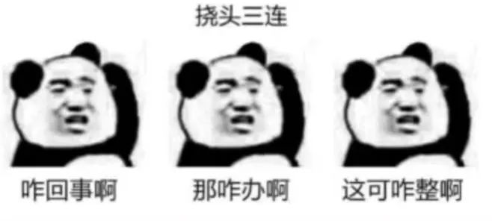
Still puzzled?

Slide 24
Two altitudes of SIST students
I know what it is, what it means, how it works and how to use.
Best.
Eventually you will get to this state.
I don’t know what it is, what it means or how it works, but I know how to use.
Better than knowing nothing.
You won’t stay at this point forever.
Eureka moment
I don’t know how to use, and I don’t want to learn.
File a request to quit ShanghaiTech (no joke)

Slide 25
NULL
A preprocessor macro.
Has a value of 0.
Used as placeholder, default value or a sign of “not found”
e.g. return NULL in a search function to signal “not found”
Billion dollar mistake
What may happen if you dereference NULL?
Never use NULL?
nullptr?

Slide 26
Memory management

Slide 27
Stack and heap
Stack: Store local variables
Arrangement fixed at compile time. (mostly)
Managed allocation and deallocation
Small size
Does not persist. (?)
Heap: Store dynamic allocated
Dynamic
Manual allocation and deallocation
Huge size
Persist until program exit

Slide 28
Stack and heap: Address conventions
Stack
Empty
Heap
Global Code
Stack:
Start near max
Grow downwards
e.g. 0xff9f77ac 0xff9f77b0 0xff9f77b4 0xff9f77b8, ……
Heap:
Start near 0
Grow upwards
e.g. 0x01605010, 0x01605440, 0x01605460, 0x01605480, ……
1st malloc(1) 2nd malloc(1) 3rd malloc(1) 4th malloc(1)
Notes:
Potential question: why it is not continuous?
A: Related to memory manager’s allocation algorithm. Mostly aligned to some power of 2 bytes to prevent using a too big memory allocation mapping. The same block of memory cannot be split further and given to two malloc() caller.

Slide 29
malloc()/free()
The way to allocate something on the heap
void *malloc(size_t size);
void free(void *ptr);
void *calloc(size_t nmemb, size_t size);
void *realloc(void *ptr, size_t size);
void *: The generic pointer. No type info.
size_t: An unsigned integer large enough to hold a pointer

Slide 30
realloc() & calloc()
realloc():
Adjust the size of an allocated array
Truncate last elements when size reduces
Extend when size increases. New regions contains random value.
The old pointer becomes dangling pointer after successful realloc()
calloc():
Can be considered convenience wrapper for malloc.
Initialize allocated memory to zero.

Slide 31
Typical usage
int *to_heap(int stack_variable) {
/* allocate space */
int *space = malloc(sizeof(int));
/* use indirection assignment to transfer it to heap */
*space = stack_variable;
/* return the pointer to this space */
return space;
}
Notice there is no explicit cast for void *
sizeof: operator to get the size of a type at compile time.

Slide 32
Typical usage
int add(int *lhs, int *rhs) {
return *lhs + *rhs;
}
void print_three() {
int *a = to_heap(1),
*b = to_heap(2);
printf("%d\n", add(a, b));
free(a); free(b);
}
<- BAD CODING STYLE.
What’s wrong?

Slide 33
The careless
void print_three() {
int *a = to_heap(3),
free(a);
printf("%d\n", *a);
}
What’s wrong?

Slide 34
The paranoid
void print_three() {
int *a = to_heap(3);
printf("%d\n", *a);
free(a);
free(a);
}
What’s wrong?

Slide 35
free() is clever
void print_three() {
int *a = to_heap(3),
free(a + 1);
printf("%d\n", *a);
}
What’s wrong?

Slide 36
The cleverest person
int *add(int lhs, int lhs) {
int result = lhs + rhs;
return &result;
}
What’s wrong?

Slide 37
Functions
A small part covered in previous recitation is repeated

Slide 38
Function prototype
Function without its body.
int main(int argc, char **argv);
size_t read_cmds(char **buf, size_t *n);

Slide 39
Scoping
#include <stdio.h>
int foo = 1;
int test(int foo) {
return -foo;
}
int main() {
int foo = 3, bar = 2;
bar = test(bar);
printf("Foo is: %d\n", foo);
printf("Bar is: %d\n", bar);
return 0;
}
What is the output? Why?

Slide 40
Call by pointer
Does it works?
How to fix?
void swap(int a, int b) {
int c = a;
a = b;
b = c;
}

Slide 41
Call by pointer: Exercise
Write a swap function to swap two generic pointers.
void swap(void **a, void **b) {
void *c = *a;
*a = *b;
*b = c;
}

Slide 42
Arrays

Slide 43
Declaration
What does these mean?
float sales[365];
char name[12];
int states[50];
int *pointers[5];

Slide 44
Initialization
How to initialize an array to make it look like this?
int days[12]={31,28,31,30,31,30,0,0,0,0,0,0};
int days[12]={31,28,31,30,31,30};
int days[]={31,28,31,30,31,30,0,0,0,0,0,0};
Combine last two to make it even shorter?

Slide 45
Array traversal
int days[]={31, 28, 31, 30, 31, 30, 0, 0, 0, 0, 0, 0};
for (int i = 0; i < sizeof(days) / sizeof(int) ; i++) {
printf("%d\n", days[i]);
}
sizeof(days): Get the byte size of this array.
Does NOT work on arrays on its pointer form.
Divide by element size to get actual element count.
Notes:
Array types carry additional info and constraint at compile time.

Slide 46
Array traversal
char **argv = {"/bin/rush", "script"};
for (int i = 0; i < argc; i++) {
printf("%s\n", argv[i]);
}
< or <=?
What if print one char per line?
Nested for
Extract function called print_chars()

Slide 47
Array or pointer?
This piece of code won’t compile. Why?
void foo() {
int days[] = {31,28,31,30,31,30,31,31,30,31,30,31};
days = &days[6];
}

Slide 48
Strings

Slide 49
Common String Ops.
Get basic info
strlen
str[index]
Search
strstr
strchr/strrchr
Compare
strcmp/strncmp
Copying
strcat/strncat
strcpy/strncpy
Tokenizing
strtok

Slide 50
Under the hood?
Show you how you would typically manipulate string
Some are naïve version.
See glibc for actual implementations
https://sourceware.org/git/?p=glibc.git;a=tree;f=string;hb=HEAD
Highly optimized

Slide 51
strchr: under the hood
Imagine how would you implement strrchr
Template for traversal of one string
char * strchr(const char *s, int c_in) {
while (*s) {
if (*s == c_in) {
return s;
}
s++;
}
return NULL;
}

Slide 52
strcmp: under the hood
Dual strings manipulation. Easily extended to more.
int strcmp(const char *p1, const char *p2) {
const unsigned char *s1 = (const unsigned char *) p1;
const unsigned char *s2 = (const unsigned char *) p2;
unsigned char c1, c2;
do {
c1 = (unsigned char) *s1++;
c2 = (unsigned char) *s2++;
if (c1 == '\0')
return c1 - c2;
} while (c1 == c2);
return c1 - c2;
}
Actual glibc implementation

Slide 53
strcat: under the hood
Use standard library
Do not reinvent the wheels
Even if you are the wheel makers…
char *strcat(char *dest, const char *src) {
strcpy(dest + strlen(dest), src);
return dest;
}
Actual glibc implementation

Slide 54
Learn by mistakes
char digits[10] = "0123456789";
char *string = "Hello world!";
printf("string: %s", &string);
char *strdup(const char *src) {
char *duplicate = malloc(sizeof(char) * strlen(src));
strcpy(duplicate, src);
return duplicate;
}
What’s wrong with all these?

Slide 55
Basic File I/O

Slide 56
fopen()
fopen(“foo.txt”, “a”)
Flags:
Access: r, r+, w, w+, a, a+
Content: b
Remember fclose()

Slide 57
fread()/fwrite()
Be aware of overflows
size_t fread(void *ptr, size_t size, size_t nmemb, FILE *stream);
size_t fwrite(const void *ptr, size_t size, size_t nmemb, FILE *stream);

Slide 58
Read/write a very large file?
Scan for ROI first. Read/write in smaller blocks
fseek()
Go to a particular location in file
Much like array subscript
Memory mapped IO
Not covered right now
Consult man 2 mmap if interested

Slide 59
fprintf()/fscanf()
printf/scanf for files.
Difference?
No.
int fscanf(FILE *stream, const char *format, ...);
int fprintf(FILE *stream, const char *format, ...);

Slide 60
Trivia: streams?
STDIN/STDOUT: Console stream
fopen: File stream
Similar design make for good code reuse
Anything operating on file stream can operate on console stream.

Slide 61
ed-- (Part A)
An ed-like editor

Slide 62
A mini project
Guided programming. Designed to help you make a project.
Last indefinitely many recitations.
This will not be graded.
You are encouraged to extend this project beyond our spec.
You are encouraged to try other ways to do this.
Sharing code with others is allowed.
Only program on recitation sessions.
We don’t want to unreasonably take too much of your time

Slide 63
Overview
A line based text editor
Basic line manipulation
Search/replace
Does not display whole file on screen
Not POSIX compatible
We only have a reduced command set to fit in recitation time.
Feel free to extend it.

Slide 64
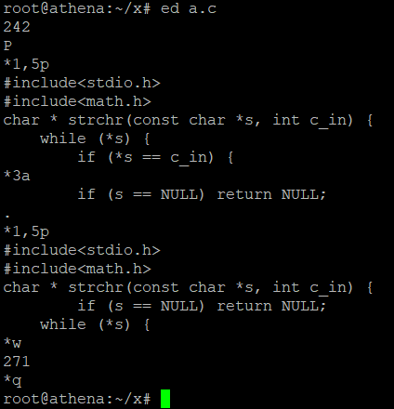
Unix ed
Commands: (start_line,end_line)action
Operate on selected lines
Action P turns on prompt
Action a append several line to selected
Action p print out selected lines
Action w write the buffer to disk
Action q quit the editor

Slide 65
Our spec
Line selection:
Absolute selection: (3,5)
Relative selection: (+3,+5)
Commands to implement
a <arg>: append one line <arg>
w: write back
p: print selected lines
pp: print every line
s <arg>: search for <arg> (plain text) in selection
r <arg1> <arg2>: replace every <arg1> with <arg2> in selection

Slide 66
Design considerations
One large main()?
Not going to work
We will condemn you for such behavior
Your code will be in “Code Smell” section next recitation
One large .c file?
Split it into pieces?
Use headers?
Decide these as you go, not from the start

Slide 67
Design considerations
Single huge buffer vs multiple smaller line buffers?
Ease of programming?
Are you skilled enough?
Do you have like 40 hours to spend on this thing?
Efficiency?
Will this be invoked a billion time?
Will this take a huge amount of time to complete?

Slide 68
Design considerations
How to organize line buffers?
Fixed length array?
Wasteful on small file
Crash on large file
Dynamic array
Line insertion?
Line removal?
The only choice so far……

Slide 69
Today’s menu
Implement search and replace
Search for first occurrence in a few selected lines
Replace all occurrence in a few selected lines
Write a simple main to test it out

Slide 70
Design considerations
How should I search/replace?
Write by hand?
Show of skill
Again, 40 hours for this?
string.h?
Which to use?
Side effects?
Barely any

Slide 71
Design considerations
How should other part of the program use this search/replace?
What this part need?
Lines to search in
String to search for
Replacement (only for replace)
What other part need?
The line number
The resulting lines
Function prototype?
Think for a while

Slide 72
Search/replace prototype
Puzzled by the pointers?
The more you practice, the more likely you understand
Ask your questions
int line_search(const char ** haystack, int len, const char *needle); char **line_replace(char ** haystack, int len, const char *needle,
const char* replacement);

Slide 73
Search/replace prototype
Notice the similarity
Both need haystack & needle
Can we reuse some code?
Let line_replace call line_search instead of reinvent searching.
int line_search(const char ** haystack, int len, const char *needle); char **line_replace(char ** haystack, int len, const char *needle,
const char* replacement);

Slide 74
Design considerations
What should I test?
Randomly generated input?
Could be.
You (should) don’t know how to do that though.
Not exhaustive.
Crafted input trying to break everything, i.e. hackers?
We won’t consider it.
Yet, of-by-one errors will still go to “code smell” section

Slide 75
Reference Implementation
Will NOT be available for your download
Contains an obvious bug and a subtle problem
The first is likely to be found in your HW2 as well
The second is more related to designing

Slide 76
Interesting Questions
VLA: Variable length arrary
int vla[argc];
Length not determined at compile time
Pros
Convenient
Fast
Clear
Cons
Not portable, e.g. MSVC
Stack overflow
Use at your own peril

