Slide 1

WTF is AI?!
An introduction to Artificial Intelligence
Hamidreza Hosseinkhani
School of AI - 2018

Slide 2
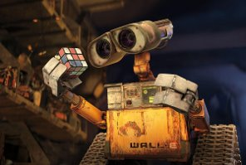
First things first,
Let’s define the AI

Slide 3
people disagree on
what intelligence
(and so AI)
really is...

Slide 4
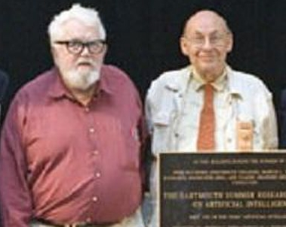
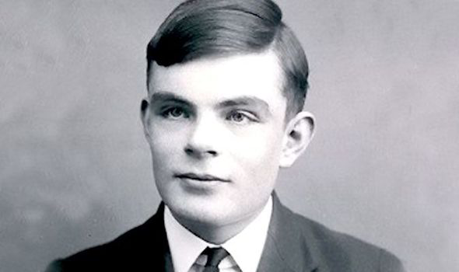
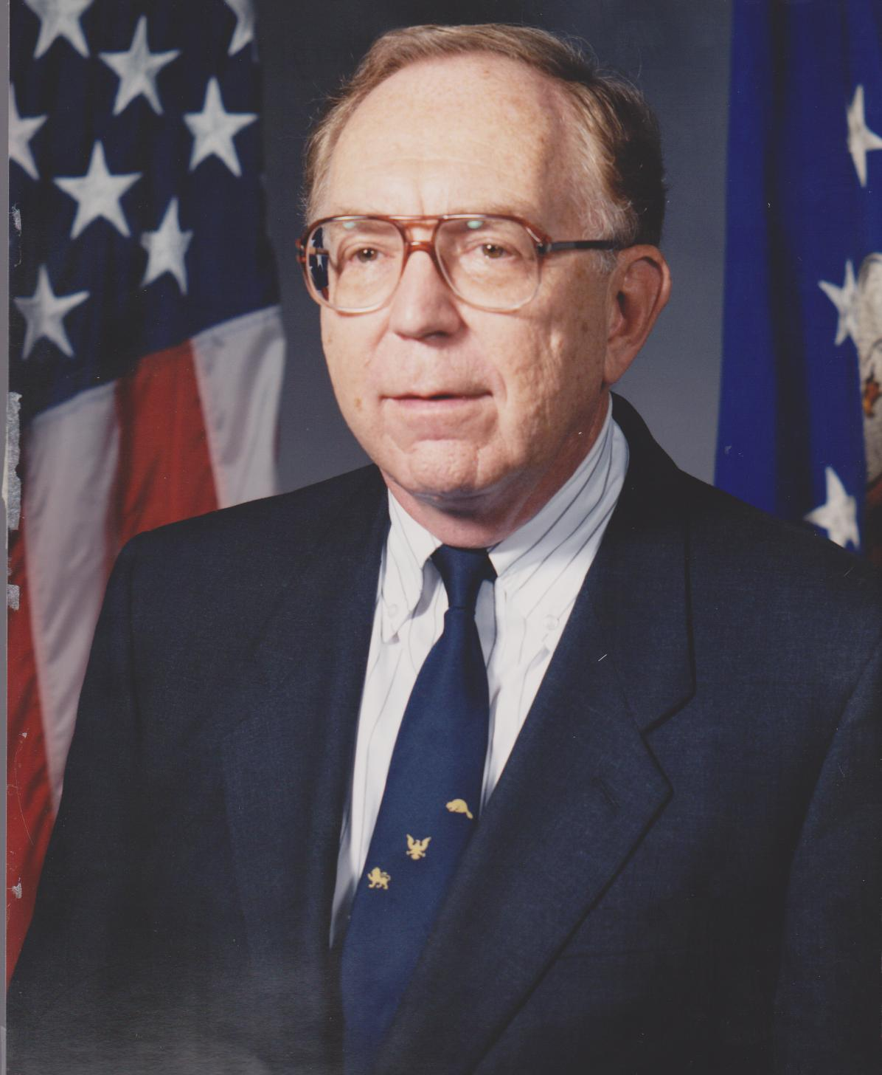
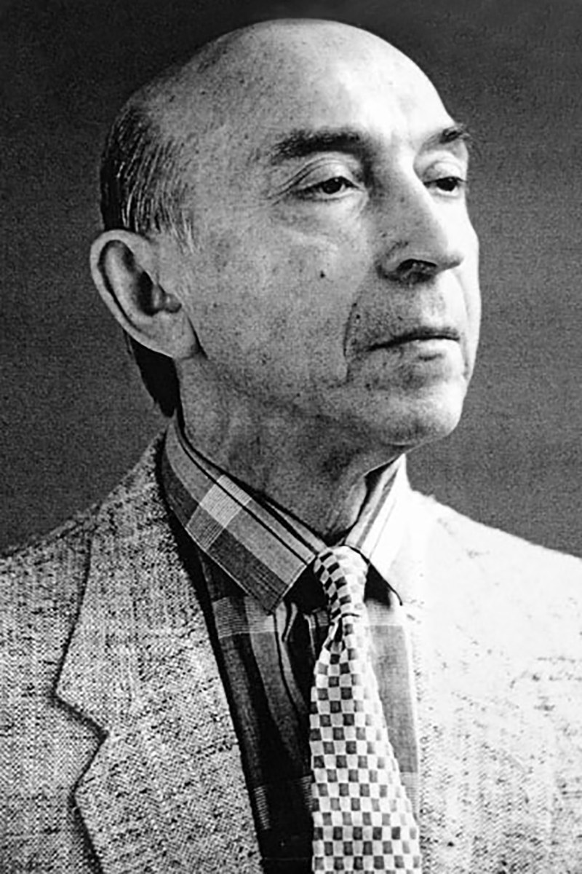
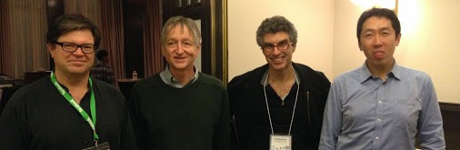
Approaches
Thinking Humanly
Acting Humanly
Thinking Rationally
Acting Rationally
Notes:
Thinking Humanly -> Cognitive Science -> John McKarthy, Marvin Minsky
Acting Humanly -> Black-box -> Psychology -> Alan Turing -> Turing Test, Total Turing Test
Thinking Rationally -> Logic -> Expert Systems
Acting Rationally -> Engineering, Modern Applications -> Andrew Ng, Yoshua Bengio, Jeffery Hinton, Yann LeCun

Slide 5
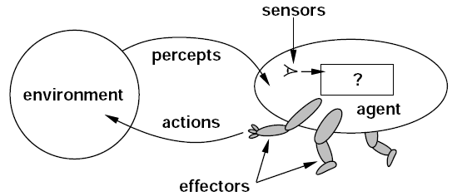
Intelligent Agent
Agent
Environment
Events, Signals (State)
Sensors, Perception
Agent Function (Policy) (?)
Actuators (Effectors)
Artificial Intelligence: a modern approach by Stuart J. Russell, Peter Norvig​
Notes:
Environment -> Unknown and Uncertain

Slide 6
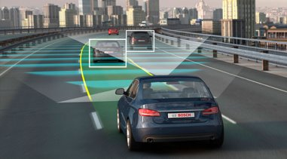
Intelligent Agent: Self-driving Car
Agent
Environment
Events, Signals (State)
Sensors, Perception
Agent Function (Policy)
Actuators (Effectors)

Slide 7
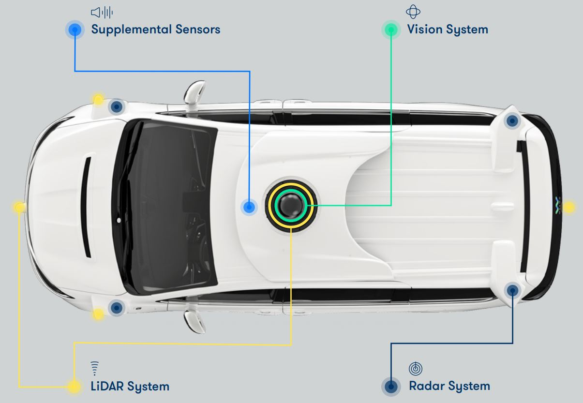

Waymo Self-driving Car Sensory System

Slide 8
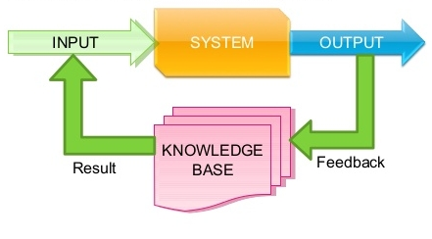
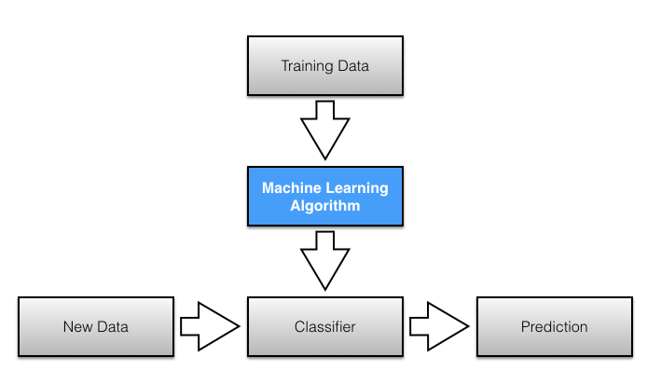
Agent Function (Policy)
Implement the explicit knowledge as a logic-based algorithm (Symbolic AI)
(Expert Systems)
Learn a model of knowledge implicitly from experience (Connectionist AI)
(Machine Learning)
"Good Old-Fashioned Artificial Intelligence"
Data-driven Approach

Slide 9
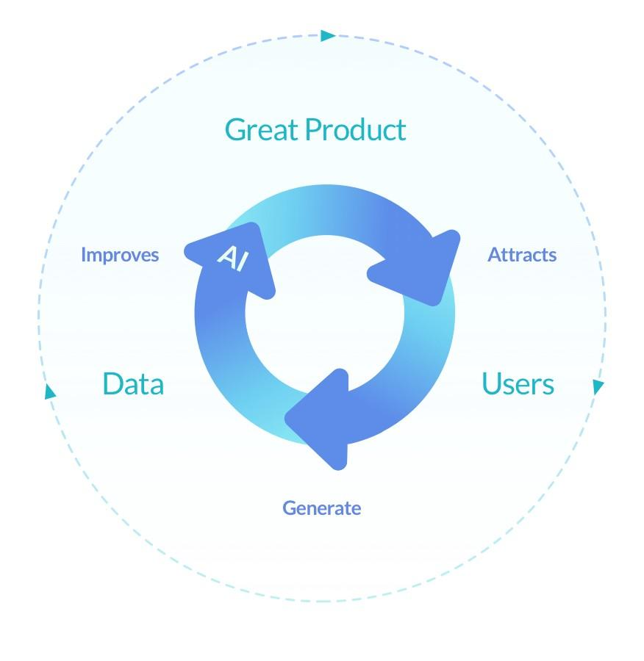
Machine Learning (Learning from Experience)
Experience -> Dataset
Massive Dataset, Big Data, Data Mining

Slide 10
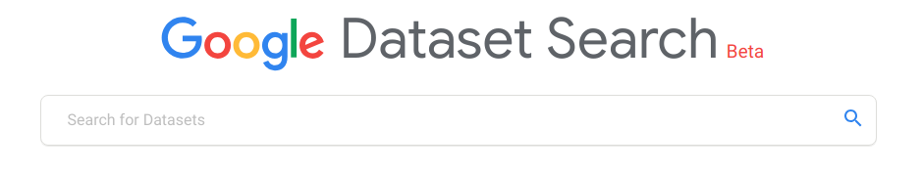
Machine Learning (Learning from Experience)
Where can I find large datasets open to the public?
https://toolbox.google.com/datasetsearch

Slide 11
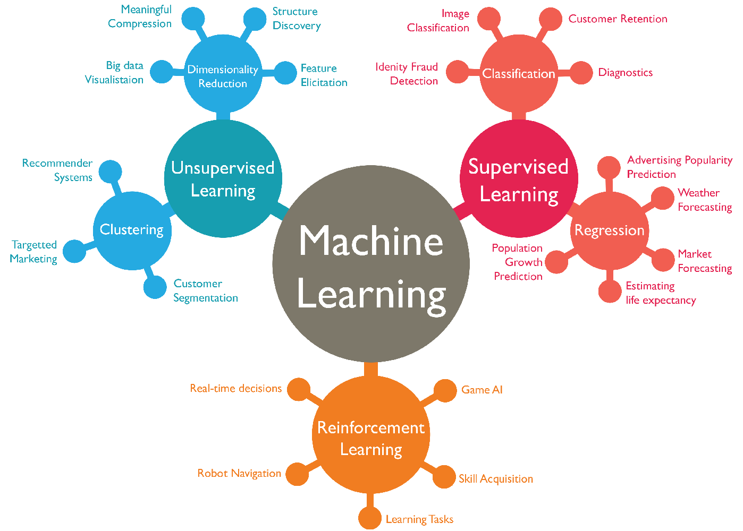
ML tasks based on the shape of the dataset
Supervised Learning
Unsupervised Learning
Semi-supervised Learning
Reinforcement Learning

Slide 12




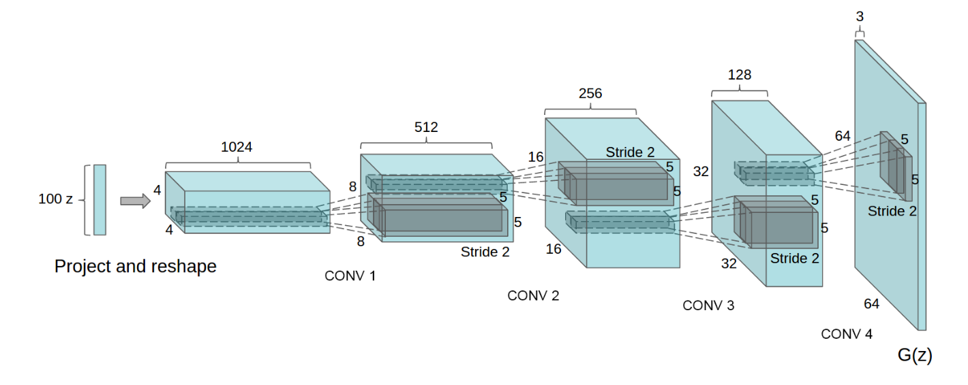
Supervised Learning
State | Desired Action
 | select class “CAT”
 | select class “DOG”
 | select class “CAT”
The dataset contains states (signals, features) and corresponding actions (for example labels)
The task is to use dataset to learn a general model that can predict desired action for any unseen data. (for example image classification, spam detection, weather forecast, etc)
Image Classifier
(Learned Supervised)
DOG
https://ai.googleblog.com/2016/03/train-your-own-image-classifier-with.html

Slide 13




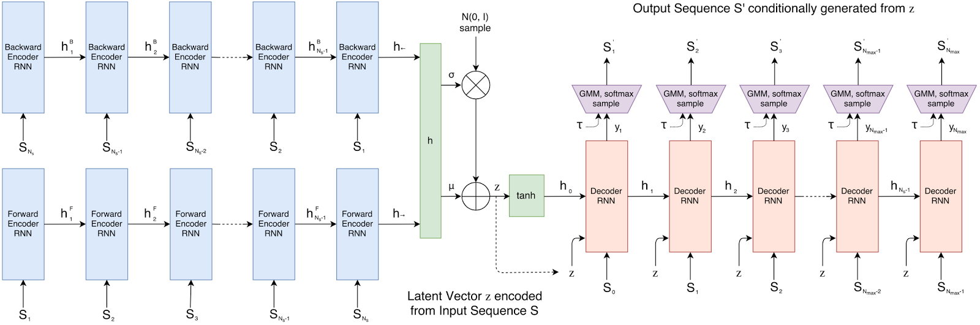
Unsupervised Learning
State
The dataset contains states (Signals) but there is not any corresponding action.
The task is to find some meaningful relationships between these data (for example find similar users in a social network, find anomalies, etc).
Drawing Predictor
(Learned Unsupervised)
https://ai.googleblog.com/2017/04/teaching-machines-to-draw.html

Slide 14




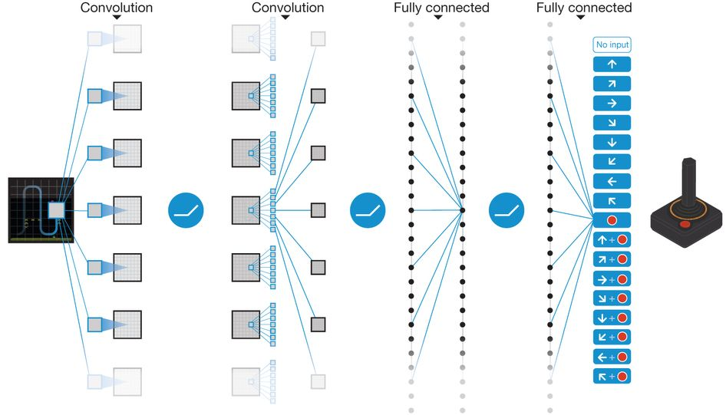
Reinforcement Learning
State | Action | Reward
 | ← | 0.78
 | → | 0.56
 | .​ | 0.25
The dataset contains states (signals), but the exact desired actions are unknown (for example when the environment is changing during the time). However, there is a good-ness measure (reward) per any possible action in each state.
The task is to build a model that can choose a good action in each state (for example game player, self-driving car, etc).
ATARI Player
(Learned by RL)
https://ai.googleblog.com/2015/02/from-pixels-to-actions-human-level.html

Slide 15
Thank You!

