Slide 1

School of AI
Introduction
Hamidreza Hosseinkhani
School of AI - 2018

Slide 2
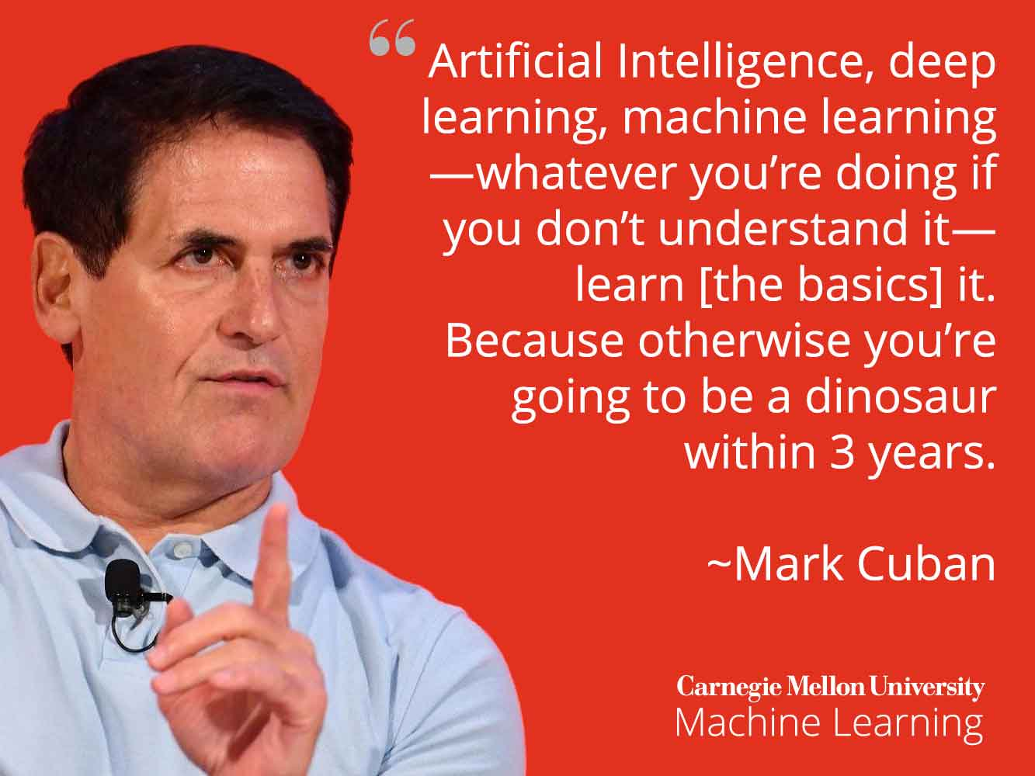

Slide 3
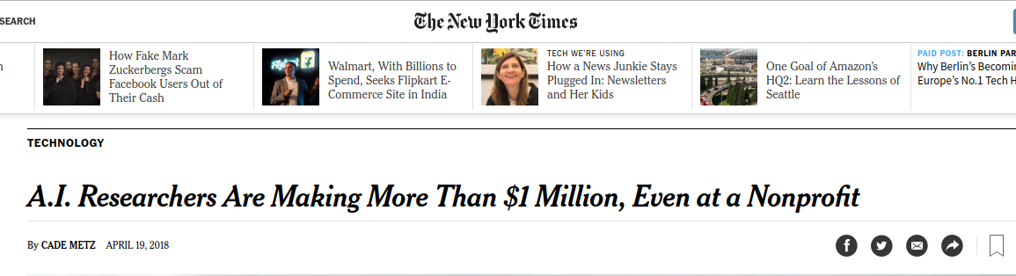

Slide 4
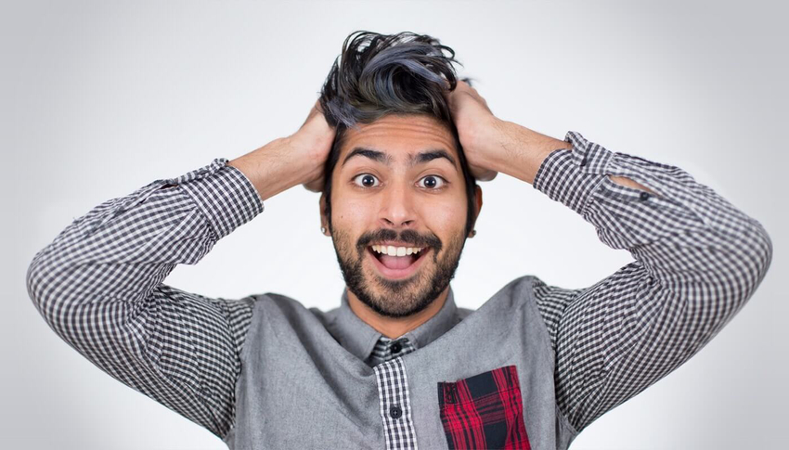


Siraj Raval
Siraj is an AI instructor, Machine Learning engineer, Data Scientist, author and of course a YouTuber.
He is on a warpath to inspire and educate developers to build AI by themselves.
He is also the founder and director of the School of AI.
https://www.youtube.com/channel/UCWN3xxRkmTPmbKwht9FuE5A
@sirajraval

Slide 5

School of AI
Our mission is to offer a world-class AI education to anyone on Earth for free.
Our doors are open to all those who wish to learn. We are a learning community that spans almost every country dedicated to teaching our students how to make a positive impact in the world using AI technology, whether that’s through employment or entrepreneurship.
theschool.ai

Slide 6
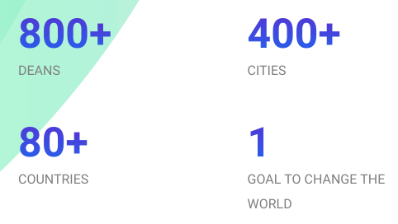
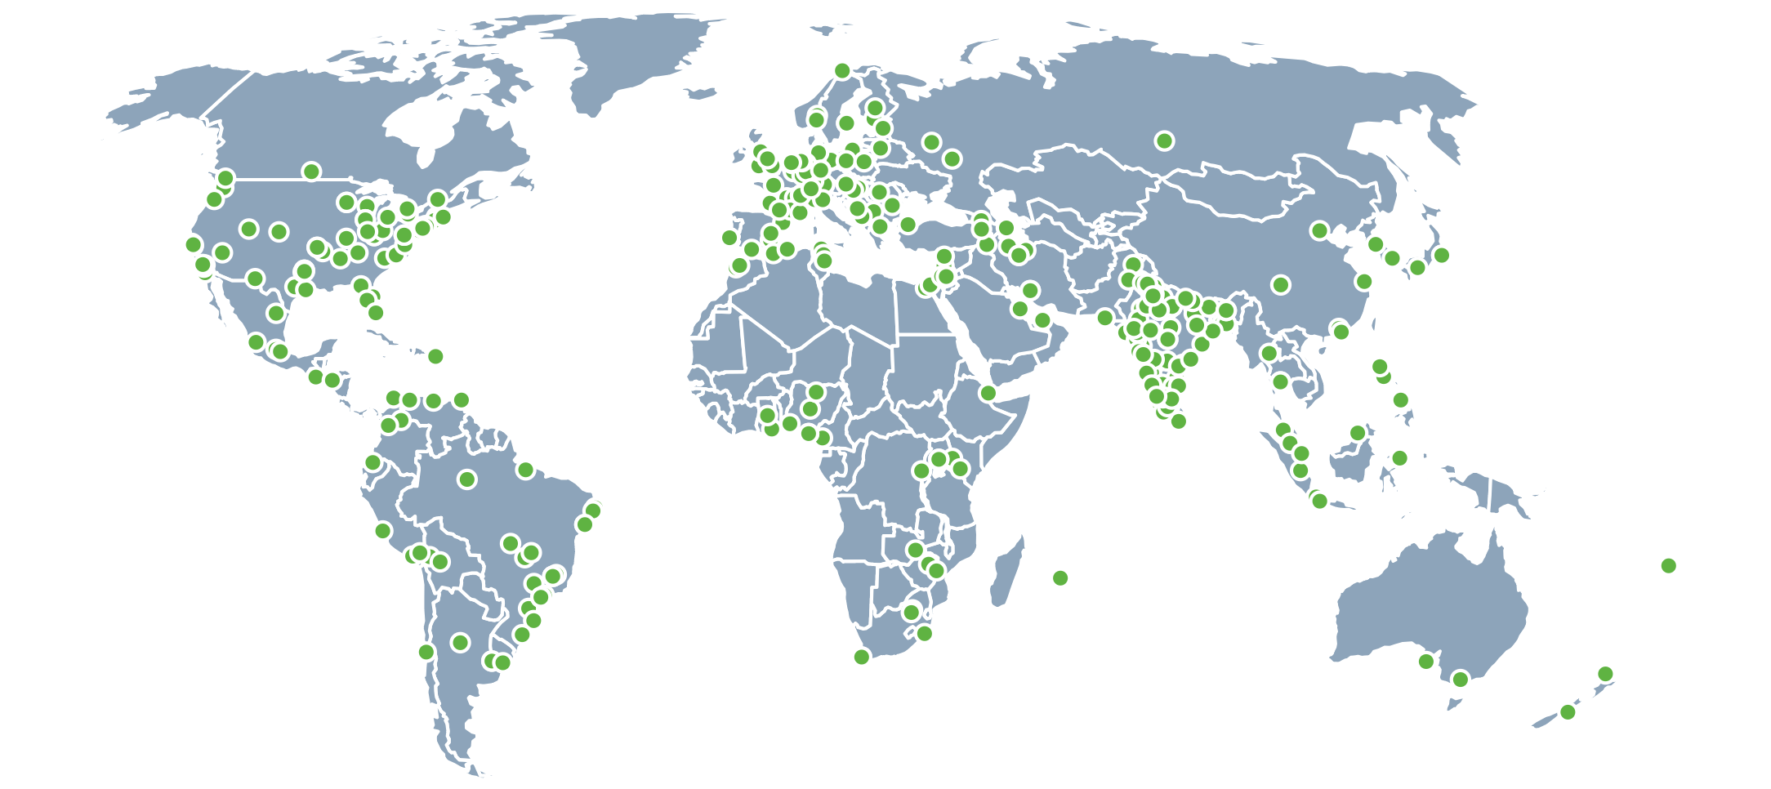
Deans
School of AI Deans are an honorary group of individuals who represent the School of AI in online and offline communities worldwide.
They are responsible for helping inspire and educate developers to build Artificial Intelligence in their local communities. Deans are guardians of our core values and mission, they live to serve developers everywhere.

Slide 7
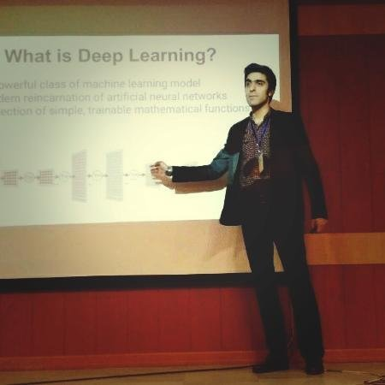











Tehran Chapter
The dean of Tehran chapter is Hamidreza Hosseinkhani
Follow us in Telegram to inform about meetups, LUGs, workshops and events.
Telegram Channel: @schoolofai
Telegram Group: lnkd.in/dCzJH3x
Virgool Blog: virgool.io/@schoolofai

Slide 8
Looking forward to the first meetup!
We are preparing a series of free workshops and meetups to help enthusiasts build their own AI-based projects from scratch and become a real Machine Learning engineers.
We are also going to team up to participate in some Kaggle competitions.

Slide 9
Thank You!

