Slide 1
Sentiment Analysis Group-28

Slide 2
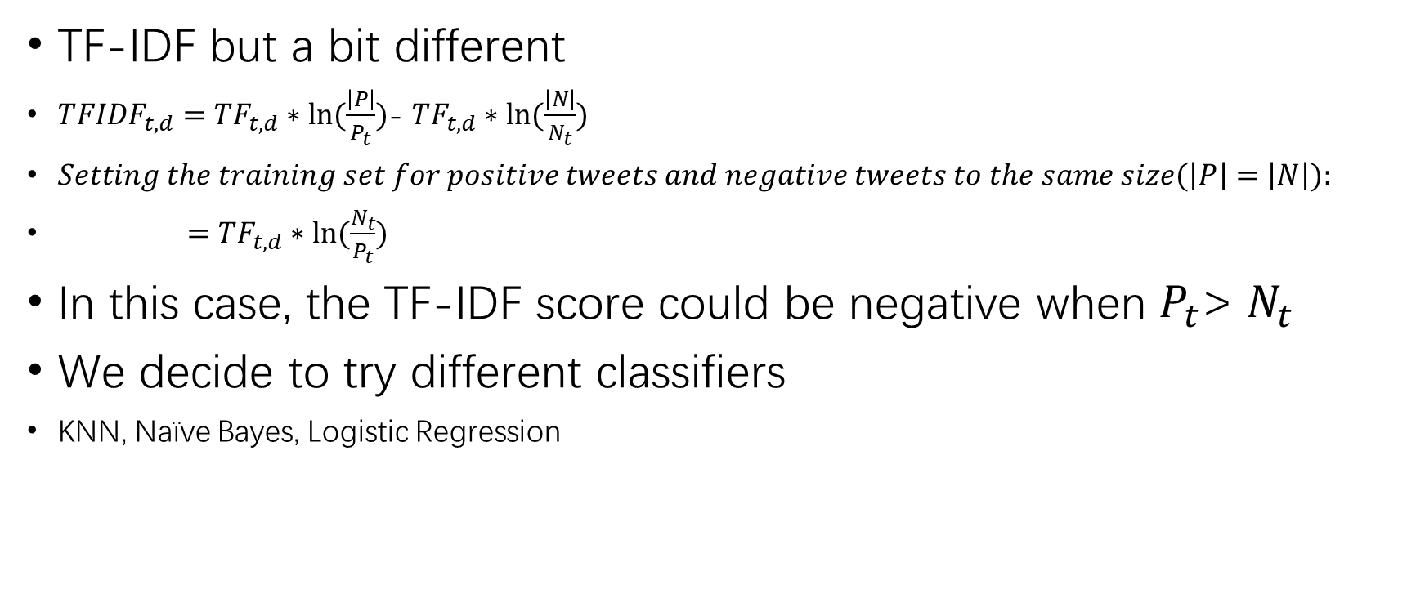
Our Approach
TF-IDF but a bit different
${TFIDF}_{t, d}={TF}_{t, d}∗ln⁡(\frac{\left|P\right|}{P_{t}})$- ${TF}_{t, d}∗ln⁡(\frac{\left|N\right|}{N_{t}})$
$Setting the training set for positive tweets and negative tweets to the same size(\left|P\right|=\left|N\right|):$
$={TF}_{t, d}∗ln⁡(\frac{N_{t}}{P_{t}})$
In this case, the TF-IDF score could be negative when $P_{t}$> $N_{t}$
We decide to try different classifiers
KNN, Naïve Bayes, Logistic Regression

Slide 3
Features to add
Weighing tf-idf scores based on the distribution difference of the word between the positive dataset and the negative dataset
Adding morphology filters to pre-processing
Filtering names, @s, tags and other internet related expression

Slide 4
Evaluation
Precision, F-score, Recall and Accuracy

