Slide 1


COMP2041
Week 5

Slide 2
Announcements
Welcome to Week 5 of COMP2041
Lab 4 due Monday 12PM AEDT
Week 04 Weekly Test due Thursday 9PM AEDT
Assignment 1 is now released
Help sessions available (will be very busy closer to the deadline)

Slide 3
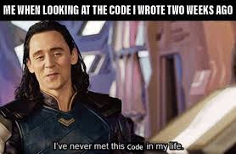
Assignment Overview
Recreating multiple scripts related to autotest
give-add
give-submit
give-summary
give-status
give-fetch
give-autotest
give-mark
give-rm
Do them in order (why do it backwards??)
In that order for a reason, some sections may depend on other sections

Slide 4
Marking Criteria
80%: Autotests
Tends to be lenient for lower marks (90% of people have marks above 50/80 for autotests)
Not as lenient for higher marks (Quite hard to achieve 70/80 for autotests)
15%: Style
5%: Test scripts What I will be covering mostly in today’s tut

Slide 5
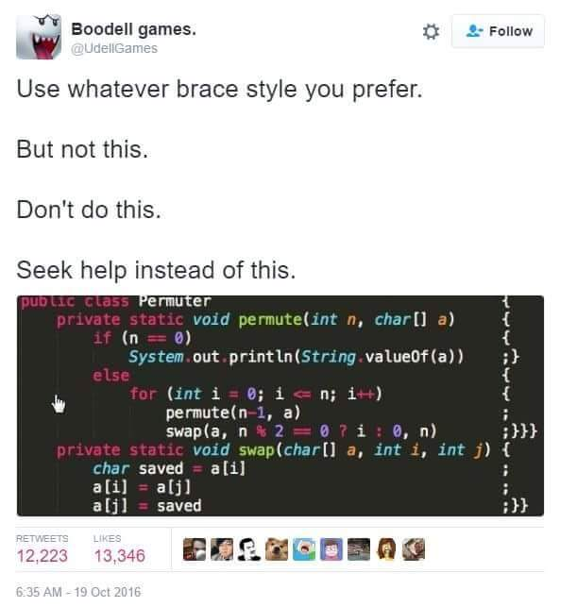
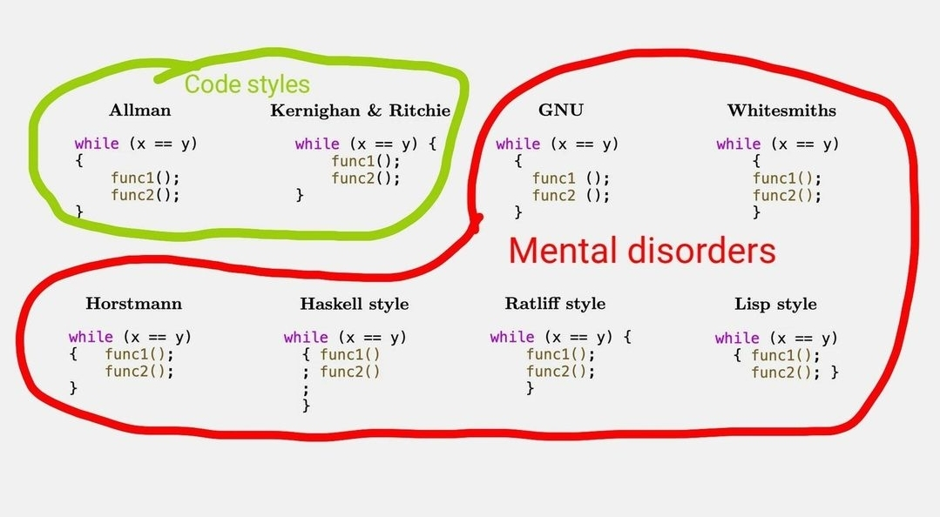
Style Marks
Example code

Slide 6


Tests
Example test case

Slide 7

To The
Lab!

