Slide 1
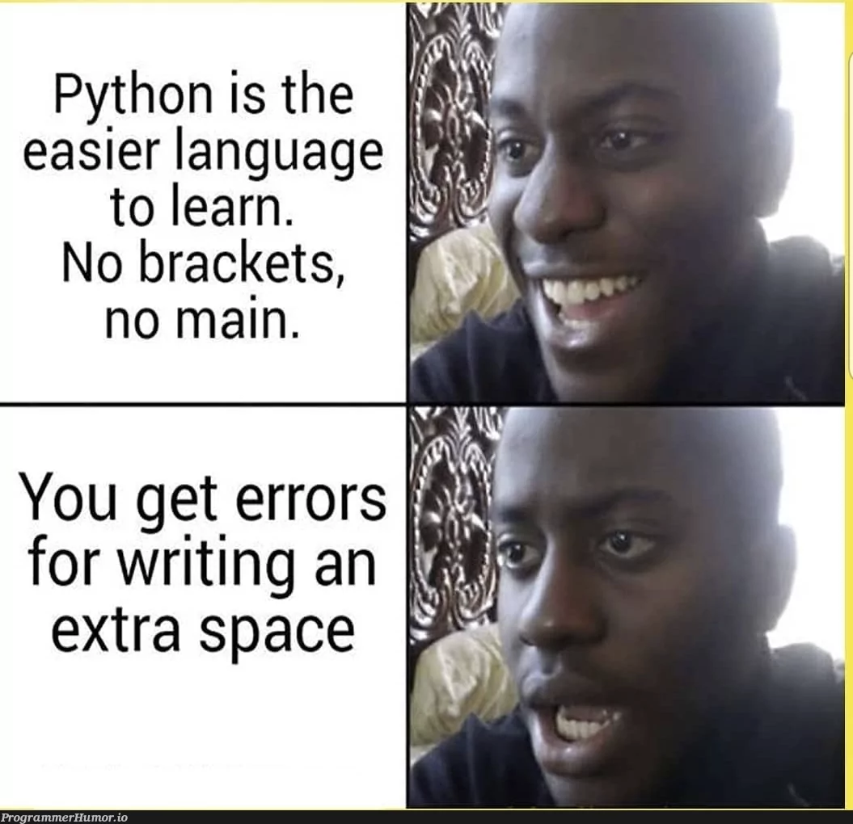
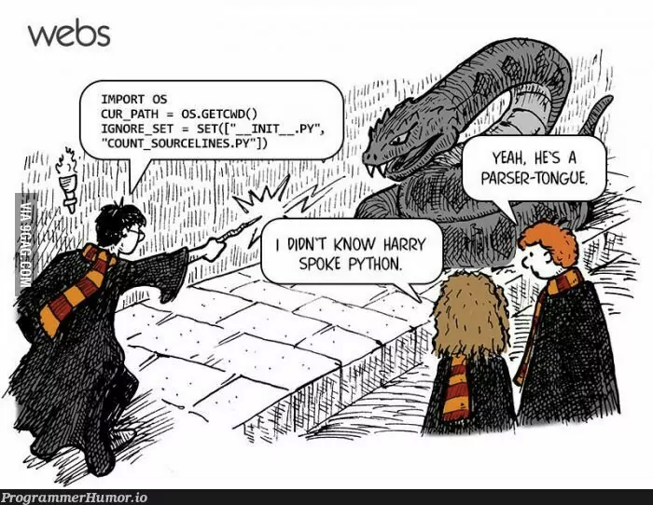
COMP2041
Week 7

Slide 2
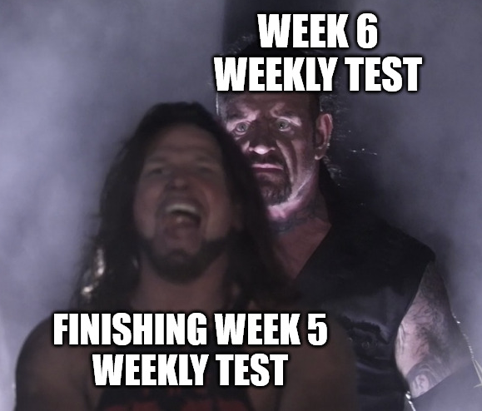
Announcements
Welcome to Week 7 of COMP2041
Weeks 5 and 6 Weekly Test due Thursday 9PM AEDT
Week 5 Labs due at 12PM Monday
Assignment 2 released
Assignment 1 due at 12PM Monday
Late penalties apply
5% per day for 5 days
Penalty applied on received mark
NOT MAX MARK

Slide 3
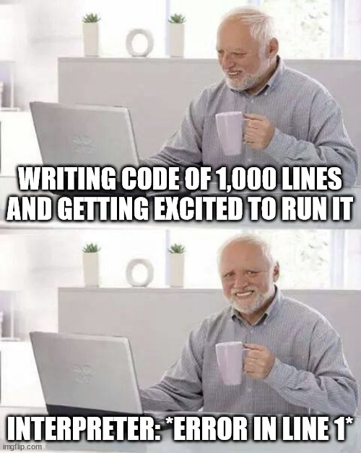
Overview
Python
Python Interpreter (REPL)
Python re module

Slide 4
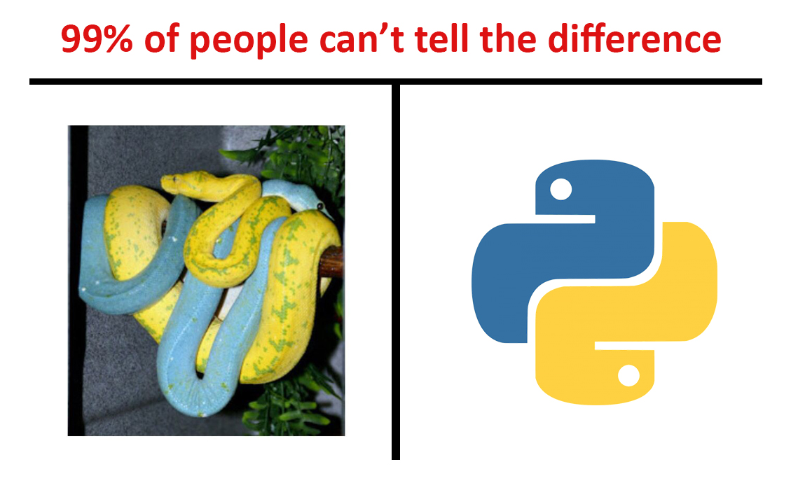
Python-specific things to remember
x is y, x is not y
x in y, x not in y
x++ (X), x += 1 (O)
x-- (X), x -= 1 (O)
How do you read lines in python? (stdin.py)
Multiline strings
Slicing strings

Slide 5
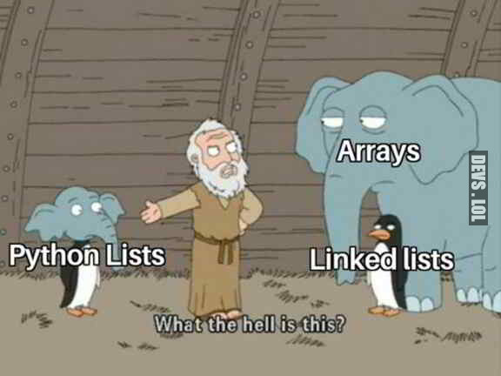
list, dict, tuple, range
List: ‘flexible array’
Dict: similar to ‘map’, you can map keys with objects
Tuple: Unchangeable list
Range: Sequence of numbers
Example code:

Slide 6
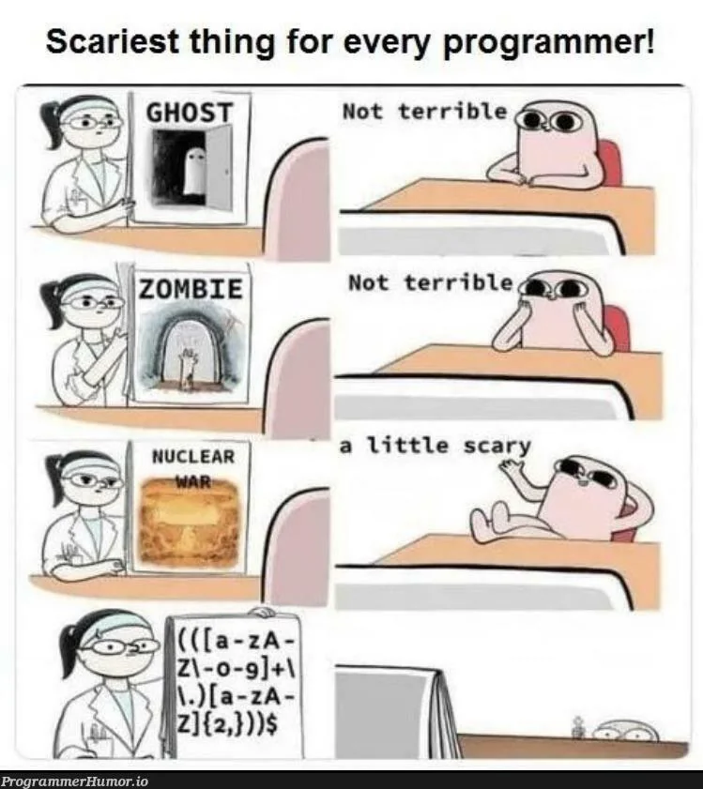
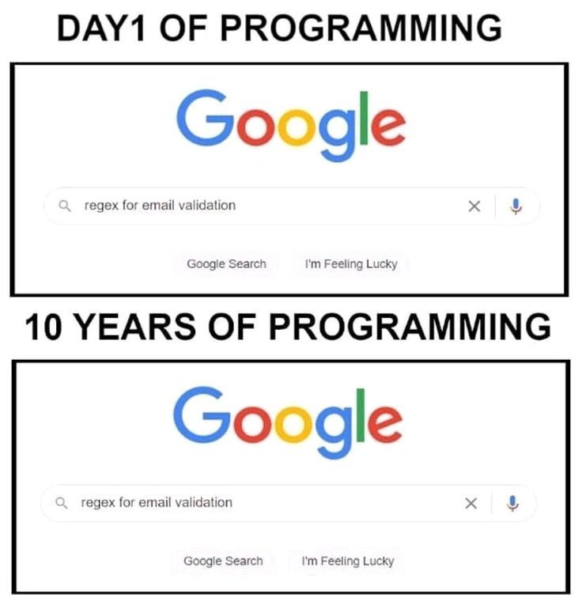
Python regex
re.search
re.match
re.fullmatch
re.sub
re.findall
re.split

Slide 7

Tutorial Questions

Slide 8

To The
Lab!

