Slide 1
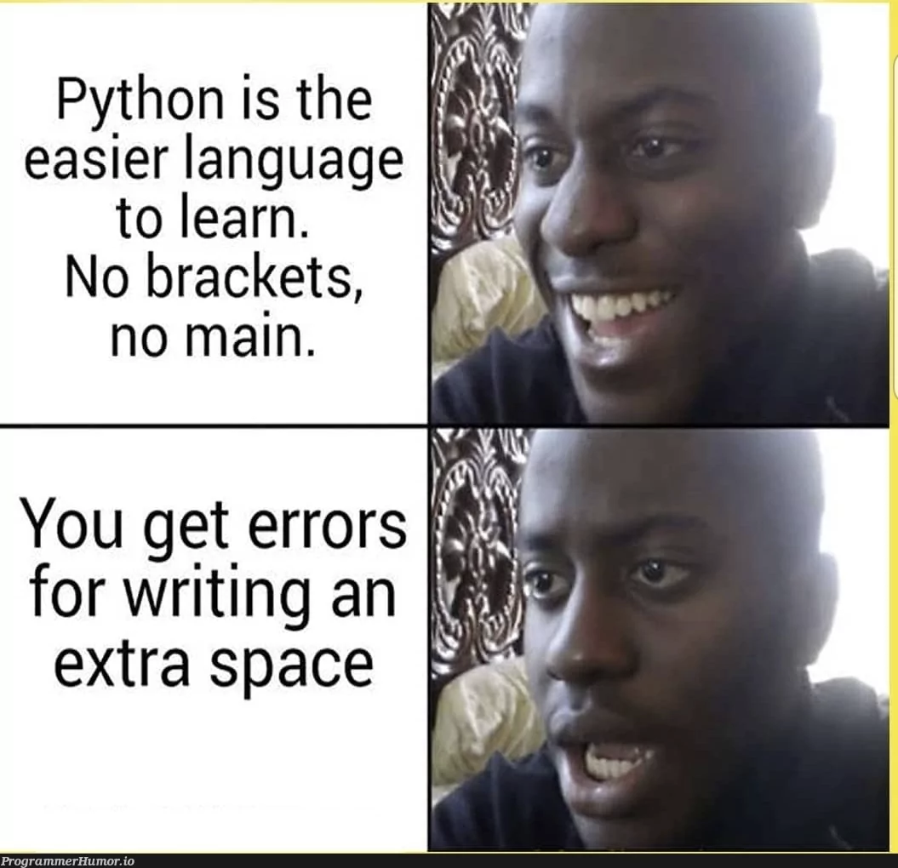
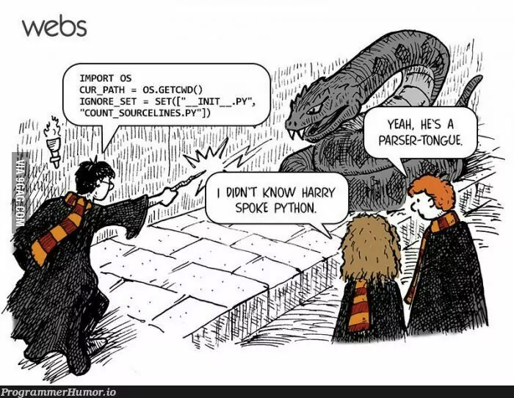
COMP2041
Week 8

Slide 2

Announcements
Welcome to Week 8 of COMP2041
Week 7 Weekly Test due Thursday 9PM AEDT
Week 7 Labs due at 12PM Monday
Assignment 2 released

Slide 3
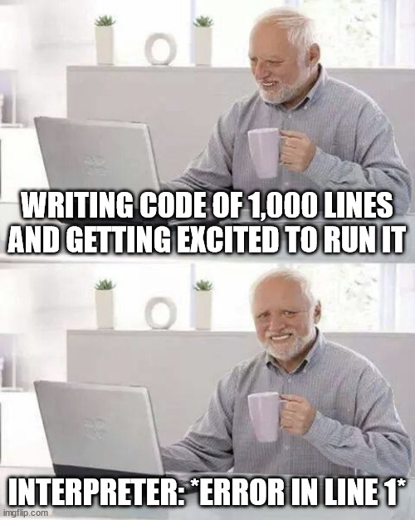
Overview
Python Programming
Types in Python???
Tutorial Questions
Assignment 2 walkthrough

Slide 4

Tutorial Questions

Slide 5

To The
Lab!

