Slide 1

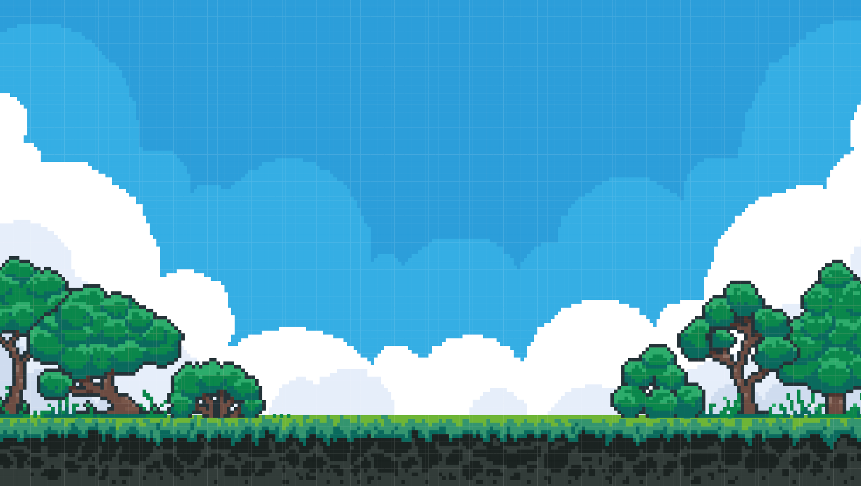
Geographically
Distributed
Kubernetes
By Alex Bissessur

Slide 2



“I do fun things with
Kubernetes.”

Slide 3
State of The Cloud in Mauritius
Cloud native naive
Until recently, the govt’s official positon was that cloud = bad
Still, most people/companies see the cloud as someone else’s computer
(or a server you don’t need to maintain)

Slide 4
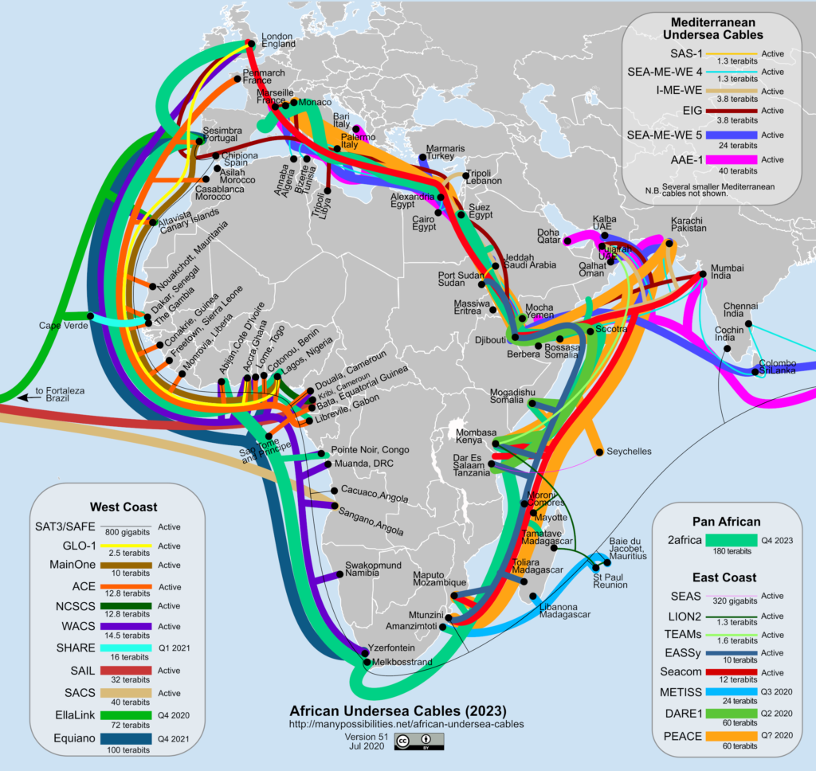
How Connected are We?

Slide 6
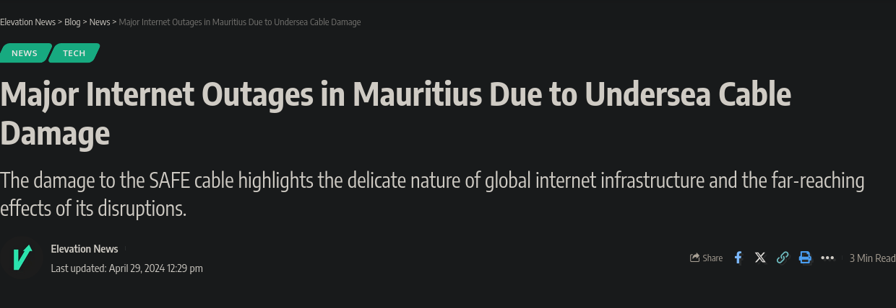

Slide 7
No Internet?
Cable damage causes:
600ms latency to Europe
1500ms latency to North America
Banking applications fail
ATMs fail
Insurance applications down
Netflix inaccessible

Slide 8
CSPs in Mauritius
Cloud.mu is the only(?) CSP in Mauritius
AWS, GCP, Azure have strict requirements for setting up DCs in a country
- network redundancy
- power redundancy
- distance between Dcs
Closest CSP is in South Africa (60ms)
and an undersea cable away

Slide 9
What T his Means for High Uptime
Running on-prem requires significant investments (UPS)
Running in a datacenter has no physical redundancy
Running my homelab is victim to powercuts

Slide 10

Solution?

Slide 11
Alex, what are you talking about?
Hosting on-prem is nice. My homelab is nice.
Losing power is not nice → lose all running services (and nice uptime stats)
Companies use multi-cloud for better reliability, right?
Then let’s have multi-homelabs, connected together and coordinated with Kubernetes

Slide 12
Our Great Plan
3 Datacenters (also called houses)
3 machines per house
Kubernetes cluster of 9 nodes
Any one house can lose power/internet and services stay running

Slide 13
Tech Stack
K3s
K3s is lightweight and has batteries included.
It makes setting up the cluster easy (one command).

Slide 14
Tech Stack
K3s
Longhorn
Longhorn provides persistent storage for the entire cluster
Easily creates volume replicas on nodes in the cluster for data redundancy
Fairly lightweight and performant

Slide 15
Tech Stack
K3s
Longhorn
Minio/S3
Longhorn can use the S3 buckets for backups
Minio would allow us to have a distributed cluster for our backups

Slide 16
Tech Stack
K3s
Longhorn
Minio/S3
Tailscale
Tailscale gives a virtual mesh network for nodes to communicate
We only have 1 public IP per house, so we cannot expose several nodes to the internet

Slide 17
Potential Issues
Latency
default etcd heartbeat timeout 100ms
Powercuts
having the CP in one place makes the cluster vulnerable
IP cycling
routers cycle IPs every 24h
Bandwidth
good connection needed for Longhorn replication

Slide 18
Future Goals
Community-focused cluster
(owned by the people for the people)
Run K3k or Vcluster to provision clusters within the larger cluster for people to use and play with
Short-term, we want to get more people involved and replace old i3-3rd gen nodes

Slide 19

Thank You!
alexbissessur.dev
t.me/alexbissessur
moris.social/@AlexB

