Slide 1

How
Safe
Are
You?
By Alex Bissessur

Slide 2



Kubernetes & Cloud Native enthusiast
Organiser of Cloud Native Mauritius
Kubernetes Person™️ at La Sentinelle
Python & Rust “dev”
Linux and FOSS enthusiast
(maybe too enthusiastic)
Most interesting thing about me?
> My homelab
A Wild ALEX
Appeared!

Slide 3
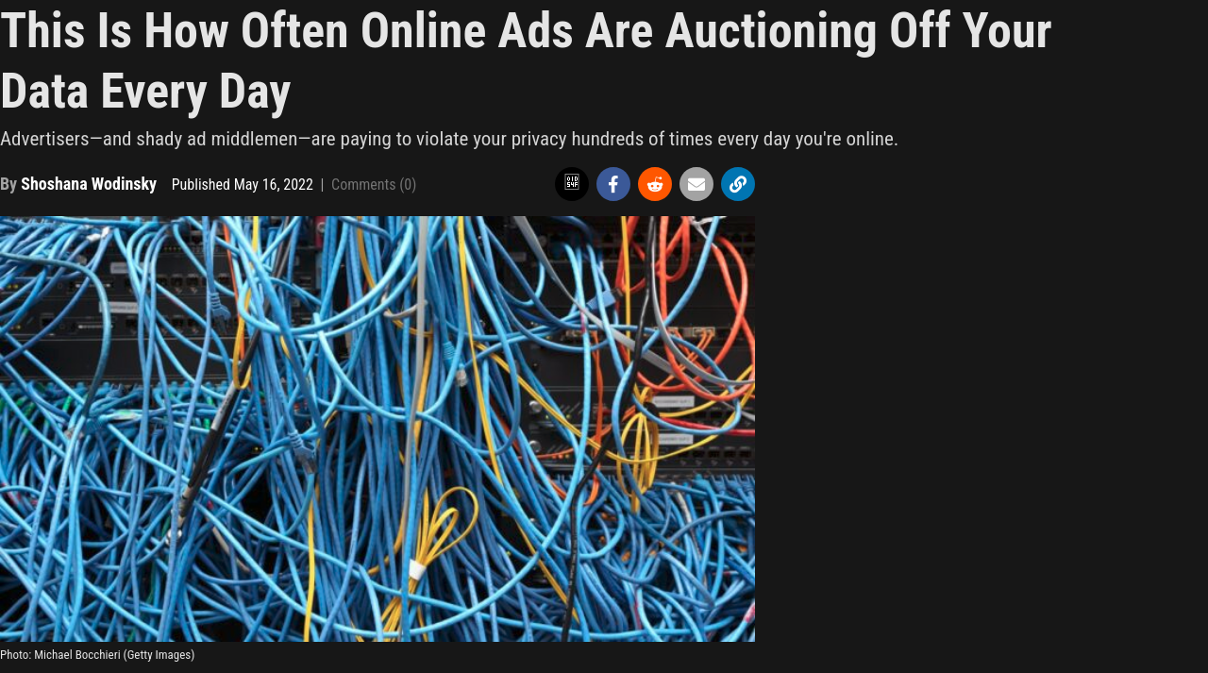

Slide 4
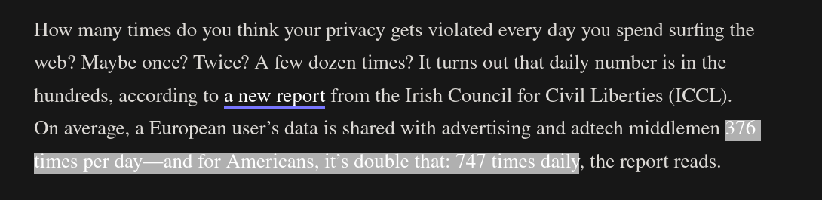

Slide 5
Your Data Is More Valuable Than Your Life.

Slide 6
Who wants your data?
Ad-serving companies for targeted advertising
Governments for surveillance
Insurance companies for targeted premiums
Malicious dudes on the dark web

Slide 7
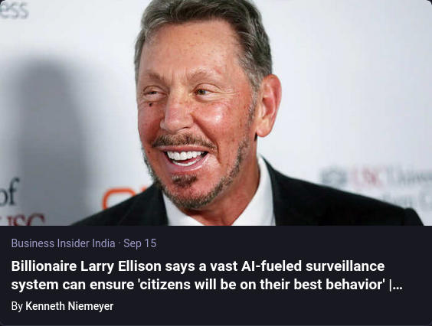
1984
Was
Supposed
To Be
Fiction
Not An
Instruction
Manual

Slide 8
Facebook
“Connect with friends and the world around you on Facebook”
Your friends and friends of your friends share pictures, tagging each other
Facebook serves to create a digital profile of who you are, who you know, and what you like

Slide 9
What Does Facebook Ask of You?
Name, surname
Address
Phone number
Birthday
Gender
School(s) attended
Education level
Contact info
Members of your family
Relationships
Political/religious affiliations
Life events

Slide 10
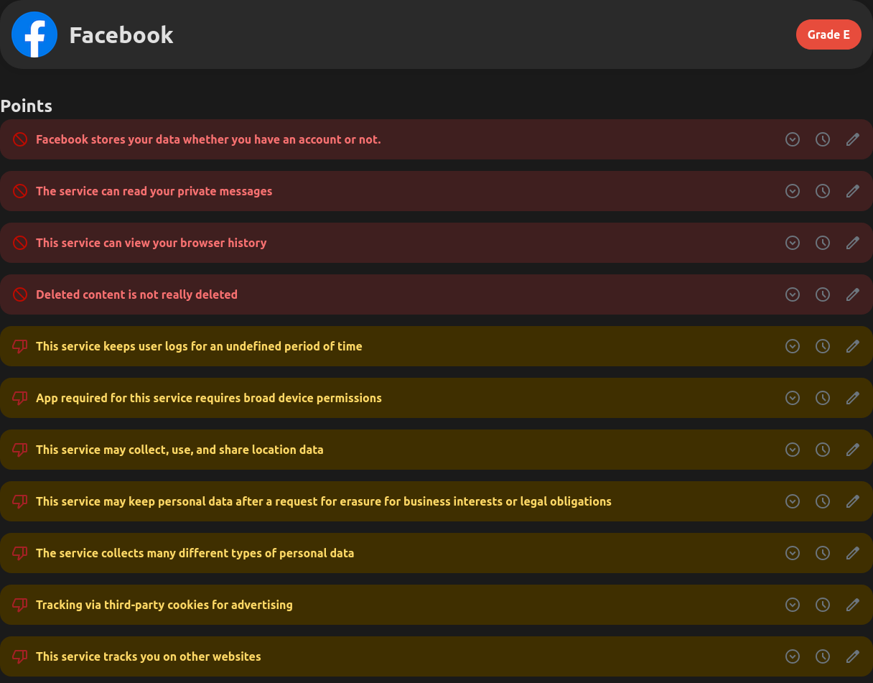

Slide 11
Google
The monopoly of the tech world.
Has Android
Has Google Chrome
Has Google (the search engine)
Has Gmail, Google Maps, Youtube, Photos, Drive, Contacts
Has Google Adsense (78% of revenue)

Slide 12
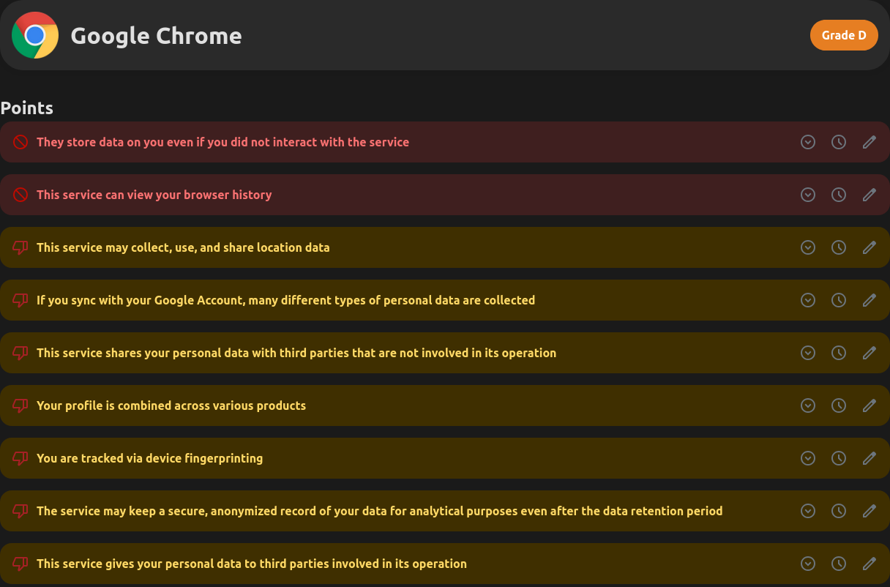

Slide 13
Google (continued)
You google search for a product eg: headphones
Google matches this interest to your profile
Google gives the link to Adsense
Adsense serves ads related to the product
Profit!

Slide 14
More Google
Google has Android
Android knows your location at all times
Location data can piece together where you are at all time
Build a digital profile of your habits, everything you do – where you work, eat, sleep, exercise etc...

Slide 15
Your ISP
ISP – Internet Service Provider (eg MyT, Emtel)
All internet traffic to/from your network passes through the ISP
Your ISP can see all the sites you visit, and data submitted on unsecured websites
MyT routers have a “backdoor” – secret admin account

Slide 16
VPNs
Sponsored by NordVPN… or not.
VPNs do not protect your data further than HTTPS
Now your VPN provider sees the websites you visit
Most VPNs keep logs on the users
VPN companies are still subject to legal regulations

Slide 17
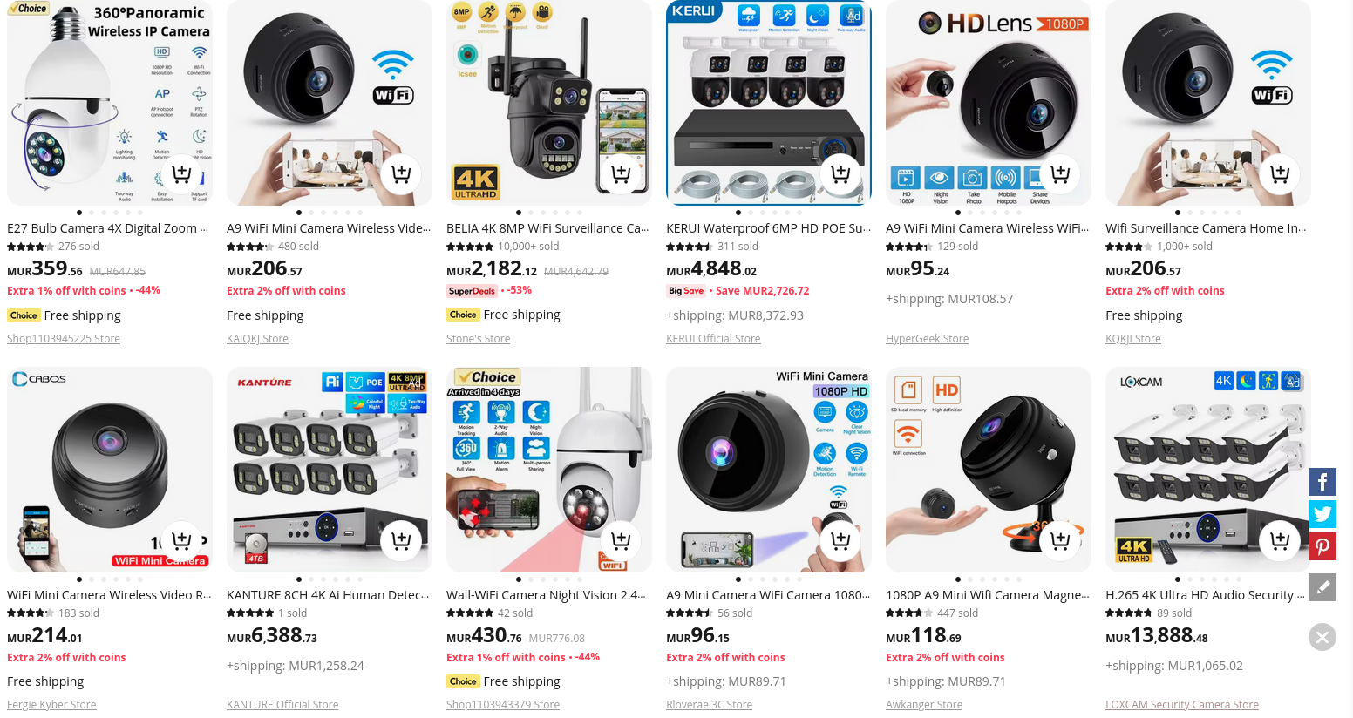
I’m watching you

Slide 18
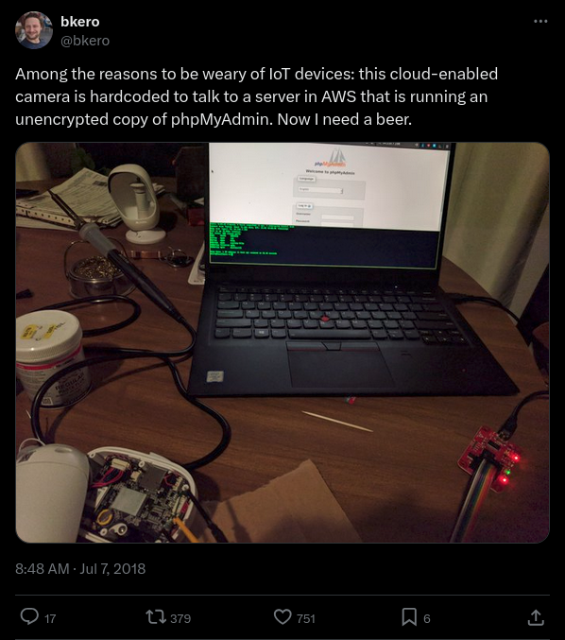

Slide 19
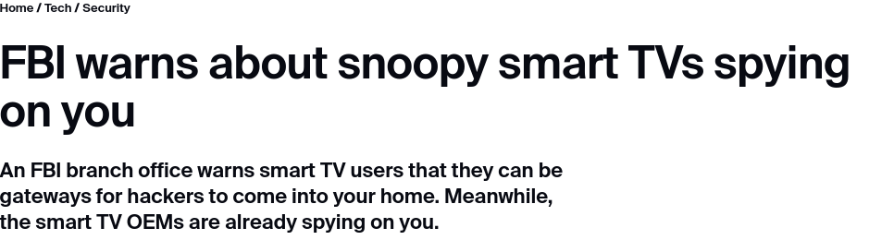

Slide 20
IoT Devices
IoT – smart devices: security cameras, smart lights etc
Many IoT devices are insecure
Many chinesium IoT devices spy on your network…
… and then call home
Your TV does this too!

Slide 21
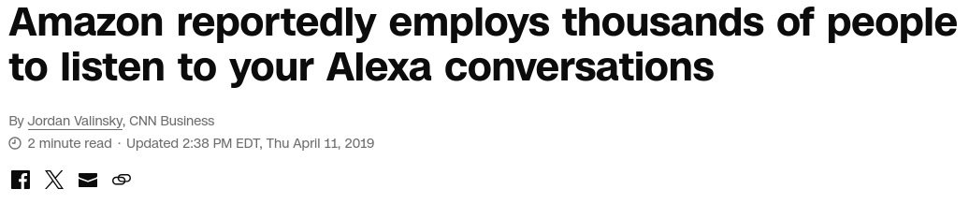
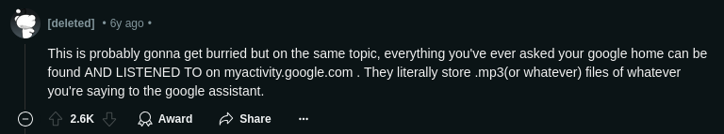

The report said Amazon doesn’t “explicitly” tell Alexa users that it employs people to listen to the recordings. Amazon said in its frequently asked question section that it uses “requests to Alexa to train our speech recognition and natural language understanding systems.”
People can opt out of Amazon using their voice recordings to improve the software in the privacy settings section of the Alexa app.

Slide 22
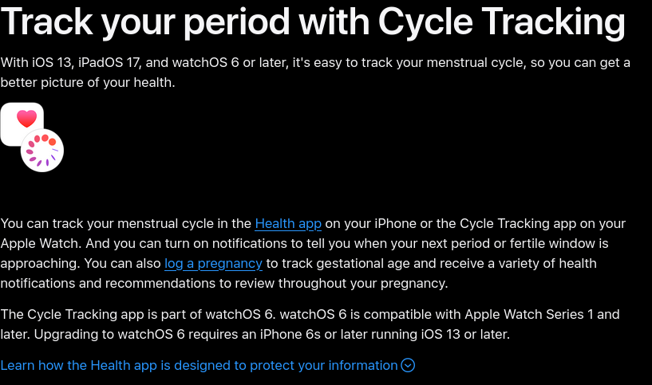
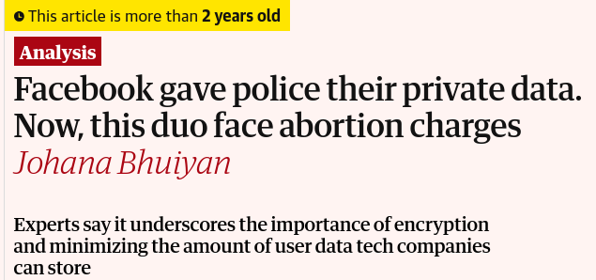
Wearables are Cool, Right?

Slide 23

Thank You!
alexbissessur.dev
t.me/alexbissessur
moris.social/@AlexB

