Slide 1
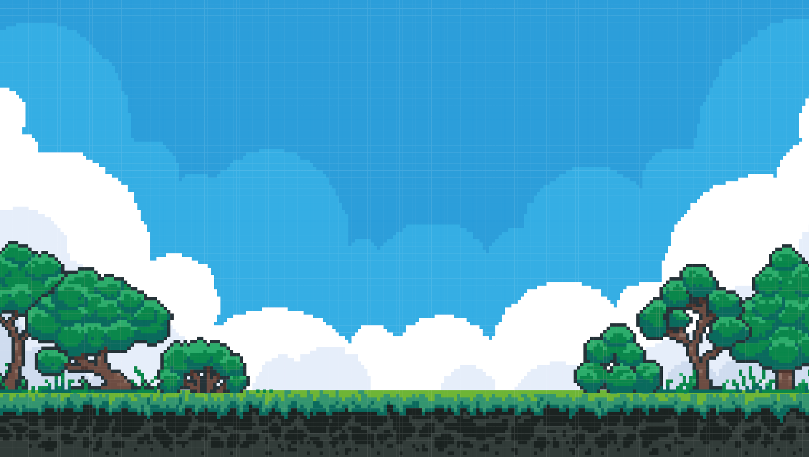
Geographically
Distributed
Clusters
By Alex Bissessur

Slide 2




Kubernetes & Cloud Native enthusiast
Organiser of Cloud Native Mauritius
Kubernetes Person™️ at La Sentinelle
Likes: Linux, FOSS, Tech Communities, Python, Rust
Dislikes: Crashloopbackoff
Q: Most interesting thing about me?
A: My homelab
“I do fun things with
Kubernetes.”
A Wild ALEX
Appeared!

Slide 3
The Cloud In Mauritius
Cloud naive not cloud native
Until recently, the govt’s official position was that cloud = bad
Most people view the cloud as someone else’s computer

Slide 4
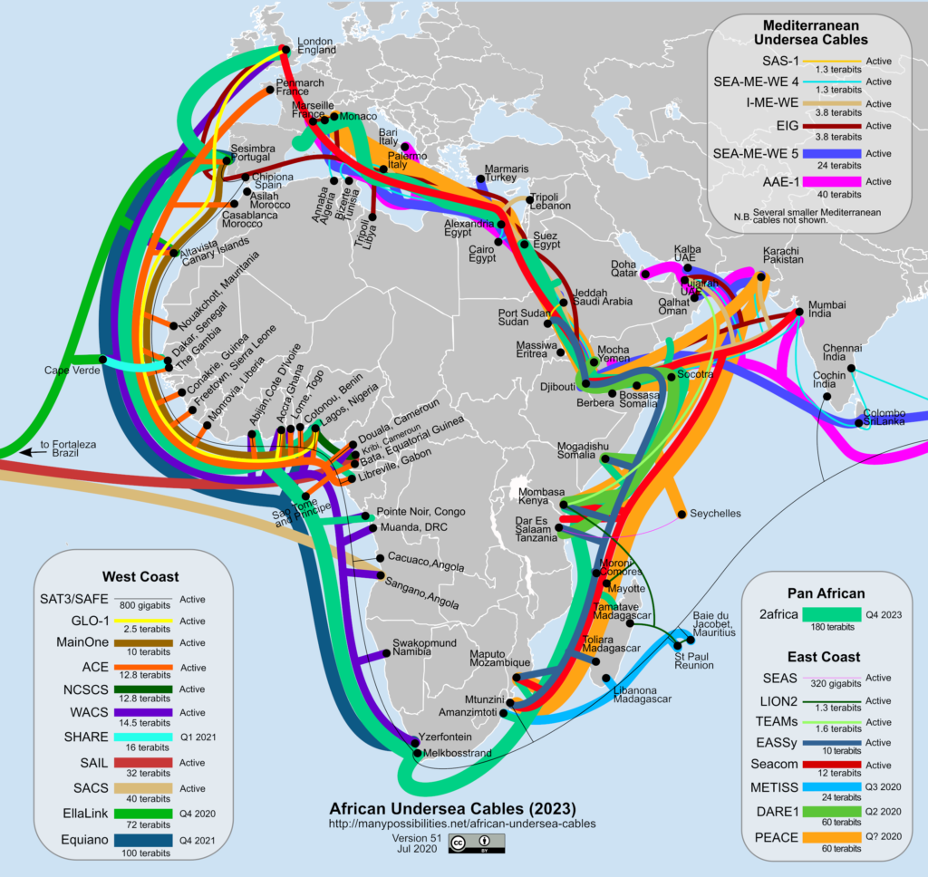
Networking Situation

Slide 6
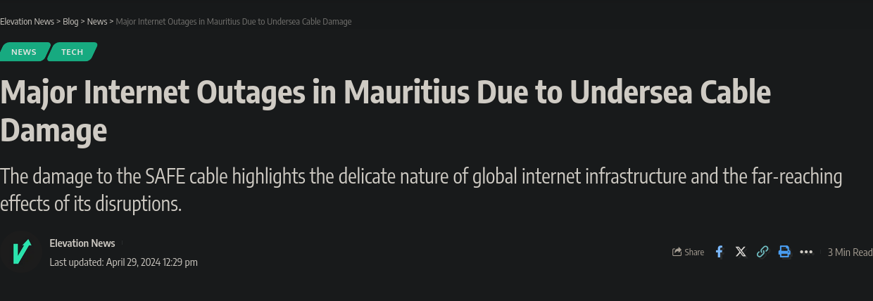

Slide 7
CSPs in Mauritius
cloud.mu is the only (?) CSP in MU
AWS, GCP, Azure have strict requirements for setting up DCs
- network redundancy
- power redundancy
- space issues
Closest is South Africa (60ms)
and an undersea cable away

Slide 8

Solution?

Slide 9
What we did
Homelab at my place – cool but power down = no service
Companies use multi-cloud for better reliability right?
Well, let’s have multi-homelabs, everything orchestrated through Kubernetes

Slide 10
The Plan
3 locations (houses)
3 machines per house
All joined in one big Kubernetes cluster

Slide 11
Tech Used
K3S for being lightweight
Longhorn for persistent storage and replication
Minio/S3 for backups
Tailscale (for now) for connecting everything together

Slide 12
Concerns
Latency
etcd heartbeat timeout 100ms
Powercuts
CP in one place makes the cluster vulnerable
IP Changes
routers cycle IPs every 24h
Bandwidth
good connection needed for Longhorn

Slide 13
Production Use
The cluster is used by a startup for their server needs
Some changes to the cluster to support their needs:
- Addition of exit nodes to Tailscale for access to non-Kubernetes nodes
- Adding special GPU nodes for AI purposes

