Slide 1


The Future
Of Digital
Infrastructure
By Alex “not a developer” Bissessur

Slide 2



“I do fun things with
Kubernetes.”

Slide 3
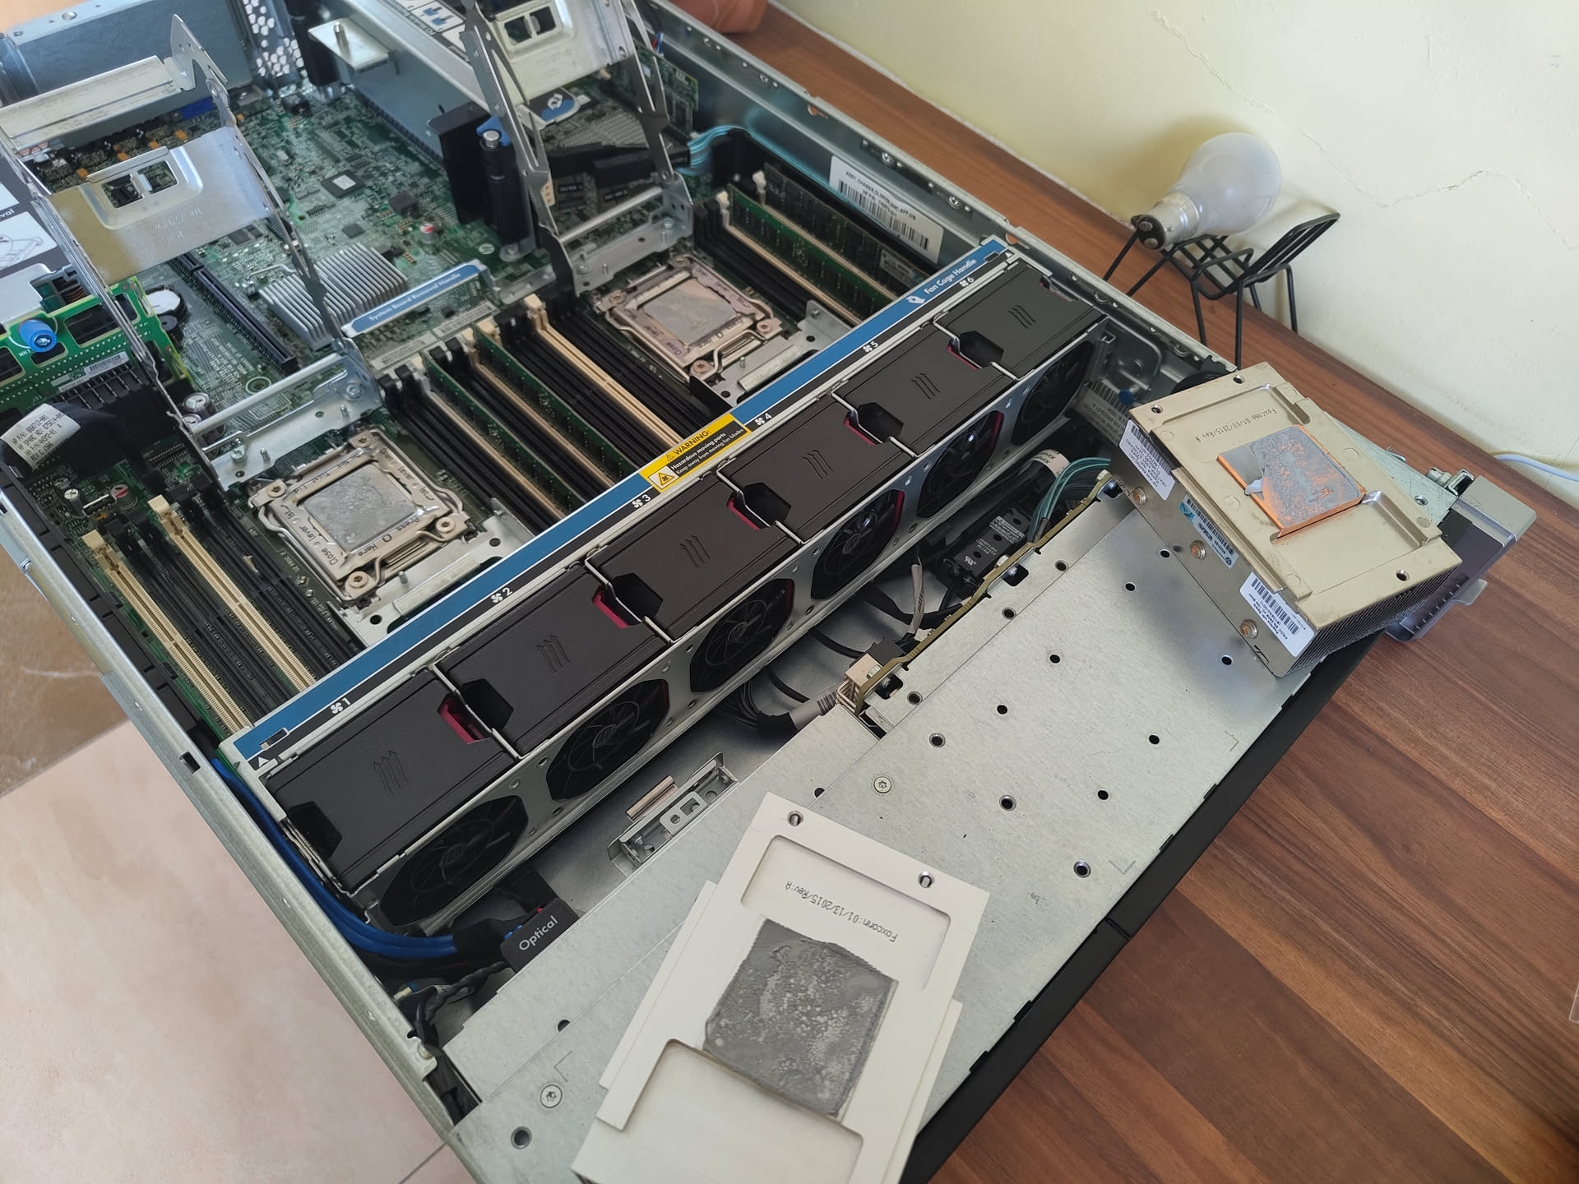

Slide 4
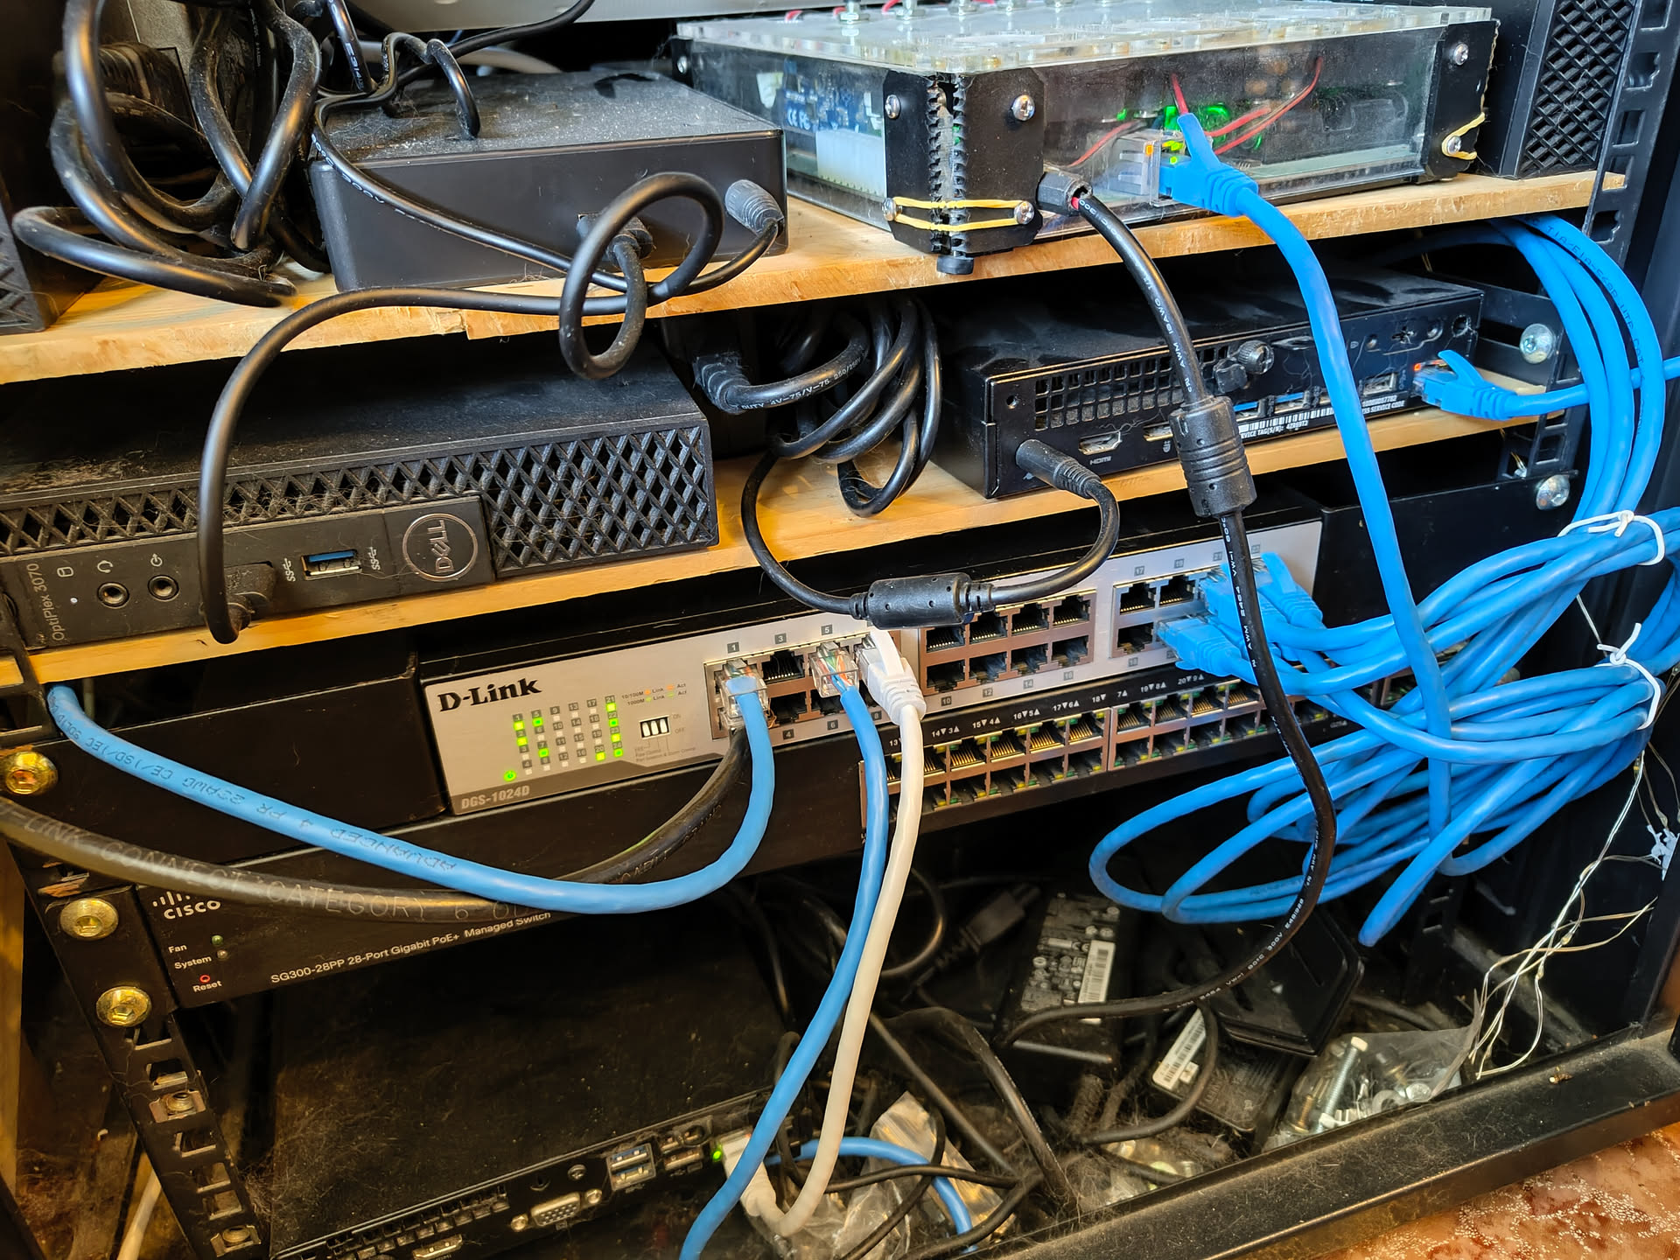

Slide 5
Glossary
Virtual Machines
Containers
Cloud Native
Kubernetes
Microservices
Infrastructure as Code

Slide 6
What is the future of IT Infra?

Slide 7
What is the future of IT Infra?
Laziness. Being incredibly lazy.

Slide 8
Virtual Machines
A complete system within a system
Runs on a hypervisor or host OS
Emulates hardware (hdd, cpu, ram)
Runs entire operating system
Runs the guest OS kernel

Slide 9
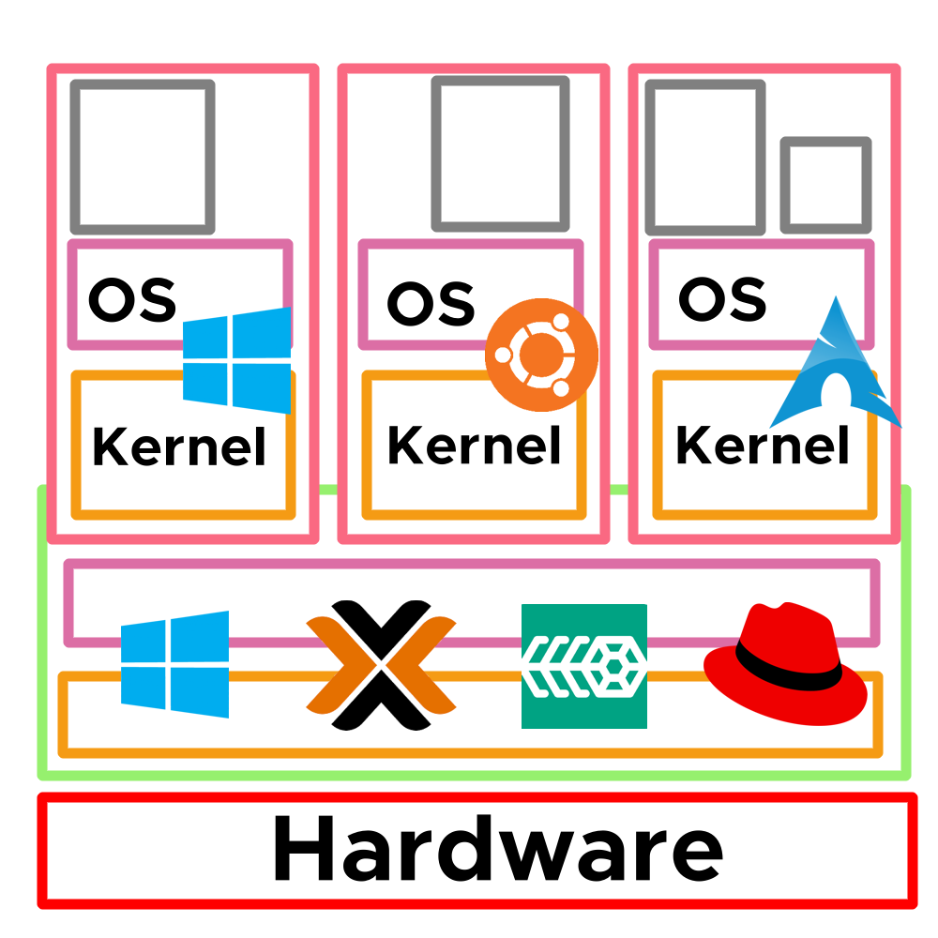

Slide 10
Issues with VMs
Heavy – requires hardware emulation and running a whole OS
- 10 Vms → 10 kernels
- OS uses resources even when idle
Large – not portable or easily moved between developers/admins
Inconvenient – setting up VMs at scale is a chore

Slide 11
Why do We Use VMs?
Isolation – separating applications which have different uses
Security – isolating applications and their data in case of breach
Dependency isolation – different applications may have different requirements – eg PHP 6 vs 8
Splitting a host – host resources can be split across VMs

Slide 12
History of Containers
chroot originated with Bill Joy in BSD in 1982
- lets you create a directory to virtualise the file system
- merged while drinking, or smoking, or both
chroot developed into Jails for BSD
- still in use today
Jails was targeted at running binaries in an isolated environment
- no access to main filesystem
- no ability to make changes to host OS

Slide 13
What is A Container
It is a Linux process.

Slide 14
What is A Container
It is a Linux process.
It provides isolation.
It is replicable.
Typically lightweight.
And runs basically anywhere*.

Slide 15
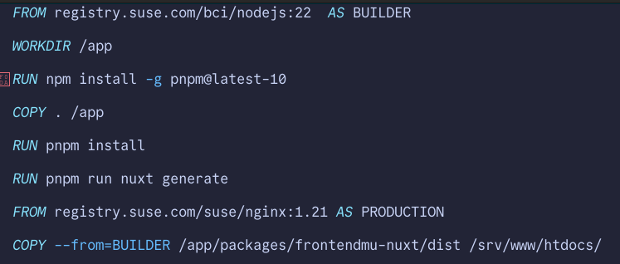
Container Definition

Slide 16
Why Are Containers Cool?
Lightweight on resources – no hardware emulation, no kernel to run, no OS bloat
Lightweight on storage – container images can be as small as 10MB
Portable – they run the same on dev laptop and prod server
Isolated – secure, and avoids conflicts in applications

Slide 18
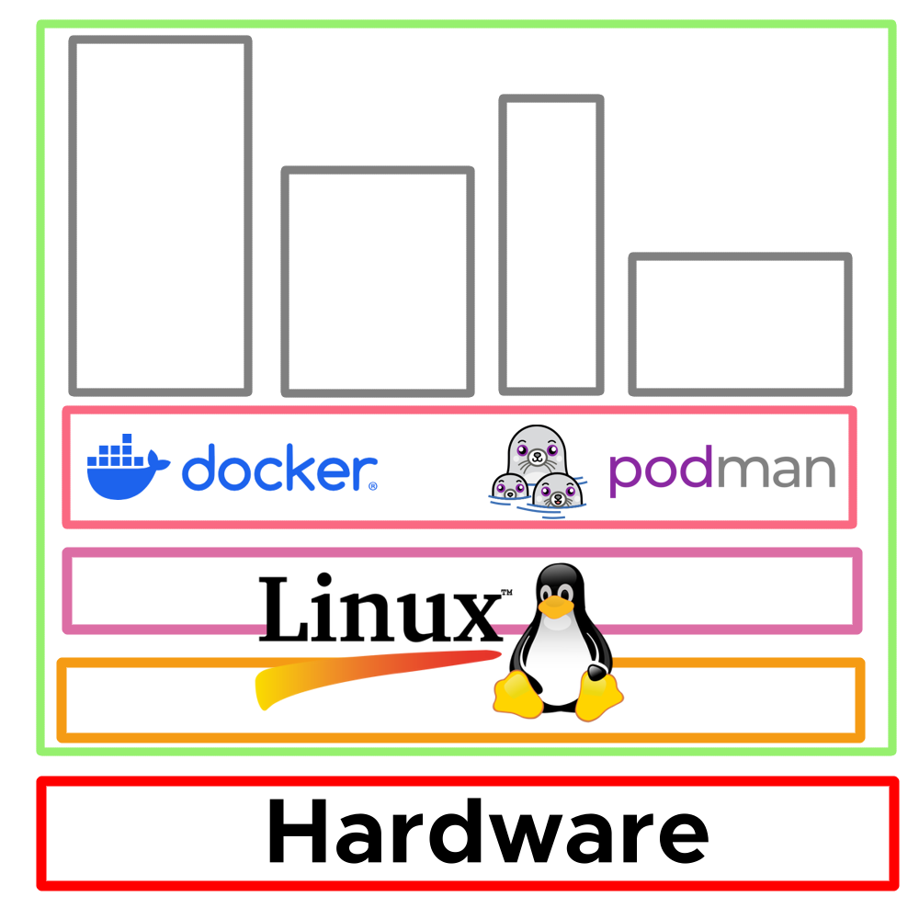

Slide 19
Demo Time
(frontendmu website)

Slide 20
Scaling
Modern day has new demands for internet services.
A single server is not enough for high load, plus physical/hardware limits
Having many servers allows large scale services
Supercomputers are built out of many smaller computers

Slide 21
Cloud Native
The practice of building software and infrastructure prioritising modern demands for internet services.
An ecosystem of tools and platforms to build infrastructure in a scalable way, often using containers.

Slide 22
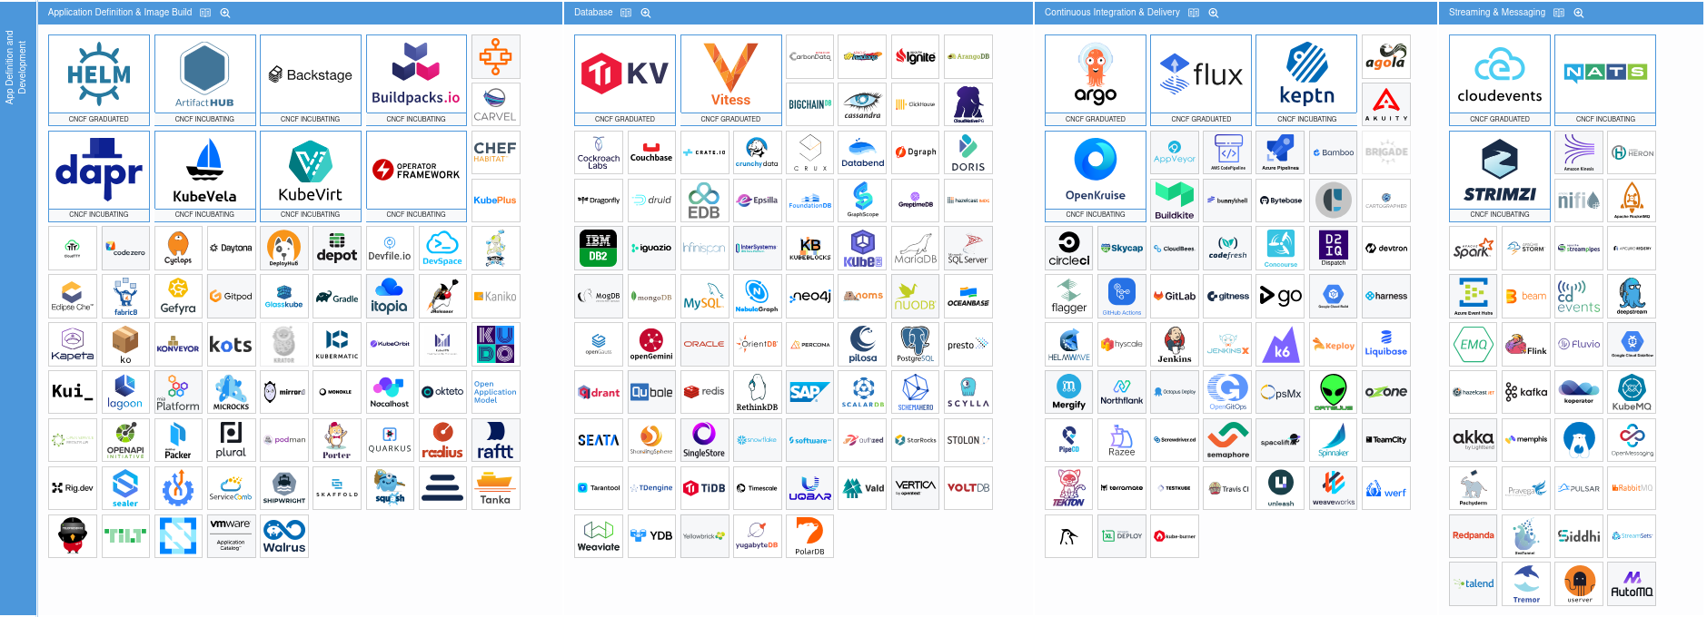

Slide 23
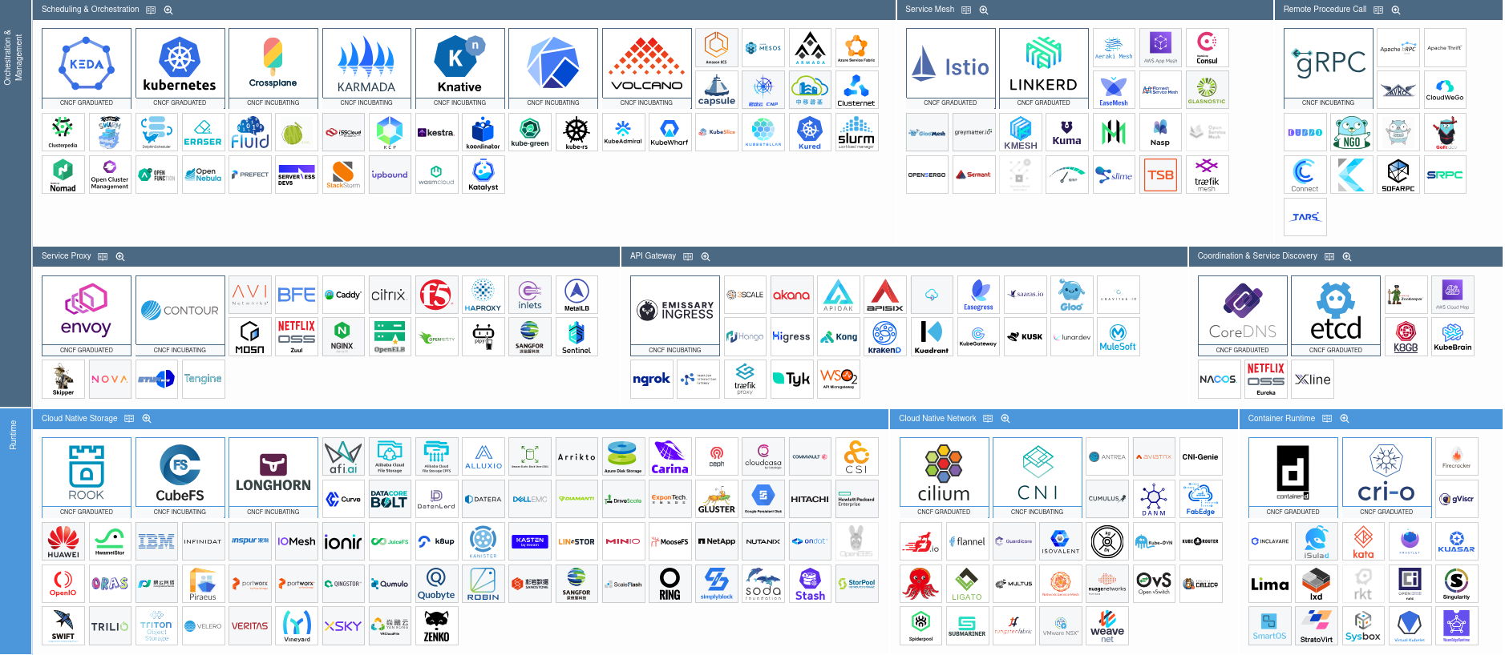

Slide 24
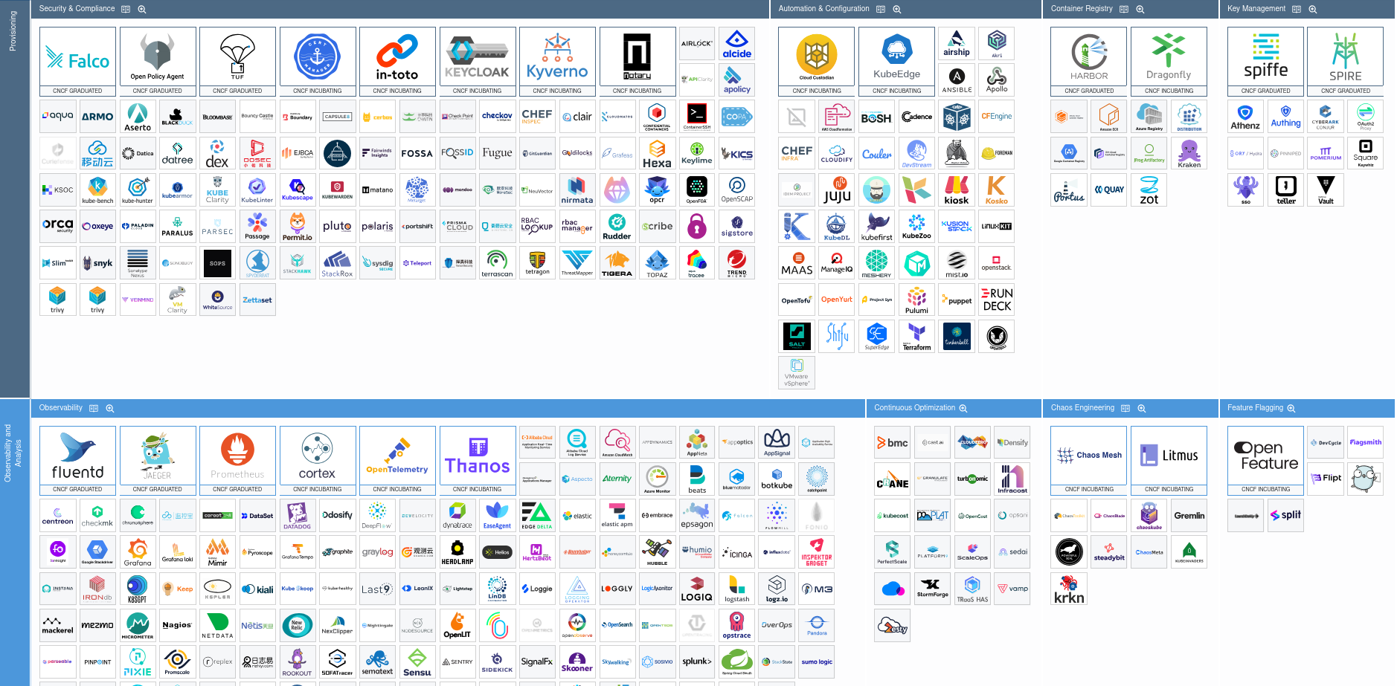

Slide 25
Why Cluster Computing?
Single computer has limited hardware upgradability.
Expand sideways, not downwards.
Netflix serving content from a single server is nuts.
Redundancy from having several servers.
Use of clusters ≡ microservices architecture.
Better upgradability, availability and portability

Slide 26
Kubernetes
Called a container orchestrator, it manages your containers for you
Originally a Google project, now is under the Cloud Native Computing Foundation, a branch of the Linux Foundation
Means “captain” or “helmsman” in Greek

Slide 27
Why Is Kubernetes Relevant?
It manages infrastructure in a declarative way
It is independent so works the same on baremetal, GCP, Azure, AWS, and more
Integrates networking, storage, security, and compute in one package
Built for scale

Slide 28


Slide 29

Thank You!
alexbissessur.dev
t.me/alexbissessur
moris.social/@AlexB

