Slide 1

Practical
Hacking
Techniques
By Alex Bissessur

Slide 2



Kubernetes & Cloud Native enthusiast
Organiser of Cloud Native Mauritius
Kubernetes Person™️ at La Sentinelle
Python & Rust “dev”
Linux and FOSS enthusiast
(maybe too enthusiastic)
Most interesting thing about me?
> My homelab
A Wild ALEX
Appeared!

Slide 3
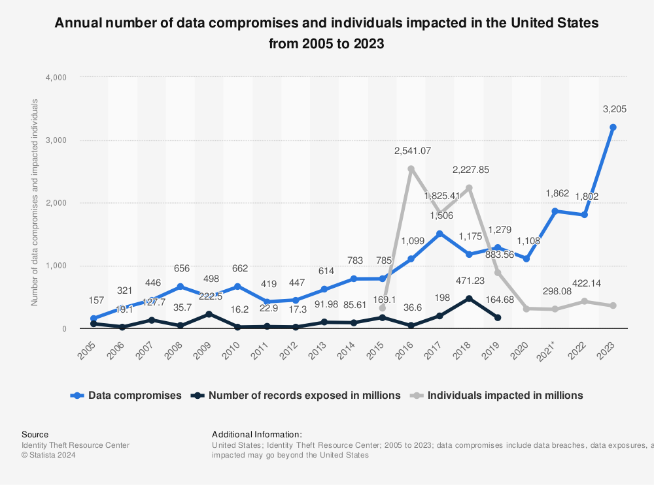
Hacking on The Rise

Slide 4
The Rising Cybersecurity Crisis
Increasing sophistication of hacks
More attack vectors
State interests
IoT vulnerabilities
AI/ML for attacks
More connected/complex software

Slide 5
Brute Forcing
Weak passwords not good
Contains easy to guess details
(name, pet name, DOB)
Long, complex passwords
Randomised with different types of characters (aA1$#)

Slide 6
Data Breaches
You may be secure, but are the companies secure?
You give your passwords to services you use.
Are those services safe? Do they protect your password?
Using the same password across services is bad.
You get hacked one place, you get hacked everywhere.

Slide 7
Phishing
Legitimate-looking messages/email asking for user action.
Might ask for login, or to validate details.
Such mail feigns urgency or threatens additional costs if you do not comply.
Contains a fake URL to steal your details.

Slide 8
Finding Your Online Presence
If you use the same password everywhere, all your accounts are at risk.
Hackers can use tools to find all your accounts and try known passwords

Slide 9
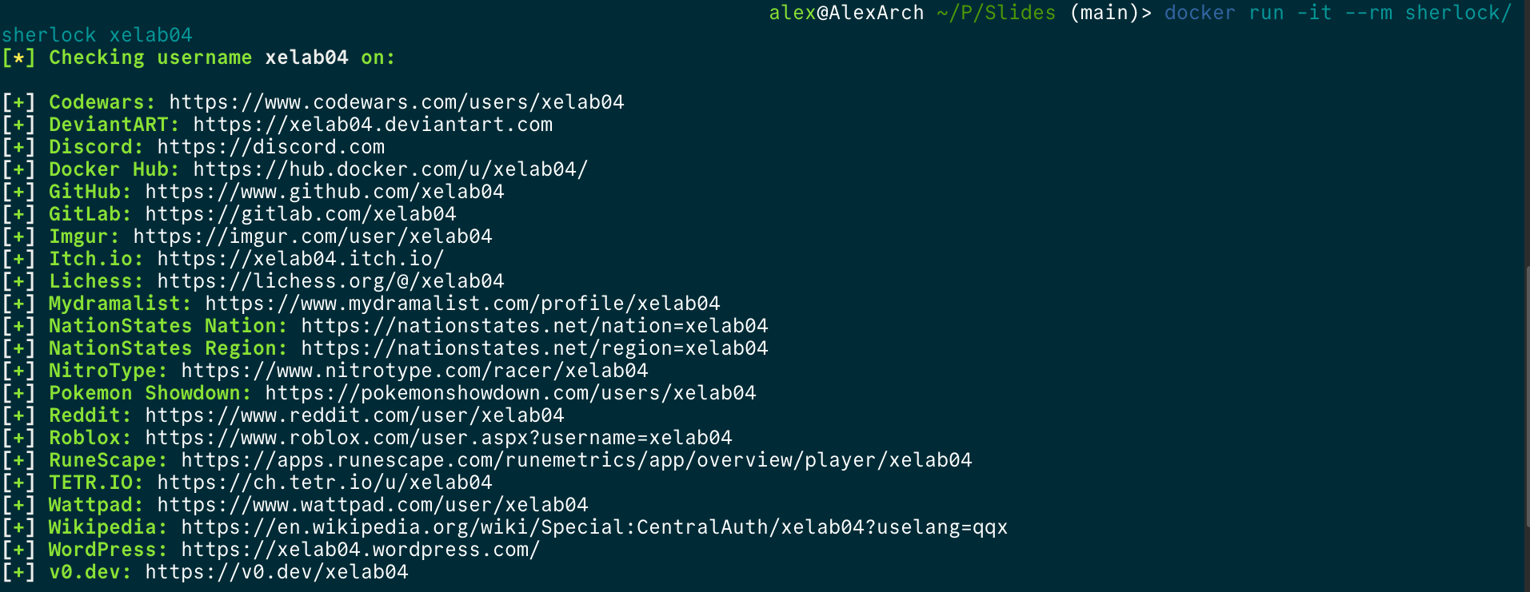

Slide 10
Dictionary Attacks
Trying already known passwords
How many have changed the passwords on their routers?
Common passwords such as “password” and “12345678” are veryyy vulnerable

Slide 11
Exposed Services
Is your security camera on the Internet?
Did you change its password?
Many Chinesium security cameras & IoT devices have hardcoded default passwords.
Compromised devices are a hinge into your network and other devices.
Who’s watching you?

