Slide 1


More YAML
With
Talos Linux
By Alex Bissessur

Slide 2



Kubernetes & Cloud Native enthusiast
Organiser of Cloud Native Mauritius
Kubernetes Person™️ at La Sentinelle
Python & Rust “dev”
Linux and FOSS enthusiast
(maybe too enthusiastic)
Most interesting thing about me?
> My homelab
“I do fun things with
Kubernetes.”
A Wild ALEX
Appeared!

Slide 3
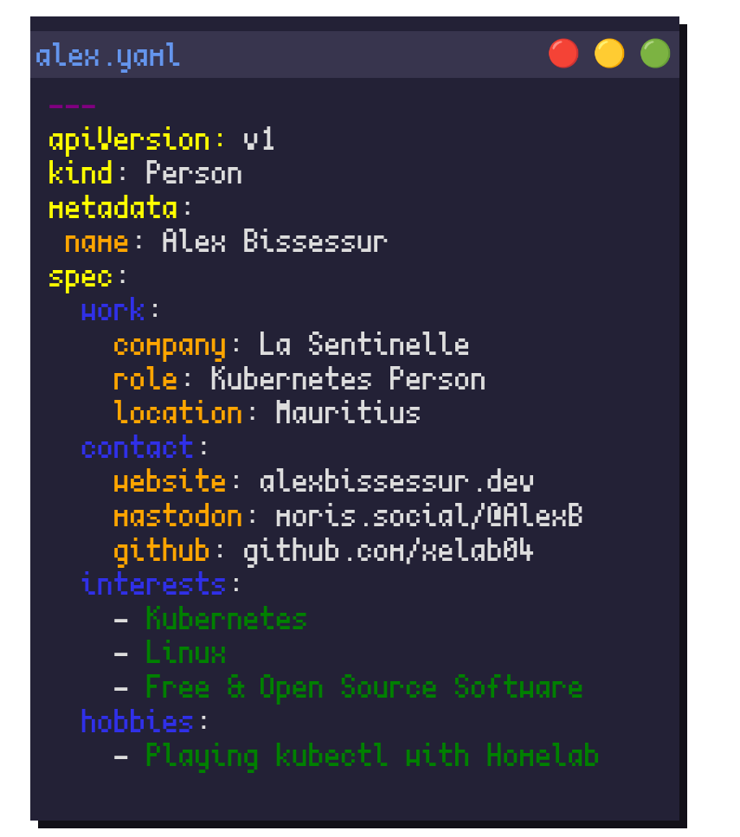
A Wild ALEX
Appeared!
“I do fun things with
Kubernetes.”

Slide 4

Let’s Talk Linux
Linux is a kernel
Linux comes in many flavours
We have Linux for desktop, for servers, for SBCs, for phones etc…
But Linux exists in 2 “main” types

Slide 5
“Full” Linux
The complete package – includes everything expected of an Operating System.
Includes: CLI, printer drivers, SSH server, audio drivers, firewall, sometimes a GUI etc etc…
Found in desktops and many servers.
ex: OpenSUSE Leap, Ubuntu 24.04, Arch Linux

Slide 6
“Micro” OS
Lightweight, slimmed-down Linux distros
Not built for normal day-to-day use
Usually features:
- reduced number of packages
- immutable root fs
- container runtimes preinstalled
Built for container workloads
Includes OpenSUSE Micro, Fedora CoreOS

Slide 7
Why “Micro” Linux
Lightweight, can run on the edge
Built for containers first
Less packages = less vulnerabilities
Immutable
Etc etc

Slide 8
Experiencing OpenSUSE Micro
I created a worklab on old servers
OpenSUSE Micro was the base OS
Installed k3s on top
Who needs a heavy host OS when everything is in a self-contained container?

Slide 9
Introducing Talos
Introducing Talos Linux
The Linux distro built for Kubernetes only
Does not do normal Linux things
Doesn’t even have a terminal or ssh!
12 unique binaries in Talos 1.7. 0

Slide 10
Which Backdoor?
❌ no ssh
❌ no systemd
❌ no glibc (uses musl libc)
❌ no rpm/deb packages

Slide 11
How You Administer Talos

Slide 12
How You Administer Talos
YAML

Slide 13
Talos Administration
Talos nodes have an API, same how Kubernetes has the KubeAPI
talosctl is the CLI client to the API (hint: kubectl)
Talos nodes are configured through yaml and applied through talosctl
And tadaa, you have Kubernetes without a normal OS

Slide 14
Why Talos
Everything is extremely replicable
Scaling clusters is a breeze
Easy Talos OS upgrades and rollbacks
(no apt update && apt upgrade)
More security, more better ;)
Easy to create a HA cluster
Lightweight (nearly as good as K3S!)

Slide 15
Maybe some kinda demo, idk

Slide 16
Thank You!
alexbissessur.dev
t.me/alexbissessur
moris.social/@AlexB

