Slide 1


Testing in
PRODUCTION
(responsibly)
By Alex Bissessur

Slide 2



“I do fun things with
Kubernetes.”

Slide 3
Have you tested in production?

Slide 4
Everybody has a testing environment. Some people are lucky enough enough to have a totally separate environment to run production in.

Slide 5
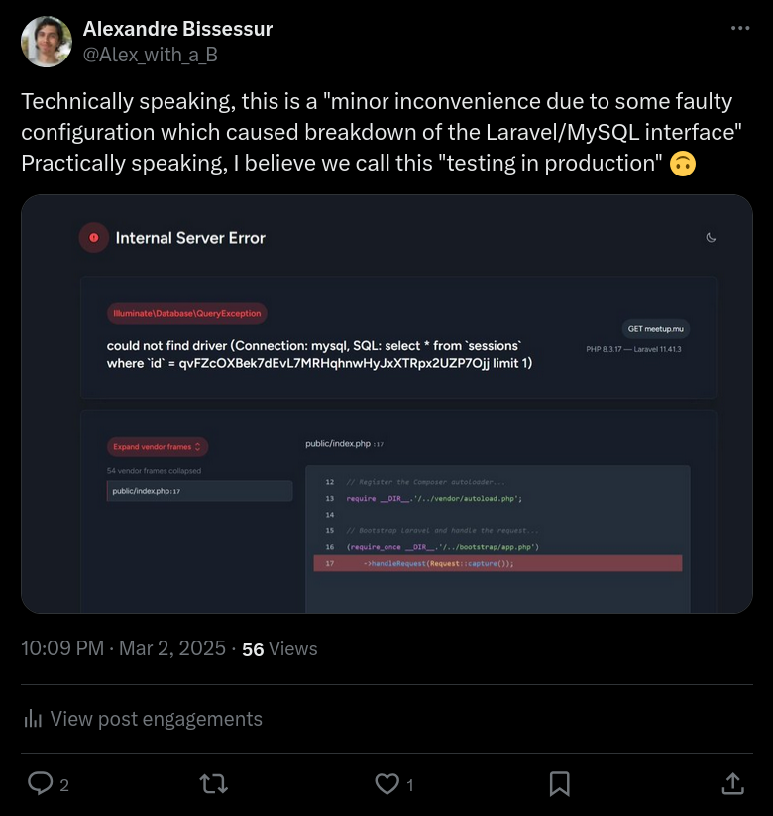

Slide 6
The Olde Way
Monolith application, annoying to deploy/update
Single server so testing is discouraged
- bugs will cause downtime and you will lose your job
Rolling back issues requires manual work
In times of crisis, priority is “fix now, investigate later”

Slide 7
New Infrastructure: Containerisation
Server application is just a container
Containers are treated as cattle, not pets
- Can (meant to) be brought up
- Can (meant to) be destroyed
Containers are fluid

Slide 8


Now:
Traditionally:

Slide 9
Resilience: Infrastructure-First
Kubernetes in production
The first step to testing in production is having a robust production
The second step is automating your work
Kubernetes leverages CNCF tools for advanced deployment features and CI/CD

Slide 10
Health Checks

Slide 11
Rolling Deployment

Slide 12
Blue Green Deployment

Slide 13
Phantom Deployment
Parallel deployment to what is served to users
Requests are mirrored to phantom deployment
Phantom deployment able to process real world data
Phantom deployment monitored for issues
Real deployment only returns traffic to users

Slide 14
Feature Flagging
Env vars for features
Allows you to test new features without changing your source code
Toggle the flag to test a feature
Disable it if you broke production

Slide 15
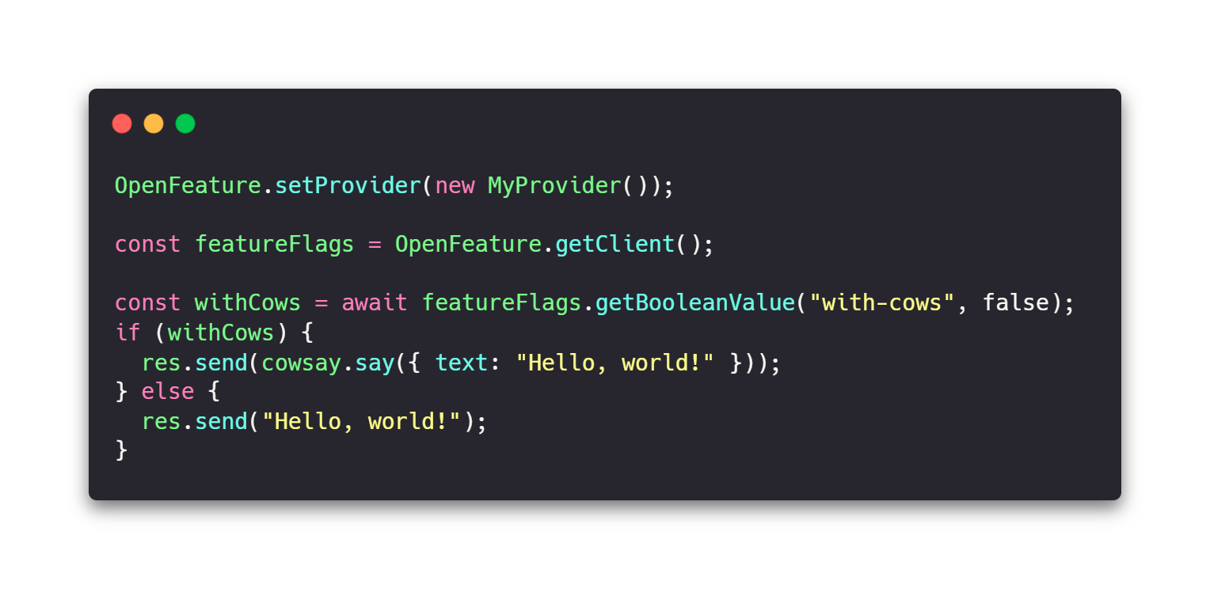
OpenFeature

Slide 16
What if you had a test environment?
With containers, it’s easy to test
In Kubernetes, deployments are defined through yaml manifests
Create a parallel deployment in a different namespace
Test your deployments on the same physical servers but separated from prod

