Slide 1
Cloud Native Mauritius
A Certified CNCF Community Group

Slide 2


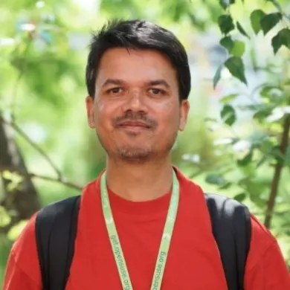
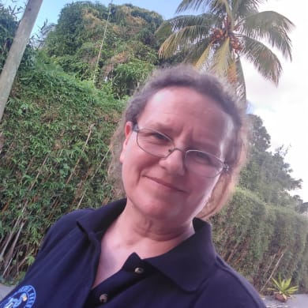
Organisers
- Alex Bissessur
- Kubernetes person @ LSL
- “I have co-organisers?”
- Arwin Neil
- Software Engineer @ Livestorm
- “I’m never in Mauritius”
- Ish Sookun
- Web Dev @ LSL
- “I make ugly websites”
- Delphine Bissessur
- Happily unemployed
- “I’m the responsible one”

Slide 3
What’s a CNCG
CNCG – Cloud Native Community Group
A fancy term for a community focused on Cloud Native technologies
Affiliated with the CNCF

Slide 4
What is a CNCF?
Cloud Native Computing Foundation
A branch of the Linux Foundation
An organisation providing structure to the new era of infrastructure
Provide a platform for cloud native projects to be developed and adopted

Slide 5
New Era of Infrastructure
Ish is an old-school Linux sysadmin.
Ish now does web development because traditional infrastructure is “meh”.
Ish has left production infrastructure to a 21 year old because he has realised he is obsolete.

Slide 6
New Era of Infrastructure
Nowadays we talk a different language
5+ nines of uptime
Scalability
Zero downtime
Agile deployment
Rolling Deployment
Move fast
EKS, GKE, AKS and a hundred platforms
We even created a new job title: DevOps

