Slide 1


Krafting a FOSS Cloud Platform
By Alex “not a developer” Bissessur

Slide 2



“I do fun things with
Kubernetes.”

Slide 3
What is Kraft?

Slide 4
What is Kraft?
A company which makes cheese.

Slide 5
DevCon 2024
I wanted to host a workshop on Kubernetes
Attendees bring laptops, tablets, phones.
OS varies from Windows, MacOS, Linux etc…
Workshops need a consistent environment
(or you spend more time troubleshooting)
The cloud is needed, but at what cost?

Slide 6
Rancher’s HobbyFarm
I used HobbyFarm at SUSE Day at KC
FOSS, and self-hostable
Deploys VMs to a CSP
Sets up lab environment
Gives users a shell in the website
Everything included, except CSP credits

Slide 7
Virtual Clusters
KinD – run Kubernetes in Docker, perfect for testing
Virtual clusters can be deployed to an existing K*s cluster
Existing options:
- VCluster, Loft Labs
- K3k, Rancher/SUSE

Slide 8
K3k and VCluster
Provision virtual clusters on a host
Virtual cluster lives in pods, with the API server exposed
Option to passthrough host resources, such as:
storageclass, ingressclass, configmaps
Virtual clusters are isolated across different namespaces

Slide 9
KRaft
Kraft is built on K3k
(also known as SUSE virtual clusters)
Ingress is handled by Traefik*
Storage by Longhorn*
K3k offers two main features:
- clusters
- virtualclusterpolicies

Slide 10
How is KRaft Made?
Kraft is split into ‘microservices’
Auth service for login, registration, pwd reset
Cluster service to provision clusters, expose the API, and retrieve kubeconfig file
Resource service to retrieve cluster metrics
Frontend of static website with Tailwind & Alpine
MariaDB

Slide 11
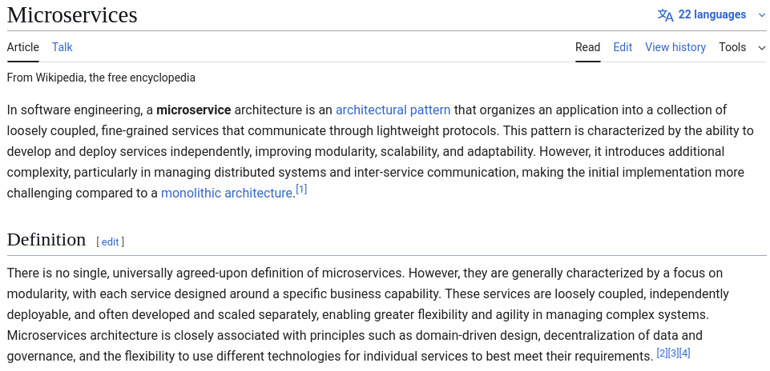

Slide 12
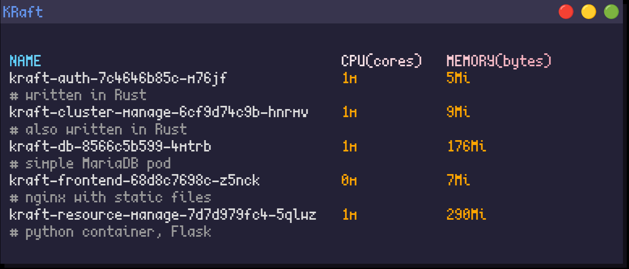

Slide 13
k3k-rs
Kube-rs is the crate for interacting with Kubernetes resources from Rust
Using K3k CRDs properly meant implementing them as Rust structs
K3k-rs is an offshoot project
- CRDs reimplemented
- Convenience fns to manage K3k-related resources

Slide 14
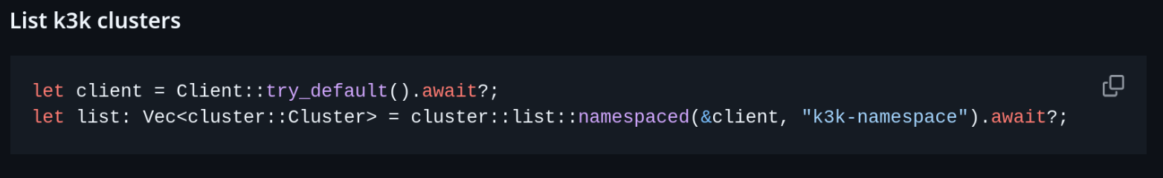

Slide 15
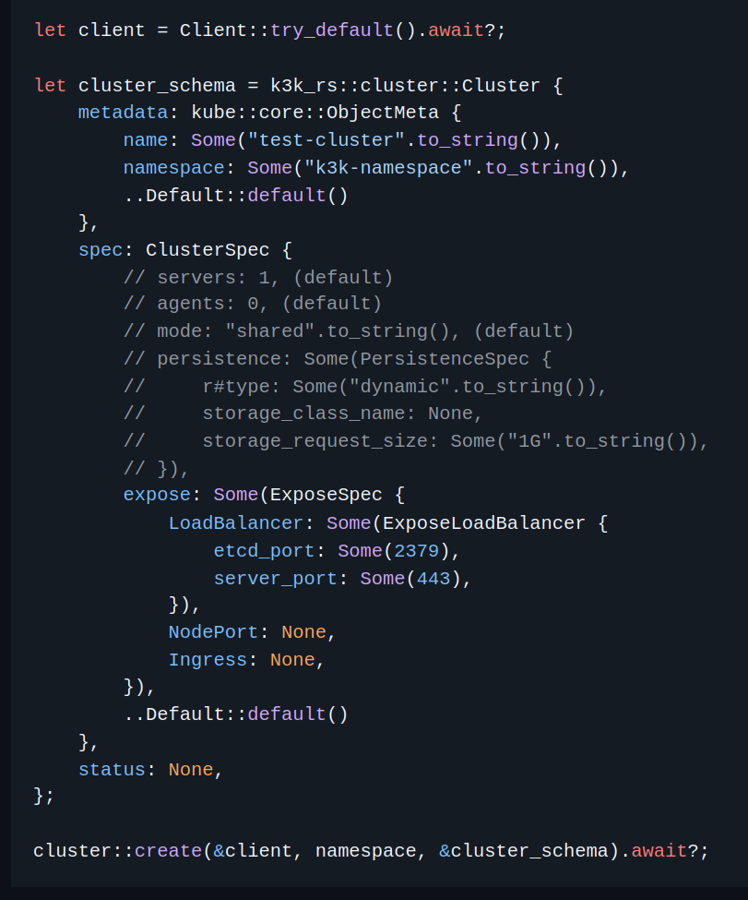

Slide 16
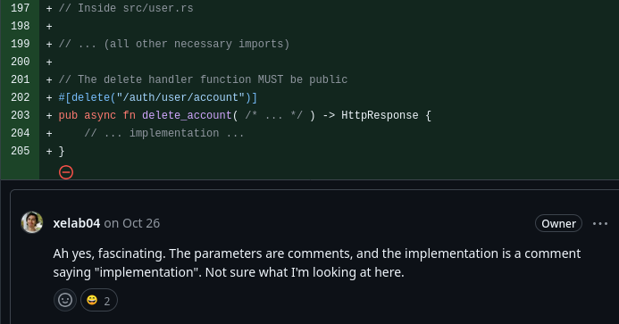
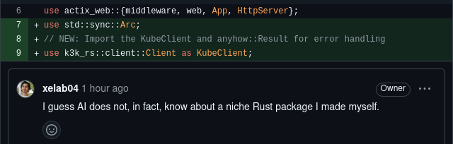
#hacktoberfest
#aislop

Slide 17
Keeping Workloads Safe
Users interact with only their virtual API
Clusters are separated by namespace
Each cluster has its own CoreDNS
Clusters are isolated through network policies
Security can be enhanced with VirtualClusterPolicies

Slide 18
VirtualClusterPolicies
VCPs provide more control over K3k clusters
Resource quotas
Default resource limits/requests
Allowed Mode
What resources to sync
PodSecurityAdmissionLevel
PriorityClass
Max resource limits/requests
Disabling network policy

Slide 19
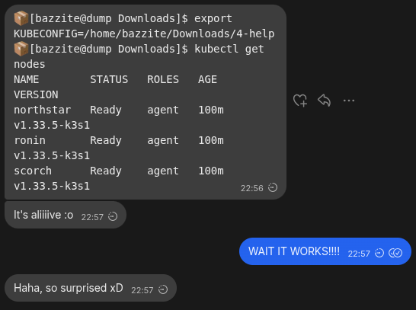
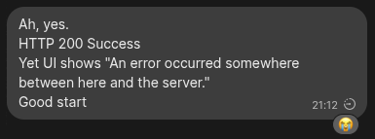
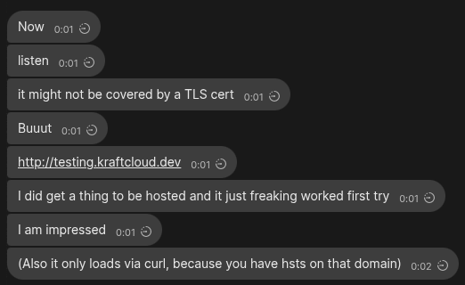

Slide 20
Work In Progress
Ingresses are across the cluster – can cause conflicts
Improvements needed on k3k-rs CRD structure
K3k does not run in restricted mode
Need to figure out backups
Portability with Helm charts to install anywhere

Slide 21
Demo Time

Slide 22

Thank You!
alexbissessur.dev
t.me/alexbissessur
moris.social/@AlexB

