Slide 1


meetup.mu the weekend project
By Alex Bissessur

Slide 2



“I do fun things with
Kubernetes.”

Slide 3
Agenda
What is meetup.mu
Development of meetup.mu
How I scrape your community
Deployment of meetup.mu
CI/CD of meetup.mu

Slide 4
What is Meetup.mu
Initially an aggregator for all tech meetups.
Born from clashing with frontendmu for the 100th time
Now an alternative to meetup.com
Organisers can create events directly on meetup.mu and attendees can RSVP directly

Slide 5
The Meetup.mu project
PHP + Laravel project with TailwindCSS
- the same setup as projects at LSL
Deployed through a FrankenPHP Dockerfile
Contributed to by around 5 people from different community groups.
Hosted on my homelab, running on Kubernetes.

Slide 6
Show: Dockerfile

Slide 7
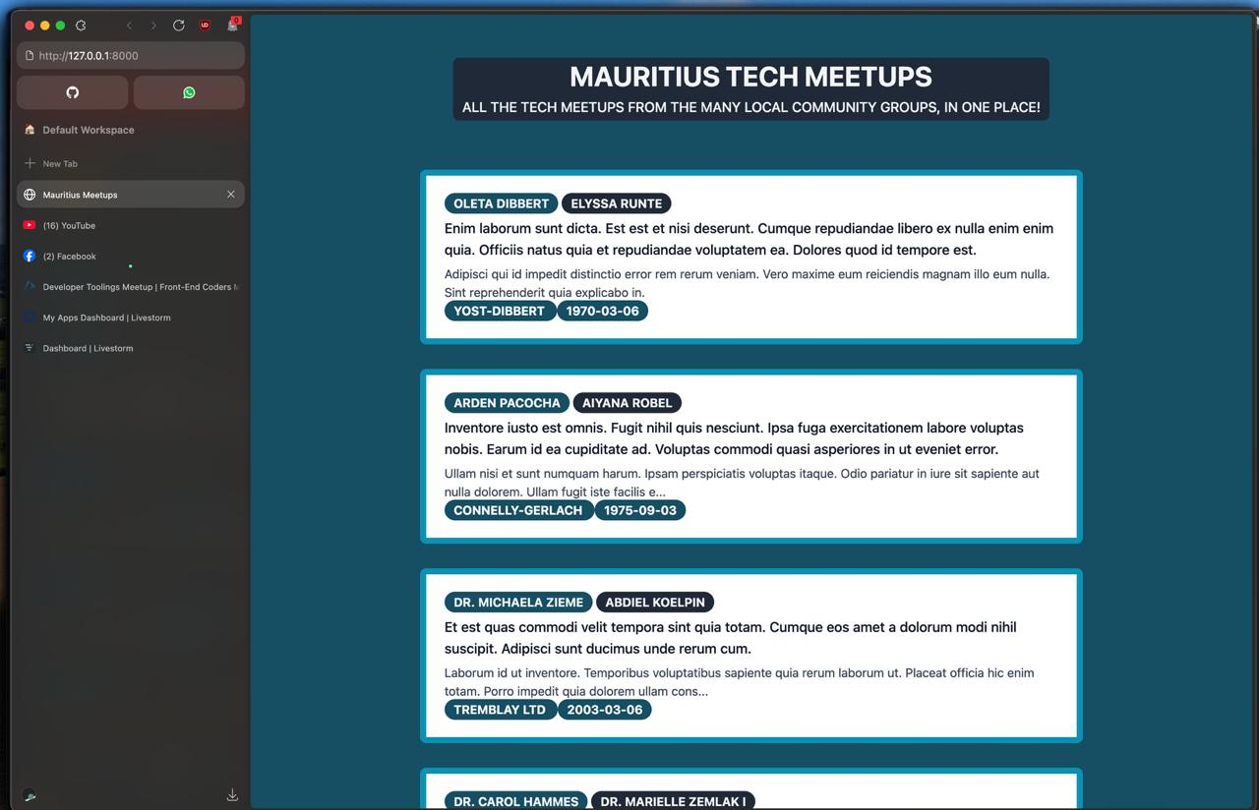

Slide 8
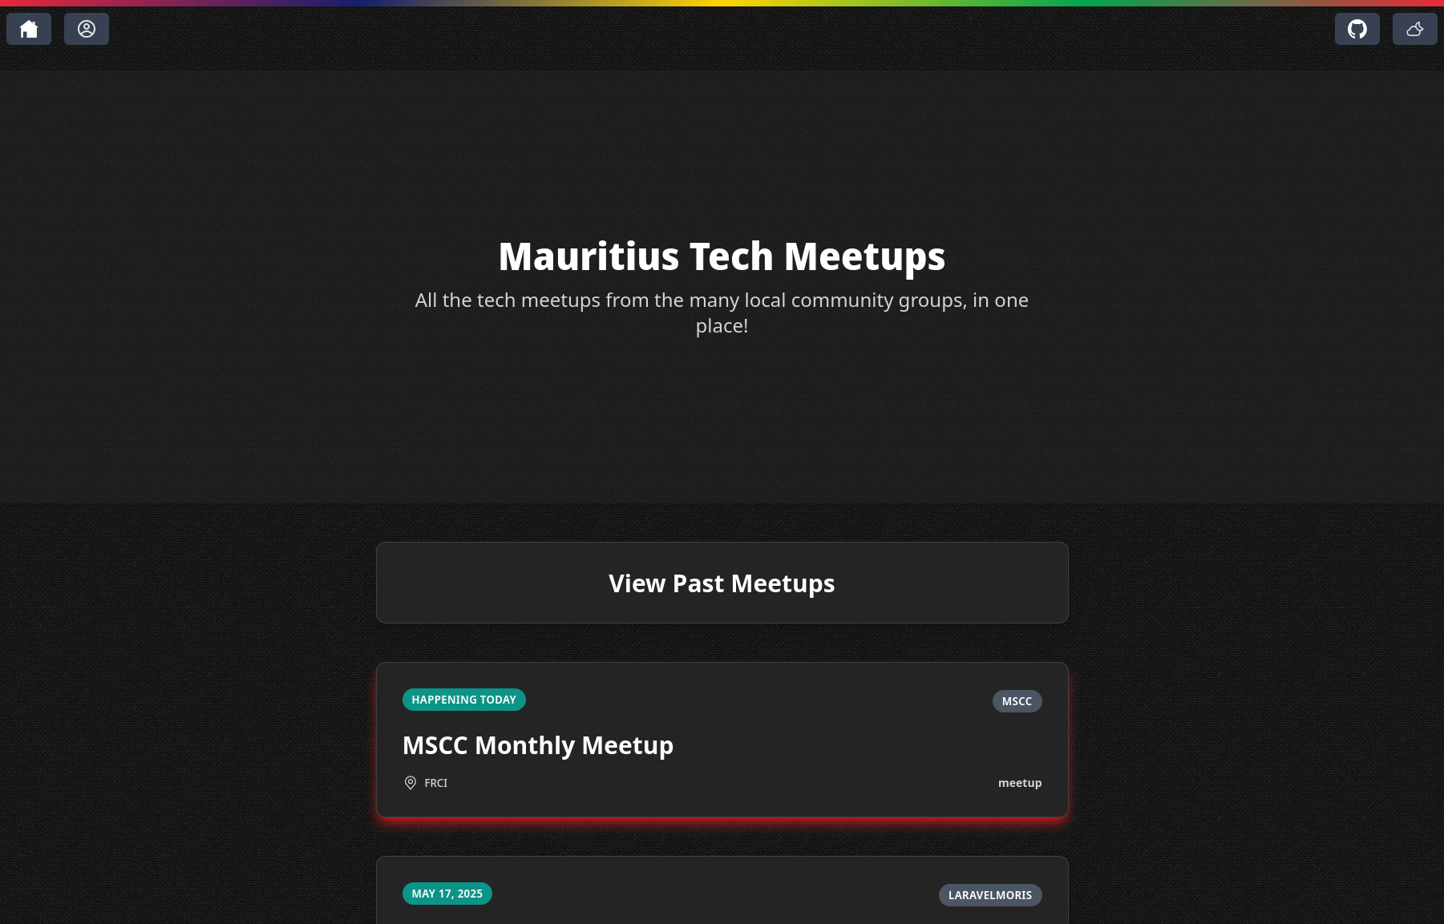

Slide 9
Scraping Community Groups and my hate for meetup.com
Frontend.mu has open data on github for all their meetups.
I added an API to Cloud Native MU’s website
MSCC, PYMUG, Laravel Moris, NUGM are on meetup.com (which doesn’t like open data)

Slide 10
Show: FrontendMU & CNMU data

Slide 11
Scraping Community Groups Meetup.com
Meetup.com provides an ical file to import into your calendar
Python script to download and parse ical
Extract data and send to database

Slide 12
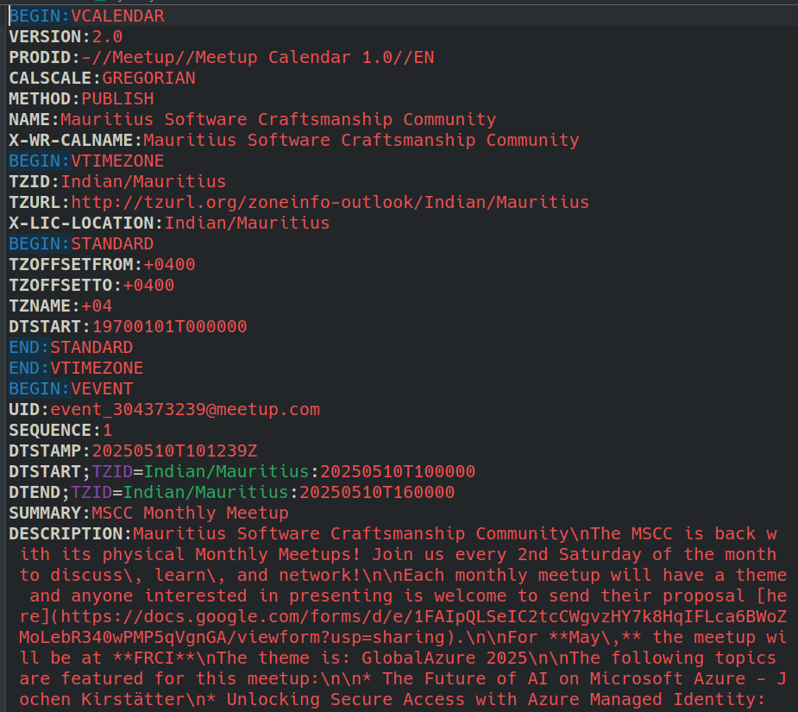
The ical file holds all (?) the information I need.
Date
Registration URL

Slide 13
The ical file holds all (?) the information I need.
Date
Registration URL
…?
MISSING SOMETHING

Slide 14
Finding the Location
Location is not present in the ical file
I am too lazy to somehow parse the description
Instead, ask my digital slave (AI)
Introducing: hosting ollama on Kubernetes
- helm chart provided for easy install
- feed description into AI and get the location back

Slide 15
What’s Helm?
Helm is a “package manager” for Kubernetes
Contains templates for your deployment
Contains all components under one “parcel”
- service, deployment, etc etc
Used to easily distribute applications
Ollama has a helm “package” to easily deploy AI models

Slide 16
Deploying Meetup.mu
Run on Kubernetes on my homelab
Components:
- Deployment – main pods for the Laravel app
- Services – expose app and does networking
- PVCs – provides persistent storage for app/db
- Configmap – for configuration, like .env
- Secret – sensitive configuration, like db creds
Applications:
- Laravel app
- Database
- Redis

Slide 17
Show: meetup.mu manifests

Slide 18
Deploying Meetup.mu
Manifests are usually deployed deployed with
kubectl apply -f *
Manifests on GitHub – you can run meetup.mu yourself
Manifests can also be deployed with ArgoCD

Slide 19
ArgoCD
The principle of GitOps – Git is your source of truth
Other *Ops – ClickOps & ManualOps
Allows 100% reproducible infrastructure
No more changes through “kubectl apply -f”
- everything through Git then synced

Slide 20
Show: ArgoCD UI

Slide 21
Deploying Meetup.mu
Meetup.mu exists as a Container Image
Container image deployed in pods as part of a deployment
Every update to meetup.mu:
- build and push new version
- update version in Kubernetes manifests
I hate manual labour

Slide 22
Github Actions for CI
On merge/push to main, trigger GH action
Action checks version number from version.txt
Build image with proper tag
Push image to my Docker registry
ArgoCD notices the change in version, deploys a new replicaset with 0 downtime

Slide 23
Show: make change to meetup.mu

Slide 24

Thank You!
alexbissessur.dev
t.me/alexbissessur
moris.social/@AlexB

