Slide 1


Owning Your Data
- by the guy who always talks about kubernetes

Slide 2


Who Am I?
“I do fun things with
Kubernetes.”
Kubernetes and Cloud Native enthusiast
Organiser of Cloud Native Mauritius
I do Kubernetes stuff at La Sentinelle
I like Python, Rust, and Linux
I have a small rack where I play with Kubernetes

Slide 3
Where I’m Coming From
I use Linux all the time
I use computers I built or I can change
I self host many services
I use phones I can look into (sorry Apple)
And I spend too long on social media

Slide 4
AI: Blessing or Curse?
AI is everywhere, in your car, in your phone, in your IDE
The entire industry is negative $600 billion annually
Projected revenue of $126 bn by next year

Slide 5
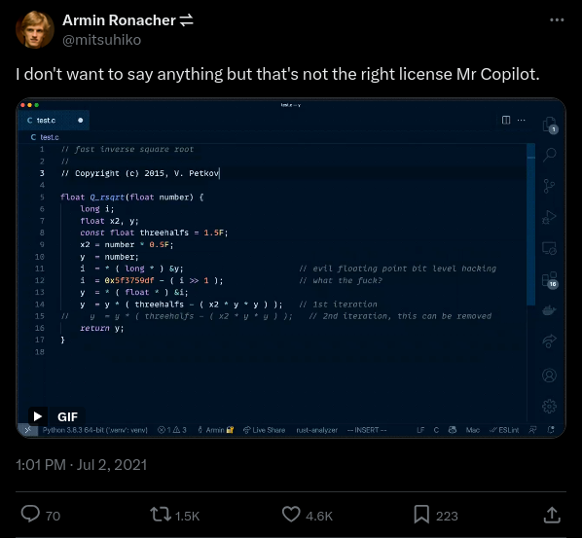

Slide 6
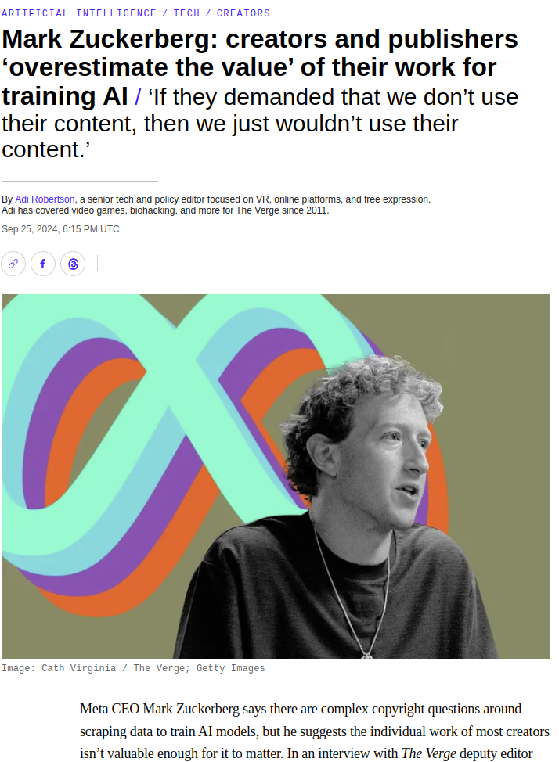
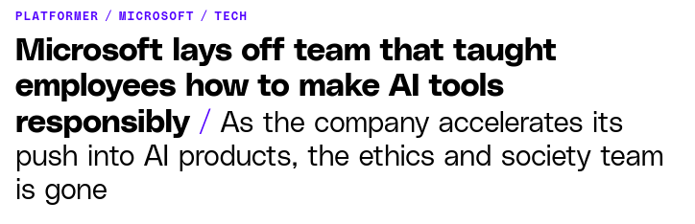
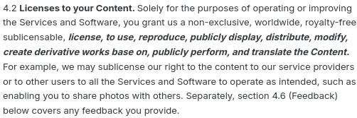

Slide 7
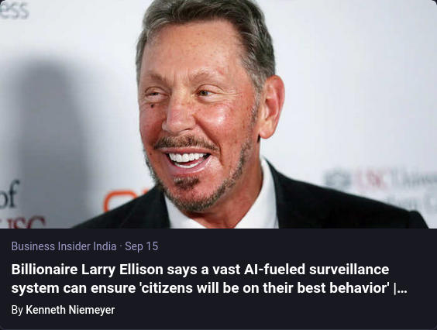
1984
Was
Supposed
To Be
Fiction
Not An
Instruction
Manual

Slide 8
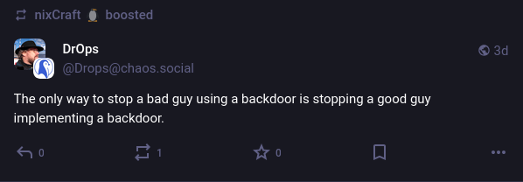
Intrusive Tech
Home
Automation
IoT
Wearables

Slide 9
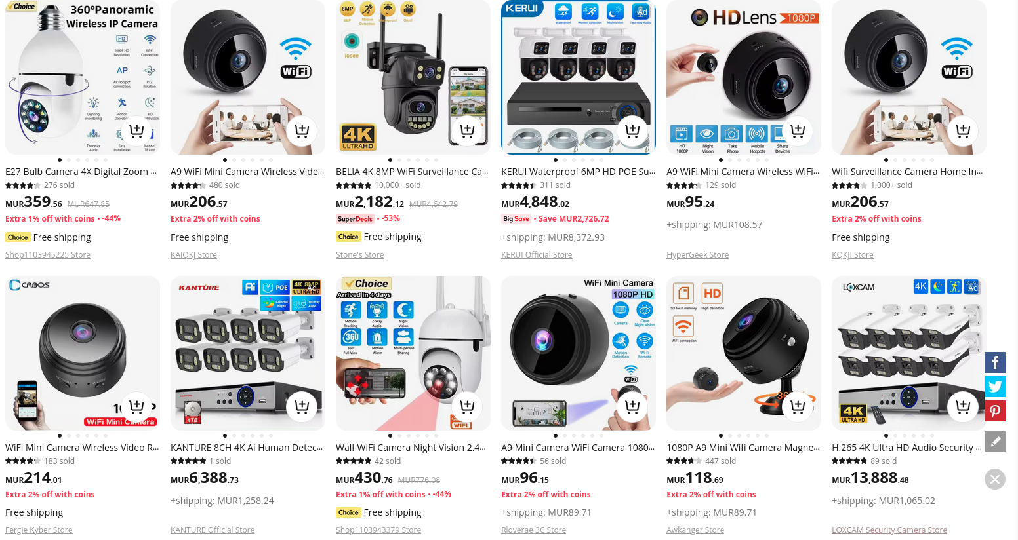
I’m watching you

Slide 10
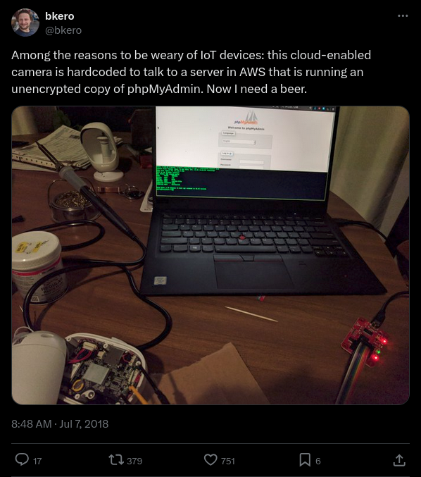
- IoT devices may have hard coded passwords
- May phone home
- May not even use https
- Likely introduce security risks into your network

Slide 11
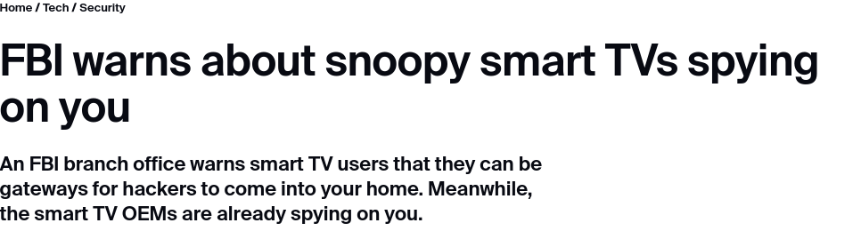
Even the FBI is Concerned

Slide 12
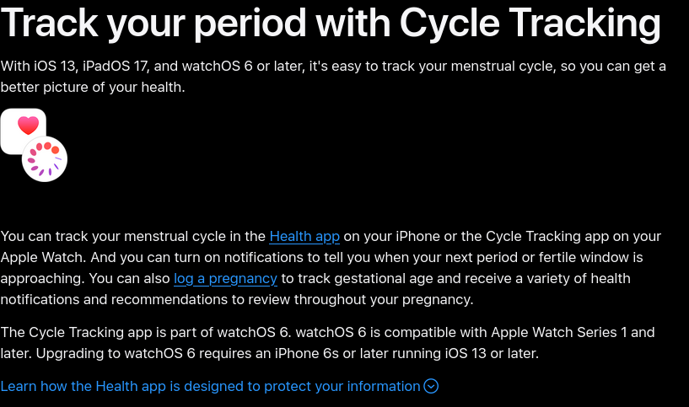
Wearables are Cool, Right?

Slide 13
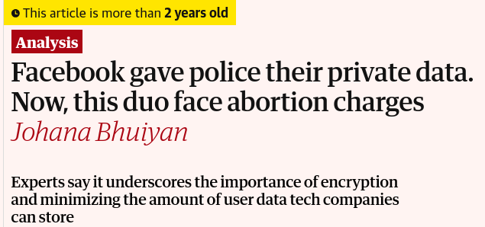
Wearables are Cool, Right?

Slide 14
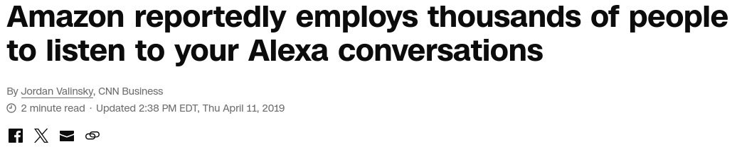
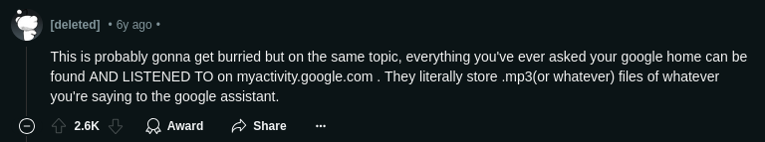

The report said Amazon doesn’t “explicitly” tell Alexa users that it employs people to listen to the recordings. Amazon said in its frequently asked question section that it uses “requests to Alexa to train our speech recognition and natural language understanding systems.”
People can opt out of Amazon using their voice recordings to improve the software in the privacy settings section of the Alexa app.

Slide 15
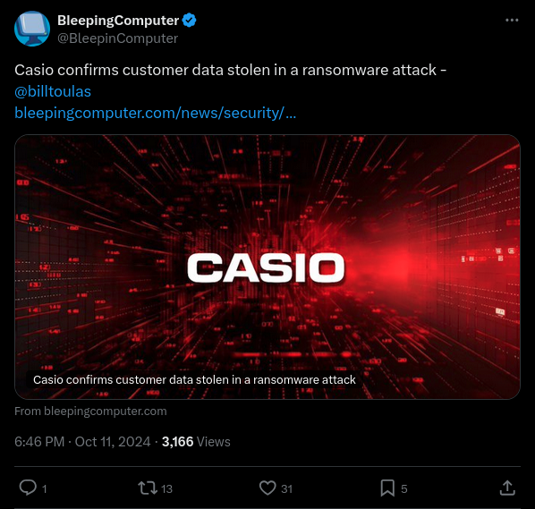
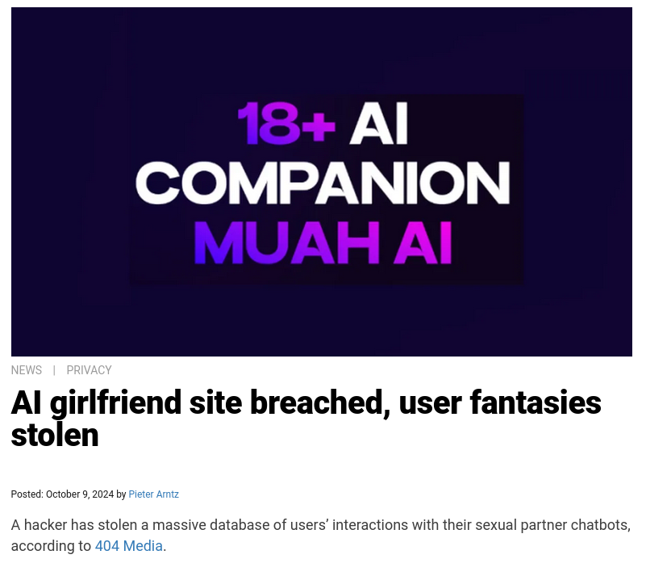
The Notiorious Hacker

Slide 16
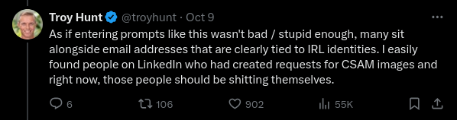

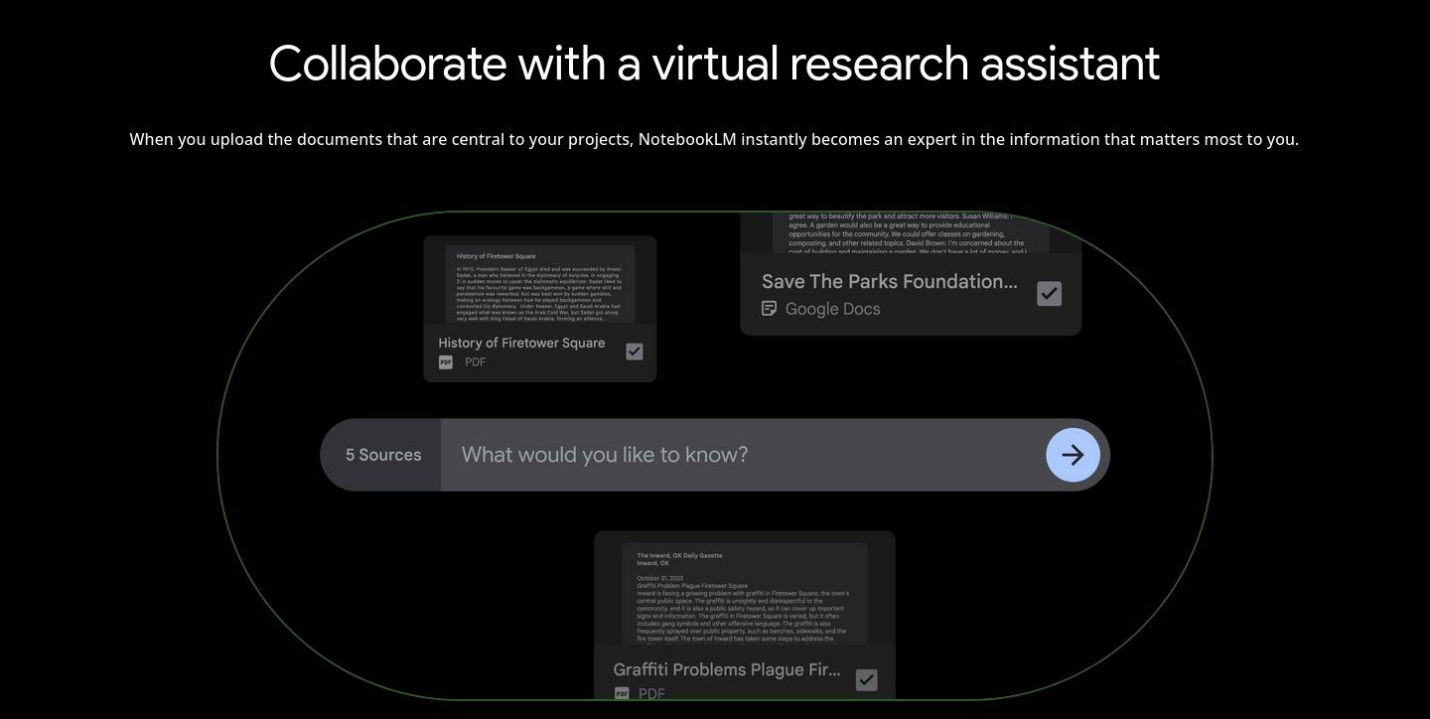

Slide 17
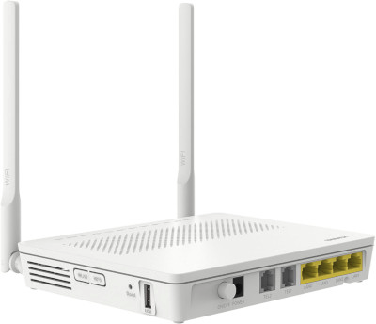
My Router Too???
Who has access?
Did you change your
defaults?
What does this entail?
And why does it restart
on its own?
And did you know it runs Linux 3.10 (2013)

Slide 18
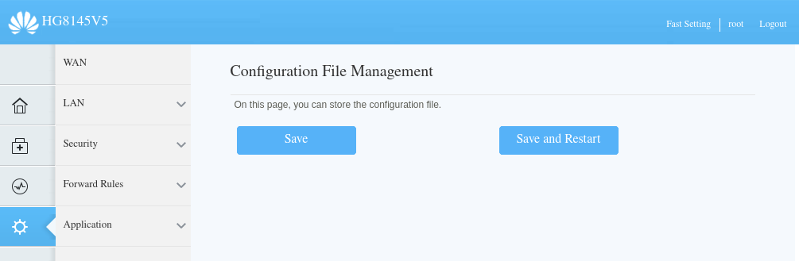
I can’t see my config file…?

Slide 19
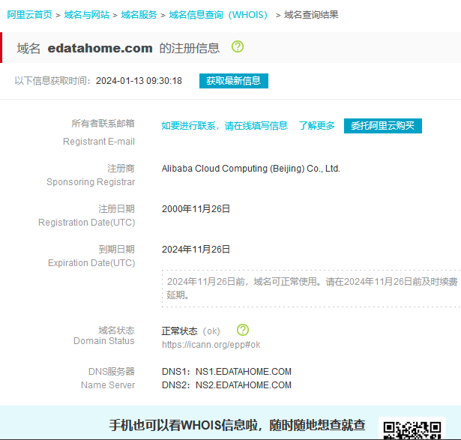
And where is my traffic going?
yjyx.gd.edatahome.com
- found in router config
- default: off

Slide 20
Windows Telemetry
Not free as in freedom or beer. Free as in roofied beer.
Windows scanning devices on LAN
Preventing MS account bypass on Win10

Slide 21
Microsoft uses the data we collect to provide you rich, interactive experiences. In particular, we use data to:
- Provide our products, which includes updating, securing, and troubleshooting, as well as providing support. It also includes sharing data, when it is required to provide the service or carry out the transactions you request.
- Improve and develop our products.
- Personalize our products and make recommendations.
- Advertise and market to you, which includes sending promotional communications, targeting advertising, and presenting you relevant offers.
We also use the data to operate our business, which includes analyzing our performance, meeting our legal obligations, developing our workforce, and doing research

Slide 22
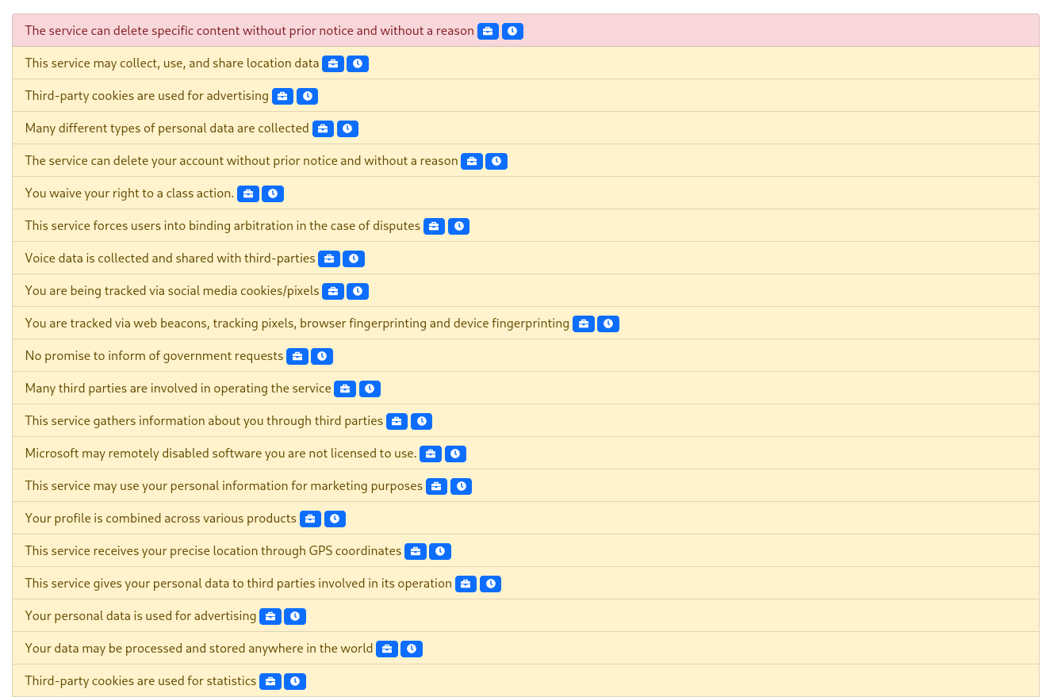

Slide 23
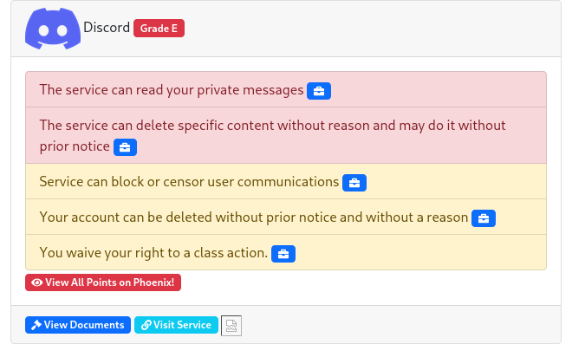
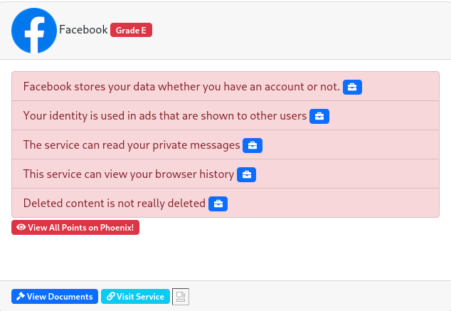
Honorable Mentions

Slide 24
How To Become Free
Use tech you can trust
Have a look at open alternatives to software you use
Photoshop → Gimp/Krita
Apple → Android → LineageOS/GrapheneOS
Closed Source Router Firmware → OpenWRT
Self host applications
Bonus point, it’s fun too
(just backup your data lol)

