Slide 1


Open
Source
Hacking
By Alex Bissessur

Slide 2



Kubernetes & Cloud Native enthusiast
Organiser of Cloud Native Mauritius
Kubernetes Person™️ at La Sentinelle
Python & Rust “dev”
Linux and FOSS enthusiast
(maybe too enthusiastic)
Most interesting thing about me?
> My homelab
“I do fun things with
Kubernetes.”
A Wild ALEX
Appeared!

Slide 3

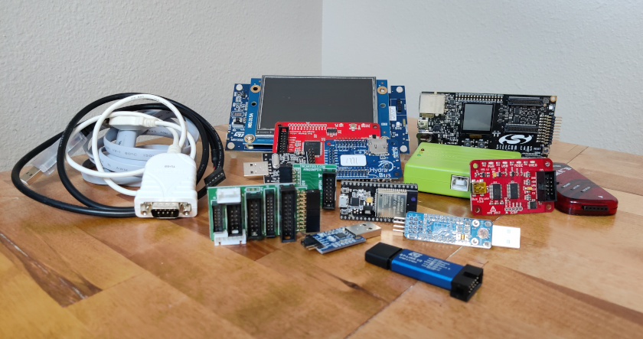

Slide 4


Slide 5
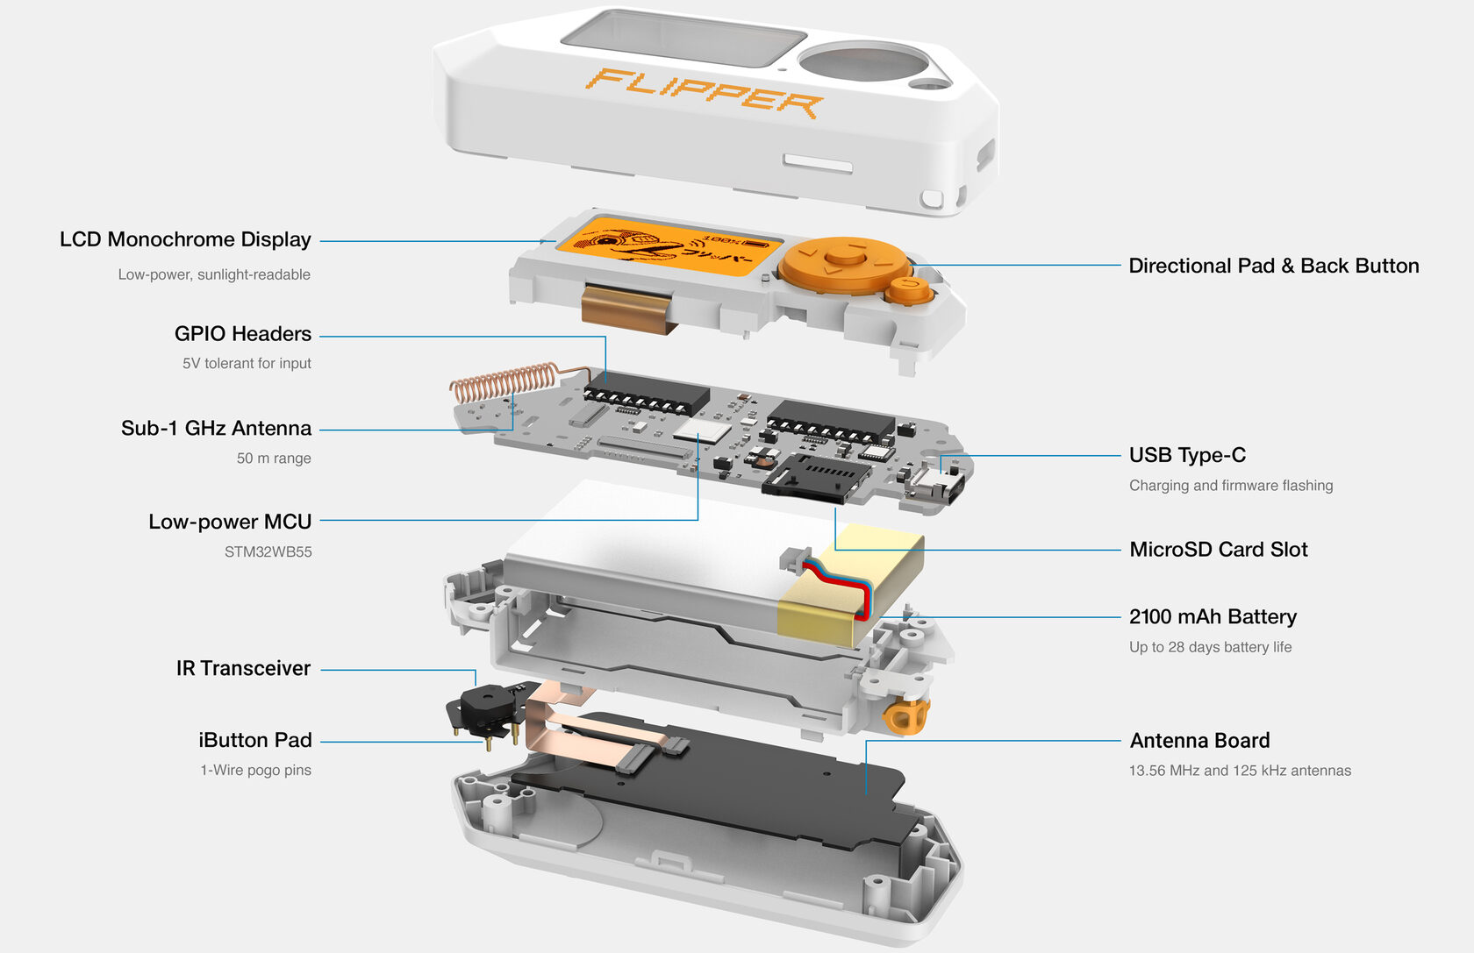

Slide 6
What Can It Do?
Spoof networks
Clone NFC cards
IR cloning
Sub-GHz capture
Bluetooth spam
Exploit vulnerabilities

Slide 7


Slide 8
“We are banning the importation, sale and use of consumer hacking devices, like flippers, used to commit these crimes.” – some 3 letter agency

Slide 9
Question time!
How well does your Org/HW/SW hold up against a Flipper Zero
Are you at risk to a kid with $200?

Slide 10
You’re Kinda Safe
Flipper Zero costs $200
Flipper Zero does not ship to MU
Flipper Zero will probably get blocked by customs.
Right?

Slide 11
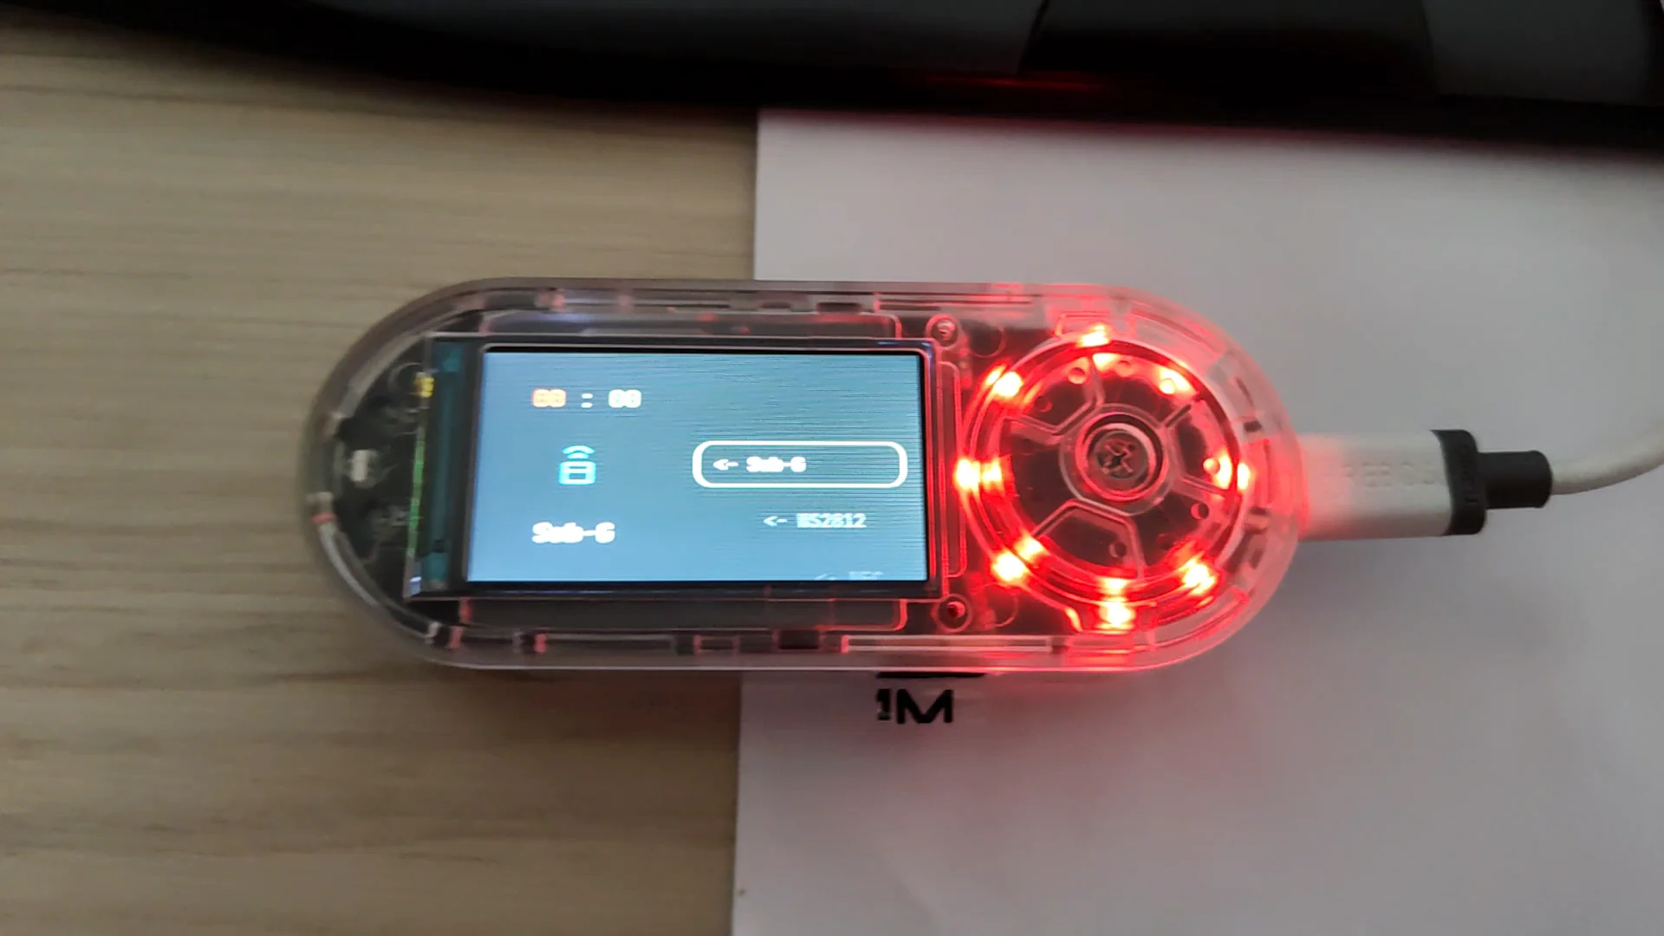

Slide 12
Open Source F0 Alternative
Introducing the Capibara Zero
Open Hardware/Source F0 alternative
Multiple firmware choices
Off the shelf components
$60

Slide 13
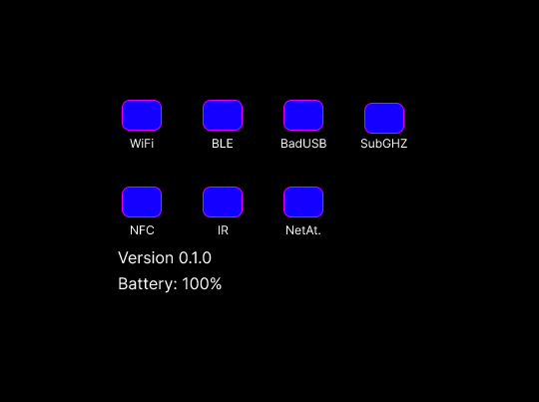
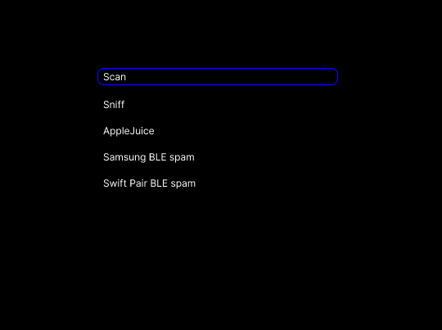
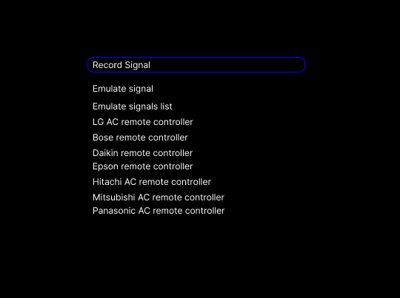
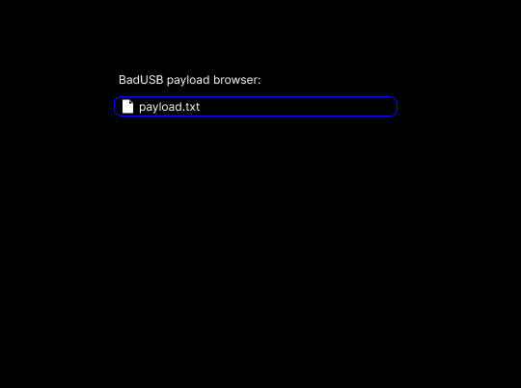

Slide 14
Thank You!
alexbissessur.dev
t.me/alexbissessur
moris.social/@AlexB

