Slide 1
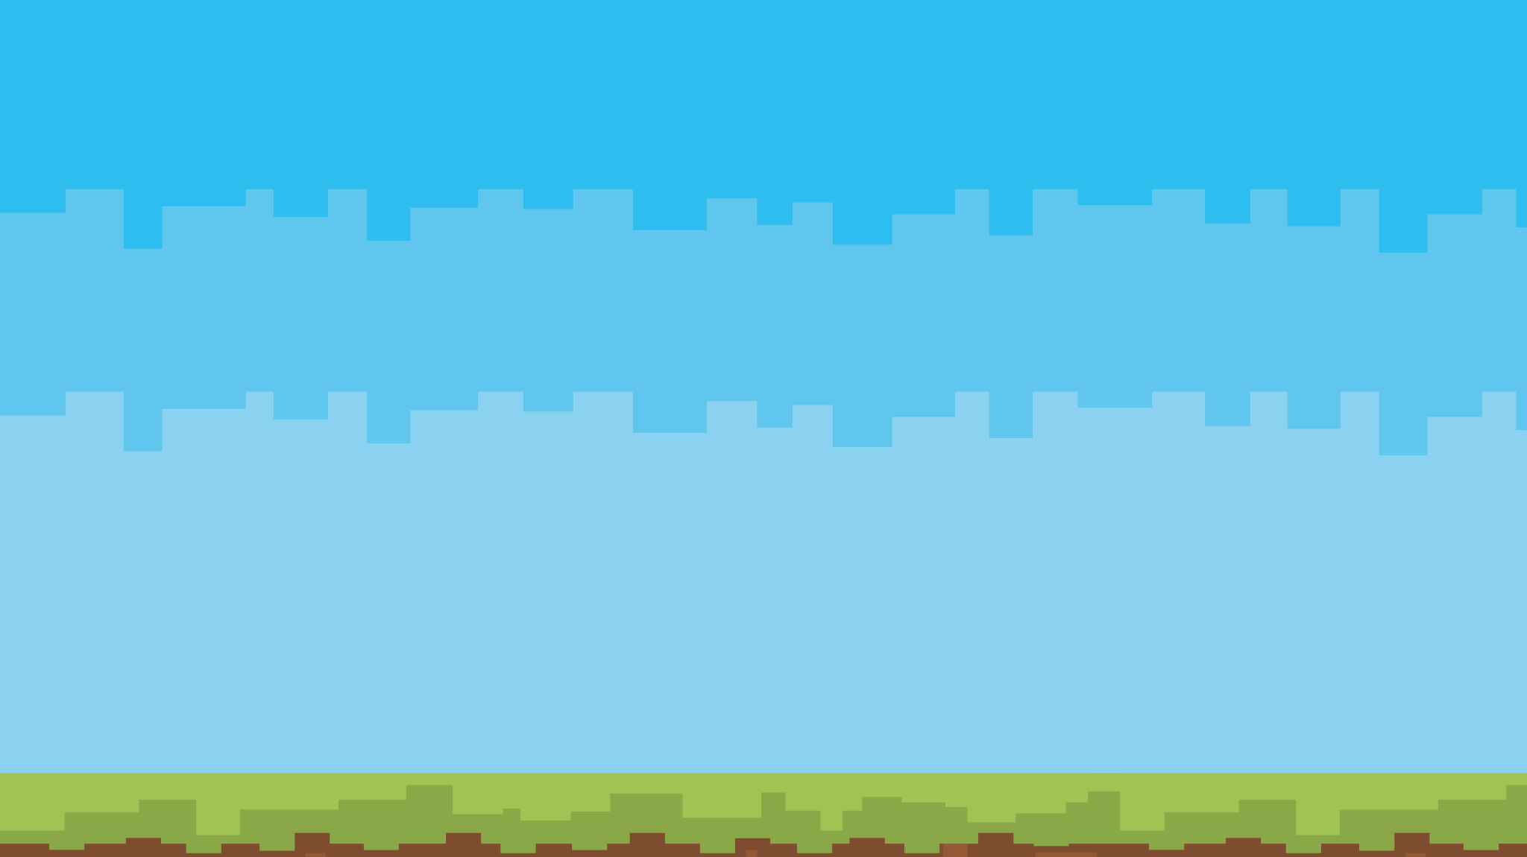
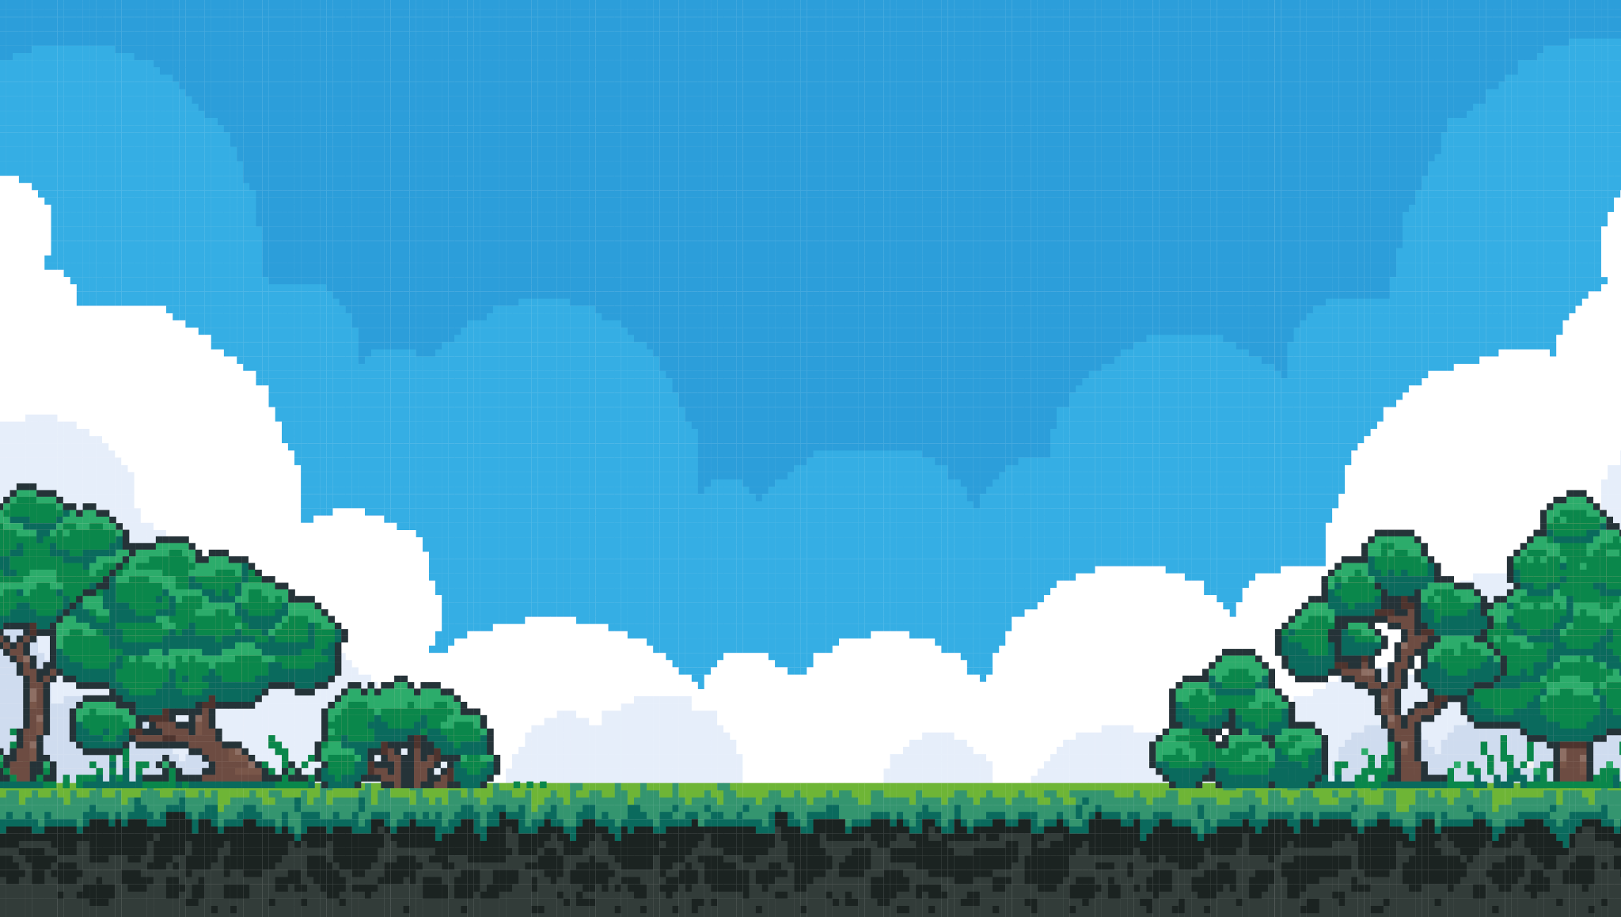
Krafting the Cloud
Building a Free, Open, and Accessible Cloud
By Alex Bissessur

Slide 2



“I do fun things with
Kubernetes.”

Slide 3
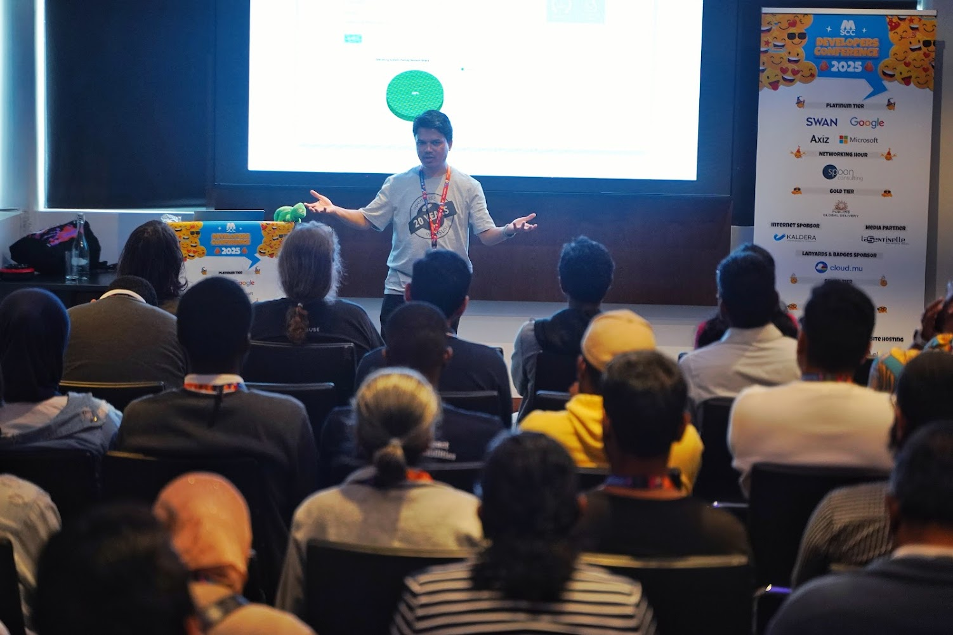

Slide 4
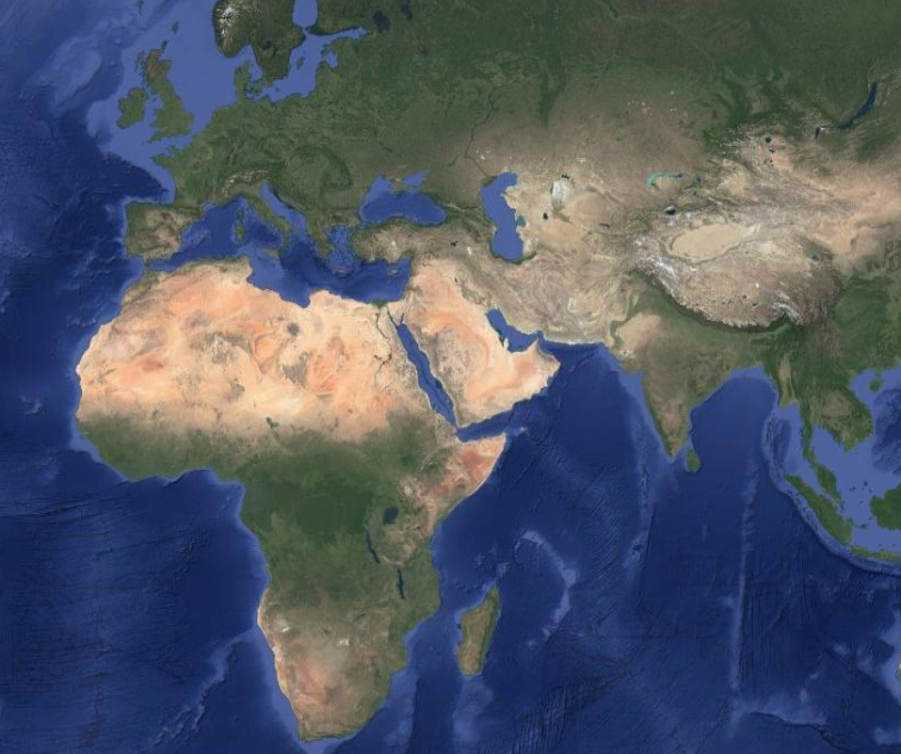


Slide 5
Placeholder for my Kubernetes workshop at DevCon 2024

Slide 6
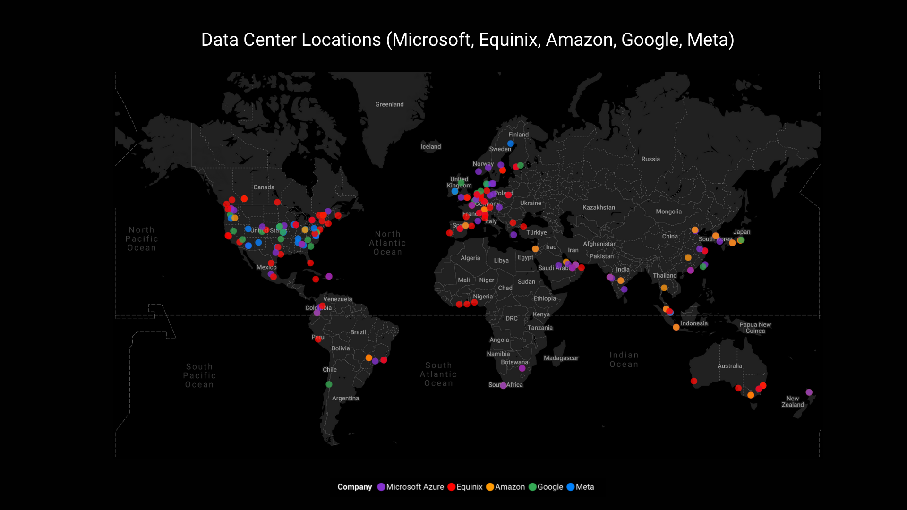


Slide 7
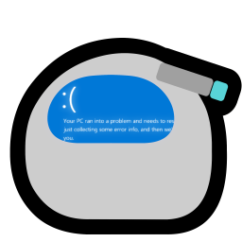

How do we build a cloud?

Slide 8
CSP requirements
Isolation – different users must stay separate and unable to interact
Cloud – it must run on someone else’s computer
Self-managed – I do not provision VMs manually

Slide 9
Virtual Clusters
KinD – run Kubernetes in Docker, perfect for testing
Virtual clusters can be deployed to an existing K*s cluster – Kubernetes in Kubernetes
Existing options:
- VCluster, Loft Labs
- K3k, Rancher/SUSE

Slide 10
K3k and VCluster
Provision virtual clusters on a host
Virtual cluster lives in pods, with the API server exposed
Option to passthrough host resources, such as:
storageclass, ingressclass, configmaps, secrets
Virtual clusters are isolated across different namespaces

Slide 11
KRaft
Pronunciation: /krɑːft/
Origin:
- K for Kubernetes
- Raft, compared to the Kubernetes ship
- Craft, for building and creating
Built with:
- K3k
- Longhorn
- Traefik

Slide 12
How is KRaft Made?
Kraft is split into ‘microservices’
Auth service for login, registration, pwd reset
Cluster service to provision clusters, expose the API, and retrieve kubeconfig file
Resource service to retrieve cluster metrics
Frontend of static website with Tailwind & Alpine
MariaDB

Slide 13
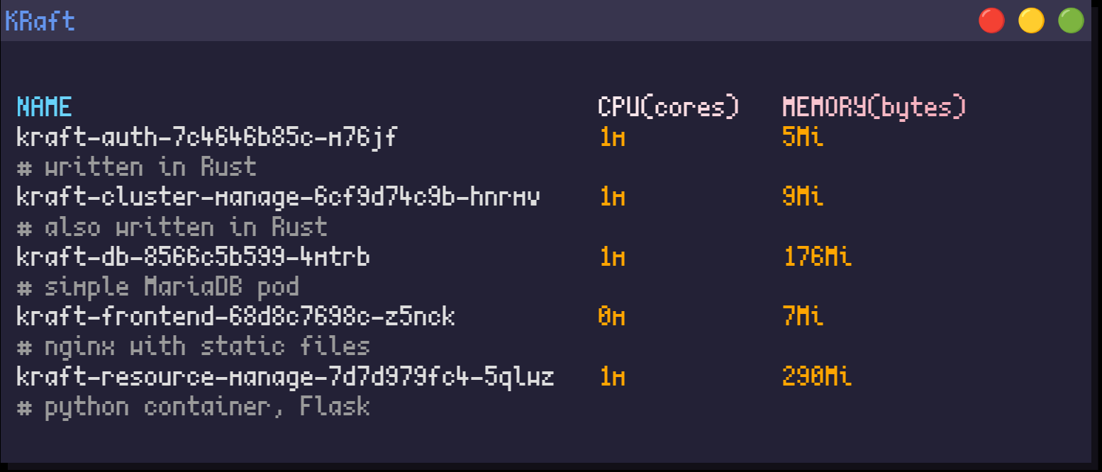

Slide 14
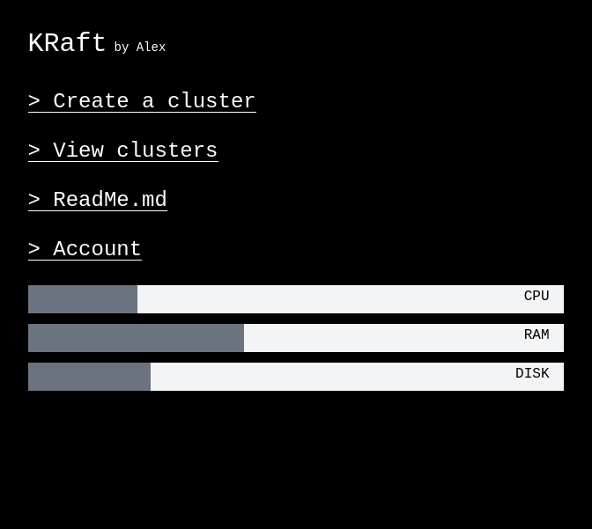

Slide 15
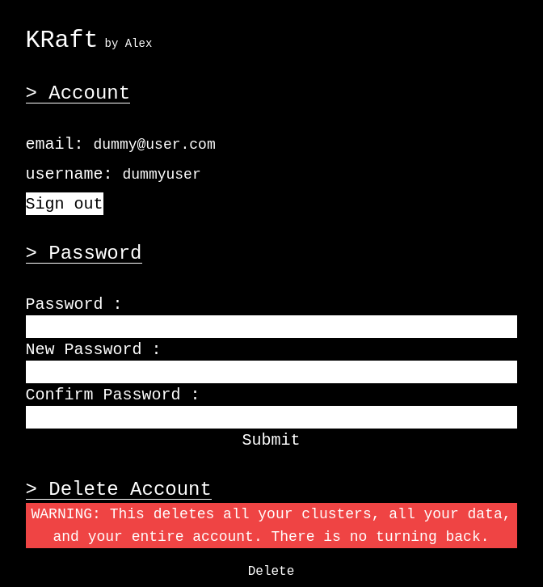

Slide 16
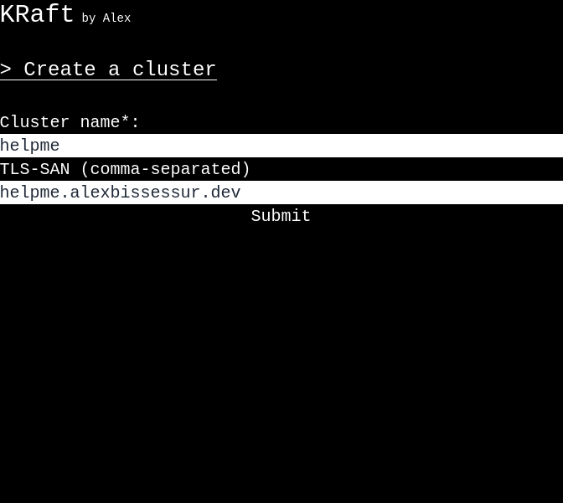

Slide 17
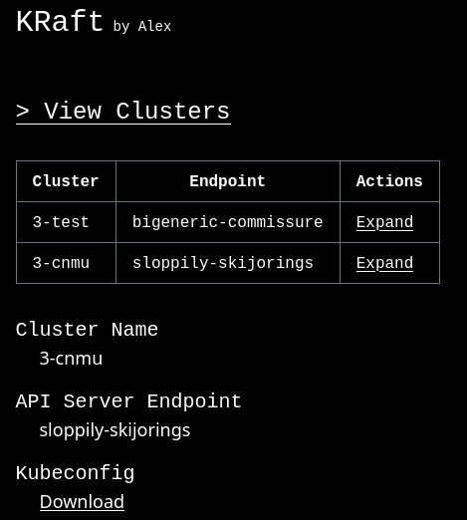

Slide 18
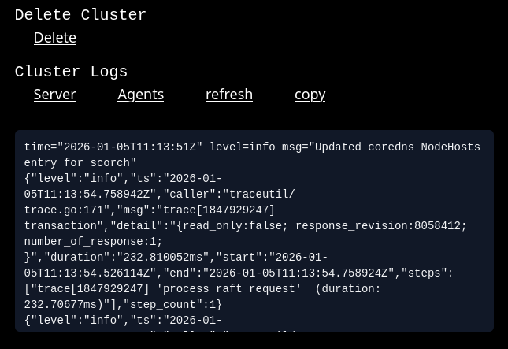

Slide 19
k3k-rs
Kube-rs is the crate for interacting with Kubernetes resources from Rust
Using K3k CRDs properly meant implementing them as Rust structs
K3k-rs is an offshoot project
- CRDs reimplemented
- Convenience fns to manage K3k-related resources

Slide 20
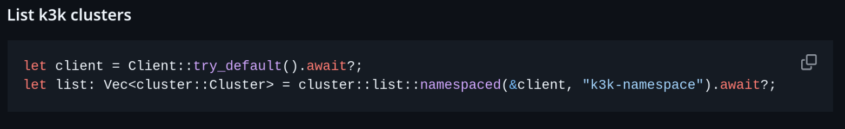

Slide 21
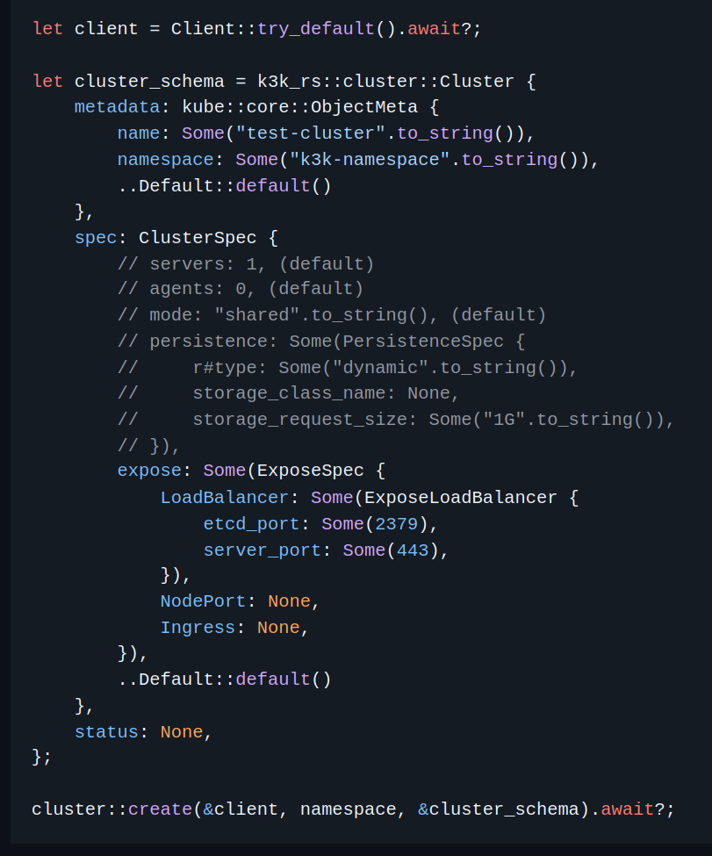

Slide 22

Keeping Workloads Safe
Users interact with only their virtual API
Clusters are
- separated by namespace
- isolated through network policies
- secured with pod security admission level
Each cluster has its own CoreDNS

Slide 23
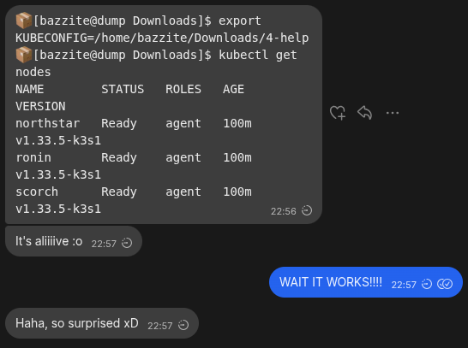
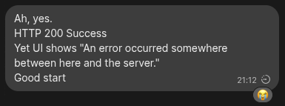

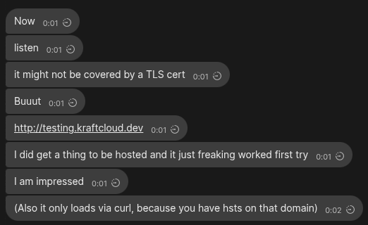


Slide 24

Work In Progress
Ingresses are across the cluster – can cause conflicts
Improvements needed on k3k-rs CRD structure
K3k does not run in restricted mode
Need to figure out backups
Portability with Helm charts to install anywhere

Slide 25

Thank You!
# to be replaced by a webpage for a list of socials

