Slide 1
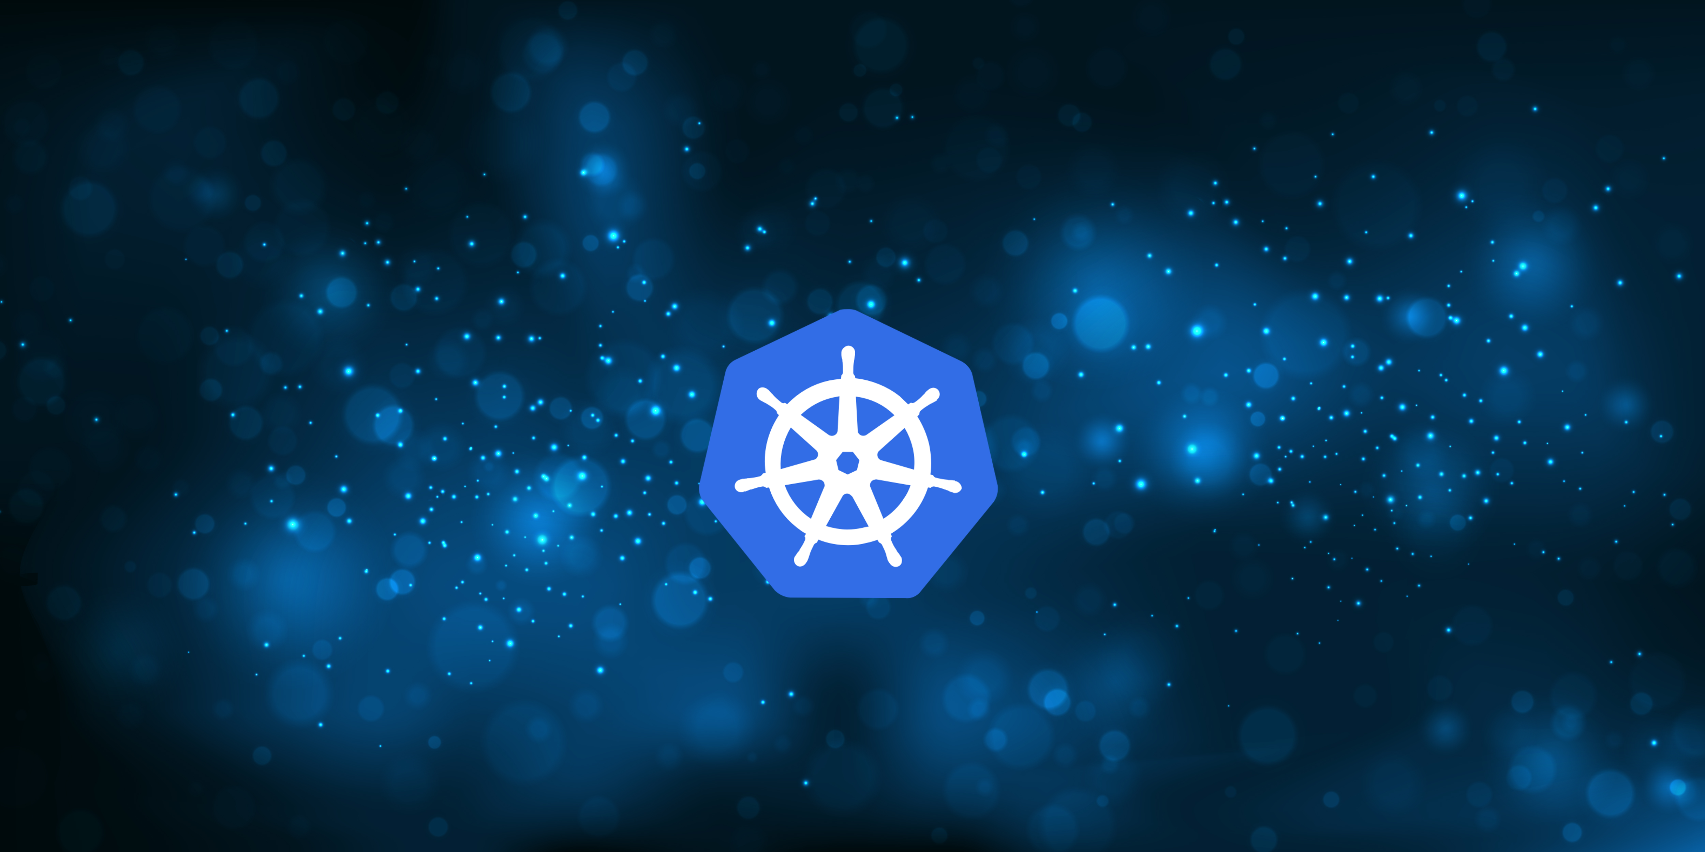
An Intro to Containers
By Alex Bissessur

Slide 2

History of Containers
chroot originated with Bill Joy in BSD in 1982
- lets you create a directory to virtualise the file system
- merged while drinking, or smoking, or both
chroot developed into Jails for BSD
- still in use today
Jails was targeted at running binaries in an isolated environment
- no access to main filesystem
- no ability to make changes to host OS

Slide 3
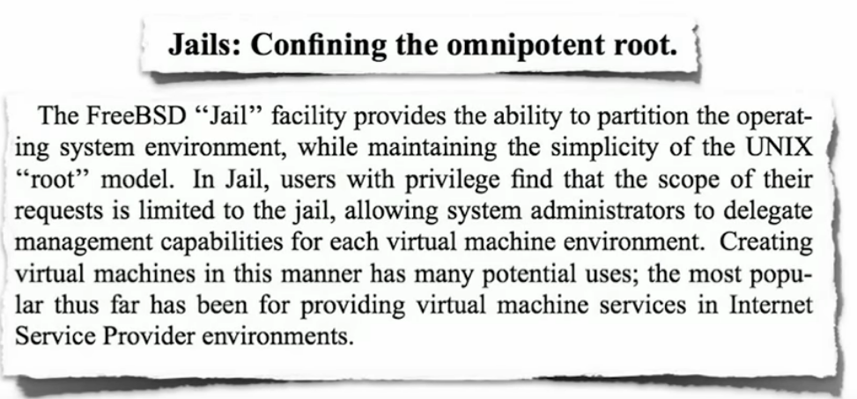
BSD’s Jail

Slide 4
Sun’s Zones
Focus shifted to OS virtualisation
Built to run more complex applications in isolated environments
Consolidating apps to a single Big Boy (Sun wanted to sell servers)
Again, protects host OS from the applications, and provides abstraction layers for security

Slide 5
Core OS-based Virtualisation Principles
Security
Isolation
Virtualisation
Granularity
Transparency
NOT
To run foreign binaries
Emulate other OS
To consolidate stacks

Slide 6
Virtual Machines
Before VM OS, there were individual machines for isolation
Virtual Machines are heavy
Every VM needs the kernel to be emulated
10 Vms => 10 kernels
Operating systems don’t do nothing
Leads to expensive resource bloat

Slide 7
The Hypervisor
Is an OS fast?
Yes.
Is an OS on an OS fast?
No.
Running VMs is expensive.
VMs today are the embodiment of paranoia.

Slide 8
Containers Today
Docker is the leading containerisation standard
RedHat has Podman because RedHat is different™️
An encoding of deployment procedures in images
https://github.com/cloud-native-mauritius/cloudnativemauritius.com/
Images are reproducible and portable between machines (and OS-es)
The developer becomes the operator.

Slide 9
Containers Today
Containers sit on top of the kernel
VMs virtualise hardware. Containers virtualise the OS
- Containerise applications, not the OS
Licensed and secure with SUSE/RedHat tooling
Simplicity is best

Slide 10
Questions or Comments?

Slide 11
The Development Process @ SWAN
I write a .NET application
I build it for prod and wait 2 minutes
Go to the folder, manually edit a config file to make the app run on IIS
Virtual Desktop to the server
Copy my files over in the kbps speeds
(re)Start the service

Slide 12
And it doesn’t work.

Slide 13
The Development Process @ SWAN
Write application in Python
Hans clones project & tries to run it. Fails.
Install/update dependencies
Conflicting dependencies for different programs
Inconsistencies between my laptop & Linux server

Slide 14
And the deadline’s approaching.

Slide 15
How Containers Help
Uniform development environment
Dependency and package conflicts avoided
Security risks do not spread to other applications
Easier control over environment your apps run in

Slide 16
How Containers Help
Containers use the host kernel
Less wasted resources
No 2nd OS (hypervisor) to run
Integration with CI/CD pipelines
Prevent over-provisioning of resources
Facilitates microservices architecture
Opens the door to Kubernetes & Cloud

Slide 17
Downside of Containers
Containers are Linux-centric (sorry Windows)
Containers are not forcibly secure
- Your applications and packages must be kept up-to-date
- Containers are not entirely isolated – on Linux they are just another process

Slide 18
Questions and Demo

