Slide 1
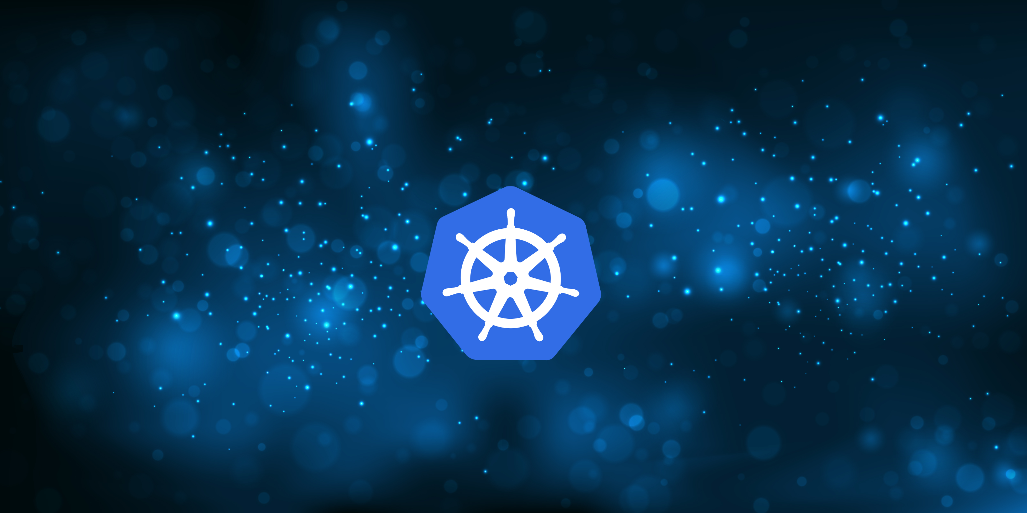
An Intro to Kubernetes
By Alex Bissessur

Slide 2
Recap of Containers
Originates from BSD with chroot, later Jails
Project created by a madman on drugs
Jails was used to run binaries in an isolated environment
- no access to main filesystem
- no ability to make changes to host OS

Slide 3
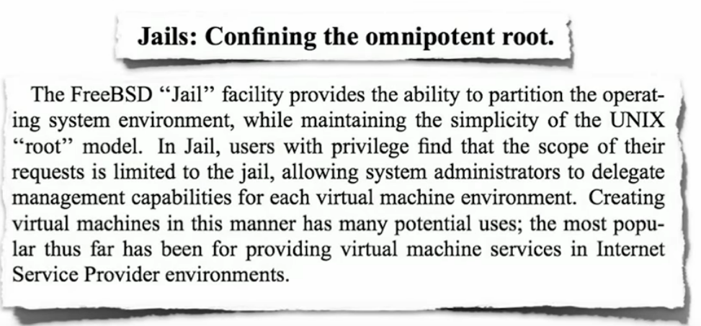
BSD’s Jail

Slide 4
Containers Today
Docker is the leading containerisation standard
RedHat has Podman because RedHat is different™️
An encoding of deployment procedures in images
https://github.com/cloud-native-mauritius/cloudnativemauritius.com/
Images are reproducible and portable between machines (and OS-es)
The developer becomes the operator.

Slide 5

Virtual Machines
Before VM OS, there were individual machines for isolation
Virtual Machines are heavy
Every VM needs the kernel to be emulated
10 Vms => 10 kernels
Operating systems don’t do nothing
Leads to expensive resource bloat

Slide 6
How Containers Help
Uniform development environment
Dependency and package conflicts avoided
Security risks do not spread to other applications
Easier control over environment your apps run in

Slide 7
How Containers Help
Containers use the host kernel
Less wasted resources
No 2nd OS (hypervisor) to run
Integration with CI/CD pipelines
Prevent over-provisioning of resources
Facilitates microservices architecture
Opens the door to Kubernetes & Cloud

Slide 8
The Development Process @ SWAN
I write a .NET application
I build it for prod and wait 2 minutes
Go to the folder, manually edit a config file to make the app run on IIS
Virtual Desktop to the server
Copy my files over in the kbps speeds
(re)Start the service

Slide 9
And it doesn’t work.

Slide 10
The Development Process @ SWAN
Write application in Python
Hans clones project & tries to run it. Fails.
Install/update dependencies
Conflicting dependencies for different programs
Inconsistencies between my laptop & Linux server

Slide 11
And the deadline’s approaching.

Slide 12
Note to self
Run ubuntu container
Then run Top
Don’t include this slide in pres

Slide 13
How Does Kubernetes Fit In?

Slide 14
What Is Cloud Native?
The term for systems built for the needs of the 21st century
Mindset prioritising:
- High Availability (no downtime)
- Scalability (match user demand)
-
No, Cloud Native doesn’t mean just Cloud
(AWS, GCP, Azure)

Slide 15
What Is Kubernetes?
“K8S is a system for automating deployment, scaling and management of containerised applications”
- Simply an abstraction/framework to run a cluster of computers
Industry standard with a whole ecosystem behind
Platform for 200~ Cloud Native Applications
Former Google product, now Open Source held by CNCF (Linux Foundation project)

Slide 16
Why is Kubernetes a Thing?
Need for cluster computing solutions which don’t suck ( Docker Swarm 🤮 )
High Availability, Redundancy, Easy to Manage
CSP agnostic (AWS / Azure / GCP / Bare Metal)
Offers a platform suited to both admins and devs

Slide 17
Why Use Kubernetes
Single PC finitely upgradeable
Expand horizontally not vertically
Quantity over quality
Redundancy
Exploiting microservices and containers
Better upgradeability, availability, portability

Slide 18
Building on Kubernetes
The power of Kubernetes is the CN Landscape
~ 200 Cloud Native projects and counting
CI/CD
App Definition & Image Build
Databases
Streaming & Messaging
Scheduling & Orchestration
API Gateway
Discovery
Cloud Native Storage
Cloud Native Network
Service Mesh
Remote Procedure Call
Service Proxy
Chaos Engineering
Continuous Optimisation
Container Runtime
Security & Compliance
Container Registry
Automation & Configuration
Key Management
Observability
Feature Flagging
Coordination & Service

Slide 19
Physical Scaling
One server cannot be upgraded indefinitely
Physical limitations in compute power
Instead of 1 server, why not have 10?
Kubernetes unifies multiple servers
Kubernetes spreads pods across all nodes to best use resources

Slide 20
Virtual Scaling
Scaling microservices
Possible due to lack of state
Allows optimal use of resources
Scale up/down to accomodate demand
Horizontal Pod Autoscaler for hands-off scaling
Automatic load balancing of applications

Slide 21
Redundancy
1 server = 1 point of failure
Self-healing of deployments in case of failure
- Pods independent from nodes
- Services “follow” pods
Longhorn/Rook+Ceph allows distributed block storage for data redundancy
Multi-cloud cluster for added redundancy
Benefits physical upgrades or OS updates

Slide 22
Saving the Developer
Focus on code, not deployments.
Automatic deployments & updates regardless of if Hans is online. (CI/CD)
Allocate resources to applications.
Environment consistency.
Microservices
GitOps – Version Control

Slide 23
Easy Development
Containerised means consistent between local, test & prod
GitOps and CI/CD pipelines for automatic deployment
No need to beg someone to deploy your app
apologies to my colleagues
Simpler scaling and resource management
- Can ensure my app doesn’t eat all the RAM

Slide 24
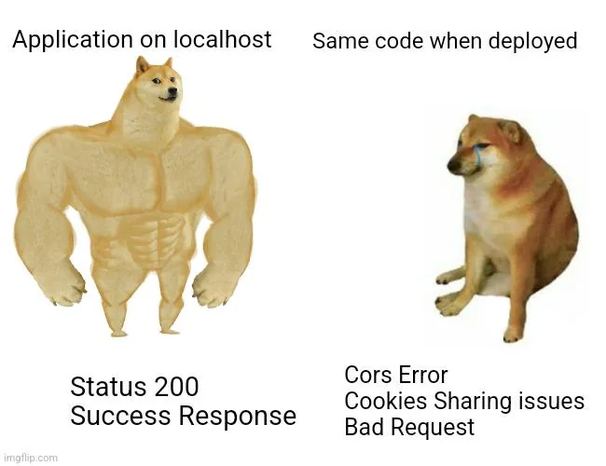

Slide 25
Fancy Deployment Strategies
Deployments can have different rollout strategies
Algorithms like Canary deployment, Rolling update
Blue/Green deployment concept
Detailed control over rollout to minimise customer impact

Slide 26
Demo Time

Slide 27


