Slide 1


Virtualisation
with
Harvester & Longhorn
By Alex Bissessur

Slide 2



“I do fun things with
Kubernetes.”

Slide 3

Me: Containerisation is the future

Slide 4

Me: Containerisation is the future
But what about my legacy VMs? :You

Slide 5
Me: Containerisation is the future
But what about my legacy VMs? :You
Me: Run VMs the Cloud Native way

Slide 6
Me: Containerisation is the future
But what about my legacy VMs? :You
Me: Run VMs the Cloud Native way
How? Why? Are you insane? :You

Slide 7
“I Like My Virtualisation Stack”

Slide 8
“I Like My Virtualisation Stack”
No, no you don’t.
(you just don’t want to change)

Slide 9
“I Like My Virtualisation Stack”
No, no you don’t.
Does Management like the cost?
someone added an extra zero to the price, overnight
How easy is your exit plan?
Is it Open Source? (digital sovereignty)

Slide 10
What is Harvester?

Slide 11
What is Harvester?
A platform for hyperconverged infrastructure.
A collection of open source software.
Your “cloud on-prem solution”
Harvester is the free version of SUSE Virtualisation

Slide 12
Hyperconverged What?
HyperConverged Infrastructure (HCI) means everything infra is under one roof.
Infrastructure is:
- compute
- storage
- network

Slide 13
Why is That Good?
From one interface, manage everything compute, networking, and storage.
Specialise in one technology rather than 3 different tech stacks (from different vendors)
Tighter integration of the 3 components
You can have everything in one nice UI rather than 3 ugly ones :)

Slide 14
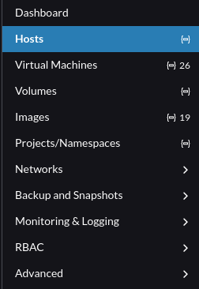

Slide 15
So What is Harvester?
Under the hood, Harvester is made up of:
rke2 – rancher kubernetes engine
Longhorn – distributed block storage
Kubevirt – VMs on top of Kubernetes
Prometheus + Grafana – monitoring & alerts
Rancher – the UI unifying management of all the parts

Slide 16
So What is Harvester?
rke2
Rancher Kubernetes Engine 2
Kubernetes distribution, fully compliant with K8s with extra security-oriented features
- Compliant with many CIS benchmarks out of the box

Slide 17
So What is Harvester?
rke2
Kubevirt
Incubating CNCF project
Open Source (duh)
Allows running VMs directly on top of Kubernetes clusters with KVM

Slide 18
So What is Harvester?
rke2
Kubevirt
Longhorn
Incubating CNCF project
(open source)
Provides persistent storage in an otherwise stateless cluster
Ability to create replicas of volumes across different nodes of the cluster for redundancy

Slide 19
So What is Harvester?
rke2
Kubevirt
Longhorn
Prometheus
Grafana
Prometheus & Grafana are built-in to Harvester for monitoring purposes
Integrated Grafana dashboard to monitor the state of host nodes and VMs

Slide 20
So What is Harvester?
rke2
Kubevirt
Longhorn
Prometheus
Grafana
Rancher
Rancher provides the UI to manage the entire cluster
Unifies all components and makes them easy to manage
(especially for ClickOps people)

Slide 21
Compute
Harvester is built on top of Kubernetes (rke2)
Harvester is meant to be clustered (ex 3 servers)
- allows seamless failover in case of server failure
VMs run through Kubevirt, storage done through Longhorn
Possibility to run containers in parallel
- past and future of infra in one platform

Slide 22
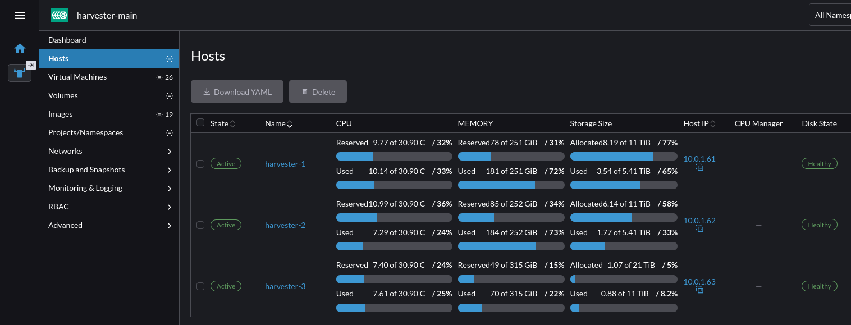
Harvester Nodes

Slide 23
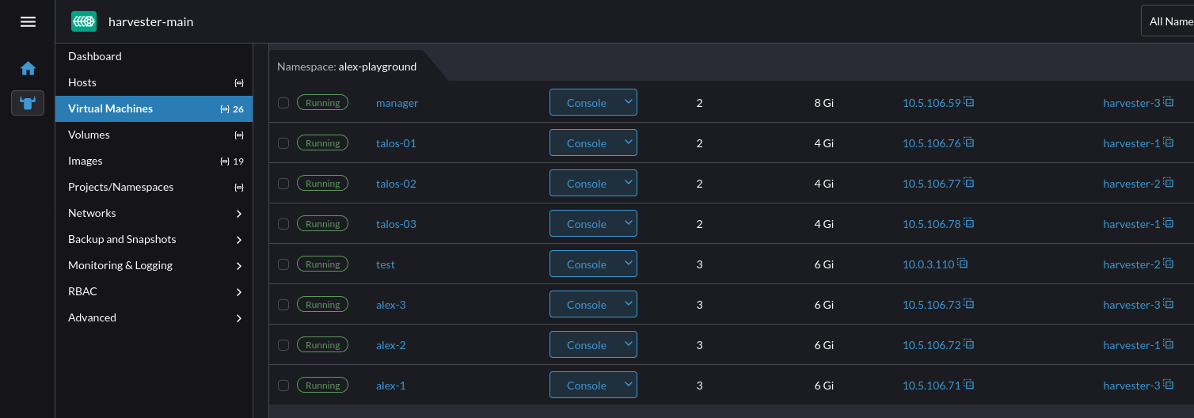
VMs

Slide 24
Networking
Create networks within Harvester for different VMs to use
Integrate VLANs with Harvester
Use physical network for different VMs
ex: reserve one ethernet port for a certain set of VMs
also use different networks for storage traffic

Slide 25
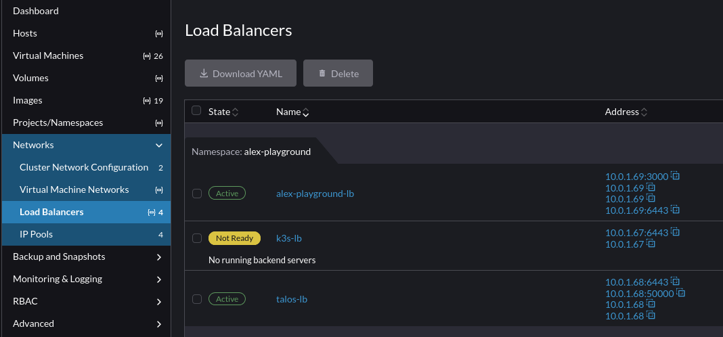
Networking

Slide 26
Storage/Longhorn
Harvester uses Longhorn, a CNCF incubating project for storage
Longhorn is an open source, cloud-native, persistent block storage solution
Data is replicated across nodes’ disks for redundancy and high availability

Slide 27
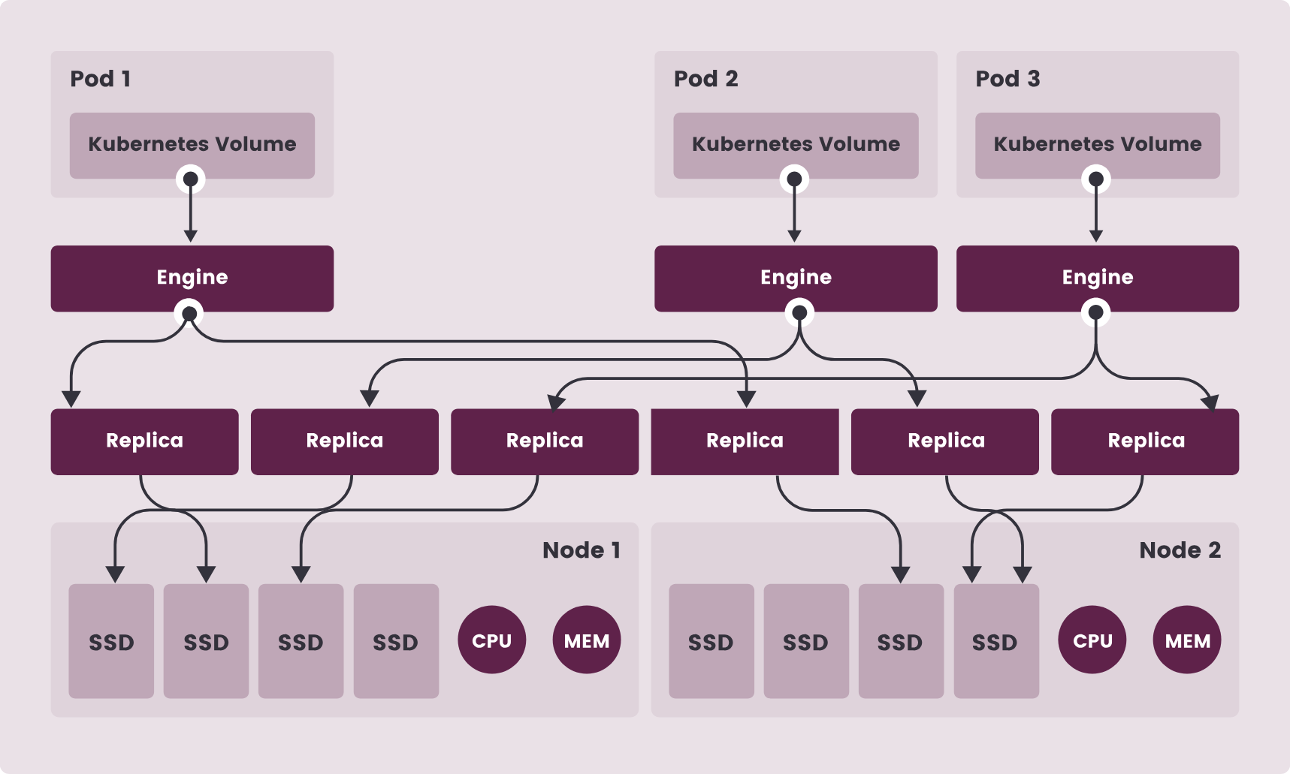

Slide 28
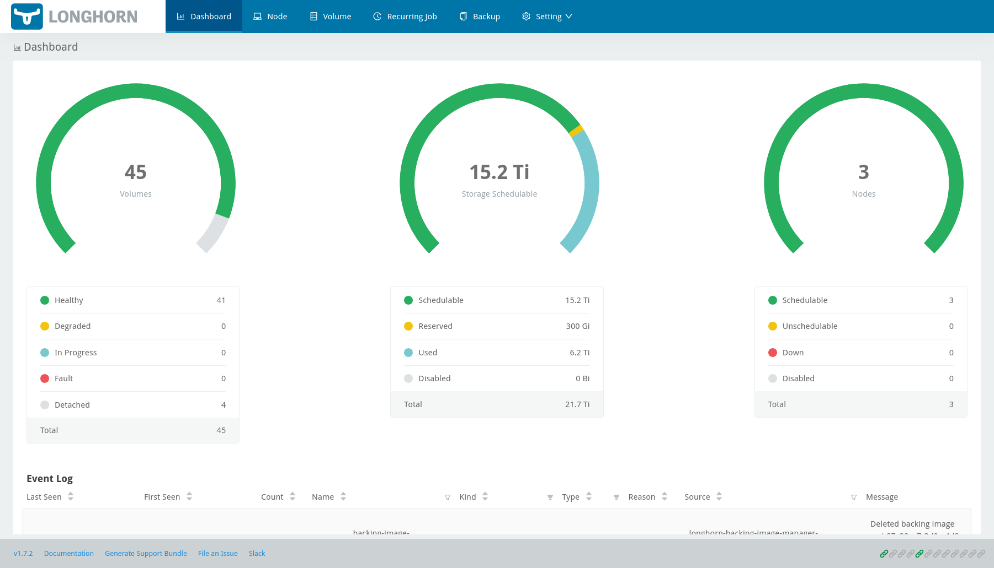

Slide 29
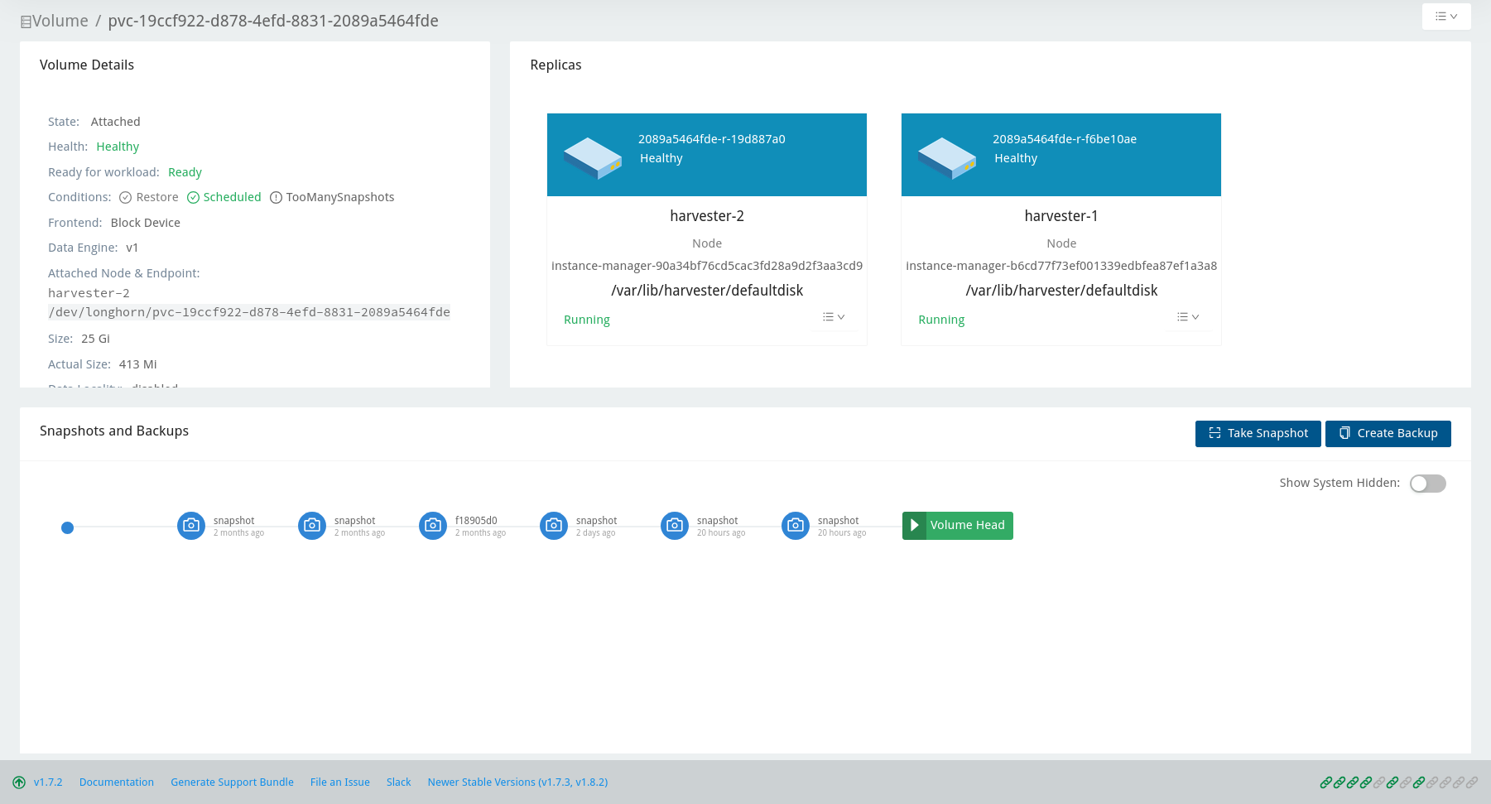

Slide 30
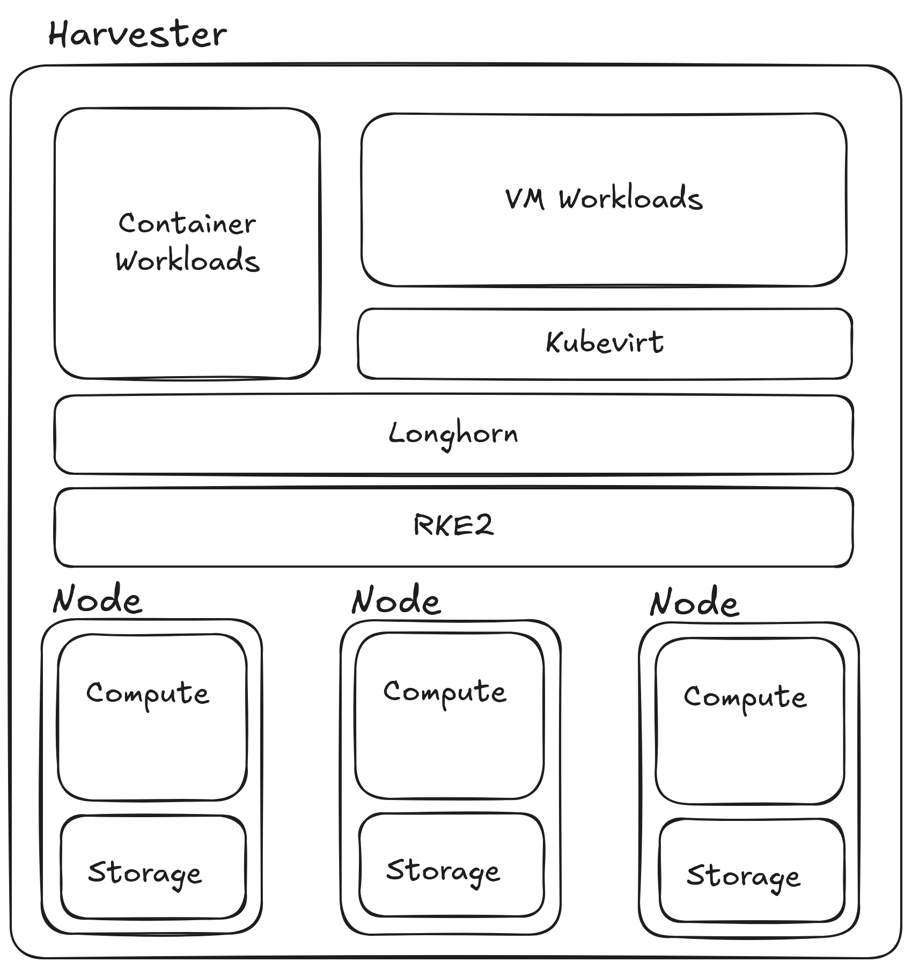
Harvester in a Nutshell

Slide 31

Thank You!
alexbissessur.dev
t.me/alexbissessur
github.com/xelab04/Slides
moris.social/@AlexB

