Slide 1

Kubernetes X Frontend MU
By Alex

Slide 2
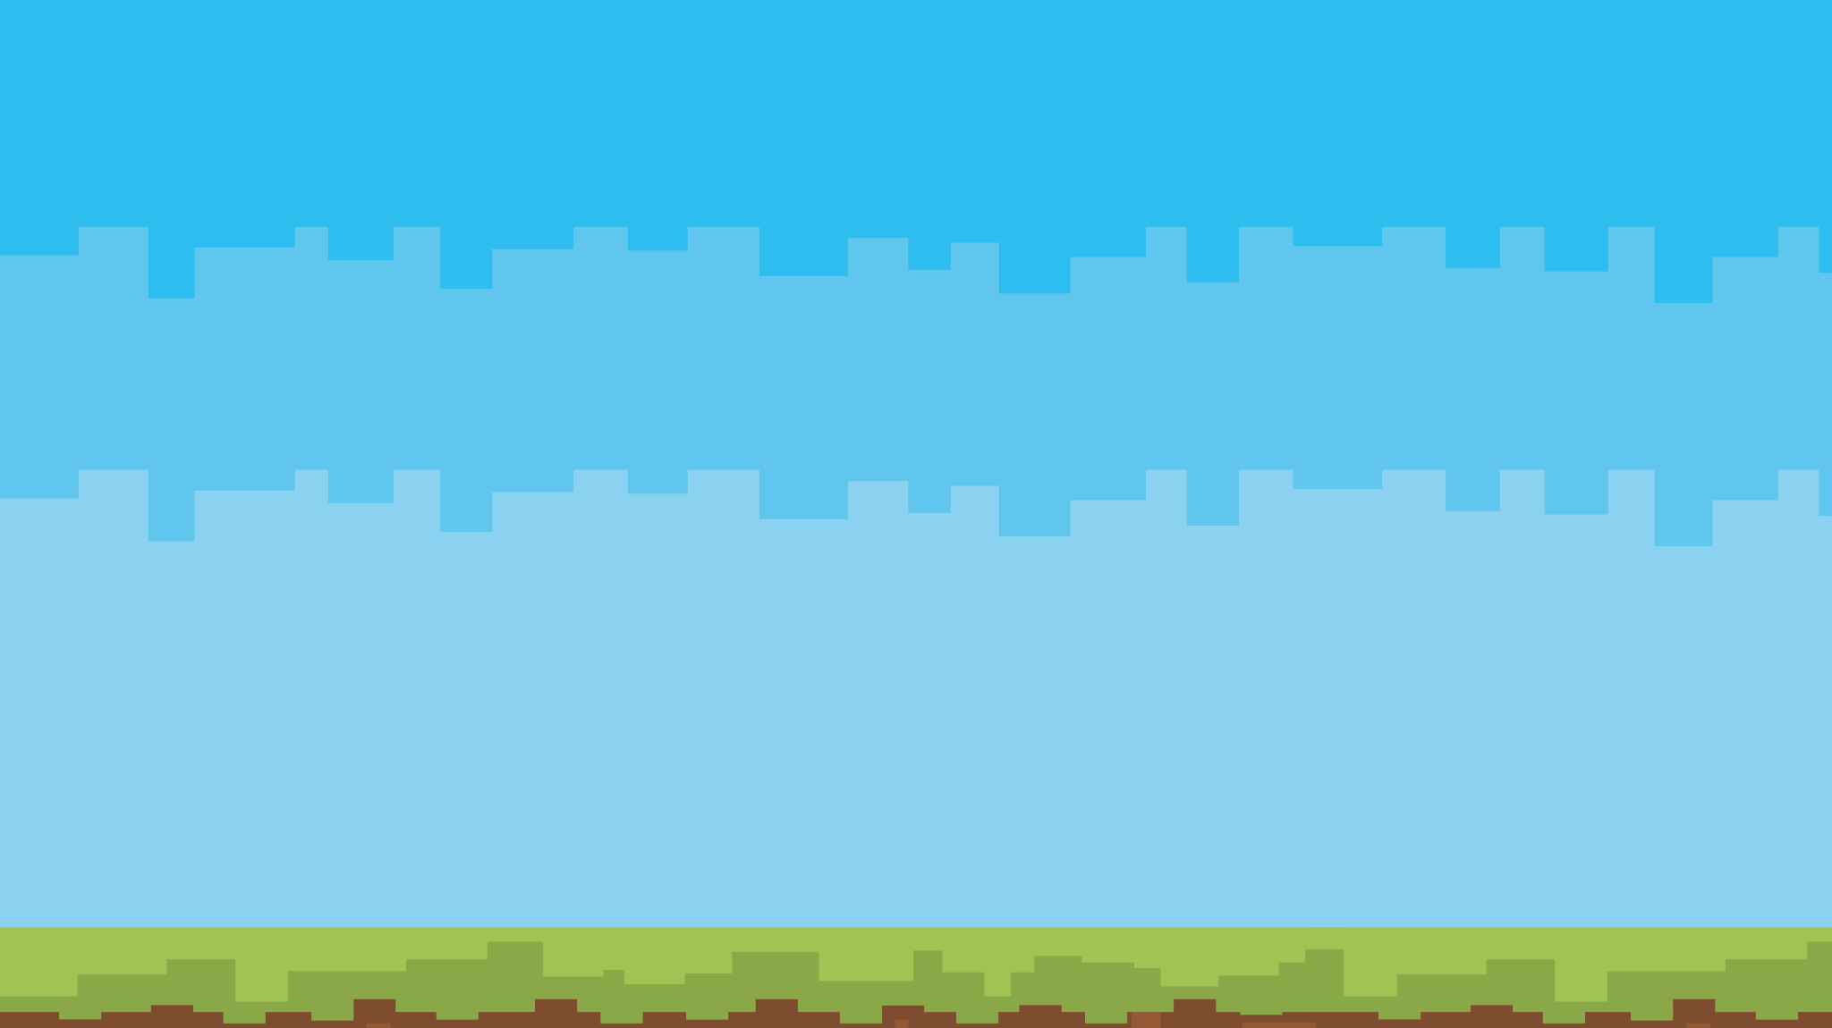



“I do fun things with
Kubernetes.”

Slide 3
Containers
Similar to VMs for workload isolation & deployment
Shares host kernel (Linux) so no need for:
- kernel
- hardware emulation
- OS overhead
Containers include dependencies & are isolated
Extremely lightweight (compute & storage)
For ex: an nginx container with a static site < 50MB

Slide 4
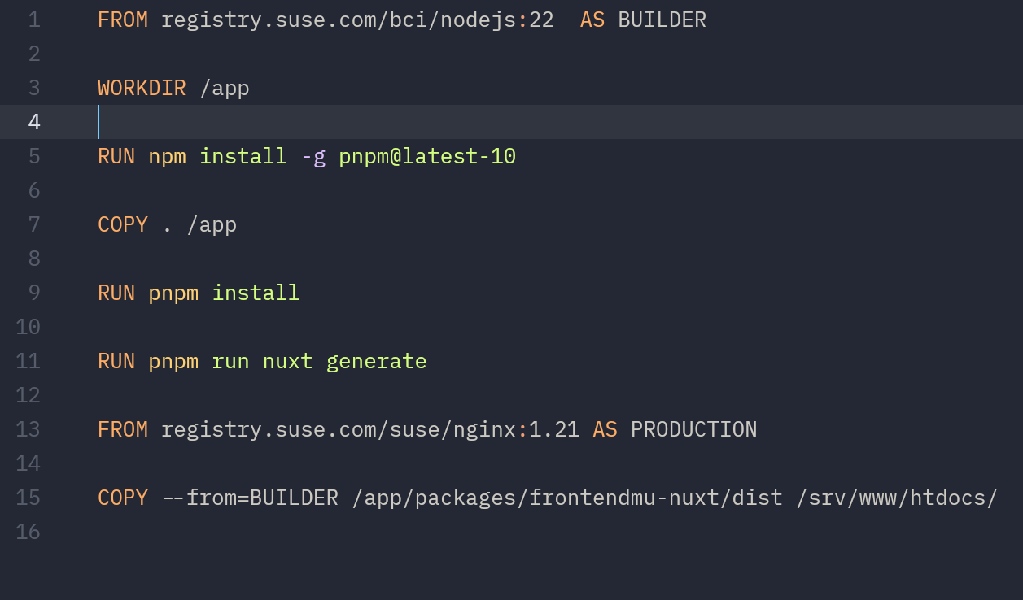
What does a Container Look Like

Slide 5
Kubernetes
Industry standard for cluster computing
“K8S is a system for automating deployment, scaling and management of containerised applications“
- Simply an abstraction to run a cluster of computers
Kubernetes in Greek translates to “helmsman” or “pilot” of a ship
Container orchestrator with a bunch of bonuses

Slide 6
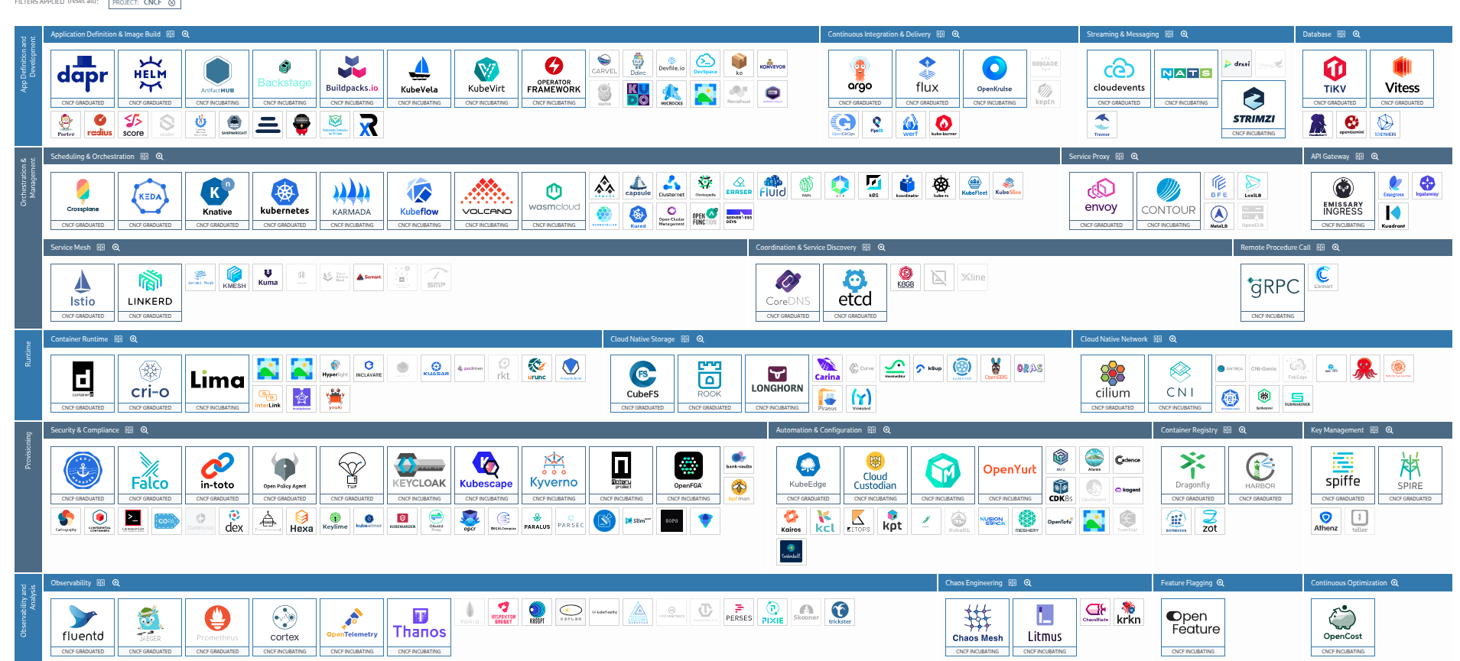
Cloud Native

Slide 7
How Kubernetes Works
It (intelligently) throws containers onto hosts
Containers are bundled into pods
- pods are the smallest unit in Kubernetes
- pods can have >= 1 container
It creates networking routes to expose applications
Gives policies and RBAC and other tools for configuring “stuff”

Slide 8
How To Use Kubernetes
1. Deploy pods to your cluster. This is done with a deployment.
2. Let deployment:
- keep pods alive
- update and rollback pods
- scale pods for high demand
3. Create service and ingress for networking
4. Add autoscaling to handle Black Friday traffic

Slide 9
Why Kubernetes
Scalability – add more containers / servers
Redundancy from having several servers
- high availability
Maintenance without having downtime
- blue-green deployments
Fine-grain control over deployments
- access perms, resource usage
Easy CI/CD integrations

Slide 10
Why Kubernetes
Self-healing – no need to call sysadmin at 3am when server dies
Portability – stateless containers can be moved to different clusters easily (eg test env)
Cloud-agnostic (also good for bare-metal)
Easy to manage – less workload on sysadmins for server management
Automatic pod scaling to match demand

Slide 11
Why Not Kubernetes?
For simplicity
- K8s needs someone who knows about infra
- Simple docker compose on $5 VPS works
Learning Curve
- Devs (esp frontend ppl) are not familiar with this approach to infra
Legacy (fat) Projects
- Not easy to containerise

Slide 12

Demo Time

