Slide 1
Equivalence partitioning
Partition system inputs and outputs into
‘equivalence sets’
  If input is a 5-digit integer between 10,000 and 99,999,
  equivalence partitions are : <10000, 10000-99999 and >= 100000
Choose test cases at the boundary of these
sets
  00000, 09999, 10000, 99999, 100001

Slide 2
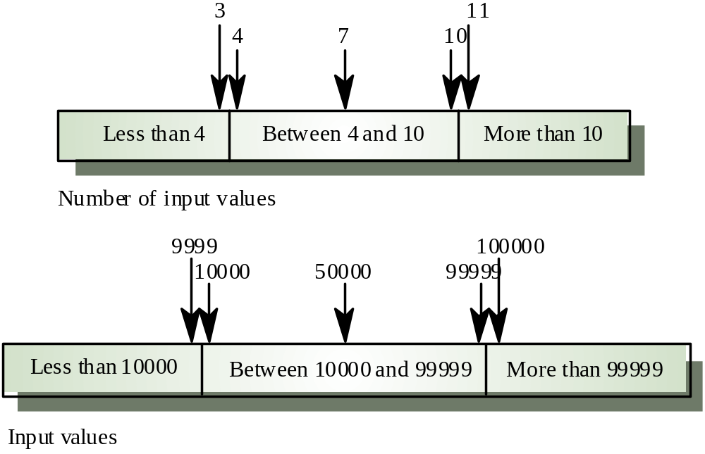
Equivalence partitions

Slide 3
Search routine specification
procedure Search (Key : ELEM ; T: ELEM_ARRAY;
Found : in out BOOLEAN; L: in out ELEM_INDEX) ;
Pre-condition
-- the array has at least one element
T’FIRST <= T’LAST
Post-condition
-- the element is found and is referenced by L
( Found and T (L) = Key)
or
-- the element is not in the array
( not Found and
not (exists i, T’FIRST <= i <= T’LAST, T (i) = Key ))

Slide 4
Search routine - input partitions
Inputs which conform to the pre-conditions
Inputs where a pre-condition does not hold
Inputs where the key element is a member of
the array
Inputs where the key element is not a member
of the array

Slide 5
Testing guidelines (arrays)
Test software with arrays which have only a single value
Use arrays of different sizes in different tests
Derive tests so that the first, middle and last elements of the array are accessed
Test with arrays of zero length (if allowed by programming language)

Slide 6
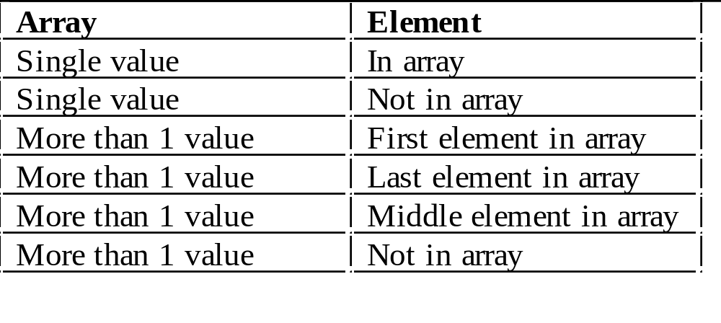
Search routine - input partitions

Slide 7
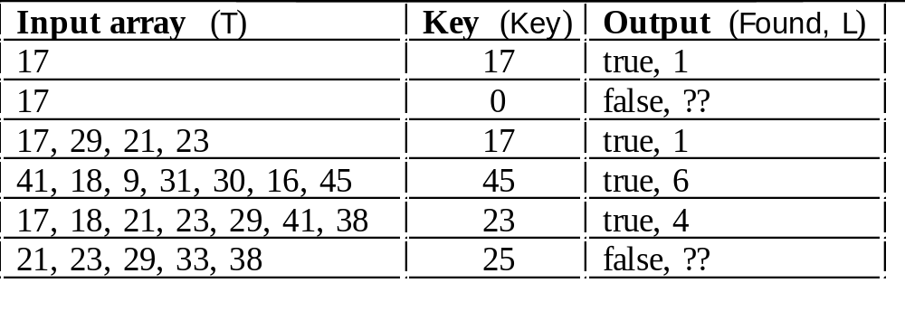
Search routine - test cases

