Slide 1
Software Engineering
Module 3
Software Quality and Process Management
Dr. Shai Koenig
Open University
Department of Computer Science

Slide 2
Document Control
Changes
Mar 2003 – hid ISO 9000 and CMM models [they can serve as projects/papers] and highlighted SPI slides
ToDo/Ideas/Open Issues
add a section on quality economics or cost of quality
use the “fix the process, not the product” maxim
add a section on post-mortems
add some info on SPICE
“construction” is shaded too dark
Nov 2001 - We do not deal with “improving fault tolerance, I.e., minimizing the likelihood that a fault will become a failure!
Nov 2001 – Add a slide that illustrates key practices of the CMM
Mar 2003 – adapt to ISO 9000-2000
Mar 2003 - Use IEEE standard for categorizing and describing reviews

Slide 3
Required Readings
Pfleeger,
  Chapter 1, Section 1.3
  Chapter 12, Sections 12.4 [pages 522-527], 12.5
ISO 12207 - Sections 6.3, 6.4, 6.5, 6.6, 6.7, 6.8

Slide 4
Project Management
The aims of a software project include meeting
scope
schedule
quality
budget
expectations [requirements, goals] !!!

Slide 5
Software Quality Management
The aims of a software project include meeting
The last module discussed
scope
Scope management
schedule
quality
Work management
budget
expectations [requirements, goals] !!!

Slide 6
Software Quality Management
The aims of a software project include meeting
scope
Scope management
schedule
quality
budget
expectations [requirements, goals] !!!

Slide 7
Software Quality Management
The aims of a software project include meeting
scope
Scope management
schedule
quality
Work management
budget
expectations [requirements, goals] !!!

Slide 8

Software Quality Management
The aims of a software project include meeting
scope
Scope management
schedule
quality
Work management
Quality Management
budget
expectations [requirements, goals] !!!

Slide 9
Software Quality Management
The aims of a software project include meeting
scope
Scope management
schedule
quality
Work management
Quality Management
budget
expectations [requirements, goals] !!!

Slide 10
Table of Contents
Software quality
  basic quality concepts
  software quality
  software quality management
Software quality assurance practices
  quality/process planning
  quality [product/process] evaluations
  corrective/preventive action
  process improvement
Quality/process standards
  ISO 9001
  CMM
Organizational Issues
Summary

Slide 11
What is software quality?
Quality, simplistically, means that a product should meet its requirements definition
This is problematical for software systems
  Tension between customer quality requirements (functionality, efficiency, reliability, etc.) and developer quality requirements (maintainability, reusablity, etc.)
  Some quality requirements are difficult to specify in an unambiguous way
  Software requirements specifications are usually incomplete and often inconsistent
  It’s easier to recognize “lack of quality” than to define “quality”

Slide 12
Basic Quality Concepts [from ISO 8402]
quality - totality of characteristics of an entity that bear on its ability to satisfy stated and implied needs.
quality policy - overall intentions and direction of an organization with regard to quality, as formally expressed by top management.
quality management - all activities of the overall management function that determine the quality policy, objectives and responsibilities, and implement them by means such as quality planning, quality control, quality assurance and quality improvment within the quality system.
quality system - organizational structure, procedures, processes and resources needed to implement quality management.
quality planning - activities that establish the objectives and requirements for quality and for the application of quality system elements.
quality control - operational techniques and activities that are used to fulfil requirements for quality.
quality assurance - all the planned and systematic activities implemented within the quality system, and demonstrated as needed, to provide adequate confidence that an entity will fulfil requirements for quality.

Slide 13
Software Quality Models
quality - totality of characteristics of an entity that bear on its ability to satisfy stated and implied needs.
What characteristics define software quality ?
  McCall - 1977
  Boehm - 1978
  ISO 9126 - 1991
  Dromey 1996
ISO 9126
Quality
Model
Functionality
Reliability
Usability
Efficiency
Maintainability
Portability
Suitability
Maturity
Understandability
Time Behavior
Analyzability
Adaptability
Accuracy
Fault Tolerance
Learnability
Resource Behavior
Changeability
Installability
Interoperability
Recoverability
Operability
Stability
Conformance
Security
Testability
Replaceability

Slide 14
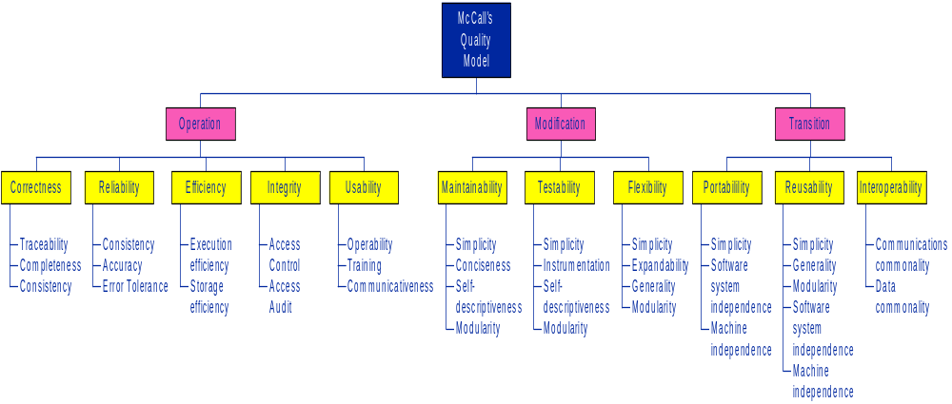
McCall’s Quality Model

Slide 15
ISO 9126 Quality Characteristics
ISO 9126
Quality
Model
Functionality
Reliability
Usability
Efficiency
Maintainability
Portability
Suitability
Maturity
Understandability
Time Behavior
Analyzability
Adaptability
Accuracy
Fault Tolerance
Learnability
Resource Behavior
Changeability
Installability
Interoperability
Recoverability
Operability
Stability
Conformance
Security
Testability
Replaceability

Slide 16
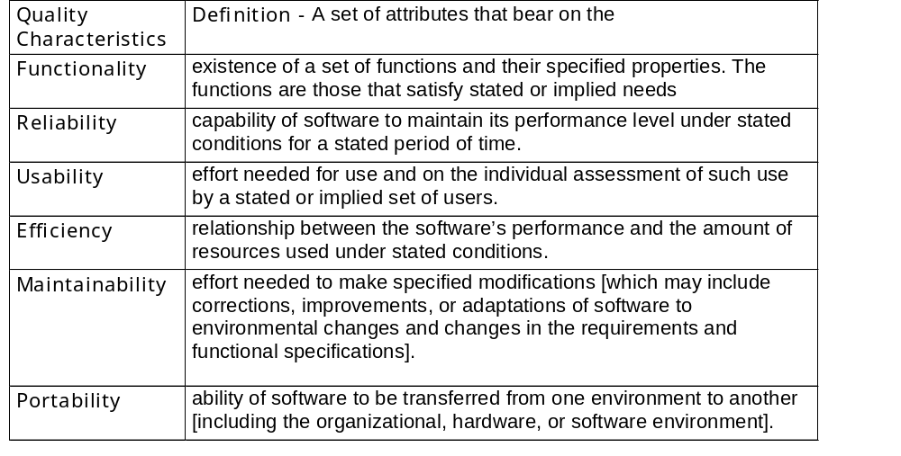
ISO 9126 Quality Characteristics

Slide 17
Principal determining factors of product quality
People
Quality
Budget & Schedule
Constraints
Product
Quality
Process
Quality
Product
Quality
Technology
Application
Domain

Slide 18
The Relationship between
SW Product Quality and SW Process Quality
The quality of a developed product is influenced by the quality of the production process
  There is a straightforward link between process and product in manufactured goods
  This is particularly important in software development as some product quality attributes are hard to assess
  “Fix the process not the product”
However, there is a very complex and poorly understood relationship between software processes and product quality
More complex for software because:
  The application of individual skills and experience is particularly important in software development
  External factors such as the novelty of an application or the need for an accelerated development schedule may impair product quality
  Fluidity of requirements, development technology, staff complicate the attainment of quality

Slide 19
Software quality management
Concerned with identifying the quality characteristics to be achieved and defining the required level for each characteristic
Concerned with ensuring that the required level of quality characteristics is achieved by influencing the determining factors [budget, schedule, people, technology and process]
Involves
  planning - defining quality goals and defining appropriate processes, standards, procedures and tools to meet those goals
  tracking - ensuring that these processes, standards, procedures and tools are properly used and that the goals are being achieved
  controlling - taking action when quality goals are not met
Should aim to develop a ‘quality culture’ where quality is seen as everyone’s responsibility

Slide 20
Terminology
error - errors are committed by developers
defect / fault - software contains defects that result from errors or deviations committed by a developer
failure / problem /incident - software fails as a result of defects in the software

Slide 21
How to improve quality -
Prevent defects/deviations from occurring
Identify defects/deviations [that were not prevented] as early as possible
Correct identified defects/deviations as they are found
Learn from the organization’s collective experience how to better prevent, identify and correct defects/deviations

Slide 22
How to improve quality -
Prevent defects/deviations from occurring
Identify defects/deviations [that were not prevented] as early as possible
Correct identified defects/deviations as they are found
Learn from the organization’s collective experience how to better prevent, identify and correct defects/deviations
Defining and using an appropriate, systematic and automated software development process will lower the level and severity of defects/deviations
process / quality planning
Invest in defect identification strategies
product / process quality evaluations
institute defect/deviation reporting, resolution and tracking procedures
Corrective / preventive action process
institute process improvement startegies, use measurements when possible and helpful
process improvement

Slide 23
How to improve quality -
Prevent defects/deviations from occurring
Identify defects/deviations [that were not prevented] as early as possible
Correct identified defects/deviations as they are found
Learn from the organization’s collective experience in order to better prevent, identify and correct defects/deviations

Slide 24
How to improve quality -
Prevent defects/deviations from occuring
Identify defects/deviations [that were not prevented] as early as possible
Correct identified defects/deviations as they are found
Learn from the organization’s collective experience how to better prevent, identify and correct defects/deviations
Defining and using an appropriate, systematic and automated software development process will lower the level and severity of defects/deviations

Slide 25
How to improve quality -
Prevent defects/deviations from occuring
Identify defects/deviations [that were not prevented] as early as possible
Correct identified defects/deviations as they are found
Learn from the organization’s collective experience how to better prevent, identify and correct defects/deviations
Defining and using an appropriate, systematic and automated software development process will lower the level and severity of defects/deviations
Invest in defect identification strategies

Slide 26
How to improve quality -
Prevent defects/deviations from occurring
Identify defects/deviations [that were not prevented] as early as possible
Correct identified defects/deviations as they are found
Learn from the organization’s collective experience how to better prevent, identify and correct defects/deviations
Defining and using an appropriate, systematic and automated software development process will lower the level and severity of defects/deviations
Invest in defect identification strategies
institute defect/deviation reporting, resolution and tracking procedures

Slide 27
How to improve quality -
Prevent defects/deviations from occurring
Identify defects/deviations [that were not prevented] as early as possible
Correct identified defects/deviations as they are found
Learn from the organization’s collective experience how to better prevent, identify and correct defects/deviations
Defining and using an appropriate, systematic and automated software development process will lower the level and severity of defects/deviations
Invest in defect identification strategies
institute defect/deviation reporting, resolution and tracking procedures
institute process improvement startegies, use measurements when possible and helpful

Slide 28
How to improve quality -
Prevent defects/deviations from occurring
Identify defects/deviations [that were not prevented] as early as possible
Correct identified defects/deviations as they are found
Learn from the organization’s collective experience how to better prevent, identify and correct defects/deviations
Defining and using an appropriate, systematic and automated software development process will lower the level and severity of defects/deviations
process / quality planning
Invest in defect identification strategies
product / process quality evaluations
institute defect/deviation reporting, resolution and tracking procedures
Corrective / preventive action process
institute process improvement startegies, use measurements when possible and helpful
process improvement

Slide 29
How to improve quality -
Defining and using an appropriate, systematic and automated software development process will lower the level and severity of defects/deviations
process / quality planning
product / process quality evaluations
corrective/preventive action process
process improvement
Invest in defect identification strategies
institute defect/deviation reporting, analysis, resolution and tracking procedures
institute process improvement startegies, use measurements when possible and helpful

Slide 30
Table of Contents
Software quality
  basic quality concepts
  software quality
  software quality management
Software quality assurance practices
  quality/process planning
  quality [product/process] evaluations
  corrective/preventive action
  process improvement
Quality/process standards
  ISO 9001
  CMM
Organizational Issues
Summary

Slide 31

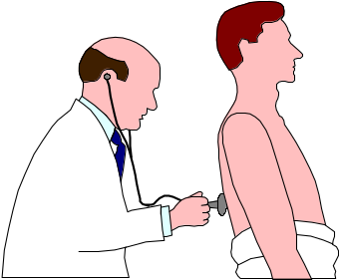


Software Quality Practices
process / quality
planning
product / process
quality evaluations
corrective / preventive action process
process
improvement

Slide 32

Software Quality Practices
process / quality
planning
product / process
quality evaluations
[tracking]
corrective / preventive action process
[controlling]
process
improvement

Slide 33
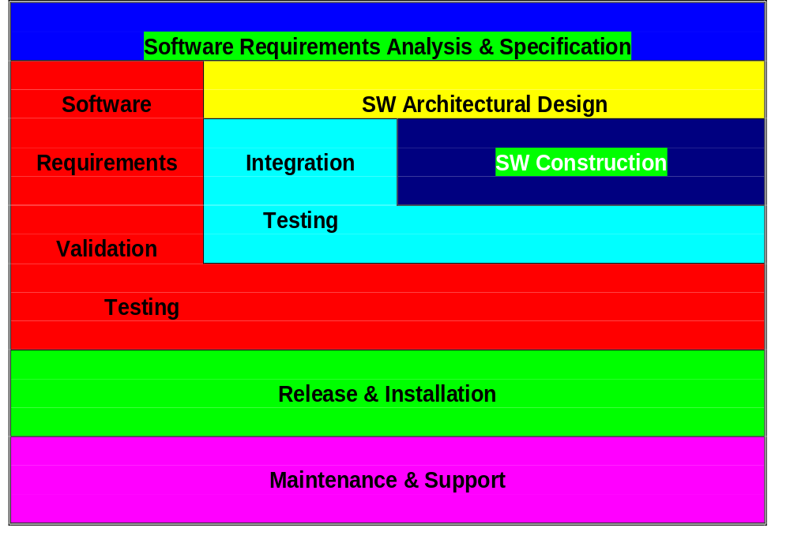
Process Planning
Define Key Software Development Activities
Notes:
4
9
Notes
This slide suggests some of the temporal relationships between the key development activities.
For example, requirements precedes design which precedes construction, validation testing (at least the planning) overlaps with design, construction and integration, integration overlaps with construction, etc.

Slide 34
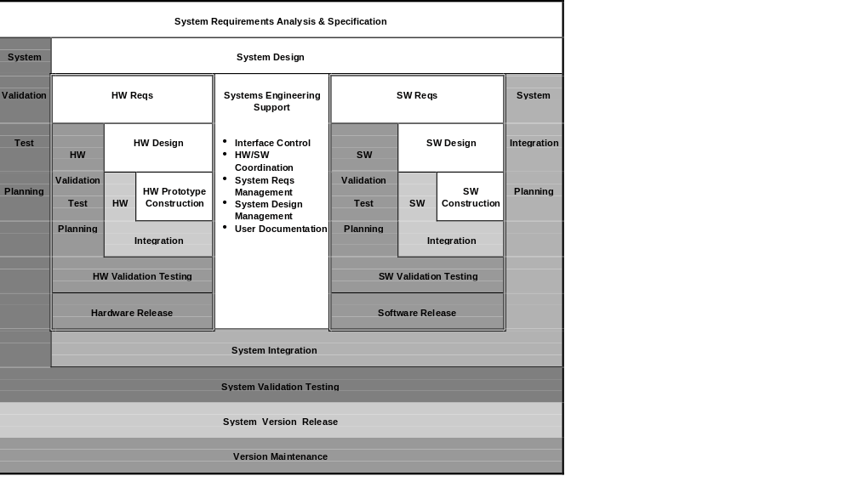
Process Planning
Key System Development Activities
Notes:
Notes
This slide presents a more comprehensive lifecycle showing the systems engineering, hardware engineering and software engineering processes, their key development activities and their interrelationships.

Slide 35

Process Planning
The software development process
should address the following issues for each key development activity
What is produced ?
Work-Products
How is it produced ?
Development practices
How is it verified ?
SQA practices
How is it controlled ?
Work-product control practices !
Notes:
NOTES
Work-products are the tangible artifacts produced by the key development activities. These may include
documents
diagrams
source files
object files
information produced using a CASE tool
Development practices are used in developing these work-products. They may take the form of document standards, procedures, techniques, tools, handbooks, etc.
Quality assurance practices are used to verify the quality of the work-products and the processes used to develop them.
Work product control practices are used to control the creation, development, storage, release and modification of individual work-products (e.g.., documents, source files) as well as groups of such work-products that constitute a system or subsystem.

Slide 36

Define Work Products
SOFTWARE
REQUIREMENTS
SW Reqs Spec
Prototypes (GUI)
Feature Reqs Spec
Information recorded
in a CASE tool
SOFTWARE
DESIGN
SW Design Spec
Information recorded
in a CASE tool
Information that is
reverse engineered
INTEGRATION
TESTING
Integration Plan
Test Cases
VALIDATION
TESTING
Validation Test Plan
Validation Test Spec
Test programs
Test Reports
DOCUMENTATION
User Manual
Installation Manual
SOFTWARE
CONSTRUCTION
source files
object files
make files
script files
Notes:
8
Notes
This slide illustrates a number of possible work-products for some key development activities.
The core requirements do not require any specific work-products, but do require that a work-product(s) be developed and contain certain kinds of information.

Slide 37

Define Work-Product Development Practices
requirements & design practices
  requirements specification techniques
  design techniques [Object-based, OO, ...]
  document standards
programming practices
  coding standards
  unit testing techniques & standards
testing practices
software development tools
  automation
  integration frameworks
Notes:
9
12

Slide 38
Define SW Quality Evaluation Practices
work-product evaluations
process assessments
internal auditing
corrective action
quality records
measurement
process improvement
Notes:
10
13
NOTES
Software quality assurance consists of a set of practices designed to evaluate software development work-products, to assess the software development process by which these work-products are developed and maintained and to assure that problems detected are effectively resolved. Software quality assurance includes the following practices.
Work-product evaluations - to ensure that work-products are developed in accordance with the relevant requirements.
Process assessments - to ensure that key development activities are performed in accordance with the relevant process requirements.
Internal auditing - the corporate Quality & Processes department shall periodically conduct internal audits of development projects to check the adequacy of the project’s SDPP, to verify compliance with the SDPP, and to identify opportunities for process improvement.
Process improvement - the software manager is responsible for reviewing and assessing the existing software development process, identifying opportunities for improvement and planning and implementing such improvements.
Corrective Action - the software manager shall establish and maintain a corrective action system to record and track the resolution of problems that are discovered in the course of work-product evaluations, process assessments, internal quality audits, validation testing and process improvement.

Slide 39
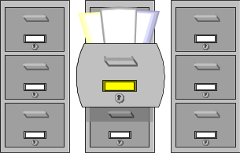



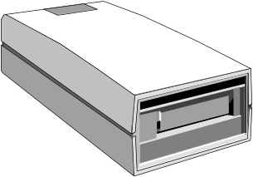
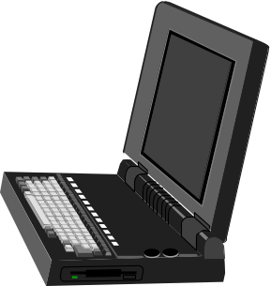
Define Work-Product Control Practices
sw development library
document control
source control
version development control
version release control
change control
identification
organization
storage
coordination
access
Notes:
12
15
NOTES
Many development problems stem from the failure to control software development work-products. Software work-product control (sw configuration management) is divided into a number of topics.
The software development library provides the basic mechanism for organizing and storing the various work-products that make up the software.
Document control practices are used to control the evolution of individual documents.
Source control practices are used to control the evolution of individual source code files.
Software version development control practices are used to control the evolution of a software version from version creation, through version development up to the point of version release
Software version release control practices are used to control the release of software versions
Change control practices are used to control changes to items that have been released.

Slide 40
Documenting the software development process
- The Software Engineering Process Matrix
 | WORK-PRODUCTS · specifications · descriptions · drawings · source code - … | WORK-PRODUCT DEVELOPMENT PRATICES · procedures · standards · techniques · tools | SW QUALITY ASSURANCE PRACTICES · wp evaluations · process assessments · internal auditing - corrective action | WORK-PRODUCT CONTROL PRACTICES · document control · source control · version control · change control
Software Requirements
Architectural Design
Software Construction
Integration
Validation testing
Release & Deployment
Maintenance & Support

Slide 41
Documenting the systems engineering process
- The Systems Engineering Process Matrix
 | WORK-PRODUCTS · specifications · descriptions · drawings · source code - … | WORK-PRODUCT DEVELOPMENT PRATICES · procedures · standards · techniques · tools | SW QUALITY ASSURANCE PRACTICES · wp evaluations · process assessments · internal auditing - corrective action | WORK-PRODUCT CONTROL PRACTICES · document control · source control · version control · change control
Marketing Analysis & Requirements
System / subsystem Requirements
System / subsystem Design
System Documentation
System / subsystem Integration
System Testing
Release & Deployment

Slide 42
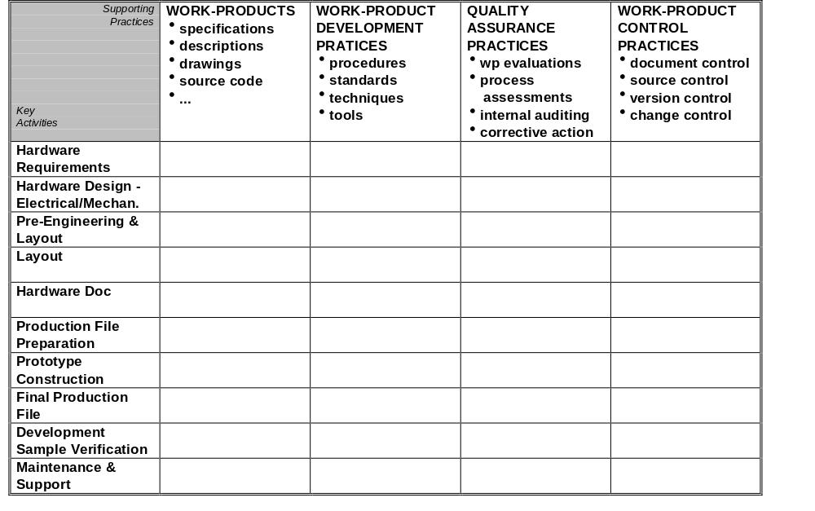
Hardware Engineering Process Matrix
Notes:
13
16

Slide 43
Software Quality Practices
process /
quality
planning
product / process
quality evaluations
[tracking]
corrective / preventive action
process
[controlling]
process
improvement

Slide 44
Product / process quality evaluations
“corridor” management
work-product evaluations/reviews
project status meetings
internal audits
external audits

Slide 45
Work-product evaluations
work
products
key development activity
“creative”
inserts defects
progressive
work
products

Slide 46
Work-product evaluations
work
products
work
product evaluation
PR
key development activity
“creative”
inserts defects
progressive
“destructive”
identifies defects
regressive
work
products

Slide 47
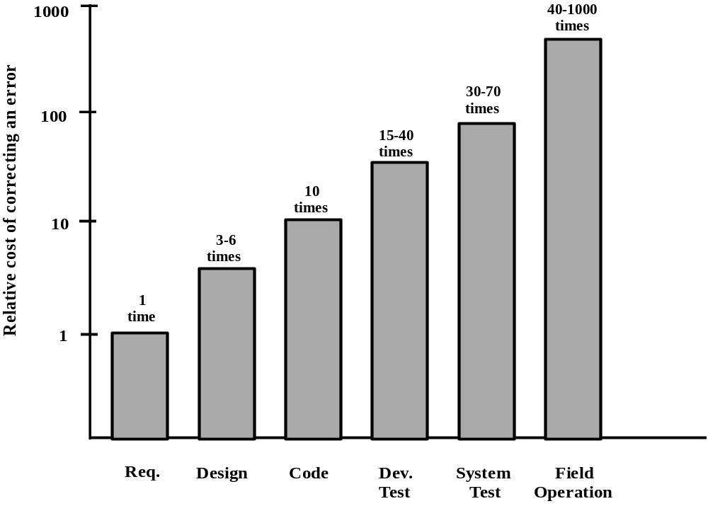
Why Evaluation Activities Pay Off ?
“Rule of 10”

Slide 48
Quality reviews
A group of people carefully examine part or all of a software work product. E.g.,
  requirements specifications, design specifications, code, test plans, process specifications
Objective is the discovery of defects and inconsistencies
Review teams should be relatively small and reviews should be fairly short
Reviews should be recorded, records maintained and problems tracked
Software or documents may be 'signed off' at a review which signifies that progress to the next development stage has been approved
Project management function - they provide information for project managers
Training and communication function - product knowledge is transferred between development team members

Slide 49
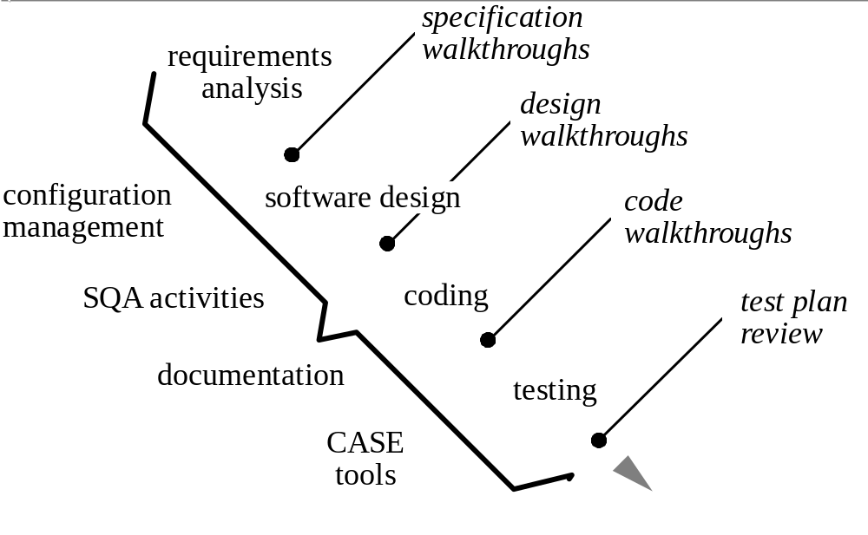
Ensuring Quality: Reviews

Slide 50
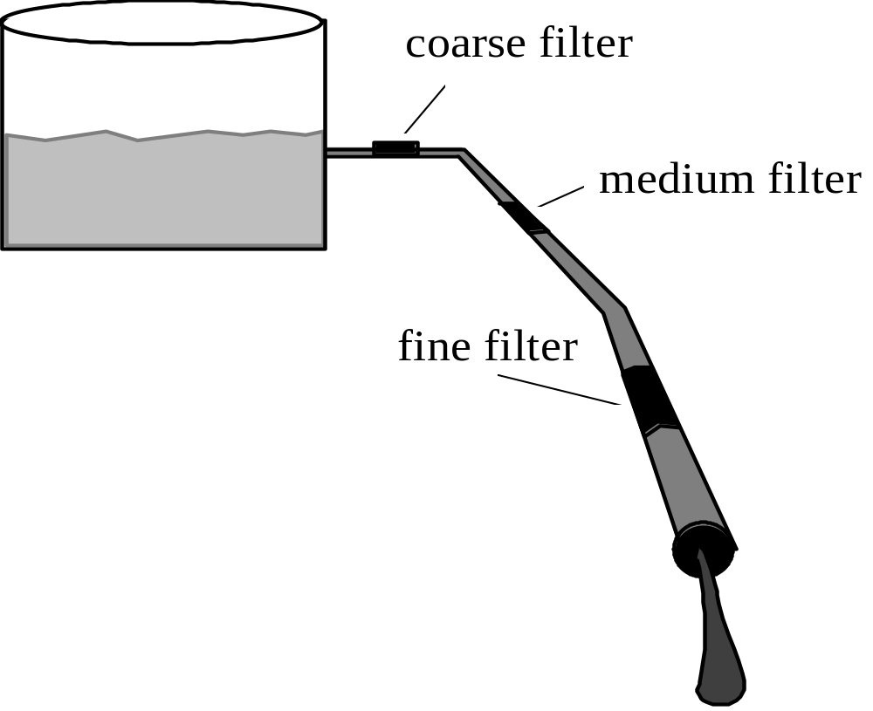
Reviews Act as a Filter

Slide 51
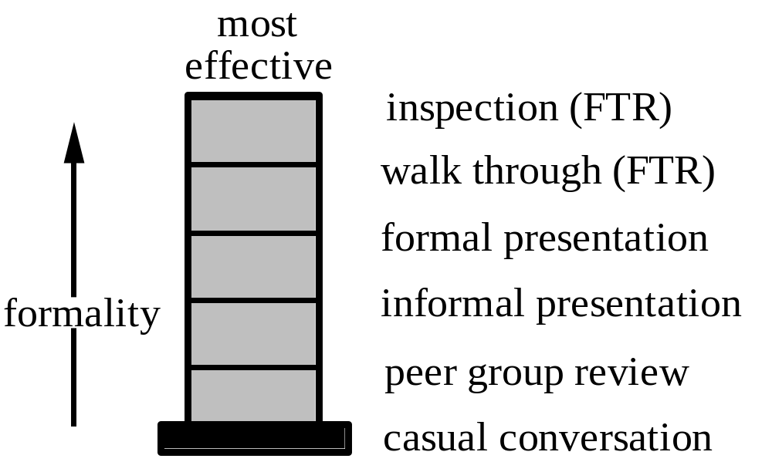
Reviews: An Effectiveness Scale
Review Types

Slide 52
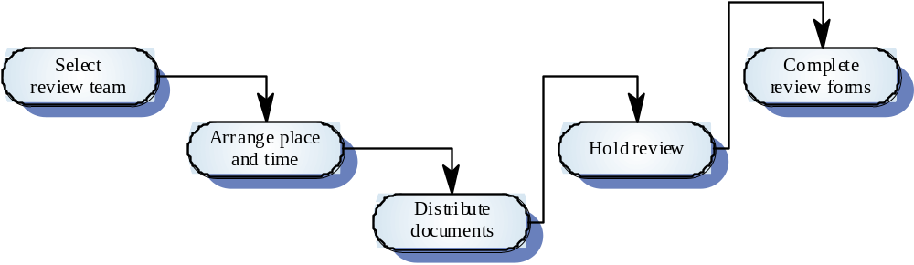
The review process

Slide 53
The review process
Plan the review
Team, place, t ime
Distribute
Materials
to be reviewed
Prepare
Conduct
review
Record /distribute
review
results
Track
corrective
action

Slide 54
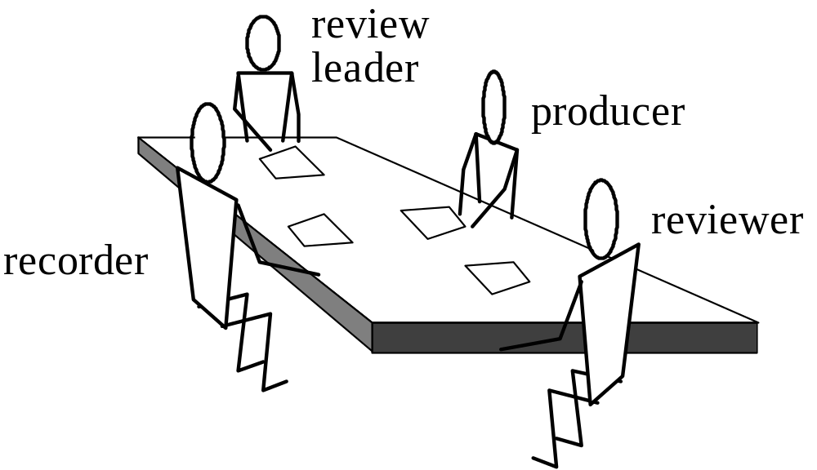
The Review Team

Slide 55
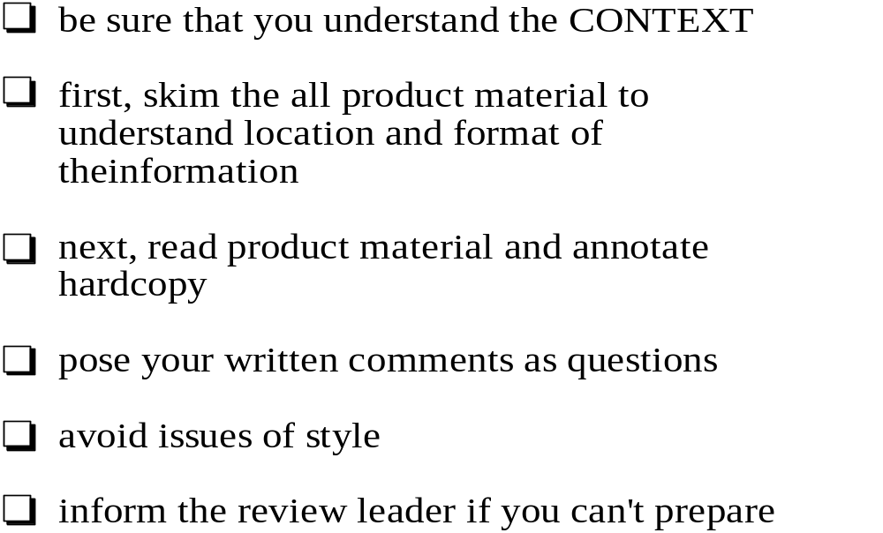
Reviewer’s Preparation

Slide 56
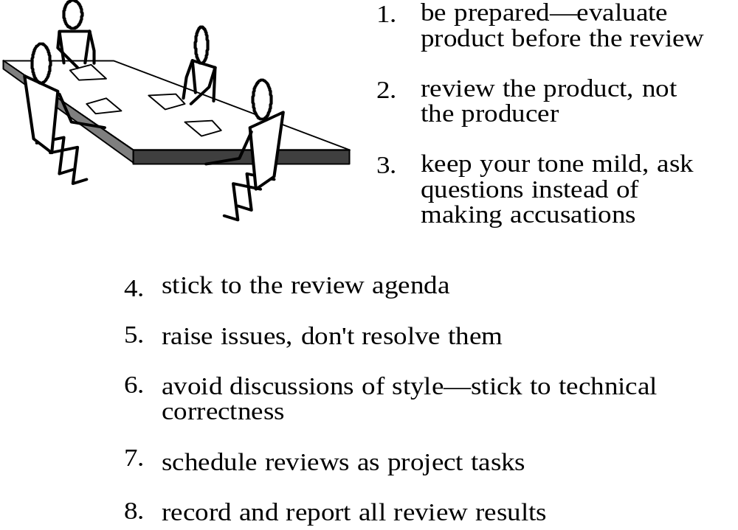
Conducting the Review

Slide 57
Review results
Comments made during the review should be
classified.
  No action - No change to the software or documentation is
  required.
  Refer for repair - Designer or programmer should correct an
  identified fault.
  Reconsider overall concept - The problem identified in the
  review impacts other issues. Some overall judgment must be made about the most cost-effective way of resolving the problem.
Requirements specification errors may
have to be referred to the client.

Slide 58
Software Quality Practices
process / quality
planning
product / process
quality evaluations
[tracking]
corrective / preventive action process
[controlling]
process
improvement

Slide 59
add slides re Process quality evaluation/assessment

Slide 60
Internal quality audits [ISO 9001 - 4.17]
The supplier shall establish and maintain documented procedures for planning and implementing internal quality audits to verify whether quality activities and related results comply with planned arrangements and to determine the effectiveness of the quality system.
Internal audits ... shall be carried out by personnel independent of those having direct responsibility for the activity being audited.
The results of the audits shall be recorded and brought to the attention of the personnel having responsibility in the area audited.
The management personnel responsible for the area shall take timely corrective action on deficiencies found during the audit.
Follow-up audit activities shall verify and record the implementation and effectiveness of the corrective action taken.
The results of internal quality audits form an integral part of the input to management review activities.

Slide 61


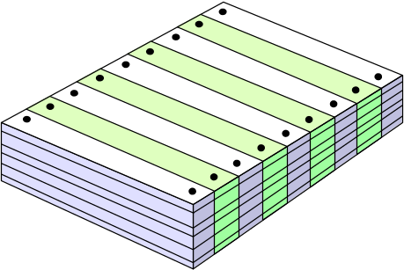
Proposed Development Process Audit Program
Project/Product/Activity oriented
  1-2 audits per year
Objectives
  evaluate quality system adequacy
  verify compliance with quality system
  identify process improvement opportunities
Development Process Audit Plan (published periodically)
  Projects to be audited
  Schedule
  Auditors
  Required preparations
QUALITY
SYSTEM
Audit
Plan

Slide 62
An Internal Audit Process
Auditor
Project/Activity/Unit
Quality
1. Conduct
Opening Meeting
2. Conduct
Audit Interviews
3. Write
Audit Report
4. Present
Audit Report
Audit Report
•
5. Establish
Findings
•
[closing meeting]
FindingsSummary
Action Plan
Finding/Action
•
AuditSummary
Forms
•
7. Track
Action Plan
Planning
•
Implementation
•
6. Implement
Approval
Action Plan
8. Follow-Up Audit
[audit the CPI
Action function]

Slide 63

The Internal Audit Process
The Audit Report
Audit Summary
Audit checklist [optional]
Findings

Slide 64
Internal Audits Lead To -
project level
  correction
  prevention
  improvement
division/corporate level
  management review
  corporate learning
  corporate improvement

Slide 65
Software Quality Practices
process / quality
planning
product / process
quality evaluations
[tracking]
corrective / preventive action process
[controlling]
process
improvement

Slide 66
Corrective / Preventive / Improvement Action
record
finding
Evaluation
establish
action plan
FINDINGS
Non-Compliance
Process
Inadequacy
Improvement
Opportunity
Tracking
implement
action plan
Auditing
track / approve
implementation
Customer
Complaint
maintain
quality records

Slide 67
Corrective / preventive action process
PR problem report
Problem Report
Report PR
  enter description
Analyze PR
  initial analysis; assign Handler, priority, due date
Handle PR
  analyze PR
  resolve PR
  analyze defect
  approve (review, test, etc.)
Validate Re/Solution
Close Task

Slide 68
Corrective / preventive action process
Problem Report [PR]
Report Problem
  enter description
Analyze Problem
  initial analysis; assign Handler, priority, due date
Handle Problem
  analyze problem
  create/define subtasks
  track subtask progress
  analyze defect
  approve (review, test, etc.)
Validate Re/Solution
Close Task
SUBTASK
Define
  synopsis
  detailed desc.
  due date
  responsible
Perform
  resolution
Close
PR problem report

Slide 69
Corrective / preventive action process
PR problem report
Report
Screen
Handle
Validate
Close
Problem
subtask
subtask
...
subtask
Define
Perform
Close

Slide 70
A Schematic Problem Tracking System
Information
/Status
Analysis
Notes
Tasks
Resolution
Notes
Defect
Data
Validation
Notes

Slide 71
A Schematic Problem Tracking System
Reporting
Information
/Status
Analysis
Notes
Tasks
Resolution
Notes
Defect
Data
Validation
Notes
Type [problem/feature]
Project...
Description...
Severity
Repeatability
Detection Info...
Reporter
Notes:
The CURRENT RESPONSIBLE of a CLOSED PR is the VALIDATOR who closed it.
The CURRENT RESPONSIBLE [or a CCB member] may return a CLOSED PR to either the SCREENING, HANDLING or VALIDATING states.

Slide 72
A Schematic Problem Tracking System
Reporting
Screening
Information
/Status
Analysis
Notes
Tasks
Resolution
Notes
Defect
Data
Validation
Notes
Type [P/C/W]
Project...
Description...
Severity
Repeatability
Detection Info...
Reporter
Screener
Validator
Notes:
The CURRENT RESPONSIBLE of a CLOSED PR is the VALIDATOR who closed it.
The CURRENT RESPONSIBLE [or a CCB member] may return a CLOSED PR to either the SCREENING, HANDLING or VALIDATING states.

Slide 73
A Schematic Problem Tracking System
Reporting
Screening
Information
/Status
Analysis
Notes
Tasks
Resolution
Notes
Defect
Data
Validation
Notes
Type [P/C/W]
Project...
Description...
Severity
Repeatability
Detection Info...
Reporter
Screener
Handler
Validator
Priority
“Resolve In” Info
Background
Symptom
Impact
Cause
Suggestion
Question
...
Notes:
The CURRENT RESPONSIBLE of a CLOSED PR is the VALIDATOR who closed it.
The CURRENT RESPONSIBLE [or a CCB member] may return a CLOSED PR to either the SCREENING, HANDLING or VALIDATING states.

Slide 74
A Schematic Problem Tracking System
Reporting
Screening
Handling
Information
/Status
Analysis
Notes
Tasks
Resolution
Notes
Defect
Data
Validation
Notes
Type [P/C/W]
Project...
Description...
Severity
Repeatability
Detection Info...
Reporter
Screener
Handler
Validator
Priority
“Resolve In” Info
Background
Symptom
Impact
Cause
Suggestion
Question
...
Synopsis
Description
Due Date
Performer
Notes
Resolution
Change Desc
Tests Performed
....
Area
Activity
Work Product
Defect Type
Description
Detection
Notes:
The CURRENT RESPONSIBLE of a CLOSED PR is the VALIDATOR who closed it.
The CURRENT RESPONSIBLE [or a CCB member] may return a CLOSED PR to either the SCREENING, HANDLING or VALIDATING states.

Slide 75
A Schematic Problem Tracking System
Reporting
Screening
Handling
Validating
Information
/Status
Analysis
Notes
Tasks
Resolution
Notes
Defect
Data
Validation
Notes
Type [P/C/W]
Project...
Description...
Severity
Repeatability
Detection Info...
Reporter
Screener
Handler
Validator
Priority
“Resolve In” Info
Background
Symptom
Impact
Cause
Suggestion
Question
...
Synopsis
Description
Due Date
Responsible
Notes
Resolution
Change Desc
Tests Performed
....
Area
Activity
Work Product
Defect Type
Description
Detection
Passed
Failed
Untested
Problem
Instructions
Other
....
Notes:
The CURRENT RESPONSIBLE of a CLOSED PR is the VALIDATOR who closed it.
The CURRENT RESPONSIBLE [or a CCB member] may return a CLOSED PR to either the SCREENING, HANDLING or VALIDATING states.

Slide 76
A Schematic Problem Tracking System
Reporting
Screening
Handling
Validating
Closed
Information
/Status
Analysis
Notes
Tasks
Resolution
Notes
Defect
Data
Validation
Notes
Type [P/C/W]
Project...
Description...
Severity
Repeatability
Detection Info...
Reporter
Screener
Handler
Validator
Priority
“Resolve In” Info
Background
Symptom
Impact
Cause
Suggestion
Question
...
Synopsis
Description
Due Date
Responsible
Notes
Resolution
Change Desc
Tests Performed
....
Area
Activity
Work Product
Defect Type
Description
Detection
Passed
Failed
Untested
Problem
Instructions
Other
....
Notes:
The CURRENT RESPONSIBLE of a CLOSED PR is the VALIDATOR who closed it.
The CURRENT RESPONSIBLE [or a CCB member] may return a CLOSED PR to either the SCREENING, HANDLING or VALIDATING states.

Slide 77
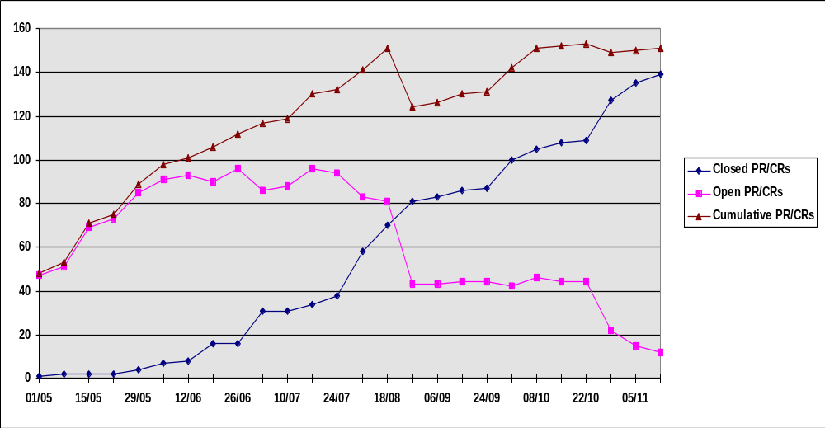
Metrics - PR Status

Slide 78
Summary of
Software Quality Assurance Practices
Process
Improvement
Develop
work-product
Corrective
Action
Dev.
Practices
evaluation
report
Evaluate
Checklist
Assess
assessment
report
Questionnaire
Audit
audit report
Notes:
11
14

Slide 79
Software Quality Practices
process /
quality
planning
product / process
quality evaluations
[tracking]
corrective / preventive action
process
[controlling]
process
improvement

Slide 80
Process and product quality
Process quality and product quality are closely
related
A good process is usually required to produce a
good product
For manufactured goods, process is the
principal quality determinant
For designs, other factors are also involved
  people
  related engineering disciplines
  management culture

Slide 81
Process improvement
Understanding existing processes
Introducing process changes to achieve organizational objectives which are usually focused on quality improvement, cost reduction and schedule acceleration
Much of process improvement work so far has
focused on defect reduction. Reflects increasing attention paid by industry to quality

Slide 82
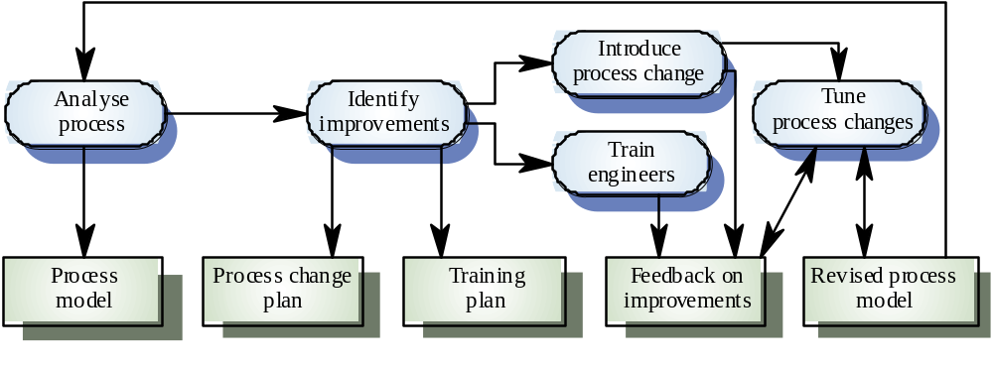
The process improvement process

Slide 83
Process improvement stages
Process analysis
  Model and analyze (quantitatively if possible) existing processes
Improvement identification
  Identify quality, cost or schedule bottlenecks
Process change introduction
  Modify the process to remove identified bottlenecks
Process change training
  Train staff involved in new process proposals
Change tuning
  Evolve and improve process improvements

Slide 84
Process analysis and modeling
Study an existing process to understand its
activities
Produce an abstract model of the process. You should normally represent this graphically. Several different views (e.g. activities, deliverables, etc.) may be required
Analyse the model to discover process
problems. Involves discussing activities with stakeholders

Slide 85
Process analysis techniques
Published process models and process
standards
  It is always best to start process analysis with an existing model. People then may extend and change this.
Questionnaires and interviews
  Must be carefully designed. Participants may tell you what they think you want to hear
Ethnographic analysis
  Involves assimilating process knowledge by observation

Slide 86
Software process model elements
Activities
  Has clearly defined objective, entry and exit conditions. Often carried out by a single person.
Processes
  Set of activities with some coherence and an agreed
  objective.
Deliverables
  Tangible output of an activity. Often a document.
Conditions
  Predicate which must hold either before [pre-] or after [post-] a process
  or activity.
Roles
  A bounded area of responsibility. Examples are configuration manager, test engineer, etc.
Exceptions
  An event which requires some special handling and is not
  processed by normal activities. Usually handled as they arise without a pre-planned strategy.
Communication pathway
  An interchange of information between people or people
  and computers, e.g., notifications

Slide 87
Software Process Modeling –
An Internal Audit Process
Roles
Auditor
Project/Activity/Unit
Quality
1. Conduct
Opening Meeting
Activities
2. Conduct
Audit Interviews
Deliverables
3. Write
Audit Report
4. Present
Audit Report
Audit Report
•
5. Establish
Findings
•
[closing meeting]
FindingsSummary
Action Plan
Finding/Action
•
AuditSummary
Forms
•
7. Track
Action Plan
Planning
•
Implementation
•
6. Implement
Approval
Action Plan
8. Follow-Up Audit
[audit the CPI
Action function]

Slide 88
Process measurement
Wherever possible, quantitative process data
should be collected
  However, where organizations do not have clearly defined process standards this is very difficult as you don’t know what to measure. A process may have to be defined before any measurement is possible
Process measurements should be used to
assess process improvements
  But this does not mean that measurements should drive the improvements. The improvement driver should be the organizational objectives

Slide 89
Classes of process measurement
Time taken for process activities to be
completed
  E.g. Calendar time or effort to complete an activity or
  process
Resources required for processes or activities
  E.g. Total effort in person-days
Number of occurrences of a particular event
  E.g. Number of defects discovered

Slide 90
Documented results of process improvement
Difficulties in collecting data
  no beginning data available, no baseline
  no standard way to measure either costs or benefits
  some benefits are not easily quantifiable

Slide 91
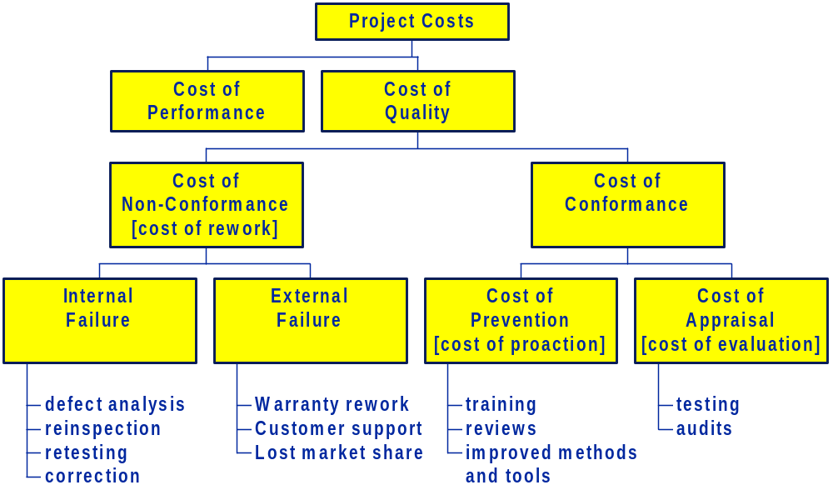
Cost of Quality

Slide 92
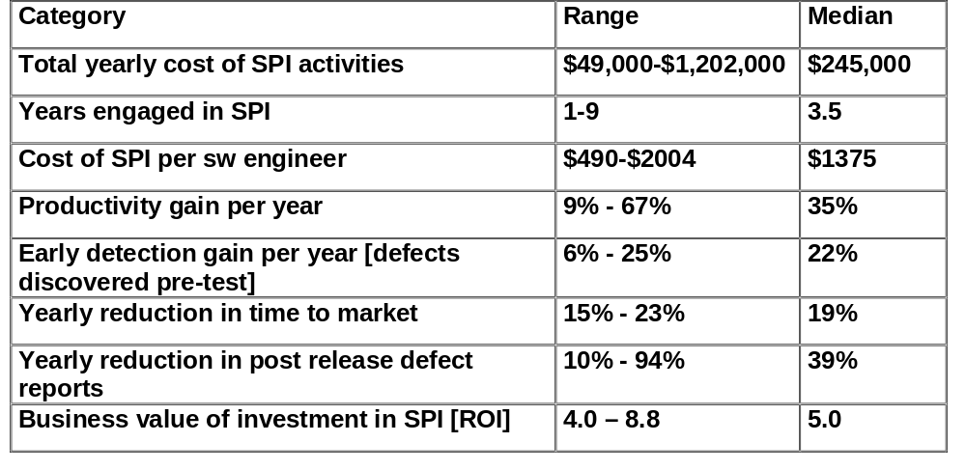
SPI data collected from 13 organizations by SEI

Slide 93
SPI Results at Raytheon
In the eight years since the sw engineering initiative was put in place, Raytheon demonstrated sustained, significant and measurable improvements to its sw engineering process
Cost of quality
  non-conformance costs reduced from 41% of project costs to 20% at the expense of small increases in appraisal/prevention costs
Software Productivity
  productivvity increased by 190% over the same eight year period
Software Predictability
  actual cost compared to budgeted cost improved dramatically from 40% overrun to 3%
Product Quality
  defect density decreased from 17.2 to 4.0 sw trouble reports per 1000
from Thomas Haley, “Software Process Improvement at Raytheon”, IEEE Software, November 1996.

Slide 94
Inspections at HP
Rework accounts for 33% of HP software cost
Inspections can save 60% of these rework costs
Cost benefit analysis for design inspections showed a ROI of 10.4
from Grady and Van Slack, “Key Lessons in Achieving Widespread Inspection Use”, IEEE Software, July 1994.

Slide 95
After the Appraisal: A Systematic Survey of Process Improvement, its Benefits, and Factors that Influence Success,
Goldenson and Herbslab,
CMU/SEI-95-TR-009, August 1995.
Factors influencing SPI success
  management support
    managers clearly stating SPI goals
    managers actively monitoring spi efforts
    Correlation between management support and SPI success
  funding
    ensuring adequate resources for SPI efforts
  staffing
    people involved in SPI should be well respected within their organizations
    people doing the technical work should be involved in the SPI effort
  excessive territorialism and organizational politics
  diagnosis, treatment and follow-up
    it’s harder to know how to improve, than what to improve

Slide 96
SPI Models
ISO 9000 - 2000
SEI - Capability Maturity Models
  SW-CMM® Capability Maturity Model for Software
  Capability Maturity Model Integration (CMMI)
  P-CMM People Capability Maturity Model
  SA-CMM Software Acquisition Capability Maturity Model
  SE-CMM Systems Engineering Capability Maturity Model
  IPD-CMM Integrated Product Development Capability Maturity Model
Spice
  European initiative, meta-model
Trillium
  Developed by Canadian telecommunications industries
  Continuous model
  Includes systems engineering
Bootstrap

Slide 97
Summary of
Software Quality Assurance Practices
Process
Improvement
SPI Models
Work
Product
Develop
Corrective
Action
Development
Processes,
Practices,
Methods,
Tools
Evaluation
Report
Evaluate
Procedure
& Tools
Checklist
Audit
Audit
Report
Questionnaire
Notes:
11
14

Slide 98
Table of Contents
Software quality
  basic quality concepts
  software quality
  software quality management
Software quality assurance practices
  quality/process planning
  quality [product/process] evaluations
  corrective/preventive action
  process improvement
Quality/process standards - projects
  ISO 9001
  CMM
Organizational Issues - exercise
Summary

Slide 99
ISO 9000
International set of standards for quality management
Applicable to a wide range of organisations from manufacturing to service industries
ISO 9001 applicable to organisations which design, develop and maintain products
ISO 9001 is a generic model of the quality process. Must be instantiated for each organization.
ISO 9000-3 provides guidelines for the application of ISO 9001 to the development, supply and maintenance of software.

Slide 100
ISO 9001 - Basic Concepts
QUALITY SYSTEM
organizational
structure
processes
procedures
resources
ISO 9001 is not a quality system
ISO 9001 specifies requirements
for a quality system
identifies the elements
specifies requirements per element
establish
document
maintain
ensure effective implementation
ISO 9000-3 provides
guidelines for the
application of ISO 9001
to SW development .

Slide 101



ISO 9001 in a Nutshell
1. Say what you do !
2. Do what you say !
3. Prove It !

Slide 102
ISO 9001 - Quality System Requirements
1. Management
  Responsibility
2. Quality System
3. Contract Review
4. Design Control
5. Document and Data
Control
6. Purchasing
7. Control of customer-
supplied product
8. Product identification
and traceability
9. Process control
10. Inspection and testing
11. Control of inspection,
measuring and test
equipment
12. Inspection and test status
13. Control of non- conforming
product
14. Corrective and
preventive action
15. Handling, storage, packaging,
  preservation and delivery
16. Control of quality records
17. Internal quality audits
18. Training
19. Servicing
20. Statistical Techniques

Slide 103
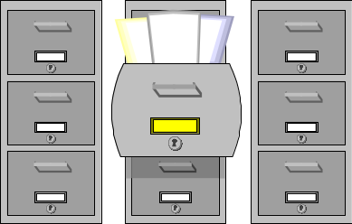
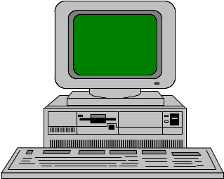
Key Practices: Quality Records
QUALITY RECORDS
  Quality records are documents that demonstrate achievement of the required quality and effective operation of the quality system. [ISO]
E.g. -
Review reports
Status reports
Test reports
Training records
Corrective Action
Quality Record Requirements
identification
collection
indexing & filing
storage
maintainenance
accessibility

Slide 104
ISO 9000 certification
Quality standards and procedures should be documented in an organizational quality manual
External body may certify that
  an organisation’s quality system conforms to ISO 9000 standards
  the organization complies with its own quality system
Customers are increasingly demanding that suppliers are ISO 9000 certified.
In Israel, “Machon Ha’tkanim” provides certification services.

Slide 105
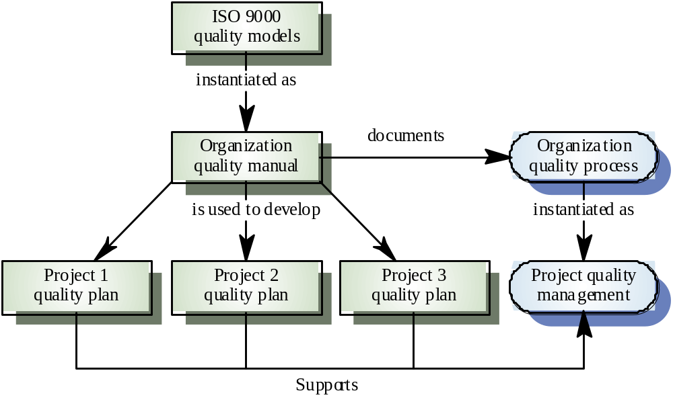
ISO 9000 and quality management

Slide 106


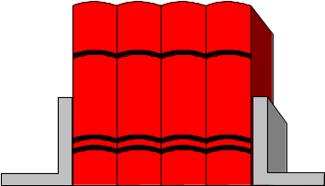


External Audits
IIS - Machon Ha’Tkanim
ISO 9001 / 9000-3
twice a year
what ?
  quality system
  implementation
  follow-up
  objective evidence
ISO
9001

Slide 107
CMM [Capability Maturity model] of the Software Engineering Institute
US Defense Dept. funded institute associated
with Carnegie Mellon
Mission - to promote software technology
transfer particularly to defense contractors
Maturity model proposed in mid-1980s, refined
in early 1990s.
Work has been very influential in process
improvement

Slide 108
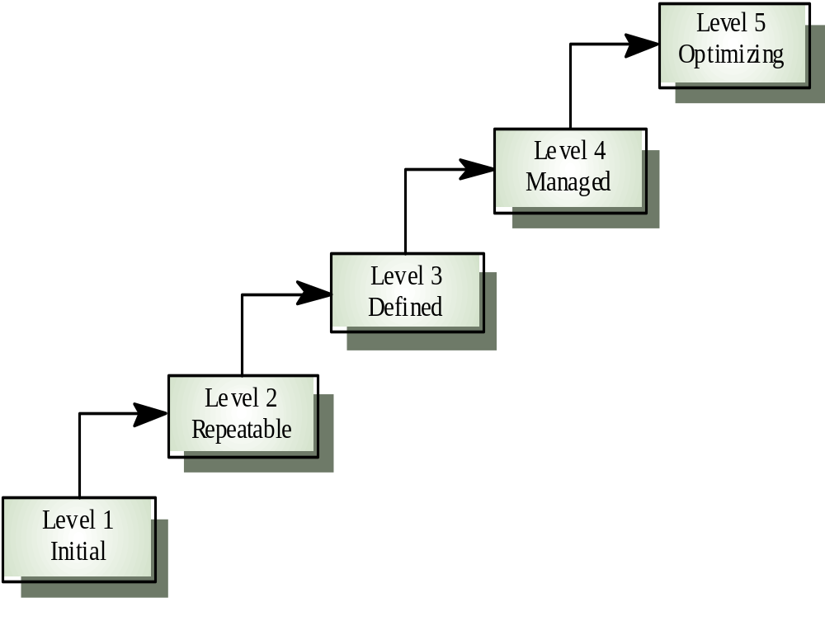
The SEI process maturity model
Process improvement strategies defined and used
Quality management strategies defined and used
Process management procedures and strategies defined and used
Product management procedures defined and used
Essentially
uncontrolled

Slide 109
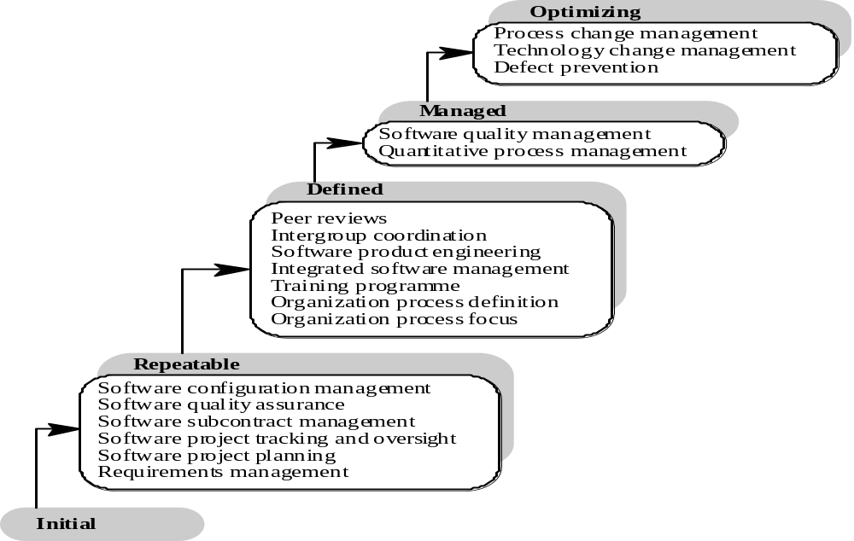
CMM Key Process Areas

Slide 110
The CMM Structure
indicate
Maturity Levels
contain
process capability
achieve
Key Process Areas
organized by
goals
address
Common Features
contain
implementation or
institutionalization
describe
Key Practices
activities or
infrastructure

Slide 111
CMM – Common Features

Slide 112
CMM – Key Practices

Slide 113
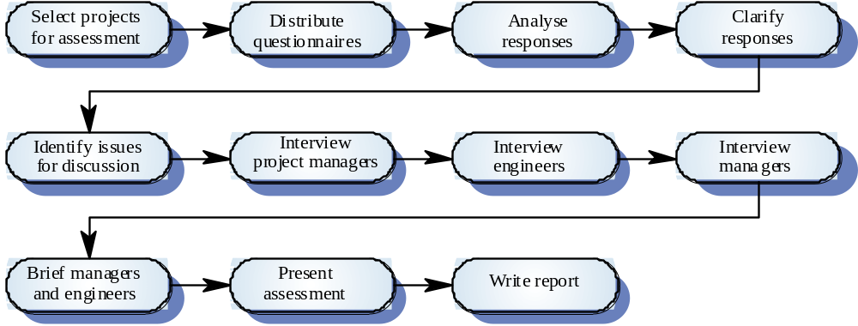
The capability assessment process

Slide 114
SEI CMM - problems
Focuses on project management rather than
product development.
Ignores use of advanced technologies [such as rapid
prototyping, code generation, etc].
Does not incorporate risk analysis as a key
process area
Imbalance in KPA’s [e.g., peer reviews vs. testing]
The CMM is a staged model - “for better and for worse”
Does not address sw development context, e.g., marketing, systems engineering, customer support

Slide 115
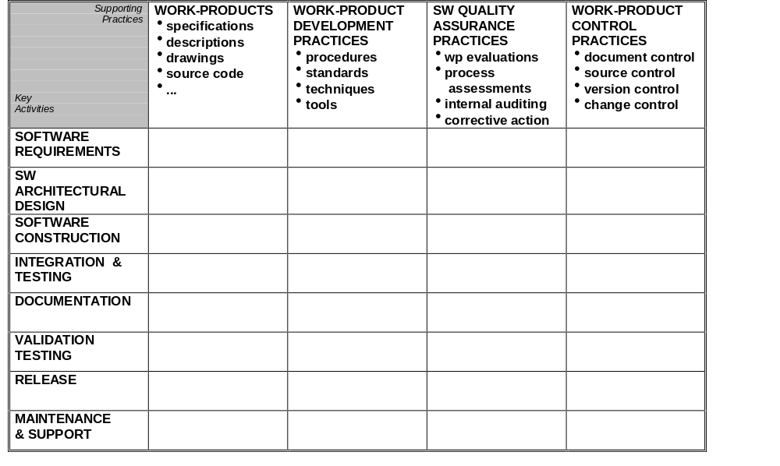
Using Process Matrices for Process Improvement
Uses of Process Matrices
describe existing processes
develop and specify new processes
plan process improvement
map available development resources

Slide 116
The SQA Organizational Issue
Does an organization need a separate SQA department? If so, what are its responsibilities, where is it situated within the organization [at the project, department, division, or corporate level], how is it related to the people doing the “work”, how is it staffed, how is it budgeted ?
The SQA group should have a reporting channel to senior management that is independent of the project and software managers.
Projects do not have the time or the resources to develop the necessary infrastructure for quality work [processes, procedures, tools, etc.]
SQA staff should be protected from adverse personnel actions that may result from organizational dependence.
Why distinguish between scope, work and risk management responsibilities and quality management/assurance responsibities ?
How can the people doing the work not be responsible for the quality of the work ?
Experience has shown that independent SQA groups are often not effective.

Slide 117
References
International Organization for Standardization, ISO 9001 : Quality system model for quality assurance in design, development, production, installation and servicing, 1994.
International Organization for Standardization, ISO 9000-3 : Quality management and quality assurance standards, Part 3: Guidelines for the application of ISO 9001 to the development, supply and maiintenance of software, 1991.
International Organization for Standardization, ISO/IEC IS 9126, Information Technology - Software product evaluation: Quality characteristics and guidelines for their use, 1991.
Humphrey, W., Managing the SW Process, Addison Wesley, 1989.
Paulk, Weber, Garcia, Chrisis and Bush, Key Practices of the Capability Maturity Model, Version 1.1, Technical Report CMU/SEI-93-TR-025, February 1993,

Slide 118
Extras

Slide 119
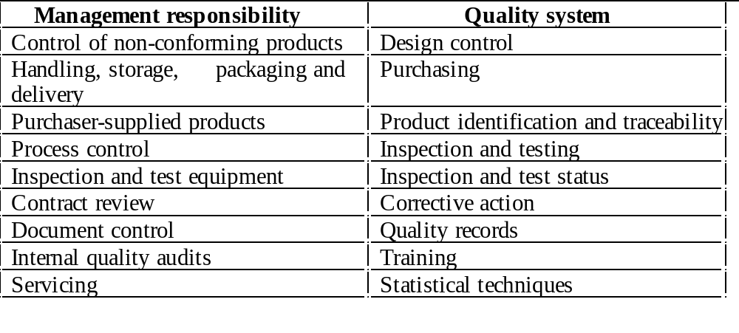
ISO 9001

