Slide 1
Chapter 5

Slide 2
Protecting Hardware / System Resources
Hardware:
  Memory, CPU, I/O
  System
  Identity (Authentication)
  Processes and address spaces
  Files
  Network (penetration, messages)
  Databases, Web sites

Slide 3
Hardware security
The lowest and most basic level
Affects all other levels
Without minimal support, no security is possible

Slide 4
Protecting Memory
Base and Bound Registers
Segmented memory
Protection keys
Virtual (Paged) memory
Segmented and Paged Virtual memory
Tagged architecture (capabilities)

Slide 5
Minimal Protection
Base
Limit
0
user
Mode Bit
Supervisor mode can load B / L registers

Slide 6
Protection Keys (IBM 360)
PSW had 4 bits protection key
Each memory partition had 4 bits protection key
To access:
  PSW key = Memory key
  Key 0 (OS) can access partition with any other key!

Slide 7
Memory Protection - Paging
Memory protection implemented by associating protection bit with each frame.
Valid-invalid bit attached to each entry in the page table:
  “valid” indicates that the associated page is in the process’ logical address space, and is thus a legal page.
  “invalid” indicates that the page is not in the process’ logical address space.
  different than in/out of memory!

Slide 8

Address Translation Architecture

Slide 9

Valid (v) or Invalid (i) Bit In A Page Table

Slide 10

Segmentation
One-dimensional address space with growing tables
One table may bump into another

Slide 11
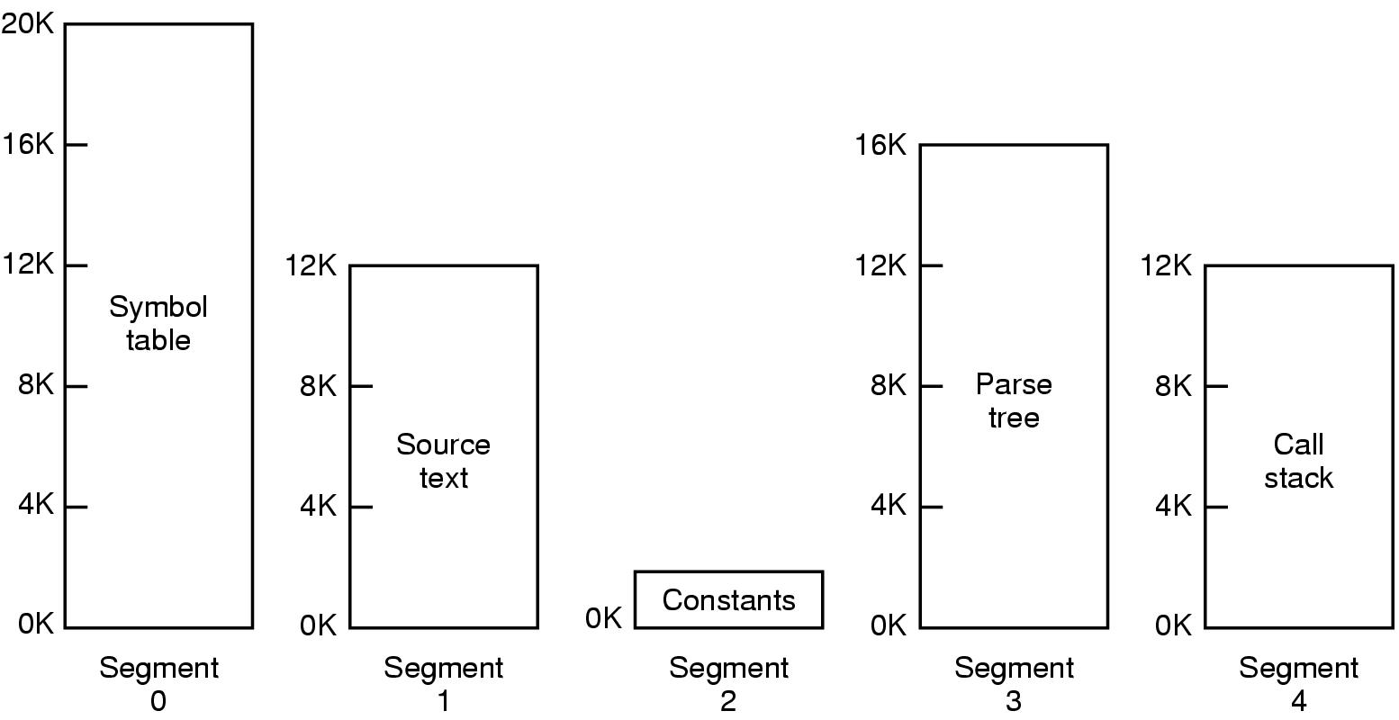
Segmentation cont.
Allows each table to grow or shrink, independently

Slide 12
Segmentation – primitive form – Intel 286 (old PC)
Data segment and Code segment
Fixed size – 64K each

Slide 13
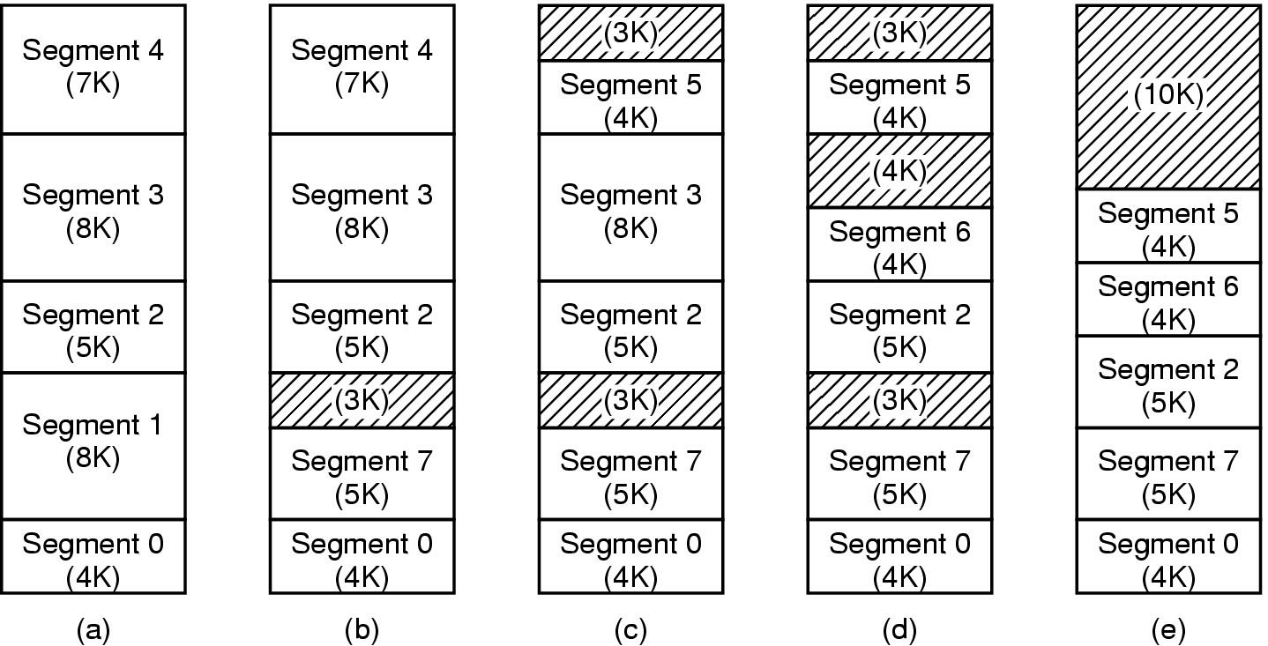
Implementation of Pure Segmentation
(a)-(d) Development of checkerboarding
(e) Removal of the checkerboarding by compaction

Slide 14
Segmentation Architecture (Cont.)
Protection. With each entry in segment table associate:
  validation bit = 0 ⇒ illegal segment
  read/write/execute privileges
Protection bits associated with segments; code sharing occurs at segment level.
Since segments vary in length, memory allocation is a dynamic storage-allocation problem.
A segmentation example is shown in the following diagram

Slide 15

Example of Segmentation

Slide 16
Segmentation - Address space structure
One address space per process
Two address spaces per process (data and code)
One address space per user process, all of them shared with an address space for the OS
A single-level address space

Slide 17
Configurations of Virtual Address Spaces
80286/386/486
NS32000
MC68020 , Z80000
Users
Supervisor
Users
Program
Data
Program
Data
Supervisor
Users
Supervisor

Slide 18

Segmentation vs. Paging
Comparison of paging and segmentation

Slide 19
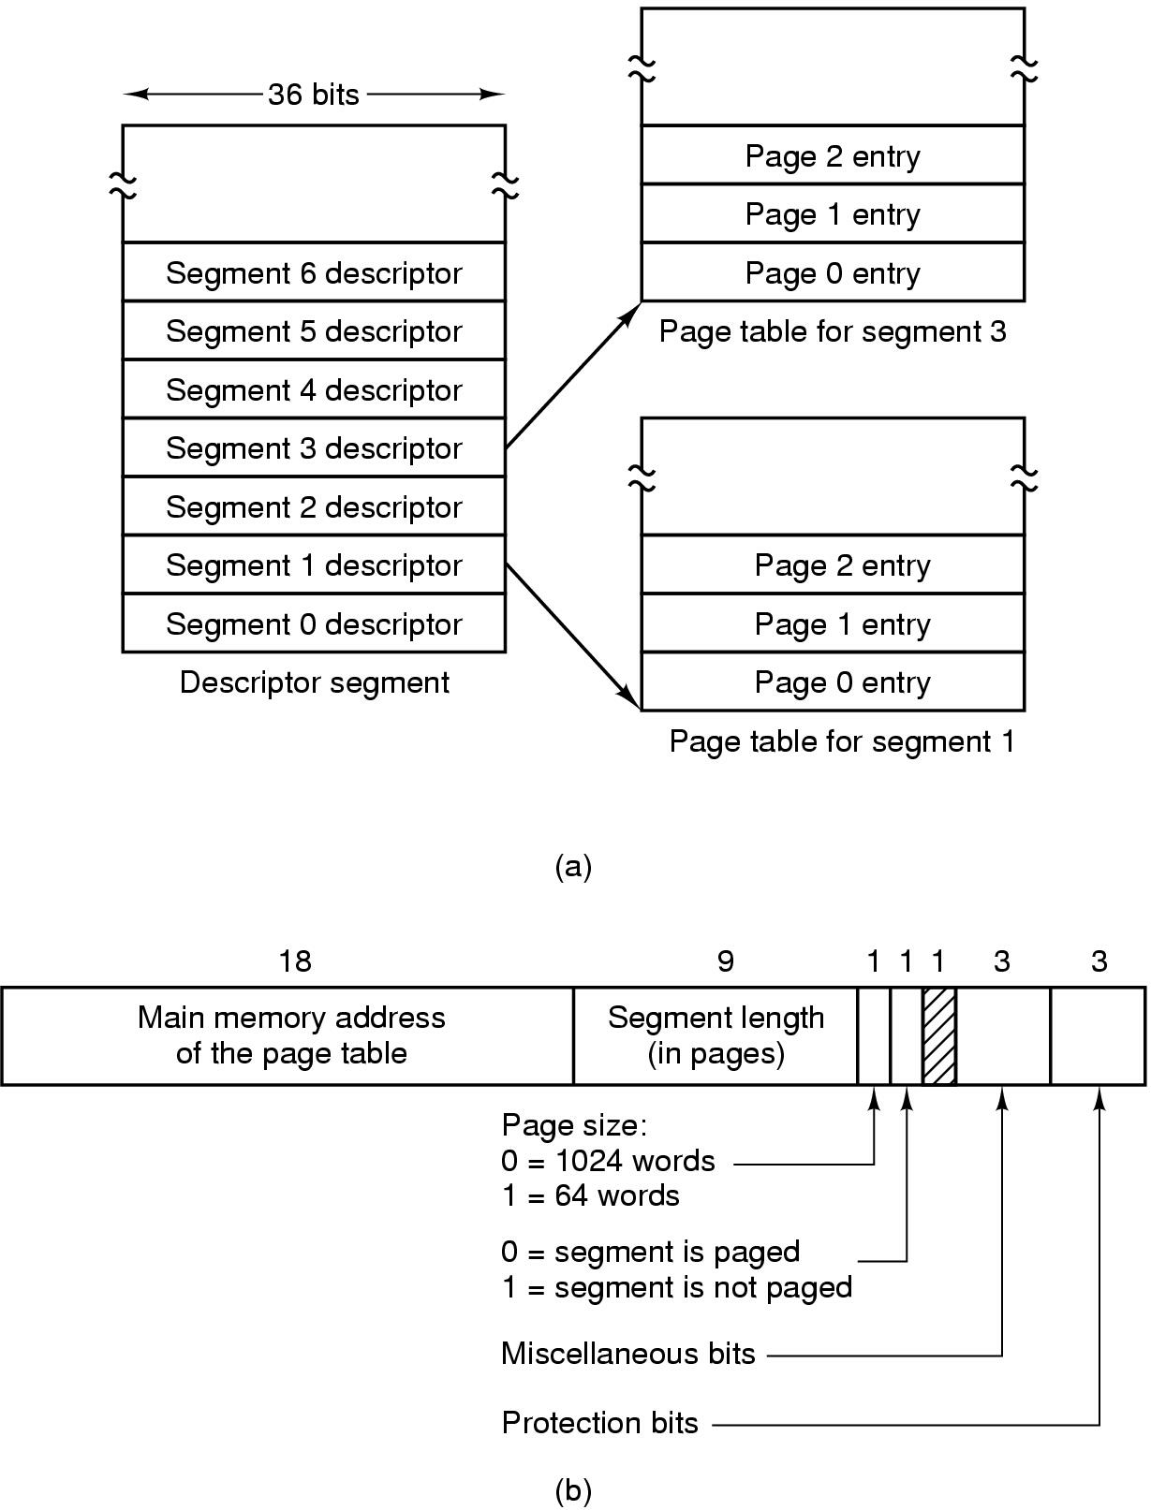
Segmentation with Paging: MULTICS (1)
Descriptor segment points to page tables
Segment descriptor – numbers are field lengths

Slide 20
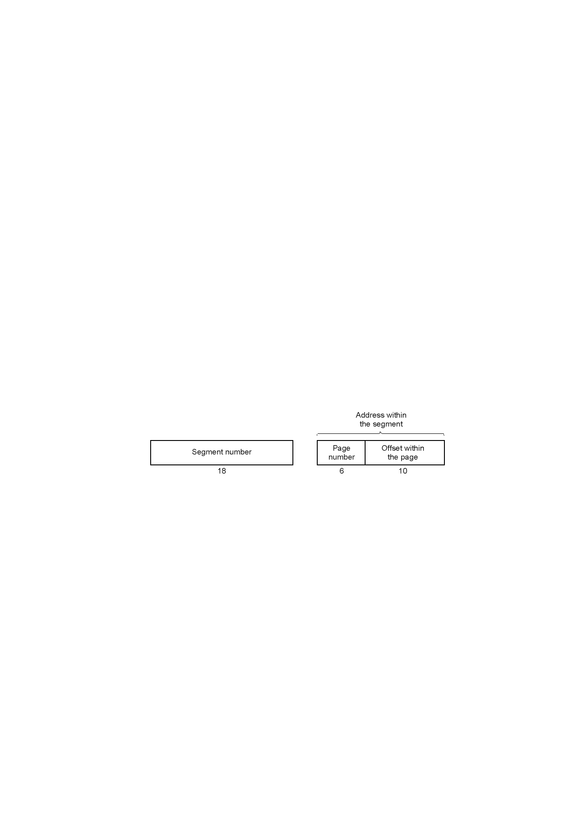
Segmentation with Paging: MULTICS (2)
Into Descriptor Segment
A 34-bit MULTICS virtual address

Slide 21
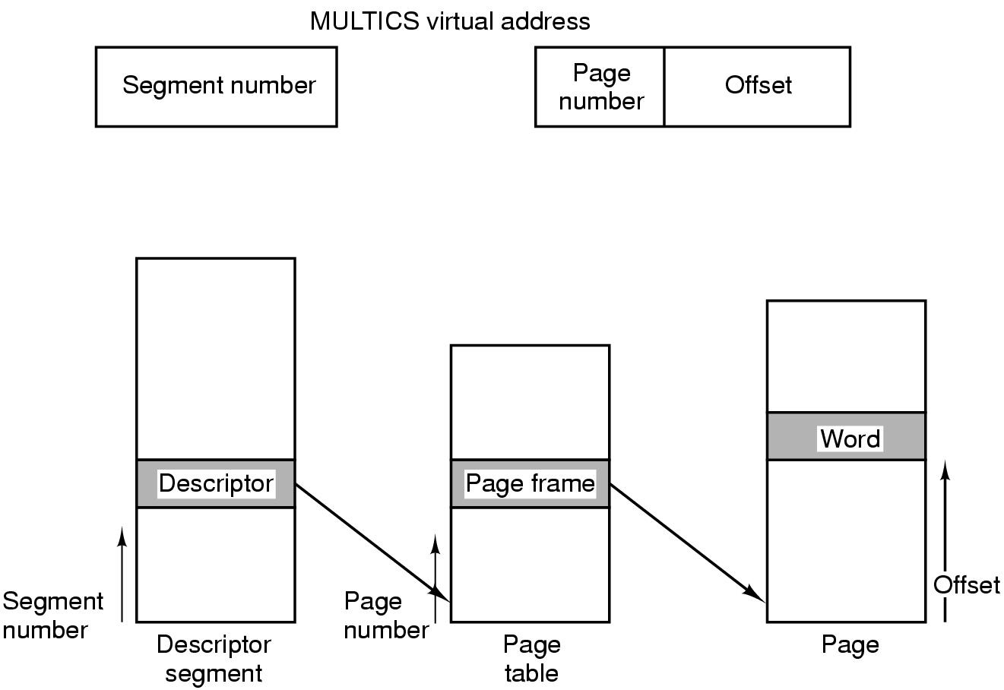
Segmentation with Paging: MULTICS (3)
Conversion of a 2-part MULTICS address into a main memory address

Slide 22
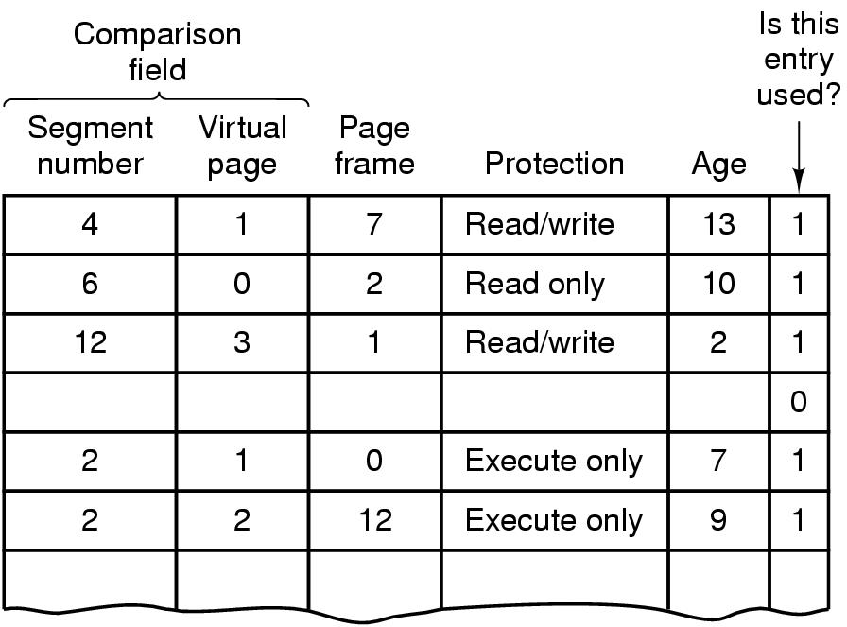
Segmentation with Paging: MULTICS (4)
Simplified version of the MULTICS TLB
Existence of 2 page sizes makes actual TLB more complicated

Slide 23
Paged segmentation on the INTEL 80386
16k segments, each up to 1G (32bit words)
2 types of segment descriptors
  Local Descriptor Table (LDT), for each process
  Global (GDT) system etc.
  access by loading a 16bit selector to one of the 6 segment registers: CS, DS, SS, (holding the 16bit selector during run time, 0 means not-in-use)
Selector points to segment descriptor (8 bytes)
0 = GDT/ 1 = LDT
Privilege level (0-3)
13
1
2
Index

Slide 24
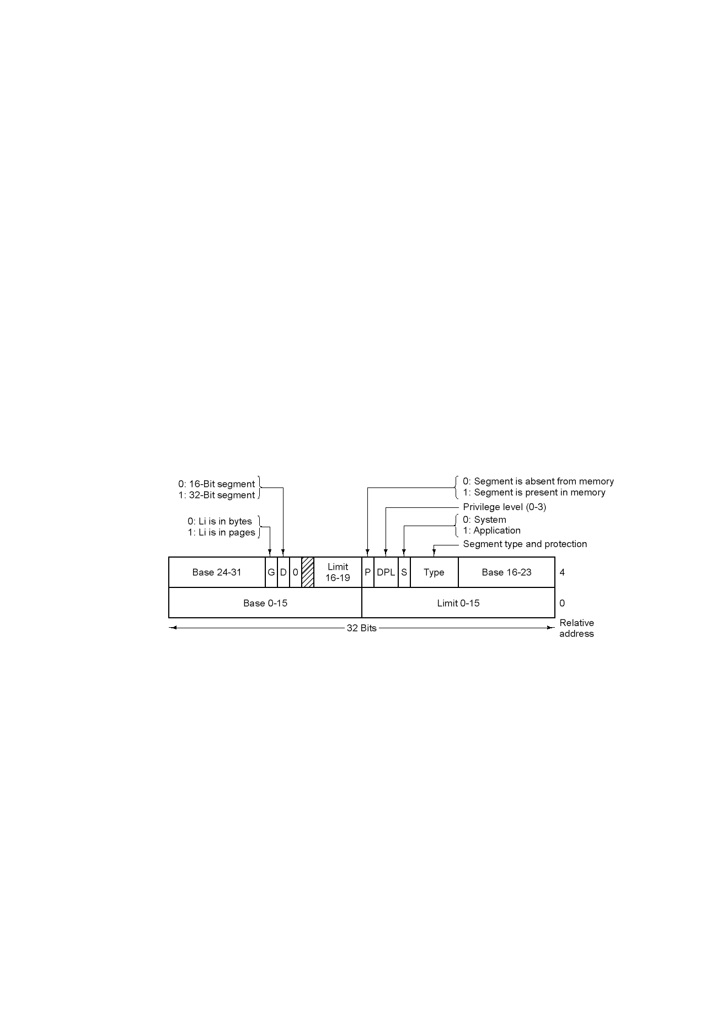
Segmentation with Paging: Pentium (2)
Pentium code segment descriptor
Data segments differ slightly

Slide 25
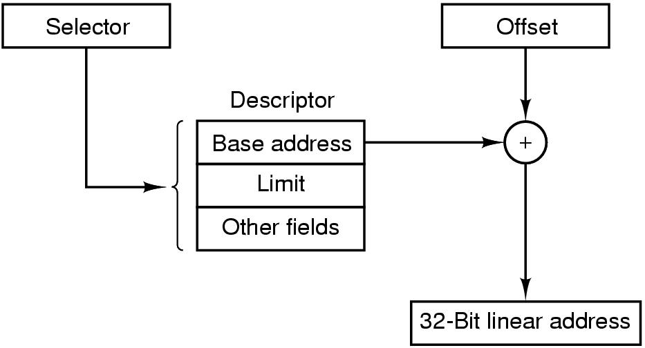
Segmentation with Paging: Pentium (3)
Conversion of a (selector, offset) pair to a linear address

Slide 26
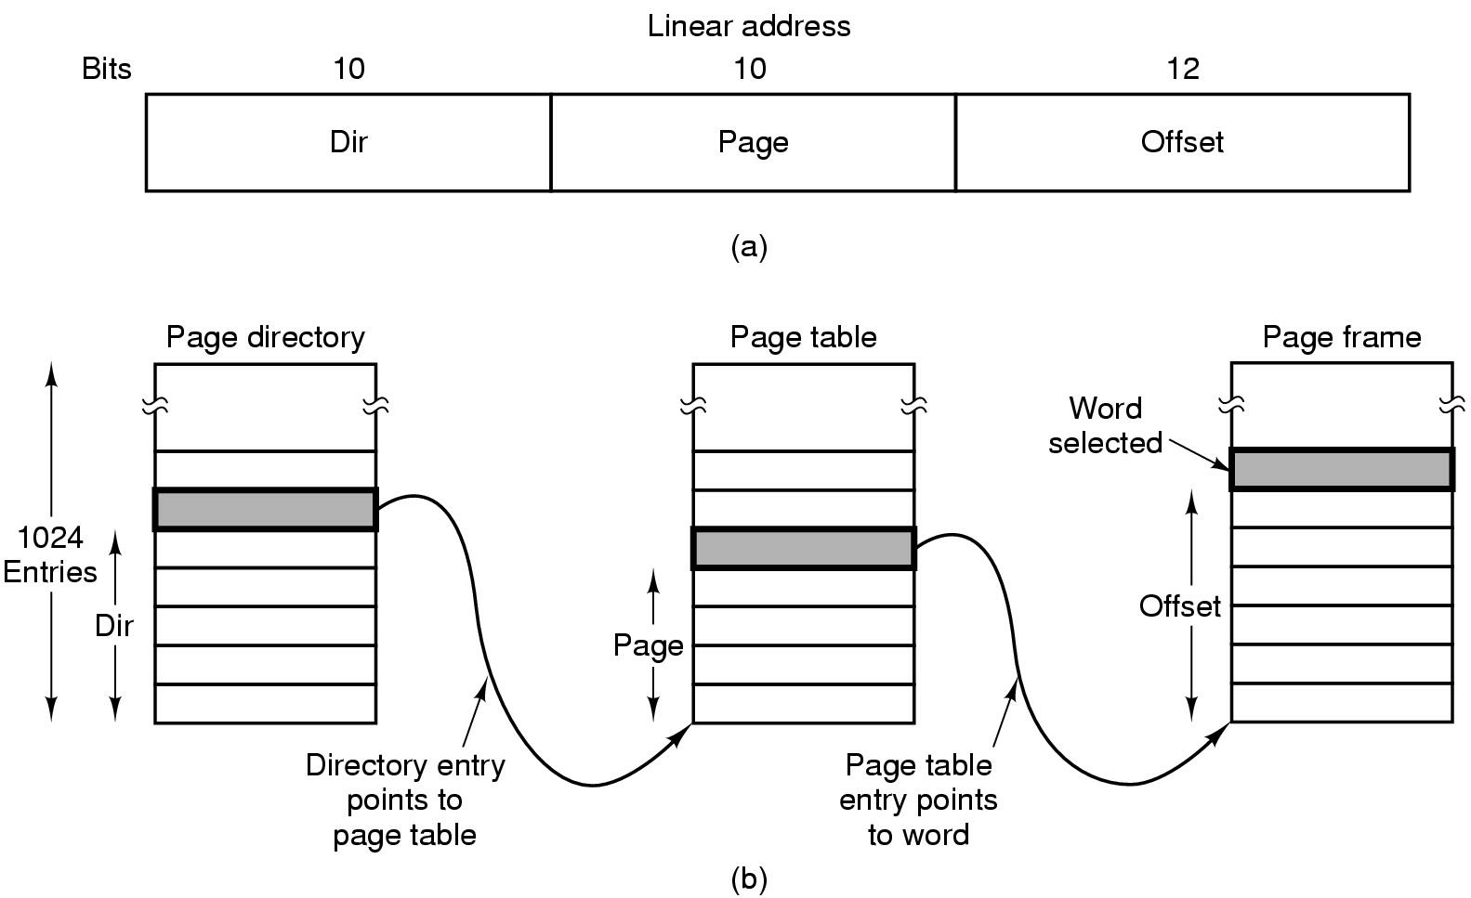
Segmentation with Paging: Pentium (4)
Mapping of a linear address onto a physical address

Slide 27

Intel 30386 Address Translation

Slide 28
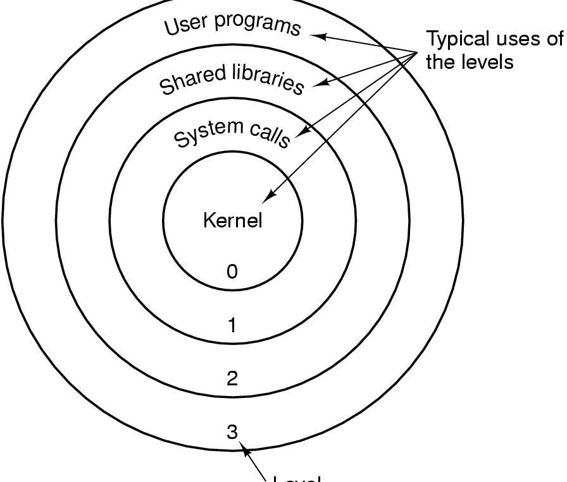
Segmentation with Paging: Pentium (5)
Level
Protection on the Pentium

Slide 29
Protecting CPU/Processes
User vs. Kernel (supervisor) mode
Amplification – System calls (Trap, SVC)
Protection rings

Slide 30
User / Supervisor Mode
Instructions
SVC
Privileged
Instructions
- Supervisor mode can execute all the instructions
- User mode can execute non-privileged instructions only
- One must trust the supervisor

Slide 31
Basic policies
Isolation—a process must be protected from other processes.
Controlled sharing—processes must be able to share resources in a controlled way.

Slide 32
Execution states or modes
At least two modes of operation are needed to have any security.
Most hardware architectures use a supervisor and a user mode. In the user mode some intructions, called privileged instructions, cannot be executed directly. In supervisor mode all the instructions can be executed. The state of a process is kept in a Program Status Word.

Slide 33
Memory protection vs. CPU protection
Both are mutually dependent!:
Without CPU protection, anyone can change keys/bound registers!
Without memory protection, anyone can change old PSW and set to Supervisor mode!
Both are needed!

Slide 34
Protection rings
Some architectures define in their hardware a set of rings (4 to 32) that correspond to domains of execution with hierarchical levels of trust. Rings are a generalization of the concept of mode of operation.
Crossing of rings is done through gates that check the rights of the crossing process. A process calling a segment in a higher ring must go through a gate.

Slide 35
Rings in Multics
r0
r1
r2
r3
r4
r5
r6
r7
Ex
C
C
W – Write
R – Read
Ex – Execute
C – Call
R – ring
W
R

Slide 36
0 = kernel
1 = OS functions
2 = safe applications
3
3 =
untrusted
applications
2
1
0
- Calls upward
(higher privilege)
- Data access toward
less privilege
- Gate crossings
- Protected entry points

Slide 37
Protecting I/O
I/O privilaged instructions
Interrupts vector in protected area
Open file table in protected area
Open requires system call
Example for combined Memory/CPU protection

Slide 38
Security in Multics - Summary
Files on disk – Access Control lists
Files equal segments in Virtual memory!
When segment is called, file is opened and ACL checked. Then segment descriptor is created and protection is via the descriptor.
Process protection using protection rings.
Process control and amplification using Gates.

Slide 39
File System Security - Unix
4000 | Set user ID on execution (see below)
2000 | Set group ID on execution (see below)
1000 | Set sticky bit (see below)
0400 | Read by owner
0200 | Write by owner
0100 | Execute by owner
0040 | Read by group
0020 | Write by group
0010 | Execute by group
0004 | Read by other
0002 | Write by other
0001 | Execute by other
Octal Representation of Access Permissions

Slide 40
File System security - Unix
Ownership – Umask, Chown (problem with Setuid)
Link (hard or soft) and sticky bit
Amplification – SetUid, SetGId

Slide 41
Protection of Files and Directories – Unix
 | Read | Write | Execute
Files | can | can | can
 | read | Write, truncate | execute
Directories | can | can | can
 | do ls | create, delete | pass through

Slide 42
Unix – Example for SetUid
1. $ chmod +r grades
$ ls –1 *grades
-rw-r--r-- 1 pat CS440 514 Apr 5 18:26 grades
-rwx--x--x 1 pat CS440 1725 Apr 2 10:26 prgrades
2. $ chmod u+s prgrades Turn on SUID permission
$ ls –1 prgrades
-rws--x--x 1 pat CS440 1725 Apr 2 10:26 prgrades
$
3. $ chmod 600 grades Just give read/write to owner
$ls –1 *grades
-rw------- 1 pat CS440 514 Apr 5 18:26 grades
-rws--x--x 1 pat CS440 1725 Apr 2 10:26 prgrades

Slide 43
Implementing Files Protection
1. Using files (Inodes) - Unix
2. Using directories ([P])
3. Using security descriptors
(windows – NT - pointed from MFT)

Slide 44
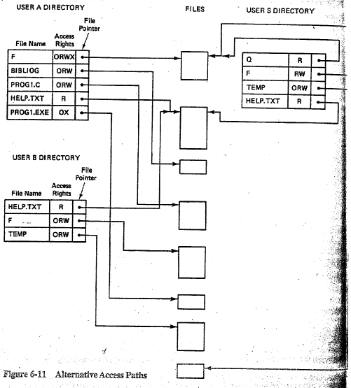
Protecting Access to General Objects

Slide 45
File System Security – Unix Group Problem
Affiliation
Limited sharing
Multiple personality
Changes in group membership (prolifiration control?)
Command newgrp

Slide 46
Unix File System Security –
Violating Security Principles [SU]
Principle of Least Privilage (group access)
Principle of Safe Defaults
Principle of Need to Know (Others access, Super-user power)
Principle of Accountability (setUid)
Always there is Tradeoff:
Security / Convenience / Performance!

Slide 47
File Encryption
K’
j1
K’
j2
. . .
K’
jn_{j}
Validation Record – k’_{j}
File F_{j}
Fig. 5. The “keys record” scheme

Slide 48
File Encryption, cont.
F₁
F₂
K’₁₁
K’₁₂
K’₂₁
0
K’₁
K’₂
U₁
1
1
U₂
1
0
File F₁
File F₂
Access Matrix
Fig. 6. The “key inversion” problem

Slide 49
File Encryption
Enciphering and Deciphering with subkeys
. . .
M
. . .
Plaintext
record
m₁
m_{j}
m_{t}
*c₁
. . .
*c_{j}
. . .
*c_{t}
Σ mod n
encipher
Ciphertext
record
C
mod d₁
decipher
Plaintext
field
mj

Slide 50
User Authentication
Basic Principles. Authentication must identify:
1. Something the user knows
2. Something the user has
3. Something the user is
This is done before user can use the system

Slide 51
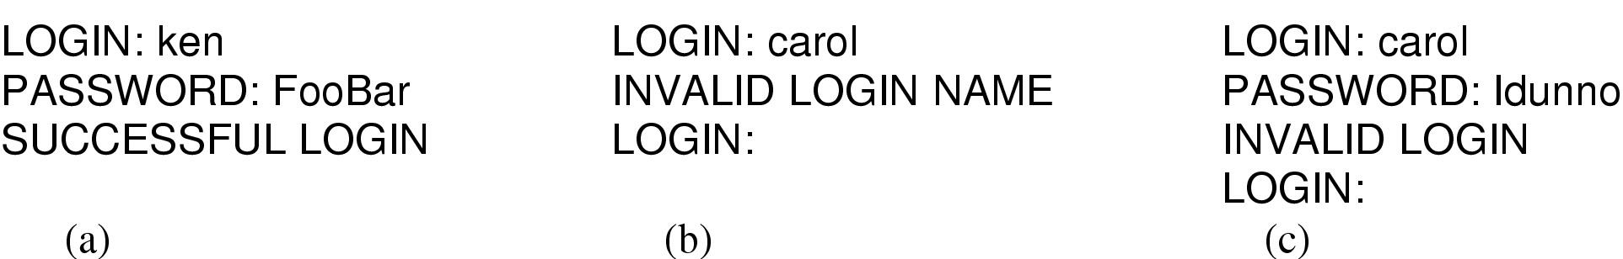
Authentication Using Passwords
(a) A successful login
(b) Login rejected after name entered
(c) Login rejected after name and password typed

Slide 52
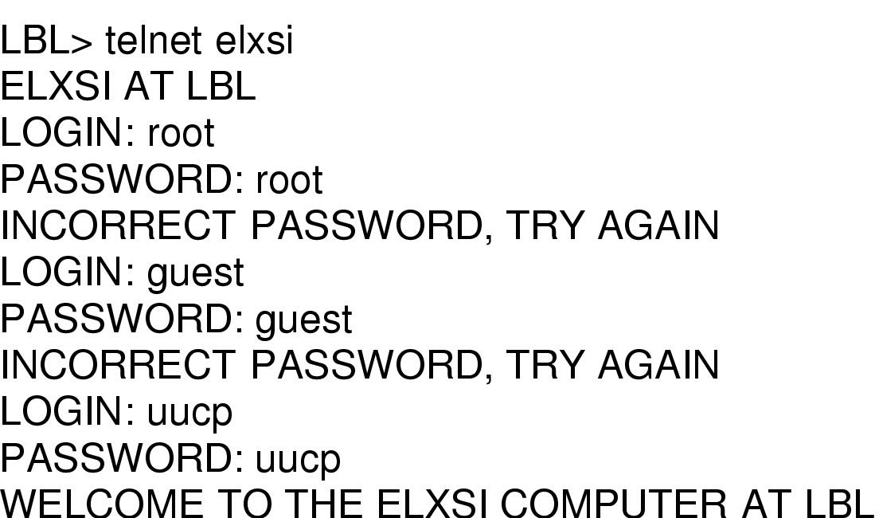
Authentication Using Passwords
How a cracker broke into LBL
  a U.S. Dept. of Energy research lab

Slide 53
Authentication –
Guidelines for Selecting Passwords
Use characters other then A-Z
Choose long passwords (>6)
Avoid actual names or words (about 150,000 words of ≥6 in English)
Choose unlikely passwords (control char, digits, etc.)
Change passwords regularly
Don’t write down; Don’t tell anyone…

Slide 54
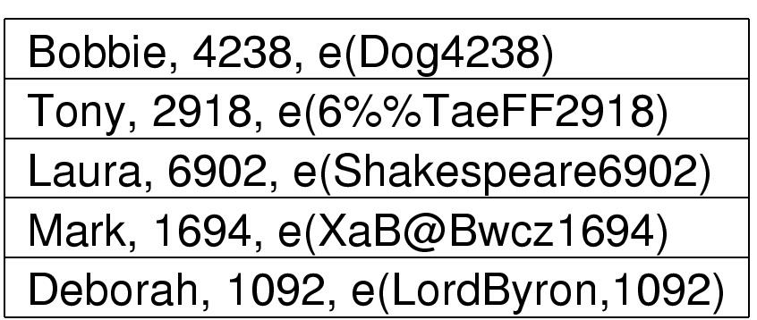
Authentication Using Passwords
Salt
Password
The use of salt to defeat precomputation of encrypted passwords

Slide 55
Authentication –
Using one-time Passwords
Use hardware card like BGU’s secur-id
Use one-way hashing functions:
i = 0 P0 = f(f(…(f(P)
n
i = 1 P1 = f(f(…(f(P)
n-1
i = n-1 Pn-1 = f(P)
Only user knows P not computer!
First try – user sends P1, computer computes P0
Second try – user sends P2, computer computes P1. Enemy who listens cannot break it!
Choose long passwords (>6)
Avoid actual names or words (about 150,000 words of ≥6 in English)
Choose unlikely passwords (control char, digits, etc.)
Change passwords regularly
Don’t write down; Don’t tell anyone…

Slide 56
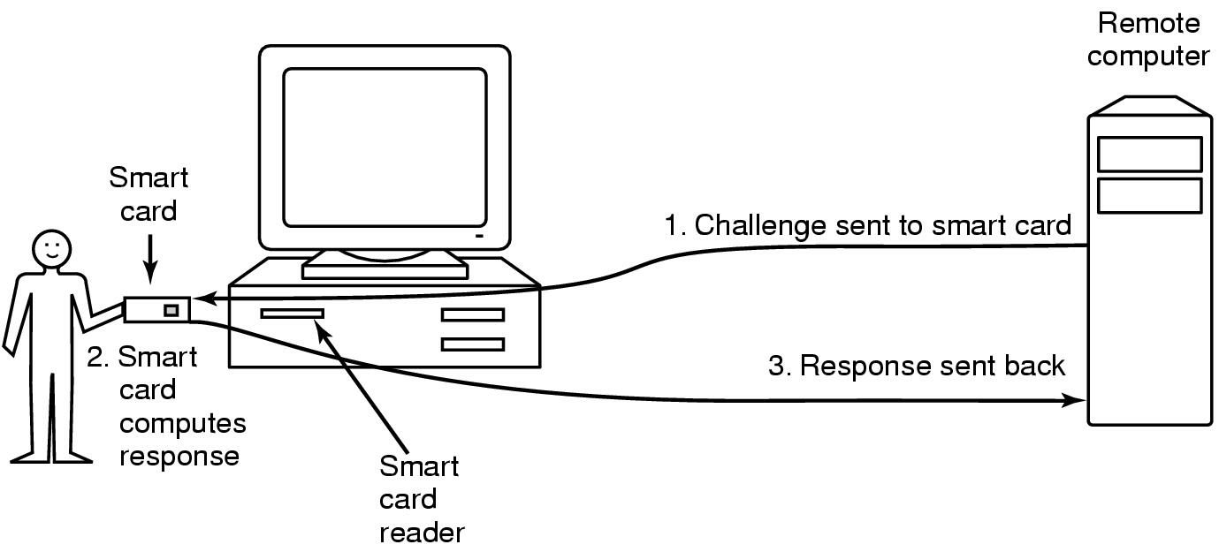
Authentication Using a Physical Object
Magnetic cards
  magnetic stripe cards
  chip cards: stored value cards, smart cards

Slide 57
Issues
Authentication applies to principals. Principals are users, host machines, sites, processes.
Principals must mutually authenticate.
Users authenticate themselves to hosts and services.
Authentication information must be protected.
Individual messages may need to be authenticated.

Slide 58
Kerberos
Kerberos -- the most important of the network authentication approaches. It is used in Windows 2000 and other systems. It was developed at MIT and its name comes from Greek mythology. It has had several versions, the current one is version 5. It uses the DES in its authentication protocol.

Slide 59
Kerberos protocol
    The Kerberos server must have the user ID (UID) and hashed password of all its registered users.
    The Kerberos server must share a secret key with each registered application server.
    The Needham/Schroeder protocol is used to distribute keys and authenticate users

Slide 60
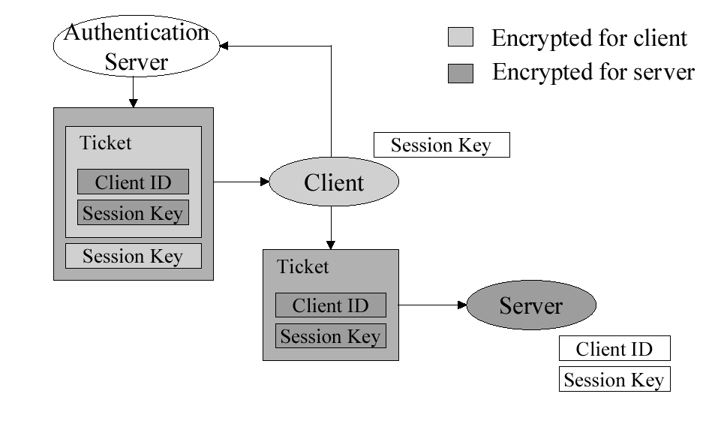
Kerberos

Slide 61

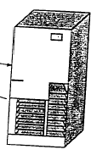
Kerberos
Once per user logon session
Request ticket granting ticket
Ticket + session key
Request ticket granting ticket
Ticket + session key
Once per
type of service
Request service
Once per
service session
Provide service authenticator

Slide 62
Kerberose Version 4
(a) Authentication Service Exchange:
to obtain ticket-granting ticket
(1) C AS: ID_{C}⎪⎢ID_{tgs}⎪⎢TS₁
(2) AS C: E_{kc}[ID_{C}⎪⎢K_{c.tgs}⎪⎢ID_{tgs}⎪⎢TS₂⎪⎢Lifetime₂⎪⎢Ticket_{tgs}]
Ticket_{tgs} = E_{Ktgs}[K_{c.tgs}⎪⎢ID_{C}⎪⎢AD_{C}⎪⎢ID_{tgs}⎪⎢TS₂⎪⎢Lifetime₂]
(b) Ticket-Granting Service Service Exchange:
to obtain service-granting ticket
(3) C TGS: ID_{V}⎪⎢Ticket_{tgs}⎪⎢Authenticator_{C}
(4) TGS C: E_{kc.tgs}[K_{c.V}⎪⎢ID_{V}⎪⎢TS₄⎪⎢Ticket_{V}]
Ticket_{tgs} = E_{Ktgs}[K_{c.tgs}⎪⎢ID_{C}⎪⎢AD_{C}⎪⎢ID_{tgs}⎪⎢TS₂⎪⎢Lifetime₂]
Ticket_{V} = E_{KV}[K_{c.V}⎪⎢ID_{C}⎪⎢AD_{C}⎪⎢ID_{V}⎪⎢TS₄⎪⎢Lifetime₄]
Authenticator_{C} = E_{kc.tgs}[ID_{C}⎪⎢AD_{C}⎪⎢ TS₃]

Slide 63
Kerberose Version 4, cont.
(c) Client/Server Authentication Exchange:
to obtain service
(5) C -> V: Ticket_{V}⎪⎢Authenticator_{C}
(6) V -> C: E_{kC.V}[TS₅+1] (for mutual authentication)
Ticket_{V} = E_{KV}[K_{C.V}⎪⎢ID_{C}⎪⎢AD_{C}⎪⎢ID_{V}||TS₄⎪⎢Lifetime₄]
Authenticator_{C} = E_{kC.V}[ID_{C}⎪⎢AD_{C}⎪⎢TS₅]

Slide 64

Authentication Using Biometrics
A device for measuring finger length.

Slide 65
Countermeasures
Limiting times when someone can log in
Automatic callback at number prespecified
Limited number of login tries
A database of all logins
Simple login name/password as a trap
  security personnel notified when attacker bites

Slide 66
Access Matrix
View protection as a matrix (access matrix)
Rows represent domains
Columns represent objects
Access(i, j) is the set of operations that a process executing in Domain_{i} can invoke on Object_{j}

Slide 67
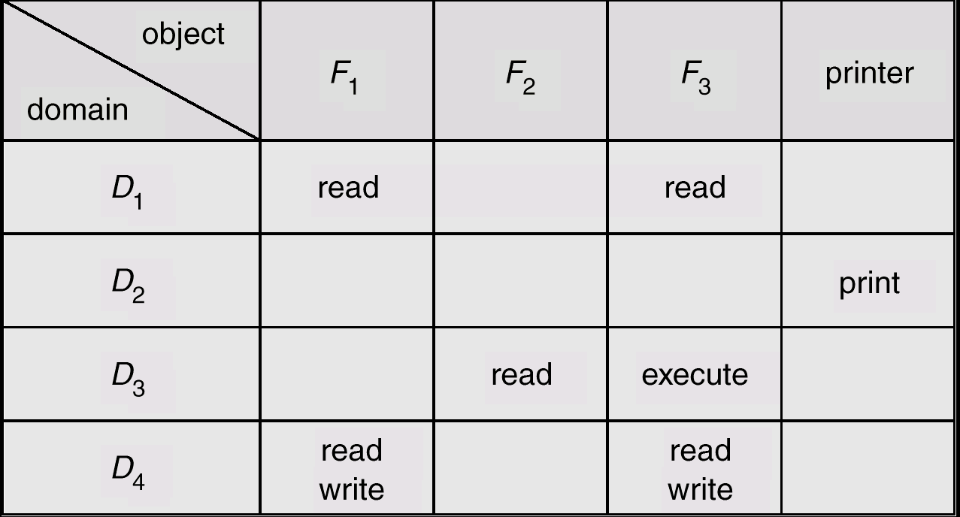
Access Matrix
Figure A

Slide 68
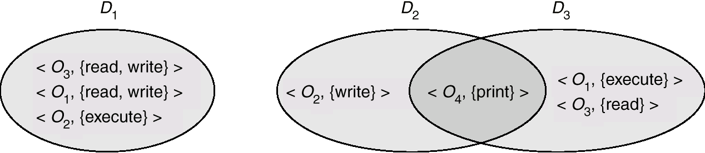
Domain Structure
Access-right = <object-name, rights-set>
where rights-set is a subset of all valid operations that can be performed on the object.
Domain = set of access-rights

Slide 69
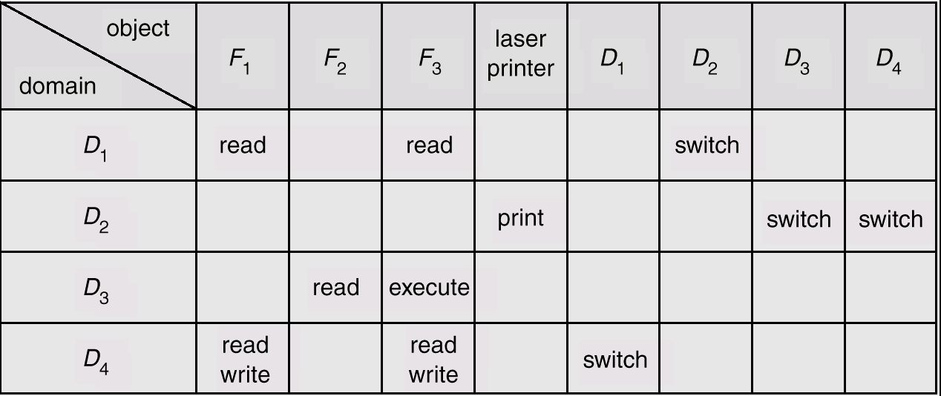
Access Matrix of Figure A
With Domains as Objects
Figure B

Slide 70
Use of Access Matrix
If a process in Domain D_{i} tries to do “op” on object O_{j}, then “op” must be in the access matrix.
Can be expanded to dynamic protection.
  Operations to add, delete access rights.
  Special access rights:
    owner of O_{i}
    copy op from O_{i} to O_{j}
    control – D_{i} can modify D_{j} access rights
    transfer – switch from domain D_{i} to D_{j}

Slide 71
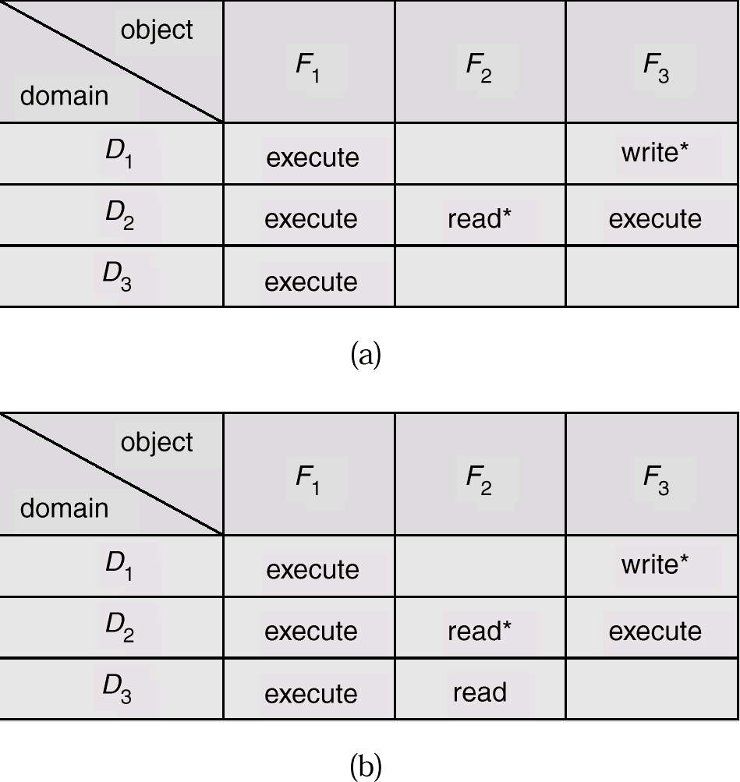
Access Matrix with Copy Rights

Slide 72
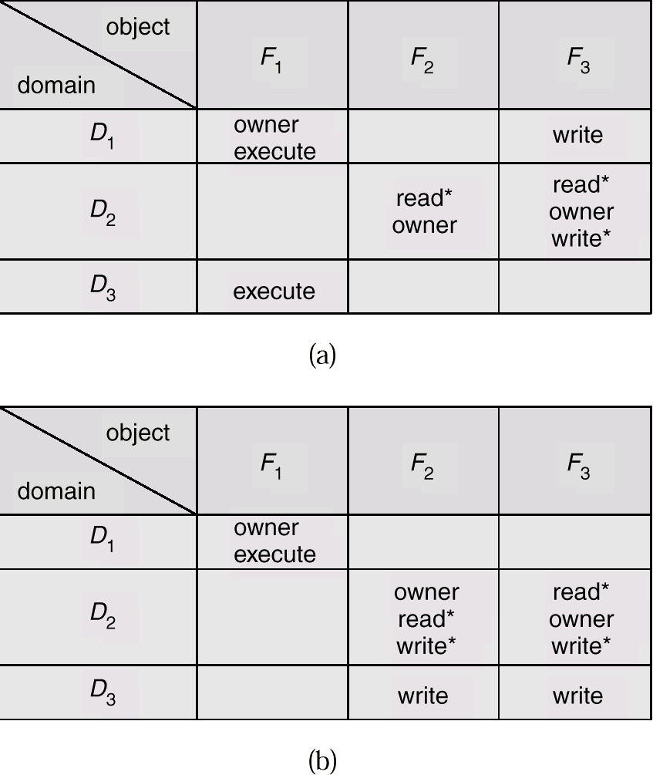
Access Matrix With Owner Rights

Slide 73
What’s the Difference Between a Subject and a Domain
A subject is usually a process. During its life-time, a subject may acquire rights or lose them. At a particular point in time, a subject has given a set of rights that’s a domain!

Slide 74
Implementation of Access Matrix
Each column = Access-control list for one object
Defines who can perform what operation.
Domain 1 = Read, Write
Domain 2 = Read
Domain 3 = Read

Each Row = Capability List (like a key)
Fore each domain, what operations allowed on what objects.
      Object 1 – Read
      Object 4 – Read, Write, Execute
      Object 5 – Read, Write, Delete, Copy

Slide 75
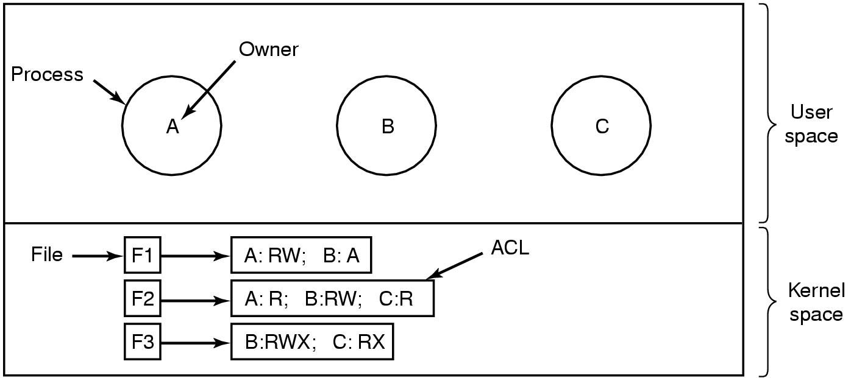
Access Control Lists (1)
Use of access control lists of manage file access

Slide 76
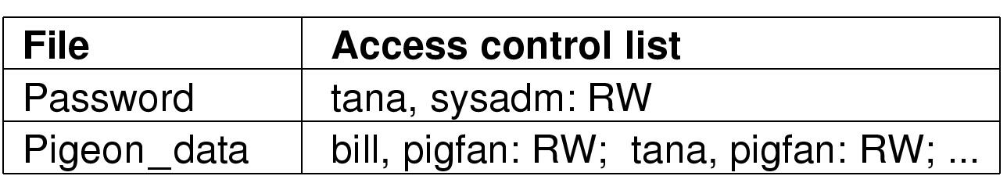
Access Control Lists (2)
Two access control lists

Slide 77
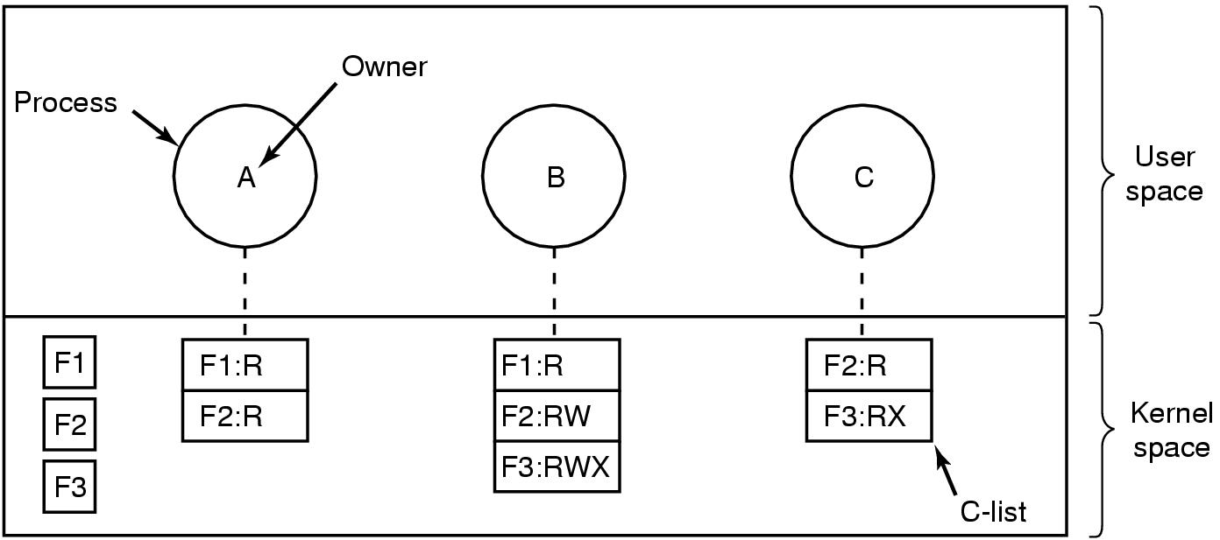
Capabilities (1)
Each process has a capability list

Slide 78
Descriptors
Descriptors are similar to capabilities but instead of being carried with the process they are loaded when the process is loaded for execution.
Because the descriptors are used also for addressing they are handled by the memory allocation unit of the OS and we need to trust now that unit.
Descriptors and capabilities can be seen as embodiments of rows of the access matrix

Slide 79
Using Capabilities for Addressing - Descriptors
Instruction address
cap
offset
Object Length Base
C
i
B
Rights Object
X
L
B
B+
C
RW
X
Capability
B+
Descriptor Table
Memory

Slide 80
Sharing Using Capabilities
F1
R
RW
D11
R
F2
RW
D1
RW
RW
R
F3
R
RW
D12
P1 C - list
D2
RW
F4
D
R
R
F5
D3
RW
R
D31
F6
Directories
P2 C - list

Slide 81
Capability-Based Systems
Hydra
  Fixed set of access rights known to and interpreted by the system.
  Interpretation of user-defined rights performed solely by user's program; system provides access protection for use of these rights.
Cambridge CAP System
  Data capability - provides standard read, write, execute of individual storage segments associated with object.
  Software capability -interpretation left to the subsystem, through its protected procedures.

Slide 82
Capabilities - Protection of
In system area – need system call for every access?
Cryptographically-protected capability
Generic Rights
  1. Copy capability
  2. Copy object
  3. Remove capability
  4. Destroy object
Server | Object | Rights | f(Objects, Rights, Check)

Slide 83
Capabilities – Amplification
Domain Switch with Protected entry Points
Rights Object
calling
procedure
RE
call
R
data
segment
Ent
C – list
calling Domain
Rights Object
called
procedure
RE
return
RW
data
segment
C – list
called Domain

Slide 84
Capabilities – Amplification
Abstract Data Type and Rights Amplification
Rights Object
calling
procedure
RE
Pop, Push
empty
Stack S
Ent
Pop
procedure
calling C – list
RE
Amplification temate
Pop / RW
Before call
C – list for
pop procedure
After call
RE
RW
C – list for
Activation of pop

Slide 85
Capabilities – Revocation
Revocation of Rights with Indirection
user:
C’
RW
X’
X’
C’
RW
Revoke
X’
X
Object
owner:
C
RW
X
Descriptor Table

Slide 86
Capabilities – Revocation
Revocation of Rights with Indirect Capability in SWARD
user:
I
RW
C_{I}
RW
X
Object
owner:
C
RW
Descriptor Table

Slide 87
ACLs and Capabilities
ACLs need not be in memory, checked at the time of first access (disadv). C-lists need to be in memory (assigned at process creation – adv)
ACL is checked only at first access (open). Capability is checked for every access (ticket for addressing). But finer granularity!
Security / performance tradeoff!
Capabilities enable easy granting/copying amplification. No simple analog in ACLs (setUid?)

Slide 88
ACLs and Capabilities, cont.
ACLs are more convenient for Objects changes (deleting objects, creating objects, changing access to objects).
Capabilities are more convenient for User changes (user deletion)
Revocation of ACLs is easy. Revocation of capabilities is hard
Capabilities can be used to control Mobile code

Slide 89
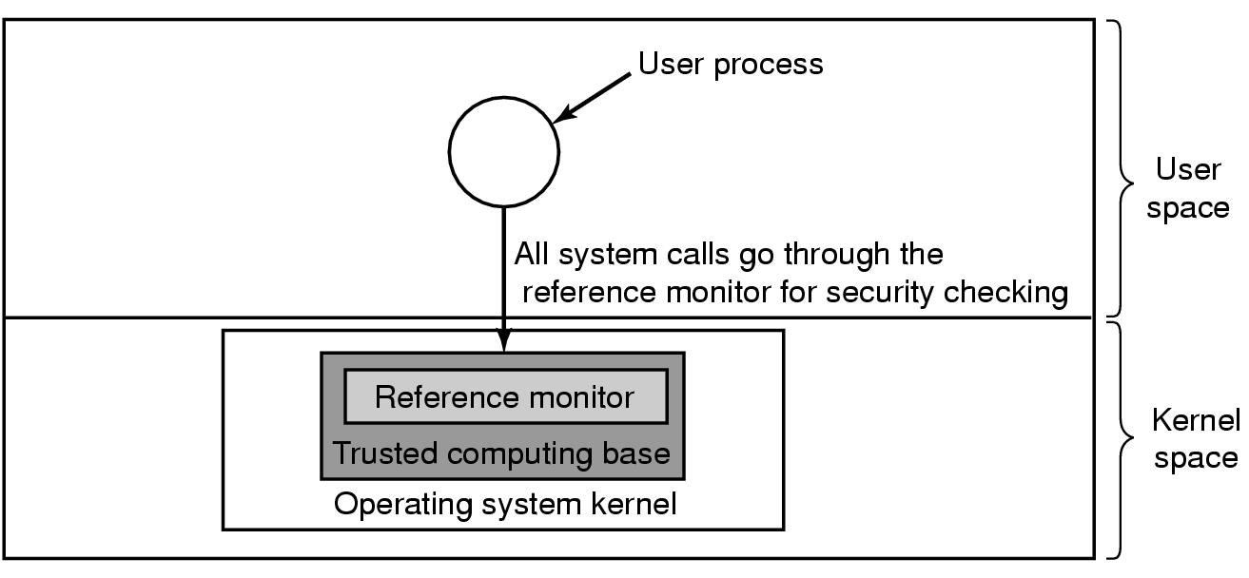
Trusted Systems
Trusted Computing Base
A reference monitor

Slide 90
Layered Operating System
Subprocesses of User Processes
User Processes
Compilers, Data Base Managers
Utility Functions
Operating
System
Systems, Device Allocation
Scheduling, Sharing,
Memory Management
Operating
System
Kernel
Synchronization, Allocation
Security Functions
Security
Kernel
Hardware

Slide 91
Principles of Security Kernel
Coverage – of each access
Separation – of security functions from rest
Unity – a single module
Modifiability and Maintenance – easy to control
Compactness – small and therefore
Verifyable

Slide 92
Formal Verification
Formal specification
Proof that implementation follows formal specification
Problem: how to “prove” the specification?
Definitions:
  a program is correct if it halts and produces correct output for every input
  A program is partially correct if whenever it halts, it produces the correct output

Slide 93
Assertions
ENTRY
P: n > 0
min
A[1]
Q: n > 0 and
1 ≤ i ≤ n and
min ≤ A[1]
i
1
i i + 1
R: n > 0 and
1 ≤ i ≤ n and
∀_{j} 1 ≤ j ≤ i –1
min ≤ A[j]
i > n
?
YES
NO
min < A[i]
?
YES
NO
min
A[j]
S: n > 0 and
i = n + 1 and
∀_{j} 1 ≤ j ≤n
min ≤ A[j]
EXIT

Slide 94
Verification and Validation
Verification: Assuring the system is correct!
Validation: Assuring it’s the correct system!
The debate around “Open Source”!

Slide 95
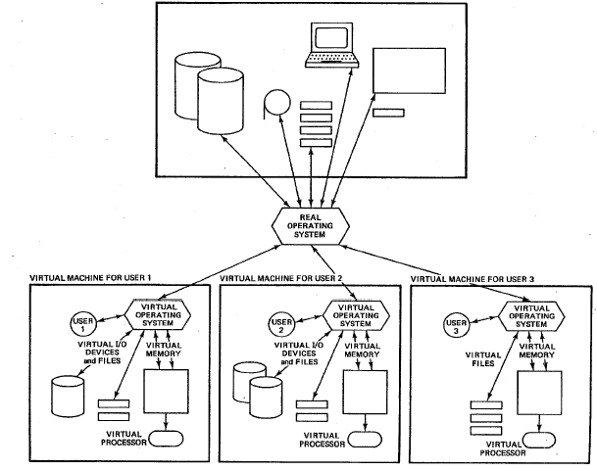
Virtual Machine

Slide 96
Computer Security Classifications
U.S. Department of Defense outlines four divisions of computer security: A, B, C, and D.
D – Minimal security.
C – Provides discretionary protection through auditing. Divided into C1 and C2. C1 identifies cooperating users with the same level of protection. C2 allows user-level access control.
B – All the properties of C, however each object may have unique sensitivity labels. Divided into B1, B2, and B3.
A – Uses formal design and verification techniques to ensure security.

Slide 97
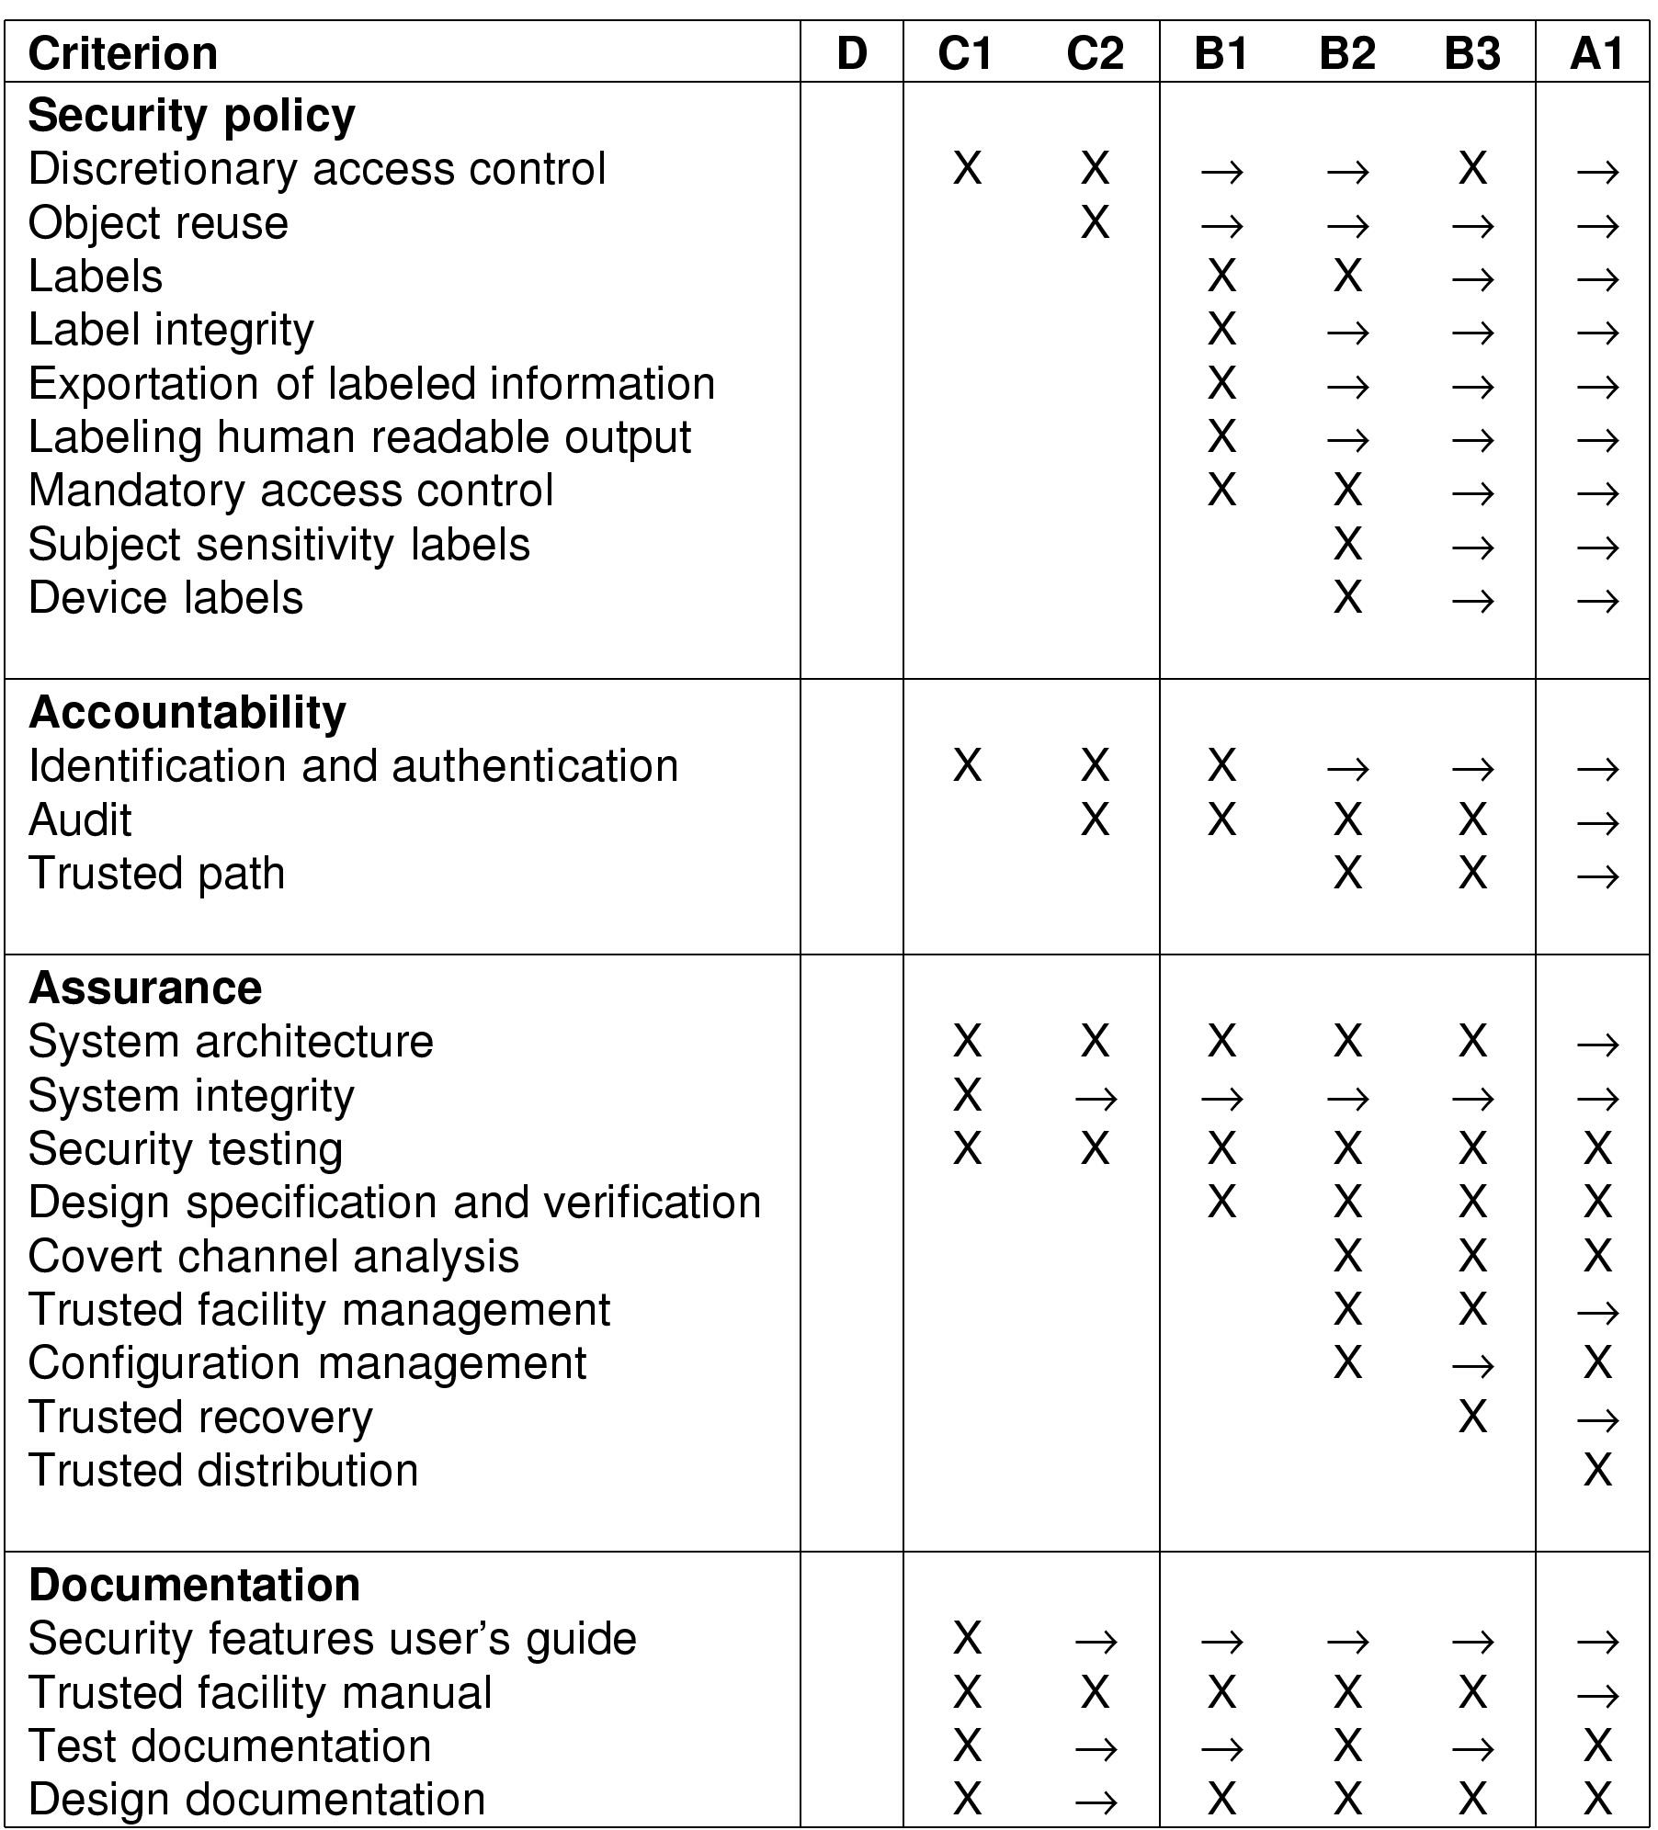
Orange Book Security (1)
Symbol X means new requirements
Symbol -> requirements from next lower category apply here also

Slide 98
Orange Book Security (2)

Slide 99
The concept of Mount
Server 1
Games
Server 2
Work
Client 1
Client 2
pacman
pacwoman
pacchild
mail
news
other
(a)
Client 1
Client 2
games
work
games
pacman
pacwoman
pacchild
work
pacman
pacwoman
pacchild
mail
news
other
mail
news
other
(b)
(c)

Slide 100
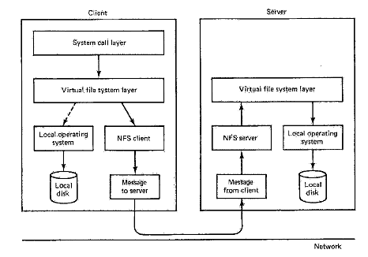
Layer Structure of NFS
Client
Server
System call layer
Virtual file system layer
Virtual file system layer
Local Operating System
NFS Client
NFS server
Local operating system
Local disk
Message to server
Message from client
Local disk
Network

Slide 101
Windows-NT Security
C2 Certified (mainly DAC and Authentication)
Monitor based architecture (SRM) plus Clients modules (LSA, SAM) for Login & Authentication
Objects based – Registry file for everything
Authentication – Passwords and Kerberos
SID (Security ID) and SAT (Security Access Token). Remote authentication.
Domains – For set of machines. Machine (SID) Authentication.
Groups and Subgroups

Slide 102
Windows-NT Security, cont.
Security descriptors (in Registry)
ACL’s. ACE – Access Control Entry – Positive and Negative.
User Profiles and Security Management.
Auditing – What and When.
File Encryption.
Web security, Certificates, SSL, etc….

Slide 103
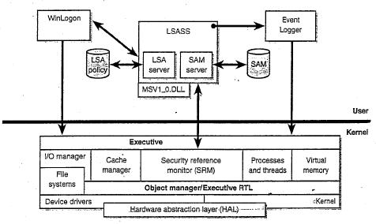
Windows NT Security Architecture

Slide 104
סוגי עצמים ב- Windows-NT
Type | Description
Process | User Process
Thread | Thread within a process
Semaphore | Counting semaphore used for interprocess synchronization
Mutex | Binary Semaphore used to enter a critical region
Event | Synchronization object with persistent state (signaled/not)
Port | Mechanism for interprocess message passing
Timer | Object allowing a thread to sleep for a fixed time interval
Queue | Object used for completion notification on asynchronous I/O
Open file | Object associated with an open file
Access token | Security descriptor for some object
Profile | Data structure used for profiling CPU usage
Section | Structure used for mapping files onto virtual address space
Key | Registry key
Object directory | Directory for grouping objects within the object manager
Symbolic link | Pointer to another object by name
Device | I/O device object
Device driver | Each loaded device driver has its own object

Slide 105
מדריך למידה – אבטחת מערכות מידע
דוגמה למתאר הגנה ב- Windows-NT
Security
Descriptor
Header
DEny
Elvis
111111
Allow
Cathy
110000
Ida
111111
Allow
Everyone
100000
SACL
File
Security
Descriptor
ACE
Header
Owner’s SID
Group SID
DACL
SACL
Header
Audit
Marilyn
111111
ACE

Slide 106
אלגוריתם גישה נוכחית
1. If the object has no DACL, the object has no protection and the security system grants the desired access.
2. If the caller has the take-ownership privilege, the security system grants write-owner access before examining the DACL. The security system grants write-owner access if it was the only access requested.
3. If the caller is the owner of the object, the read-control and write-DACL access rights are granted. If these rights were the only access rights requested, access is granted without examining the DACL.
4. Each ACE in the DACL is examined from first to last. If the SID in the ACE matches an enabled SID (SIDs can be enabled and disabled) in the caller’s access token(whether that be the primary SID or a group SID), the ACE is processed. If it is an access-allowed ACE, the rights in the access mask in the ACE are granted; if all the requested access rights have been granted, the access check succeeds. If it is an access-denied ACE and any of the requested access rights are in the denied-access rights, access is denied to the object.
5. If the end of the DACL is reached and some of the requested access rights still haven’t been granted, access is denied.

Slide 107
Audit Trails
Not all auditing is configured through the default GUI.
Audit log sizing.
Audit of important things:
  Audit failed login attempts
  Audit use of backup/restore rights
  Audit changes to the registry

Slide 108
The Registry
A Security Nightmare!
The repository for all important data
A haven for trojan horse attacks
Too complicated, too arcane, too opaque
Remote access
Lock it and audit, audit, audit…

Slide 109
Security in Windows 2000
Structure of an access token
Header | Expiration time | Groups | Default CACL | User SID | Group SID | Restricted SIDs | Privileges

Slide 110
Security API calls (2)
Principal Win32 API functions for security
Win32 API function | Description
InitializeSecurityDescriptor | Prepare a new security descriptor for use
LookupaccountSid | Look up the SID for a given user name
SetSecurityDescriptorOwner | Enter the owner SID in the security descriptor
SetSecurityDescriptorGroup | Enter a group SID in the security descriptor
InitializeAcl | Initialize a DACL or SACL
AddAccessAllowedAce | Add a new ACE to a DACL or SACL allowing access
AddAccessDeniedAce | Add a new ACE to a DACL or SACL denying access
DeleteAce | Remove an ACE from a DACL or SACL
SetSecurityDescriptionDacl | Attach a DACL to a security descriptor

Slide 111
The Registry (2)
Some of the Win32 API calls for using the registry
Win32 API function | Description
RegCreateKeyEx | Create a new registry key
RegDeleteKey | Delete a registry key
RegOpenKeyEx | Open a key to get a handle to it
RegEnumKeyEx | Enumerate the subkeys subordinates to the key of the handle
RegQueryValueEx | Look up the data for a value within a key

Slide 112
PWDump and NTCrack
Lots of press!
PWDump
  Dumps the user contents of the SAM, including encrypted passwords.
  Requires administrator or backup privilages
    %SystemRoot%\Repair\SAM._
NTCrack
  Simple implementation of an off-line dictionary attack for Windows-NT

Slide 113
Conclusions
Windows-NT can be secure
By default, it isn’t secure
Over time, users have a tendency to make less secure
  Insecure defaults
Watch the security alerts; understand enough to estimate their importance.

Slide 114
OS attacks
Remote login weaknesses
Password guessing
Bypass file permissions
Scavenge memory
Buffer overflow attacks
Denial of service attacks (resource hogging)

Slide 115
Generic Security Attacks
Typical attacks
Request memory, disk space, tapes and just read
Try illegal system calls
Start a login and hit DEL, RUBOUT, or BREAK
Try modifying complex OS structures
Try to do specified DO NOTs
Convince a system programmer to add a trap door
Beg admin's sec’y to help a poor user who forgot password

Slide 116
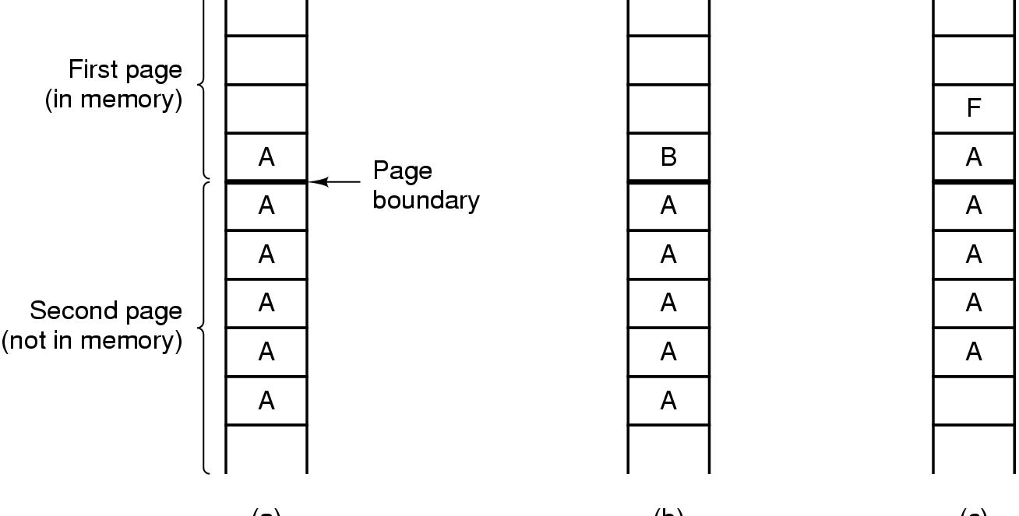
Famous Security Flaws
(a)
(b)
(c)
The TENEX – password problem

Slide 117
Weaknesses
Both Unix and Windows use passwords for authentication. Unix keeps passwords encrypted but the password file is readable by all users. This allows a user to make a copy and use dictionaries and parallel processing to guess passwords.
Process protection is based mainly on the user/supervisor mode separation and kernel processes are not protected against each other.
Even if hardware architectures offer further protection, e.g., descriptors and rings, commercial OSs do not use them in an effort to get more performance

Slide 118
Weaknesses II
The concept of superuser, an almighty user, typically the systems administrator, is a poor security decision.
Inheritance of rights in forked processes is another flaw commonly exploited in attacks. If an attacker tricks a program in superuser mode to execute a Trojan Horse, this inherits the rights of that program and runs in superuser mode
Transfer of rights between processes—In Unix every user has a unique id, UID. If a bit in a file permission (setuid) for a file containing an executable program is turned on, the program executing that program acquires the rights of the file owner. Windows has an impersonation token, that has a similar effect. This violates the principle of accountability.

Slide 119
Weaknesses III
Lack of conceptual model. The file permission structure doesn’t follow the access matrix or any other security model. The interpretation of rights for directories makes things even more muddled
Directory problems. An attacker can place his own file in the path of a writable directory and maybe get higher privileges when the file is invoked.
Most systems lack the concept of a trusted path [Los00]. A trusted path is a user connection to a part of the system that provides secure login, authentication, and rights.
Some systems do not have auditing facilities or the audit log is within reach of the superuser (and could be changed by a hacker acting as a superuser).

Slide 120
Weaknesses IV
Complex, poorly designed, and poorly tested utilities. Microsoft’s Outlook is a Swiss cheese. The Sendmail program in Unix is another source of trouble.
Some flaws come from implementation languages, e.g., buffer overflow. Buffer overflow occurs when a variable in a procedure is filled with more values that it can hold. The overflow can overwrite the return address and if the hacker put her code there her program could get superuser mode [Dil]
Finally, configuration of these systems is complex and administrators make many mistakes. There are many demo programs and rarely used utilities which can be exploited by hackers. This is even more true for PCs where the users usually have no idea what they get in their software

Slide 121
OS defenses
Memory protection (supported by hardware)
File protection
Access control for I/O devices
Requires good processor support for low overhead and to avoid bypassing of high-level mechanisms
Capabilities and descriptors are effective mechanisms
Firewalls to protect access to the system
Authentication (part of login)
Notes:
Memory can be protected with hardware assistance: descriptors and capabilities are effective ways
Files can be protected in the file system or through the memory system
I/O devices may have special access controls
Good processor support is required to apply controls, some RISC processors don’t do well in this respect
Capabilities are the most secure approach, require minimal trust. There are no commercial cap computers now (poor performance). Descriptors are next in security value (used in Intel processosrs and in IBM S/6000).

Slide 122
Threat Monitoring
Check for suspicious patterns of activity – i.e., several incorrect password attempts may signal password guessing.
Audit log – records the time, user, and type of all accesses to an object; useful for recovery from a violation and developing better security measures.
Scan the system periodically for security holes; done when the computer is relatively unused.

Slide 123
Threat Monitoring (Cont.)
Check for:
  Short or easy-to-guess passwords
  Unauthorized set-uid programs
  Unauthorized programs in system directories
  Unexpected long-running processes
  Improper directory protections
  Improper protections on system data files
  Dangerous entries in the program search path (Trojan horse)
  Changes to system programs: monitor checksum values

Slide 124
Hardened OSs
IBM’s AIX [Cam90]—It implements a TCB to support DAC. Instead of read/write/execute rights AIX defines an Abstract Data Type (class), with higher-level operations, appropriate for the type of object such as copy, save, query, and set. These accesses define an access matrix implemented as Access Control Lists. The ACLs are set by the owners of files and by administrators. ACLs can be permissive or restrictive. AIX reduces the privileges of the system administrator by defining five partially-ordered roles

Slide 125
Hardened OSs II
Virtual Vault [HP, Rub94]—A trusted version of HP-UX operating system (A Unix variant). It uses compartments based on the multilevel model to isolate portions of the OS. It also reduces the root privileges and controls inheritance of rights in forked threads.
Argus Pitbull [Arg]—This is a system based on:
    Compartmentalization using a multilevel MAC model.
    Least privilege applied to all processes, including superuser. The superuser is implemented using three roles: Systems Security Officer, System Administrator, and System Operator.
    Kernel-level enforcement.

Slide 126
Evaluation
Popular O.S.s have poor security designs
Require a good authorization model
Must fit Java, databases, and web servers models of security
Protection only at the file level , no protection of document content
Protection against internal attacks
Notes:
Unix and Windows NT are rather weak, although they have improved considerably.
Some of their utilities, eg, sendmail, outlook, are easy to attack.
Can only protect whole files, not specific portions.
Most OS consider the DBMS as a single subject.

Slide 127
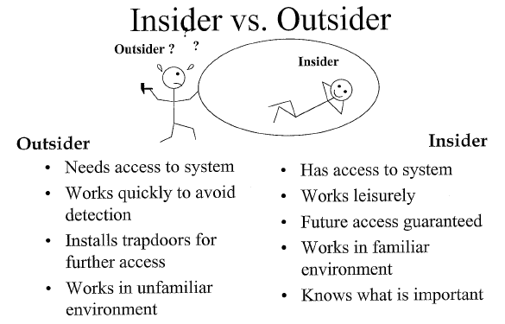
Insider vs. Outsider

Slide 128
Design Principles for Security
System design should be public
Default should be n access
Check for current authority
Give each process least privilege possible
Protection mechanism should be
  simple
  uniform
  in lowest layers of system
Scheme should be psychologically acceptable
And … keep it simple

