Slide 1
The Safety Problem in Access Control
HRU Model
Ravi Sandhu
Laboratory for Information Security Technology
George Mason University
www.list.gmu.edu
sandhu@gmu.edu

Slide 2
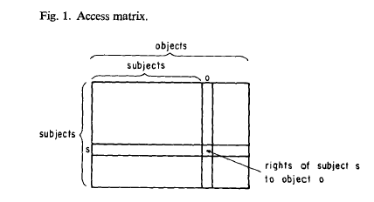
The Access Matrix Model, Lampson 1971

Slide 3
Access Control Models
Authentication
who is trying to access a protected resource?
Access Control Models
Access Control Architecture
Authorization
Enforcement
who should be allowed to access which protected resources?
who should be allowed to change the access?
how does the system enforce the specified authorization

Slide 4
The OM-AM Way
A
s
s
u
r
a
n
c
e
What?
Objectives
Models
Architectures
Mechanisms
How?

Slide 5
The HRU (Harrison-Ruzzo-Ullman) Model, 1976
F
G
U
r w
V
r
r w

Slide 6
The HRU (Harrison-Ruzzo-Ullman) Model, 1976
F
G
U
r w
V
r
r w own

Slide 7
The HRU (Harrison-Ruzzo-Ullman) Model, 1976
F
G
U
r w
r
V
r
r w own

Slide 8
HRU Commands and Operations
command α(X1, X2 , . . ., Xk)
if rl in (Xs1, Xo1) and r2 in (Xs2, Xo2) and ri in (Xsi, Xoi)
then
op1; op2; … opn
end
enter r into (Xs, Xo)
delete r from (Xs, Xo)
create subject Xs
create object Xo
destroy subject Xs
destroy object Xo

Slide 9


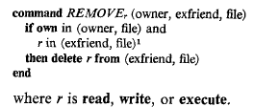
HRU Examples

Slide 10
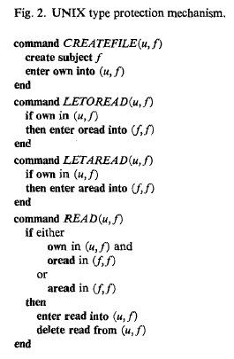
HRU Examples

Slide 11
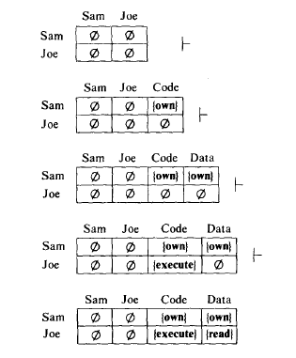
HRU Examples

Slide 12
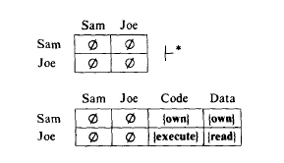
HRU Examples

Slide 13
The Safety Problem
Given
  initial state
  protection scheme (HRU commands)
Can r appear in a cell that exists in the initial state and does not contain r in the initial state?
More specific question might be:
can r appear in a specific cell [s,o]

Slide 14
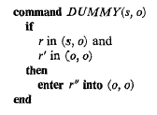
The Safety Problem
Initial state: r’ in (o,o) and nowhere else

Slide 15

Safety is Undecidable in HRU

Slide 16
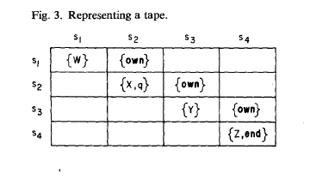
Safety is Undecidable in HRU

Slide 17
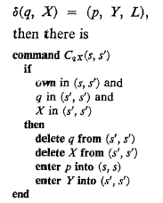
Left Move

Slide 18
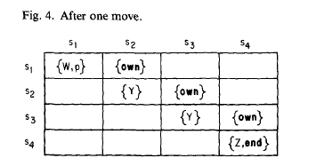
Safety is Undecidable in HRU

Slide 19

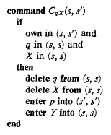
Right Move

Slide 20
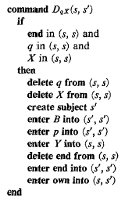
Right Move to New Cell

Slide 21


Mono-operational systems
Safety for mono-operational systems is NP-Complete

Slide 22
Monotonic HRU
command α(X1, X2 , . . ., Xk)
if rl in (Xs1, Xo1) and r2 in (Xs2, Xo2) and ri in (Xsi, Xoi)
then
op1; op2; … opn
end
enter r into (Xs, Xo)
delete r from (Xs, Xo)
create subject Xs
create object Xo
destroy subject Xs
destroy object Xo

Slide 23
Safety in HRU
Undecidable in general
HRU unable to find interesting decidable cases.
  Mono-operational: decidable but uninteresting and NP-complete
  Monotonic: undecidable
  Bi-conditional monotonic: undecidable
  Mono-conditional monotonic: decidable but uninteresting

Slide 24
The Safety Problem in HRU
HRU 1976:
  “It would be nice if we could provide for protection systems an algorithm which decided safety for a wide class of systems, especially if it included all or most of the systems that people seriously contemplate. Unfortunately, our one result along these lines involves a class of systems called “mono-operational,” which are not terribly realistic. Our attempts to extend these results have not succeeded, and the problem of giving a decision algorithm for a class of protection systems as useful as the LR(k) class is to grammar theory appears very difficult.”
2004:
  Considerable progress has been made but much remains to be done and practical application of known results is essentially non-existent.
    Progress includes: Take-Grant Model (Jones, Lipton, Snyder, Denning, Bishop; late 79’s early 80’s), Schematic Protection Model (Sandhu, 80’s), Typed Access Matrix Model (Sandhu, 1990’s), Graph Transformations (Koch, Mancini, Parisi-Pressice 2000’s)

