Slide 1
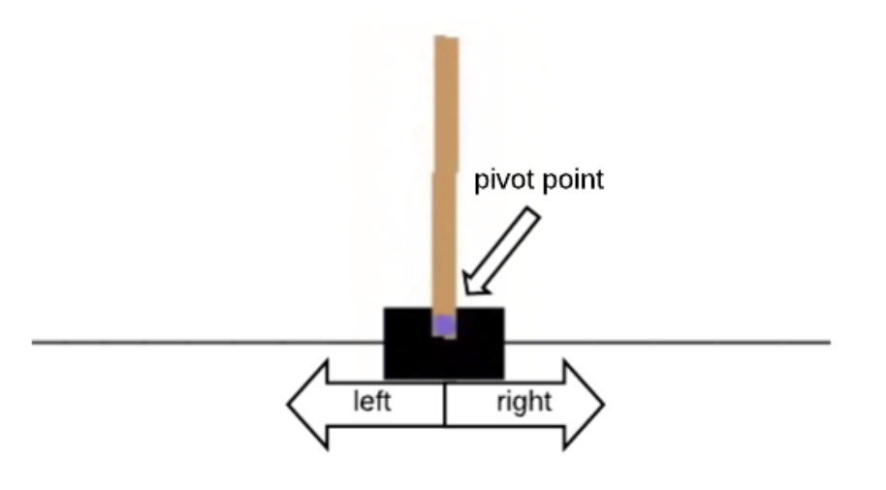
Open AI Gym: Cartpole Problem
State
Cart Position (-2.4, 2.4)
Cart Velocity (-Inf, Inf)
Pole Angle degrees (-41.8, 41.8)
Pole Velocity at Tip (-Inf, Inf)
Episode Termination
Pole angle is more than +- 12
Cart Position is more than +- 2.4
Episode length is greater than 200 frames
Actions
Push cart to left or right
Rewards
+1 for each frame cart is alive
Goal
Build RL Agent to maximize cumulative reward in an episode

Slide 2
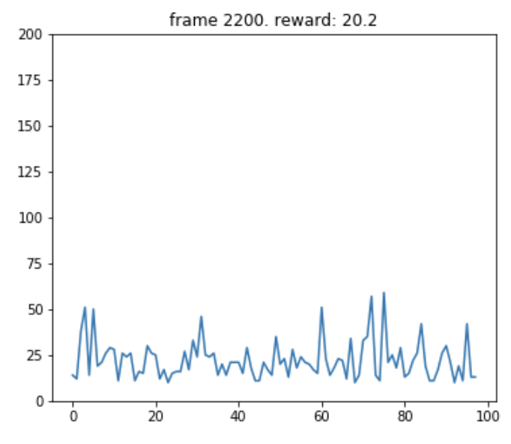
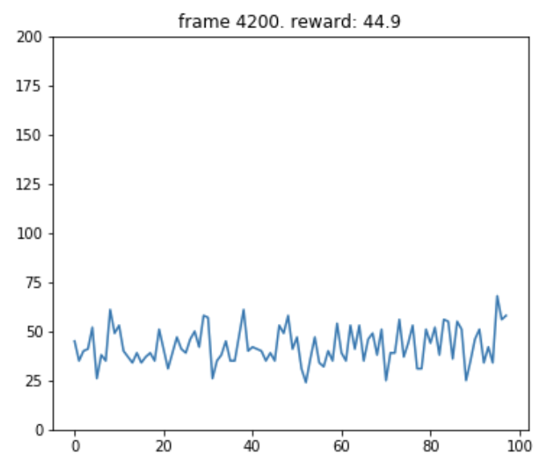
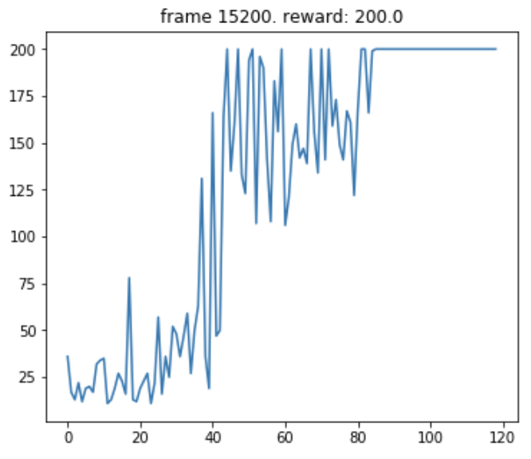
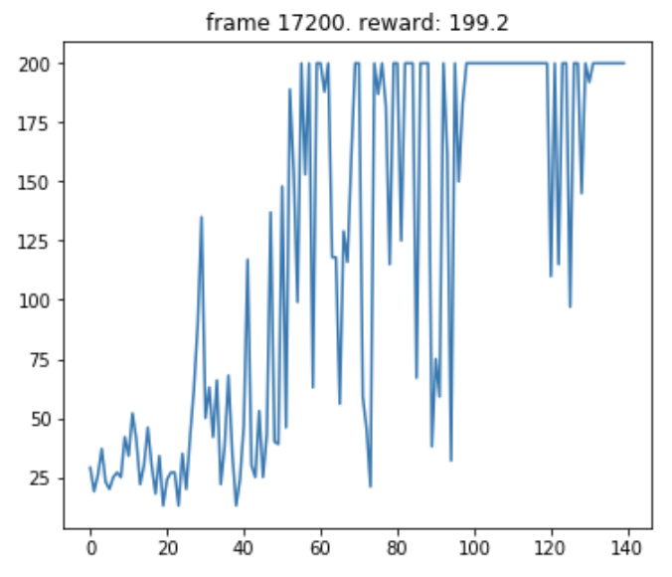
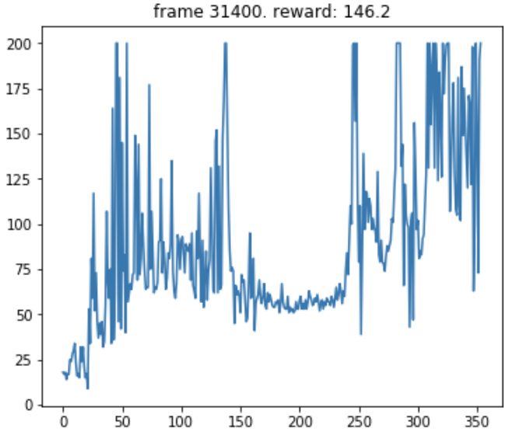
Rule:
If pole is tilted left, move cart left.
If pole is tilted right, move cart right.
Random Policy
Rule Based
DQN
Policy Gradient
Actor Critic

