Slide 1
What makes an asset class attractive
CS109B Group 16 Project| Spring 2022 | Yang Liu, Ellen Sun, Hayden Mckee, Qi Chu

Slide 2

Project Background
Countless investment professionals invest across asset classes in US secondary market
With the wide range of investment signals available, people often run into the risk of cherry picking
Building a machine learning tool that systematically extract visual and technical features

Slide 3
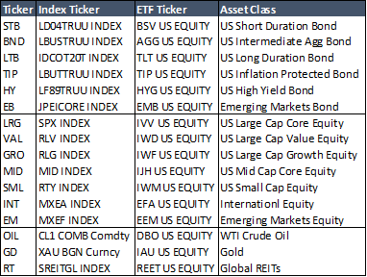
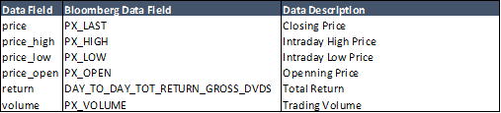
Project Outlines
16 major indices across asset classes
Time series of daily open/close/high/low prices from 1970 - 2022
Input
Time series data
Graiman Angular Fields (GAF) (CNN specific)
Markov Transition Fields (MTF) (CNN specific)
Feature Extraction
Baseline model: linear regression, FFNN
CNN models
RNN/LSTM models
Training
Prediction of forward one week return
Multi-asset long-short trading strategy
Output

Slide 4
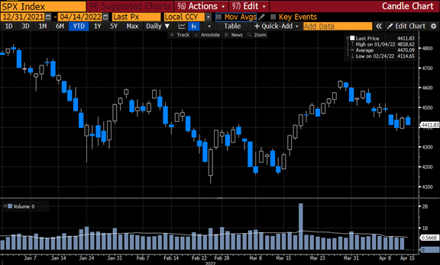
Project Outlines
16 major indices across asset classes
Time series of daily open/close/high/low prices from 1970 - 2022
Input
Time series data
Graiman Angular Fields (GAF) (CNN specific)
Markov Transition Fields (MTF) (CNN specific)
Feature Extraction
Baseline model: linear regression, FFNN
CNN models
RNN/LSTM models
Training
Prediction of forward one week return
Multi-asset long-short trading strategy
Output

Slide 5
Project Outlines
16 major indices across asset classes
Time series of daily open/close/high/low prices from 1970 - 2022
Input
Time series data
Graiman Angular Fields (GAF) (CNN specific)
Markov Transition Fields (MTF) (CNN specific)
Feature Extraction
Baseline model: linear regression, FFNN
CNN models
RNN and LSTM models
Training
Prediction of forward one week return
Multi-asset long-short trading strategy
Output

Slide 6
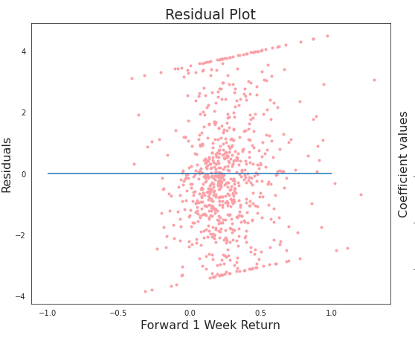
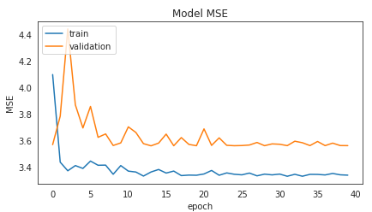
Baseline Model
Linear Regression
A simple multi-linear regression model
Forward 1 week return as the response variable
Top 10 principal components from trailing 21 or 63 days of data as predictors
Feed-forward neural network
Fully connected with 3 layers and 100 nodes each layer
FFNN
* Using 21d lookback for US Large Cap Core equity as an example here

Slide 7
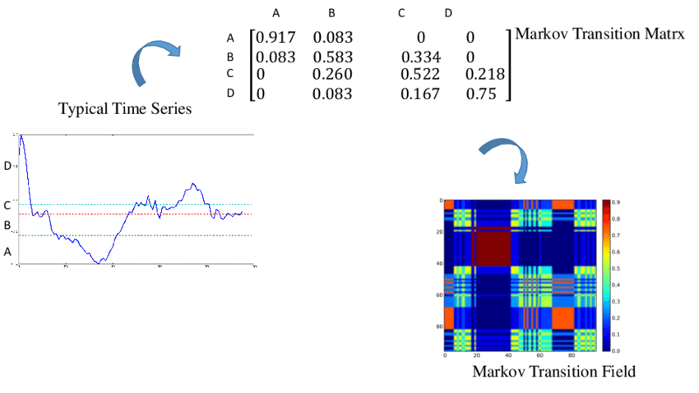
CNN Models – Data Transformation (Wang and Oates, 2015)
Graiman Angular Fields (GAF)
Map normalized time series into polar coordinates with mathematical operations.
Gives a relationship between every data point and every other data point over time.
Graiman Angular Difference Fields (GADF) vs Graiman Angular Summation Fields (GASF)
Markov Transition Fields (MTF)
Extracts positional information of data points
Conclude how related to two data points are in the time series via transition matrix

Slide 8
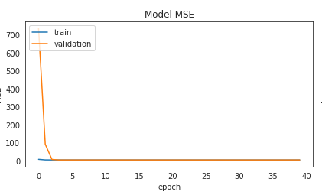
CNN Models – Model Setup
Three blocks of convolution operations with kernel size of 2 and max pooling size of 2
One block is defined by convolution layer + max-pooling layer + normalization layer
Overall using 21-day lookback period outperforms 63-day
GAF outperforms MTF, GADF outperforms GASF in terms of MSE
GADF contains more information as GASF are symmetric
Many fields in MTF will be sparse given non-stationary nature of finance time series data
* Using GADF 21d lookback for US Large Cap Core equity as an example here

Slide 9
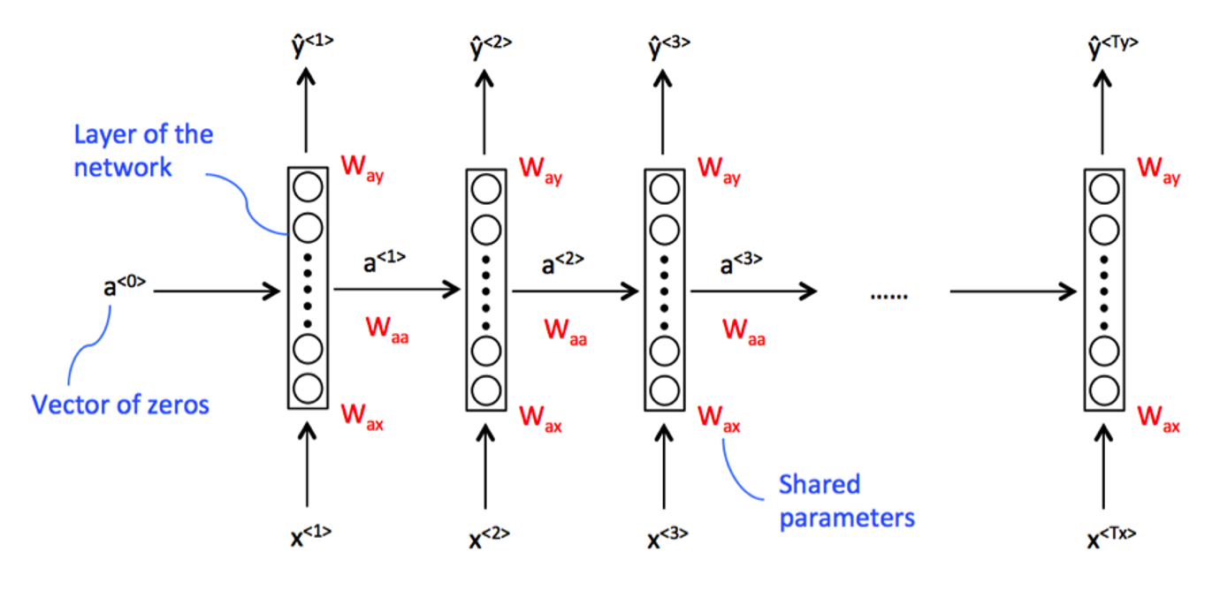
RNN Model

Slide 10
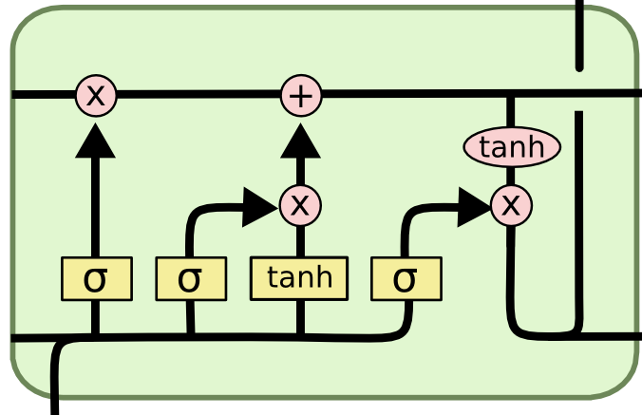
LSTM Model

Slide 11
Reasons for trying more than just CNN
Diversify approaches, try out a traditional time series forecasting method
Interest in seeing effectiveness of LSTM for one of its key general uses

Slide 12
LSTM Findings
Early architecture attempts able to strongly overfit
Performs better in terms of metrics, but will it generalize well?

Slide 13
Bi-Directional LSTM Model
Input - reshape the input data for the time step
Block of 1 day (4 price values – Open / Close / High / Low)
Block of 7 days (28 price values – Open / Close / High / Low)
Multi-Period Bi-LSTM - blocks of 1-day (4 price values), 3-day (12 price values), 7-day (28 price values), 21-day (84 price values)
Output
Next week’s return (1 value, linear activation function)
Assumes equal weights to the time factors (1/3/7/21 days), can adjust as long as they sum up to 1

Slide 14
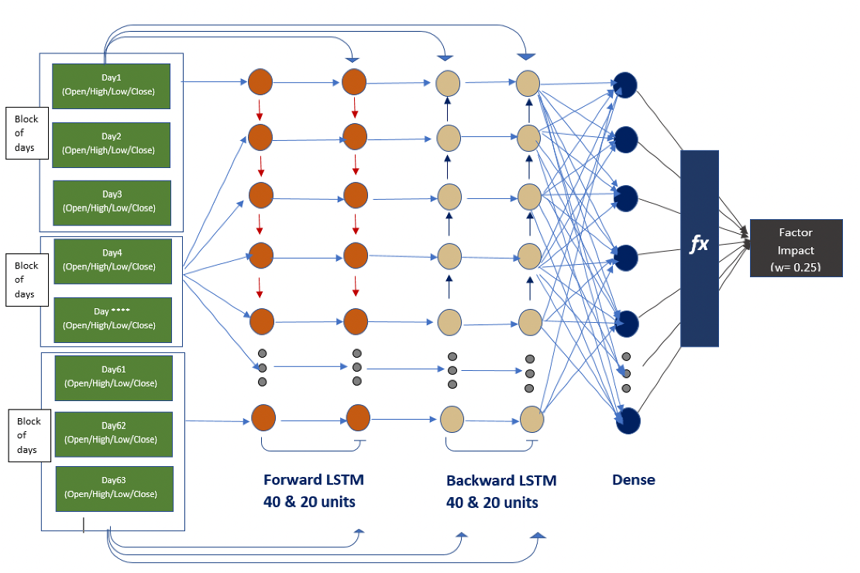
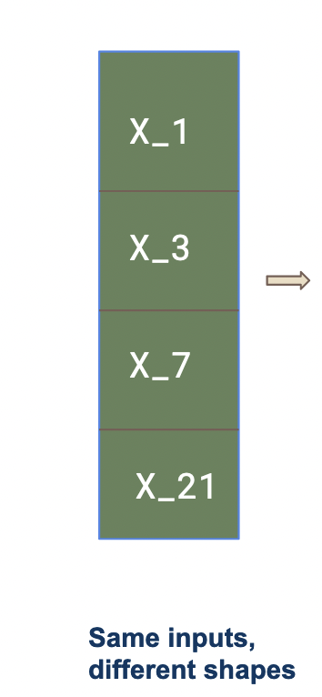
Bi-Directional LSTM Model
Multi-Period Model Architecture

Slide 15
Backtest Performance (2008 - 2022)
Model | REV1 | LR_21 | LR_63 | FFNN_21 | FFNN_63 | GADF_21 | GASF_21 | GADF_63 | GASF_63 | LSTM_RET_63 | LSTN_COHL_63 | Bi_LSTM_1D | Bi_LSTM_7D | Bi_LSTM_multi period
Alpha | -1.37% | -2.67% | -3.27% | -1.08% | -1.78% | 4.81% | 7.98% | -2.30% | 5.45% | -3.35% | -4.54% | 4.49% | 4.49% | 5.02%
IR | -0.07 | -0.16 | -0.20 | -0.07 | -0.12 | 0.32 | 0.50 | -0.16 | 0.31 | -0.20 | -0.29 | 0.26 | 0.26 | 0.29
TE | 18.79% | 16.44% | 16.38% | 15.21% | 15.23% | 14.93% | 16.05% | 14.77% | 17.67% | 16.36% | 15.78% | 17.24% | 17.24% | 17.19%
MDD | 89.10% | 103.6% | 88.30% | 53.21% | 50.74% | 21.66% | 25.89% | 69.37% | 34.00% | 89.21% | 93.70% | 31.74% | 31.74% | 30.30%
Alpha - excess return the portfolio produces compared to a benchmark index; the higher the better
IR - Information Ratio, measurement of portfolio returns beyond the returns of a benchmark; the higher the better
TE - Tracking Error, the standard deviation percentage difference between the portfolio return vs. benchmark return; the lower the better
MDD - Maximum Drawdown, maximum observed loss from a peak to a trough of a portfolio, before a new peak is attained; the lower the better

Slide 16
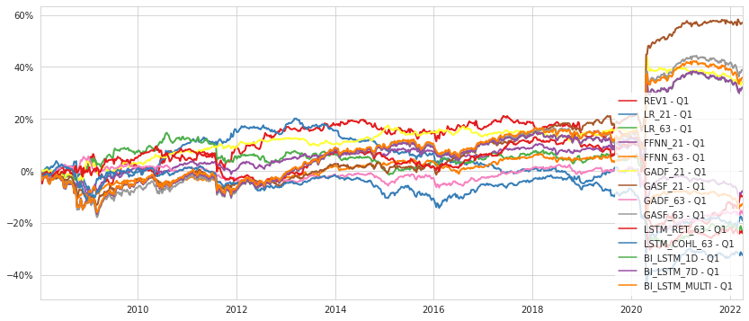
Cumulative Performance

Slide 17
Conclusions
Comparing within the same image transformation method in CNN, one can see 21-day lookback window outperforms 63-day as it captures short-term reversal more effectively.
Bi-directional LSTM also works well in generating backtest returns
GASF gives the best backtesting performance out of all model specs with good balance between risk and return.
A large portion of the outperformance comes from 2020 covid crisis.
As can be observed from several model specs, good MSE performance does not always generalize to good backtesting return
Non-stationary nature of financial dataset

Slide 18
Next Steps
Next we can try to test preferred specs on more sophisticated models.
AlexNet, GoogleNet
Express data in traditional time series graph manner and run saliency analysis. Such graphs are more intuitive to understand and thus give us a better understanding of what’s driving the model
Expand sample size by building the same model with stock-level (S&P500) data
Can consider adjusting the model architecture for each asset class

Slide 19
Reference
[1] Wang, Z., T. Oates. 2015. Encoding Time Series as Images for Visual Inspection and Classification using Tiled Convolutional Neural Networks, Trajectory-Based Behavior Analytics: Papers from the 2015 AAAI Workshop.
[2] Jiang, J., Kelly, B., and Xiu, D. 2020. (Re-)Imag(in)ing Price Trends (December 1, 2020). Chicago Booth Research Paper No. 21-01

