Slide 1
UNIVERSITY INSTITUTE OF COMPUTING
Master of Computer Applications/ Bachelors of Computer Applications/Science
Minor Project
21CAR-708/21CAR-728/21CAR-748/20CAR-319/20SCR-319
REAL TIME WEATHER API SITE
An Overview
of Computing
&
Career Planning
Student Name: Subham Kumar
UID:20BCA1539
Section/Group:20BCA4/B
Supervisor Name: Preeti
Employee Code: E8780
Designation: Supervisor
Minor Project Presentation
DISCOVER . LEARN . EMPOWER

Slide 2
CONTENT
INTRODUCTION
OBJECTIVE
CLIENT IDENTIFICATION AND RECOGNITION OF NEED
PREREQUISITES
REQUIREMENTS OF THE PROJECT
TIMELINE OF PROJECTIN IN WEEKS
FEATURES OF PROJECT
ADVANTAGE OF THE PROJECT
OUTPUT OF THE PROJECT
FUTURE SCOPE OF THE PROJECT
FUTURE IMPROVEMENTS IN THIS PROJECT

Slide 3
INTRODUCTION
Real Time Weather forecasting is an application of science and technology used to predict the conditions of the atmosphere for a given time and location. People have attempted to predict the weather informally for millennia because weather change occurs primarily due to air pressure, temperature, and moisture differences between one place to another. Weather forecasts are made by collecting quantitative data about the current state of the atmosphere, land, and ocean and using meteorology to project how the atmosphere will change at a given place.

Slide 4
OBJECTIVE
The purpose of a weather forecast is to provide as accurate as possible prediction of what the weather will be like in the near future.
They are important to most aspects of day-to-day life, including aviation, boating, other modes of transportation, farming, tourism, sports, etc. Without accurate weather forecasts people involved in activities like the ones I've listed may end up in dangerous situations they were unprepared for and end up injured or worse.
Weather is forecasted by taking measurements of various atmospheric conditions and formulating an interpretation of how these atmospheric conditions will react with each other. These measurements include how much moisture is in the air, the air temperature and the air pressure, plus others from numerous ground locations as well as vertically above those locations

Slide 5
Client Identification and Recognition of Need
Weather is something everybody deals with, and accurate data of it like what is coming can help people to make correct decisions. Undoubtedly, weather forecasting has come a long way, helping people to know about weather conditions. So, if you are in an area where weather frequently changes from sunny to torrential rain in a matter of minutes, then what is the easiest way to make sure to be prepared for. A suitable answer is a weather application. The best weather apps for Android are like pocket weather channels, and they do not just tell anyone when the sun is going to shine and the rain is going to fall, these apps tell us the wind speed, the UV level, humidity levels, and even “feels like” temperature to account for the dreaded wind chill. So, if you as a startup have made-up your mind to develop your own weather application like AccuWeather and NOAA Weather Radar, here, we have mentioned top three features that you can consider.

Slide 6
PREREQUISITES
HTML:-
HTML is the standard markup language for web pages. With HTML we can create our own Website.
CSS:-
CSS stands for Cascading style sheets. CSS saves a lot of work. It can control the layout of multiple web pages all at once. It used to design the web page.
JavaScript:-
JavaScript is a lightweight, interpreted programming language. It is designed for creating network-centric applications.
API:-
API stands for application programming interface, which is a set of definitions and protocols for building and integrating application software.

Slide 7
REQUIREMENTS OF THE PROJECT
Visual Studio code
Go live Server
extension
API(Application programming interface)

Slide 8
Timeline of the project in weeks.
NUMBER OF WEEKS | TASK TO BE DONE
1-2 | Selecting Project From basket, Research work, Selecting team members.
2-3 | Selecting the title of project Real Time Weather API and starting the working on frontend of Website
3-4 | Completing the frontend part and starting working API.
4-7 | Design the UI/UX .
7-8 | Working on the CSS part of the frontend.
8-9 | Debugging and testing

Slide 9
FEATURES OF THE PROJECT
Time to time weather Updates
Temperature Update
Next 7 days data Analysis
Accurate and easy to use
User can search weather anytime and anywhere.
Provide weather all over world
Helps user to get ready for every situation.

Slide 10
ADVANTAGE OF THE PROJECT
The essential weather app features include:
Multiple Location
Wind Speed tracker
Weekly Predictions
Updates about Humidity
Cloud Status.
Map about Climatic condition

Slide 11
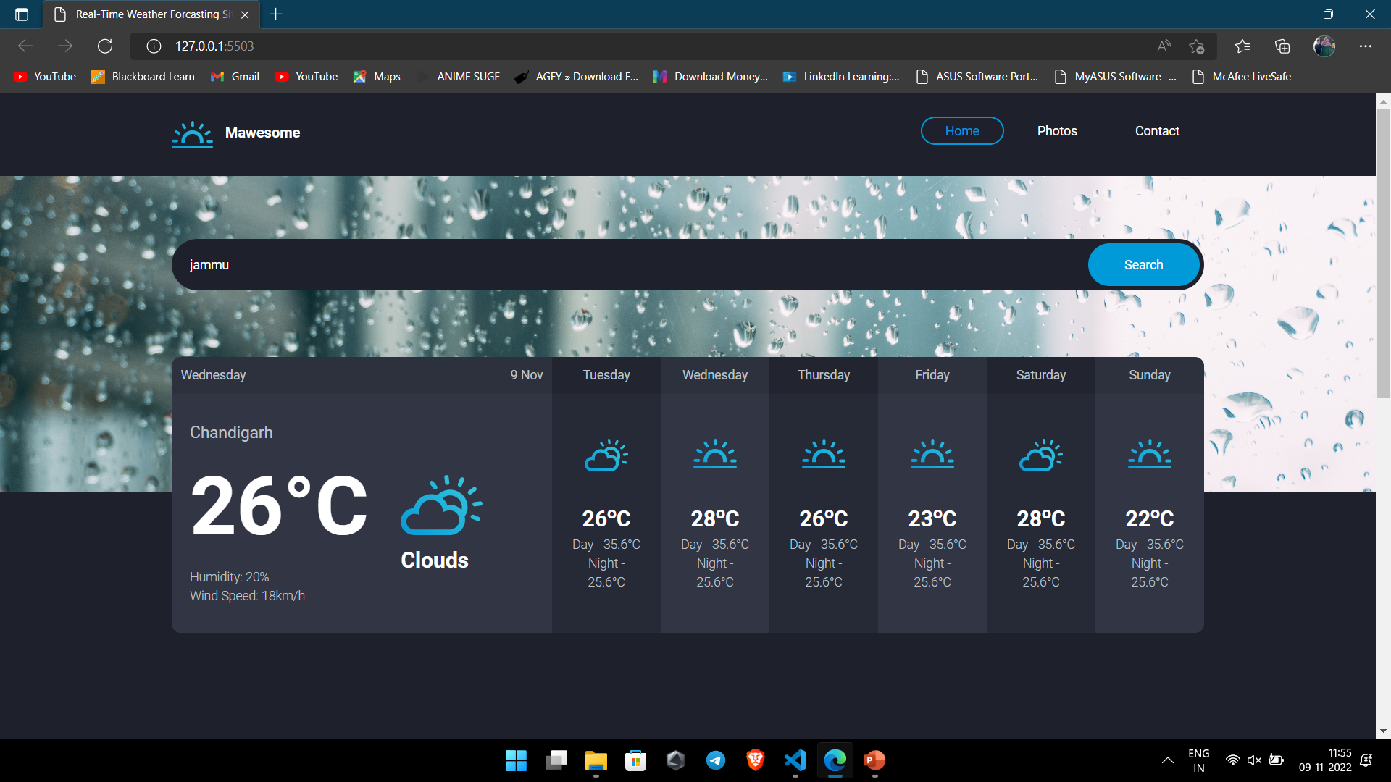
OUTPUT OF THE PROJECT

Slide 12
FUTURE SCOPE OF THE PROJECT
The purpose of a weather forecast is to provide an accurate possibility of predicting what will the weather will be like in the near future.
They are important to most aspects of day-to-day life, including aviation, boating, other modes of transportation, farming, tourism, sports, etc. Without accurate weather forecasts people involved in activities like the ones I've listed may end up in dangerous situations they were unprepared for and end up injured or worse.
The weather affects almost everything we do in our daily lives. It affects what we wear and what types of activities that we do. In many professions, it affects either where we work or when we work, and often times, it affects if we work at all that day.
Traditional observations made at the surface of atmospheric pressure, temperature, wind speed, wind direction, humidity, precipitation are collected routinely from trained observers, automatic weather stations or buoys.

Slide 13
FUTURE IMPROVEMENT IN THIS PROJECT
So the project we have done is not near complete it require a lot of features considering other weather sites and apps we have seen online.
So we can add a lot of things like
Better UI
More Features like temperature in farenhite, in kelvin etc
Also there is also a need of live map that can help a person access the map and search for the city by clicking on the map online only
The main disadvantage of this project is it is online and if the connection is not stable the api will not fetch the location so we can try making a log in which when the connection is storng it will store future weather in case if the internet is not stable

Slide 14
THANK YOU

