Slide 1
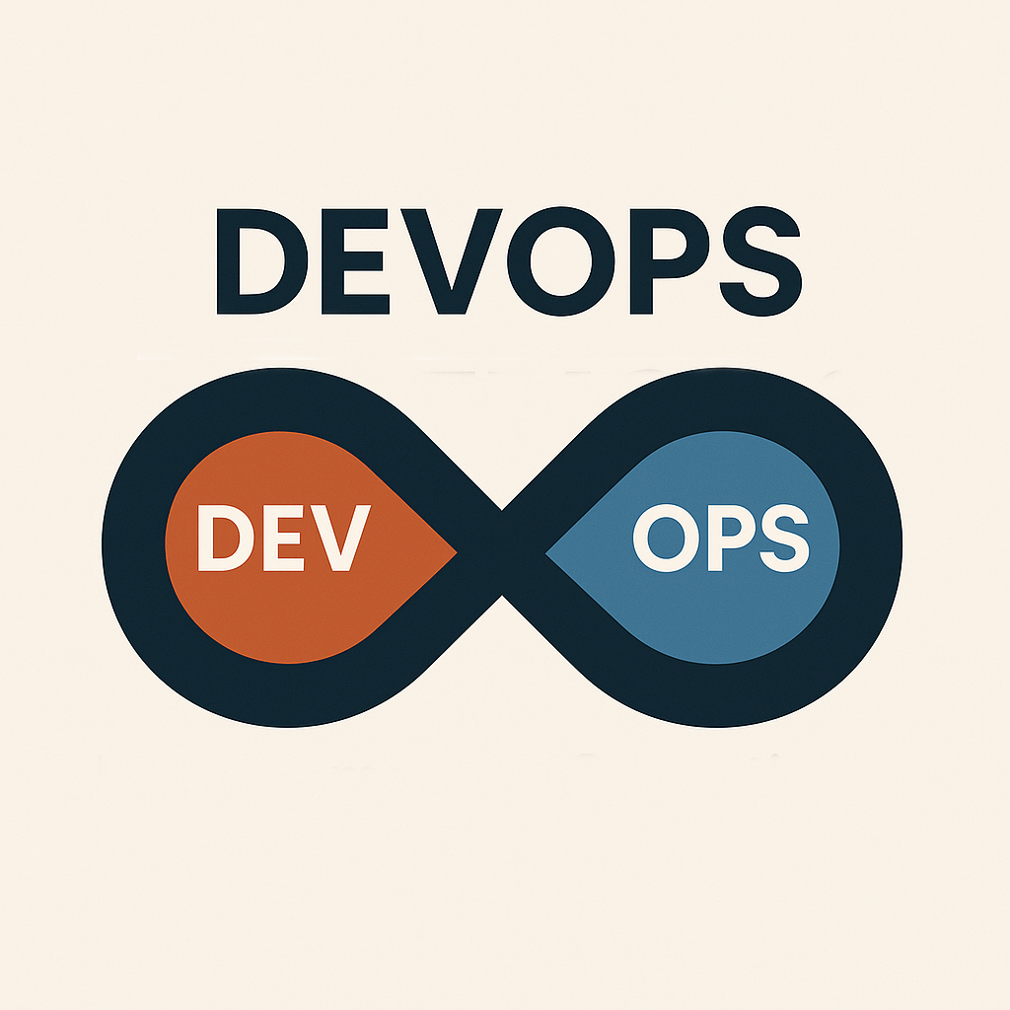
Innovation in an infinite loop

Slide 2
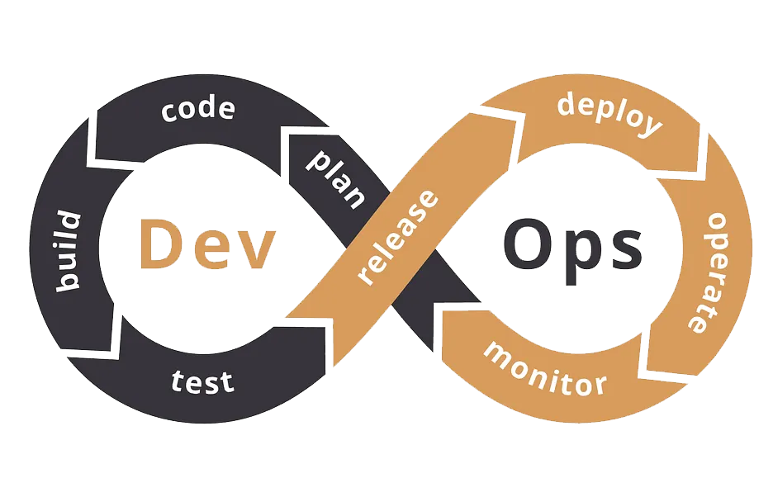
What is DevOps?
Infinite collaboration of Development and Operations.
Think of it as developers and operators sitting at the same table.

Slide 3



Why DevOps?
Faster
Delivery
Team release features quicker and more often
Better Collaboration
No more ‘us vs them’
Between Devs and Ops
Continuous
Improvement
The loop means we’re always optimizing, always learning

Slide 4
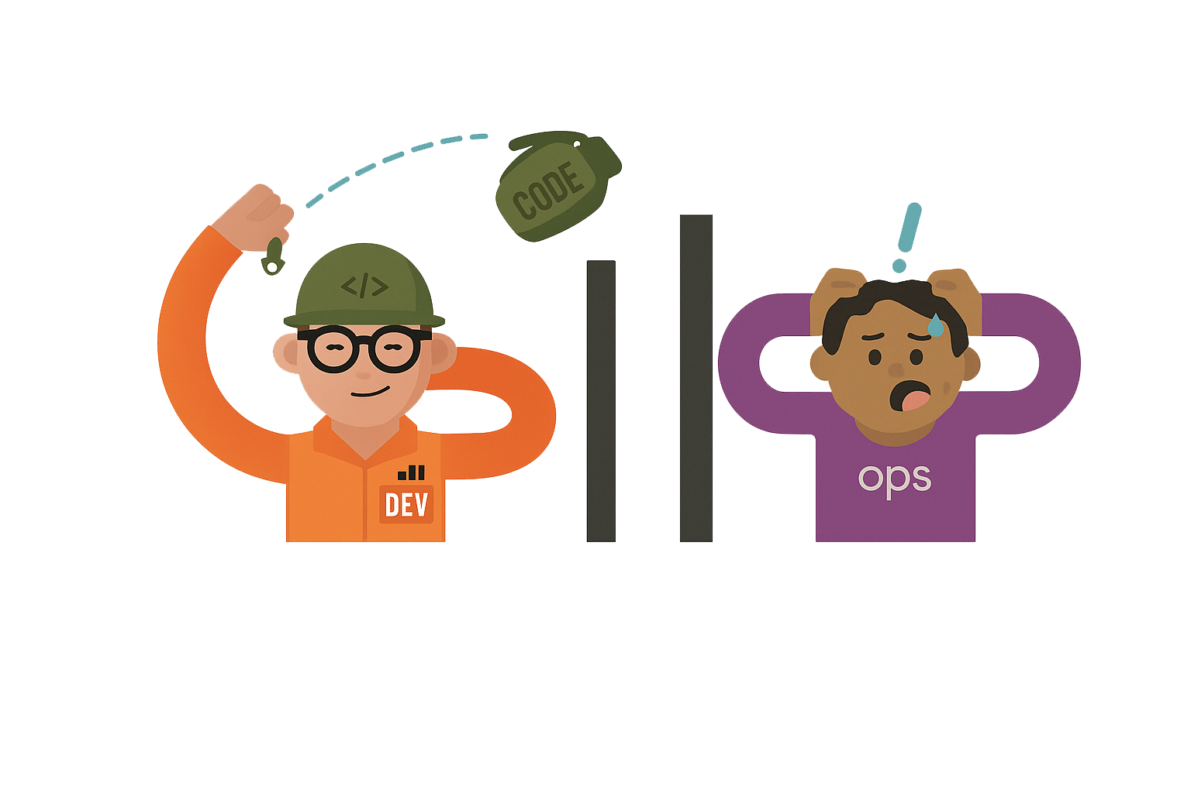
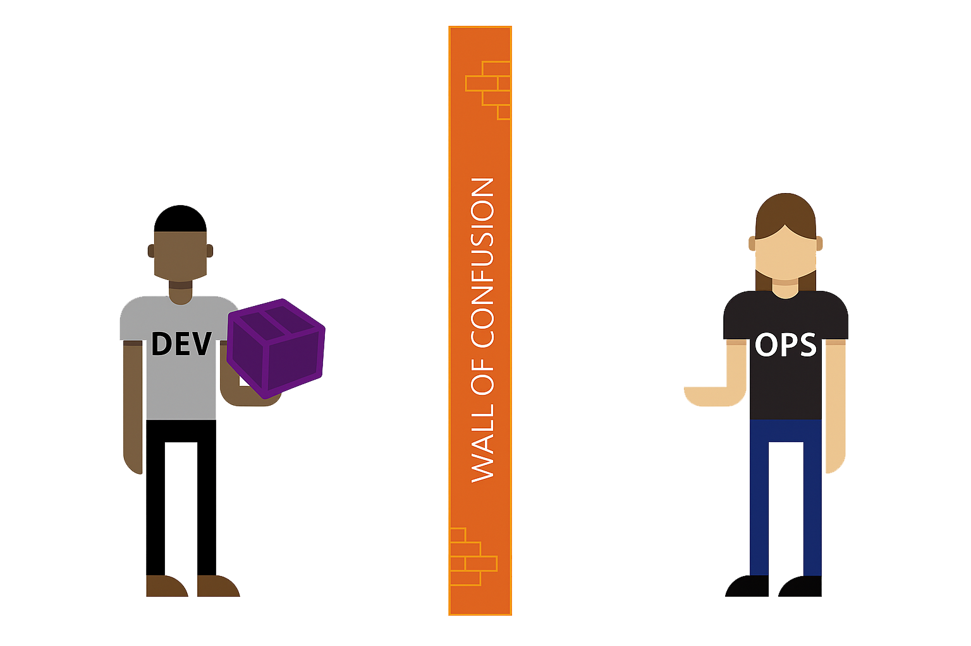
The problems before DevOps?

Slide 5
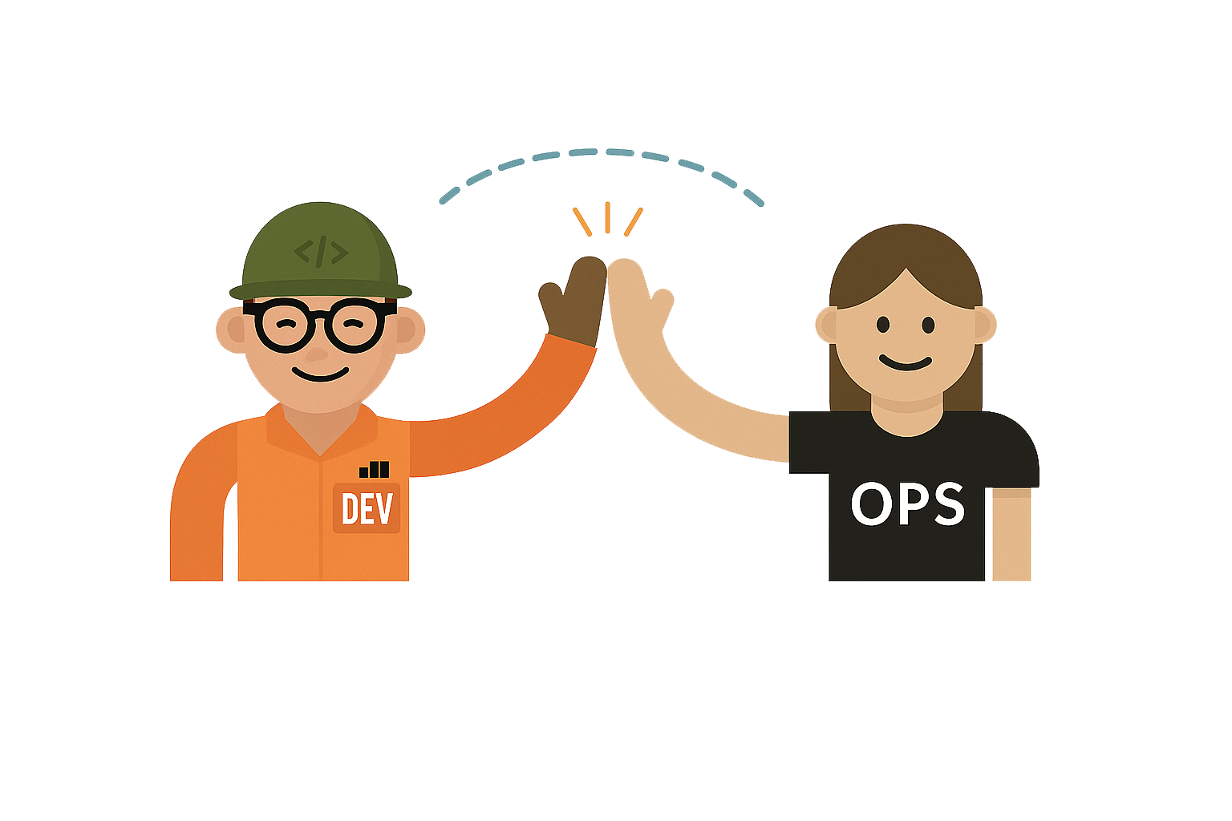
Enters DevOps?
DevOps bridge teams together by
uniting their focus on collaboration and efficiency

Slide 6




DevOps Lifecycle?
The lifecycle generally consists of three phases
Continuous
Integration
Continuous
Delivery
Continuous
Deployment

Slide 7
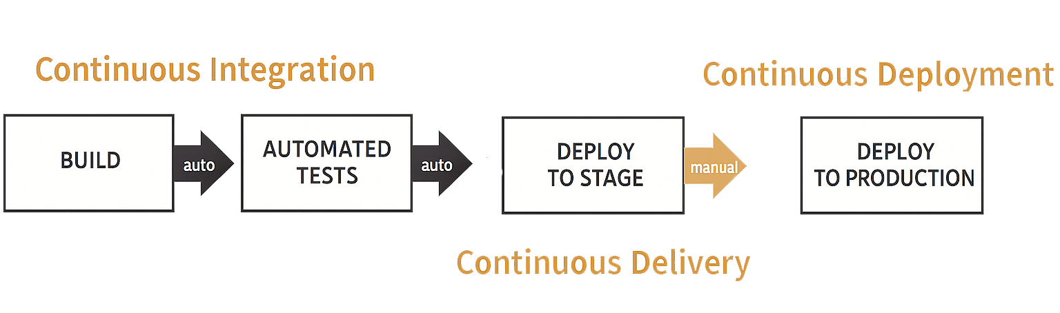
Life Cycle

Slide 8
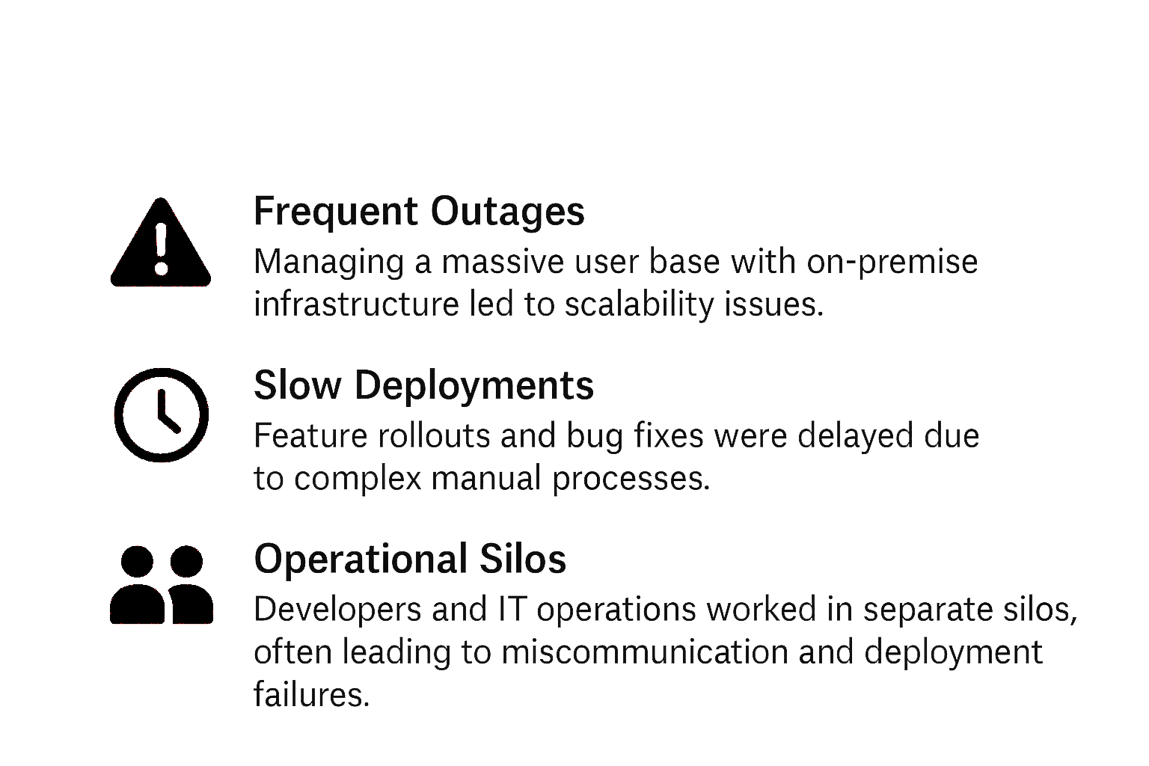
Netflix: Case Study
When Netflix got popular it started struggled to maintain high availability, rapid innovation, and top-tier user experience
Challenges faced by Netflix

Slide 9




After Implementing DevOps:
High Availability & Reliability- They're online 99.99% of the time
Faster Deployments - They fix 1000’s of bugs and launch updates everyday
Improved Scalability- Netflix can handle millions of users streaming at the
same time
Better User Experience- Users rarely face issues and if they do, Netflix fixes
them on the go using DevOps

Slide 10
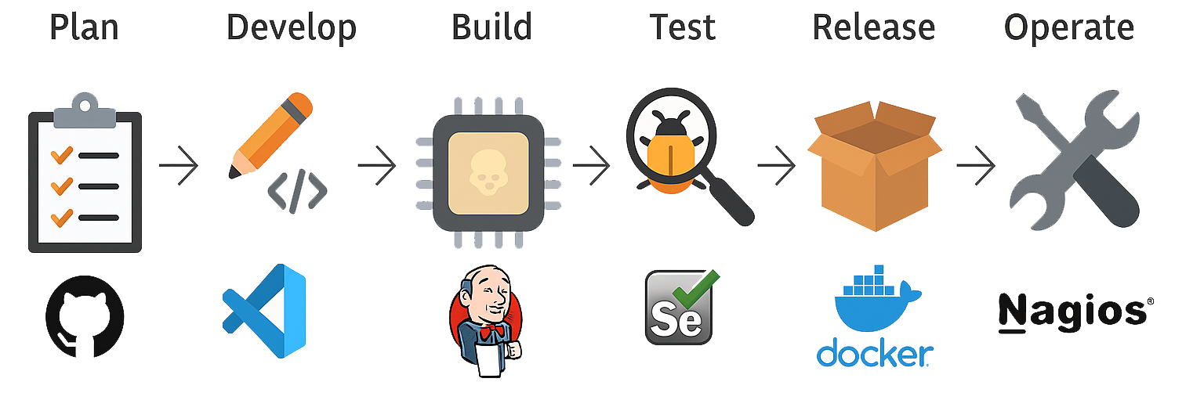
DevOps Tools?
GitHub
Vscode
Jenkins
Selenium
Docker
Nagios

Slide 11
DevOps Tools?
GitHub
Vscode
Jenkins
Selenium
Docker
Nagios

Slide 12
DevOps: Were innovation loops infinitely

